Slide 1
CS 171
Introduction to Artificial Intelligence
Discussion Session
Agents, Environments, and Search

Slide 2
The Wumpus World Environment
Task Environment | Observable | Deterministic/Stochastic | Episodic/Sequential | Static/Dynamic | Discrete/Continuous | Agents
Wumpus World

Slide 3
The Wumpus World Environment
Task Environment | Observable | Deterministic/Stochastic | Episodic/Sequential | Static/Dynamic | Discrete/Continuous | Agents
Wumpus World | Partially | Deterministic | Sequential | Static | Discrete | Single

Slide 4
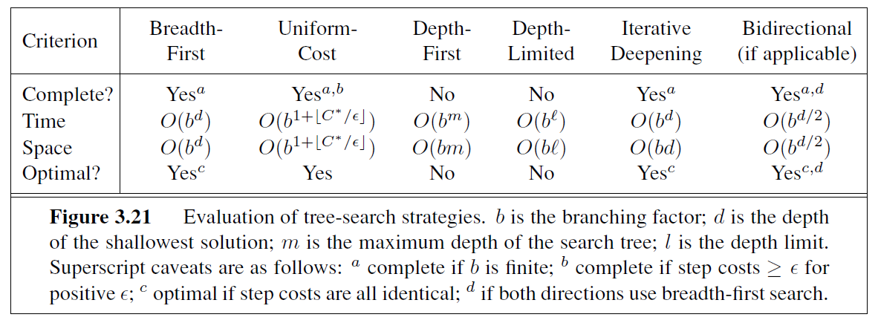
Comparing uninformed search strategies
Section 3.4, Russell and Norvig

Slide 5
Informed search strategies
Informed search methods may have access to a heuristic function h(n) that estimates the cost of a solution from n.
The generic best-first search algorithm selects a node for expansion according to an evaluation function.
– Greedy best-first search expands nodes with minimal h(n). It is not optimal but is often efficient.
– A∗ search expands nodes with minimal f(n) = g(n) + h(n). A∗ is complete and optimal, provided some conditions on h(n).

Slide 6
Uniform Cost Search vs GBFS vs A*
f(n) = h(n) + g(n)
g(n) = path cost
h(n) = heuristic estimate
Q. How do you use these values to do GBF, A*, and uniform cost search?

Slide 7
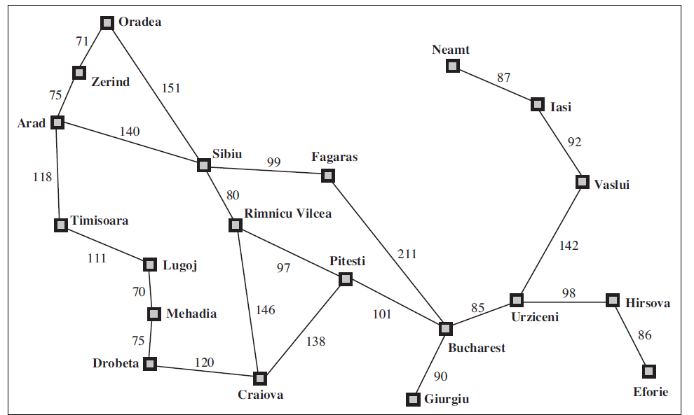
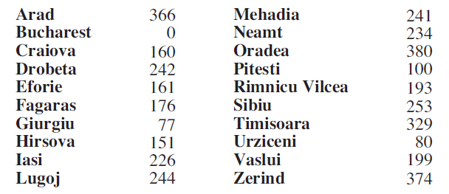
Example- Path from Arad to Bucharest
Heuristic function values h(n)
Section 3.5, Russell and Norvig

Slide 8
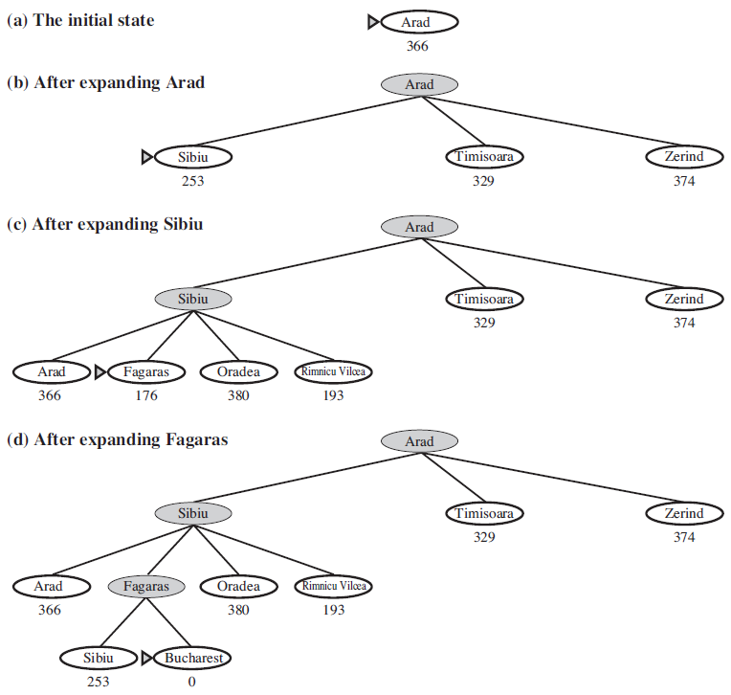
GBFS
Section 3.5, Russell and Norvig

Slide 9
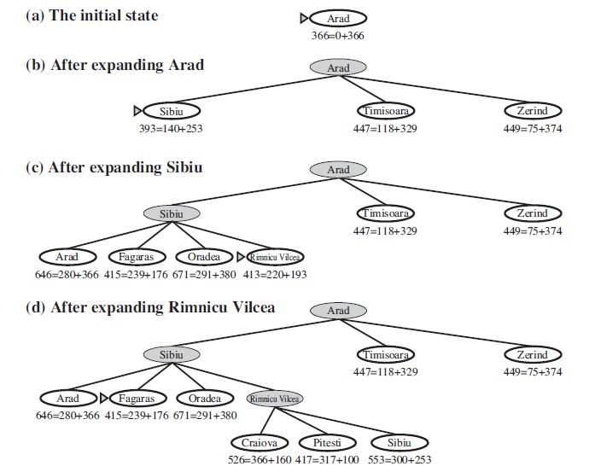
A* search
Section 3.5, Russell and Norvig

Slide 10
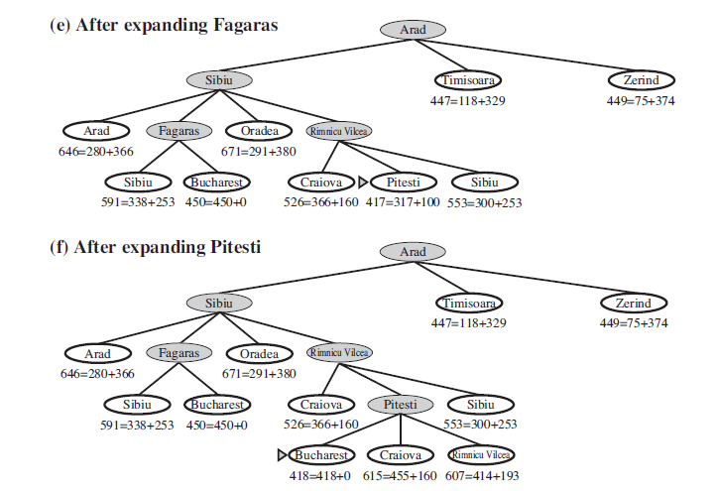
A* search
Section 3.5, Russell and Norvig

Slide 11
Questions?
Any other questions

