Slide 1
CS 171
Introduction to Artificial Intelligence
Discussion Session
Quiz #1 and Local Search

Slide 2
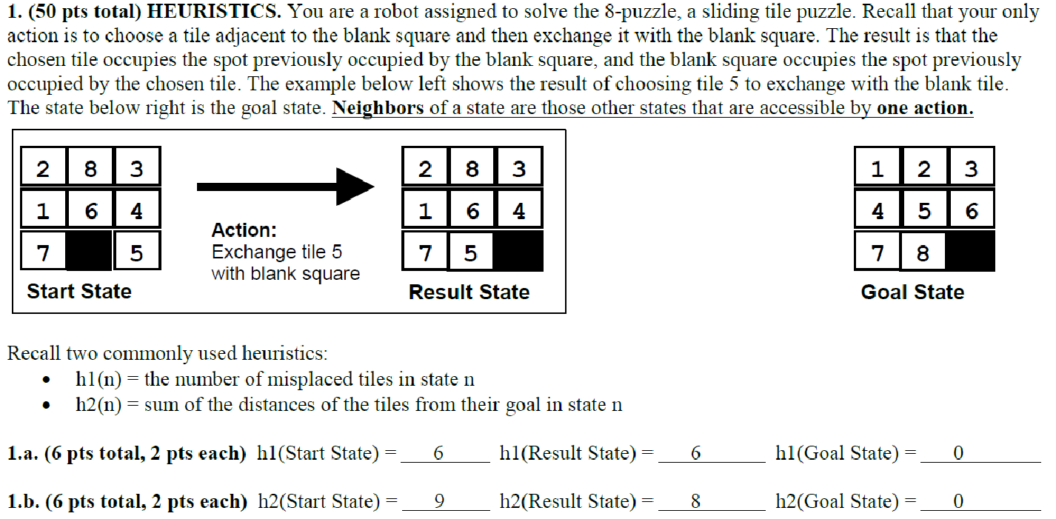

Slide 3
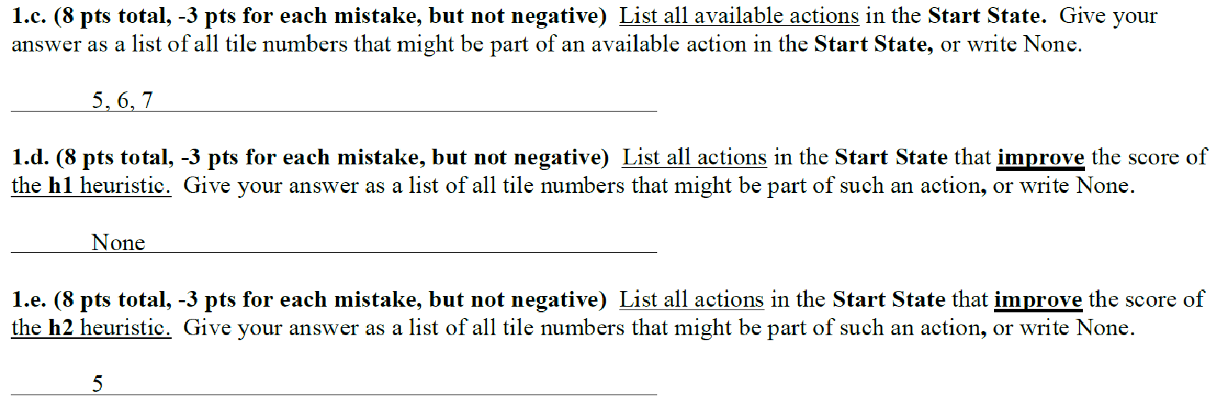

Slide 5
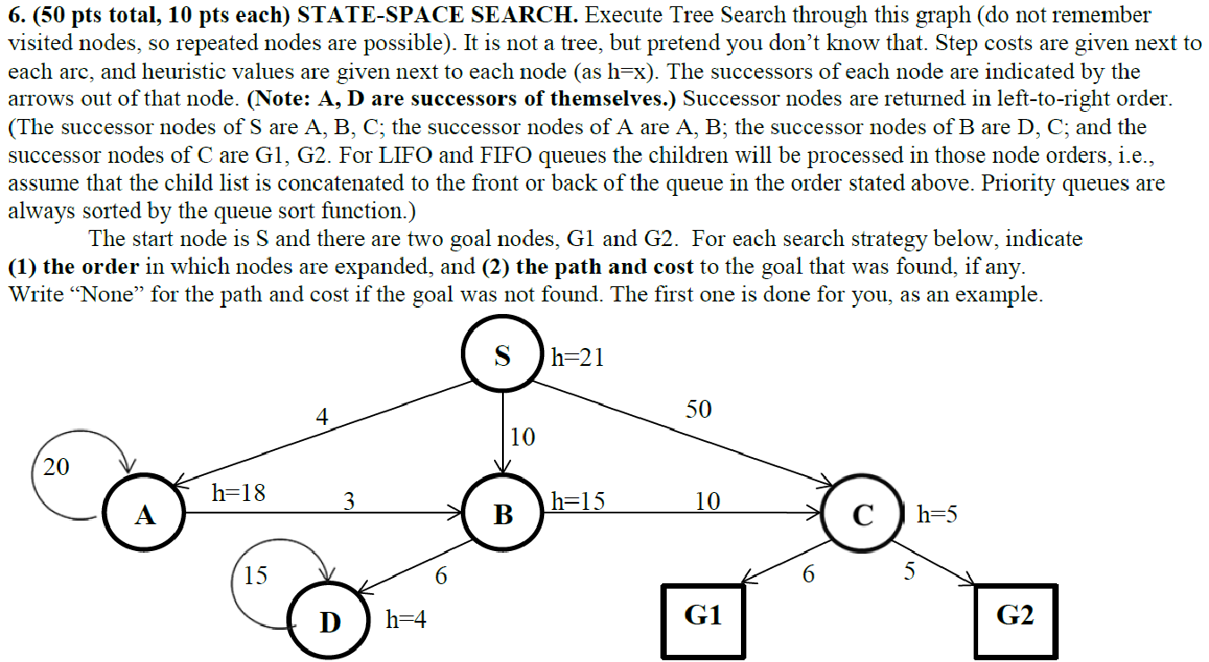

Slide 6
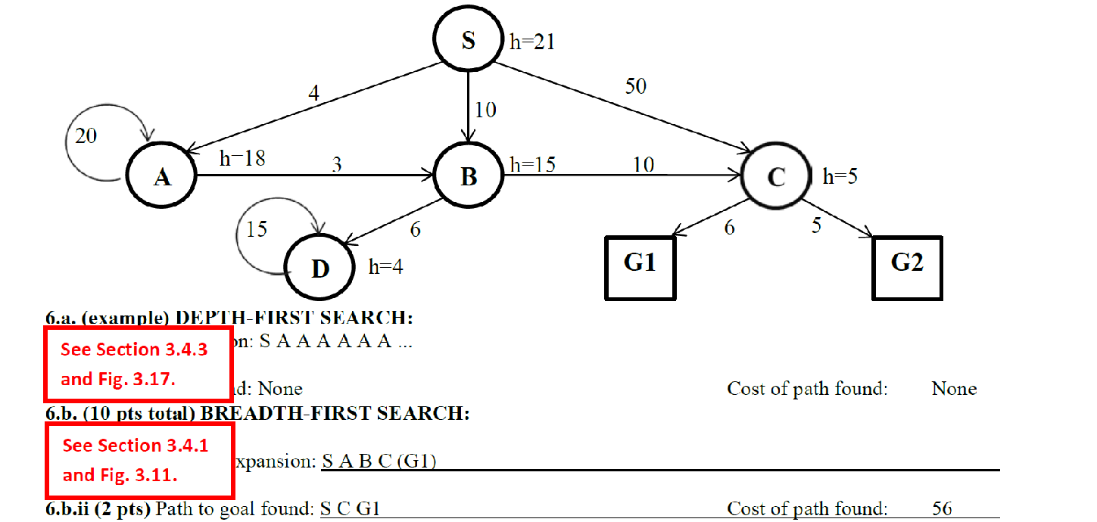

Slide 7
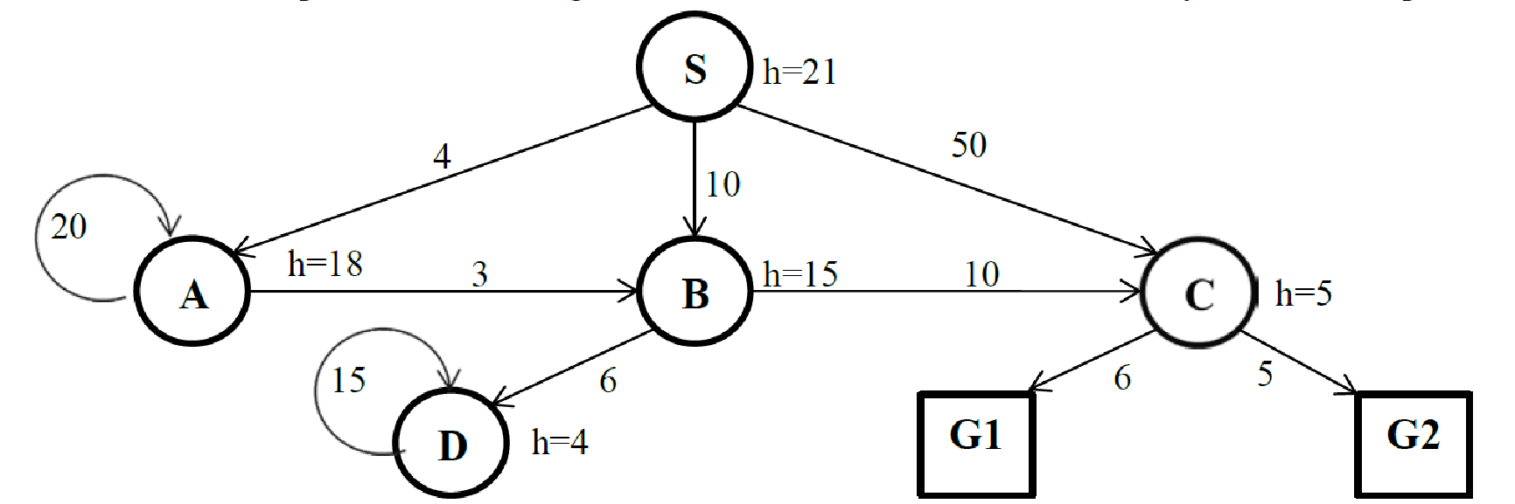

Slide 9
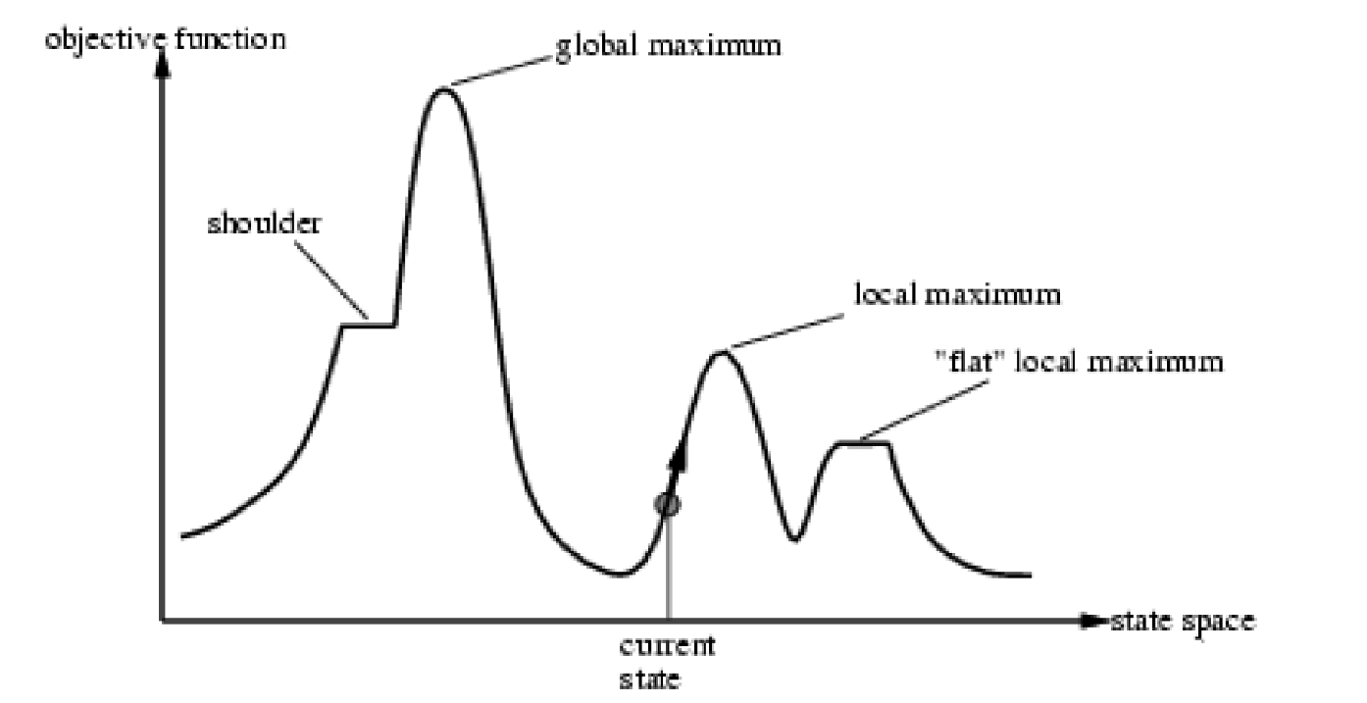
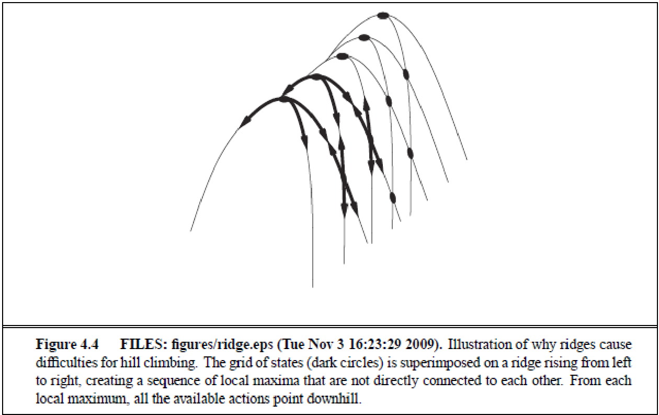
Terminology

Slide 10
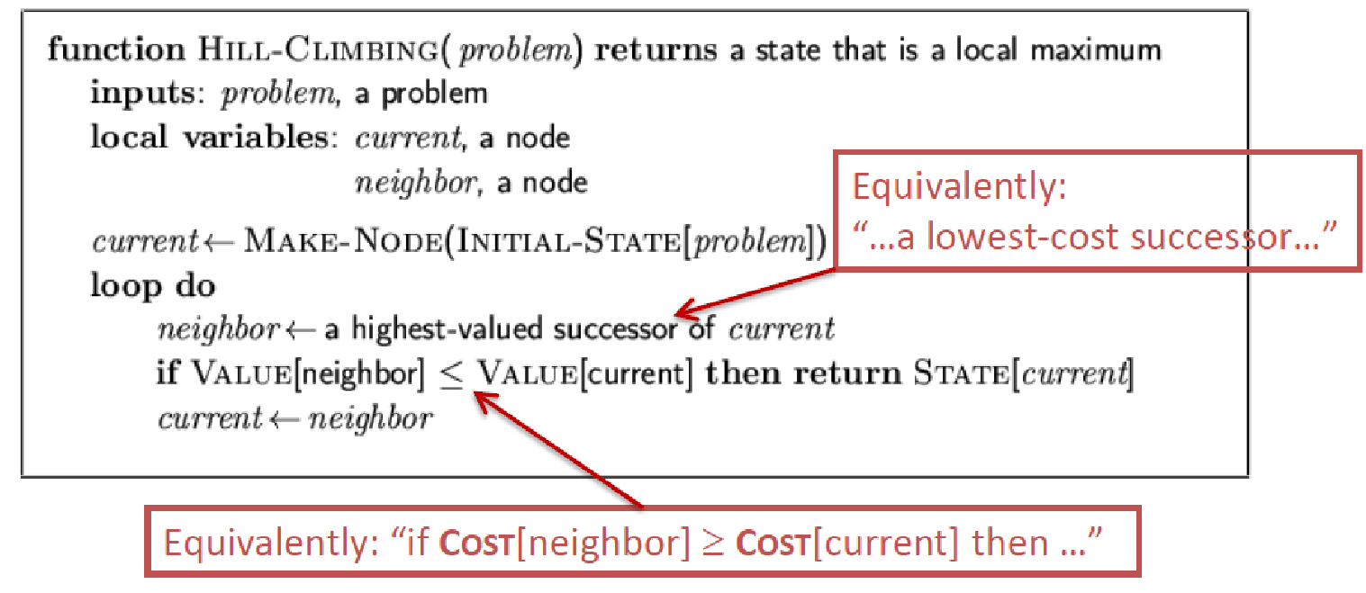
Hill Climbing Search
Gets stuck at local maxima (incomplete)

Slide 11
Hill Climbing with Random Restarts
If the search fails, restart the search from a random position
If each search has a probability p of succeeding, expected number of random restarts is 1/p

Slide 12
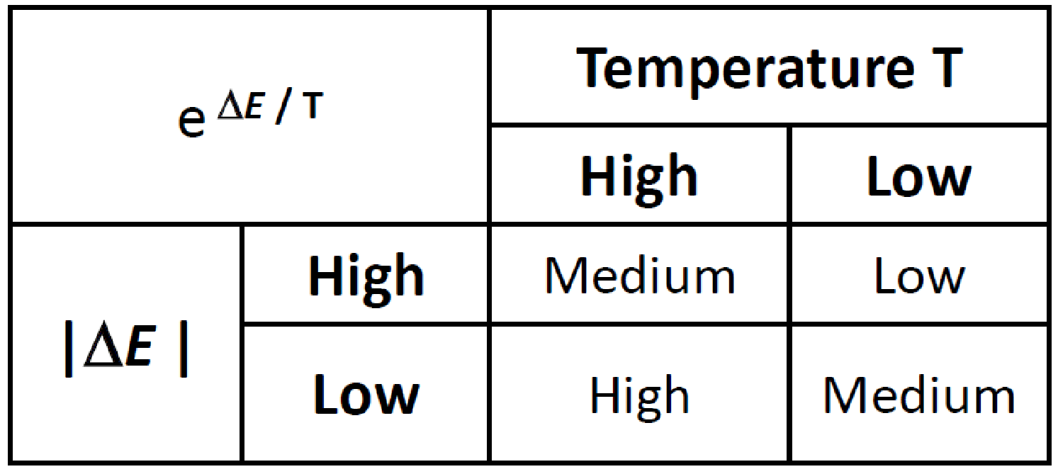
Simulated Annealing

Slide 13
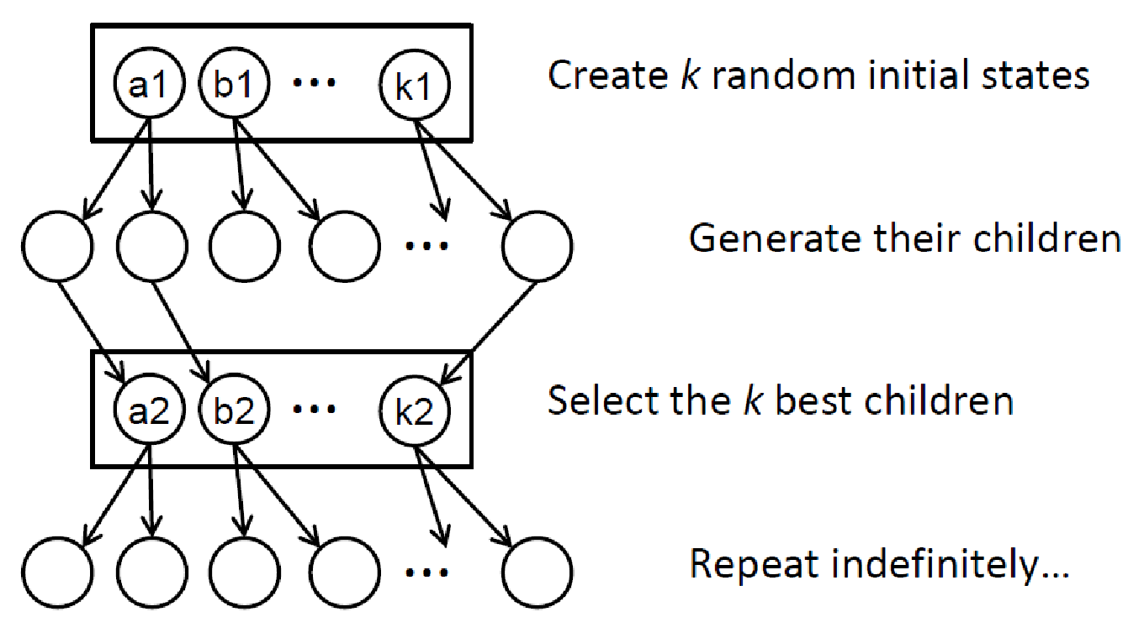
Beam Search
Stochastic version:
Randomly select k children according to its value

Slide 14
Genetic Algorithms
How crossover occurs is very important
Imagine a situation in which we crossover by randomly selecting a position from each parent for every position instead of selecting a point at which to split them

Slide 15
2017-fq-cs-171-midterm-exam.pdf
Question 1

Slide 17
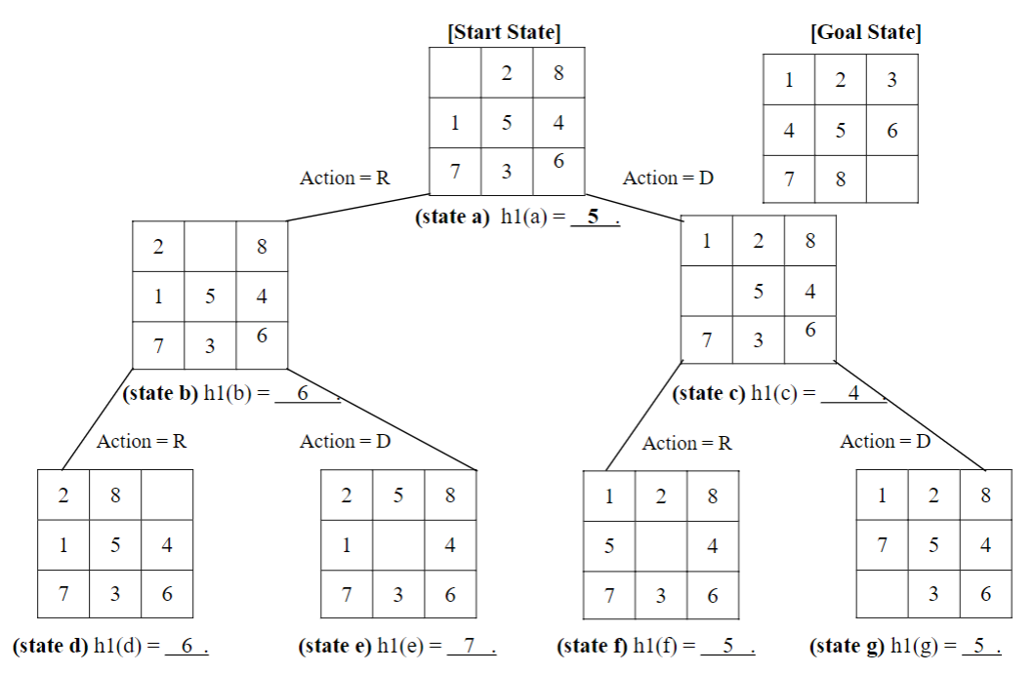
Solution

Slide 18
Q1. b and c

Slide 19
Q1. b and c solutions

Slide 20
Questions?
Any other questions

