Slide 1
CS 171
Introduction to Artificial Intelligence
Discussion Session
Probability and Bayesian Networks
Credit to: Yue Yu

Slide 2
Bayes Rule
P(B|A) = P(A|B)P(B)/P(A)
How do we obtain Bayes rule from the product rule?

Slide 3
Product Rule
Ch 13 Slides - Prof Lathrop

Slide 4
Sum Rule
Ch 13 Slides - Prof Lathrop

Slide 5
Homework Chapter 13

Slide 6
Solution
P(Windows | Hardware) = 15/75 = 0.2
P(Hardware | Windows) = (0.25 x 0.6) / (0.25 x 0.6 + 0.75 x 0.2)
= 0.5

Slide 7
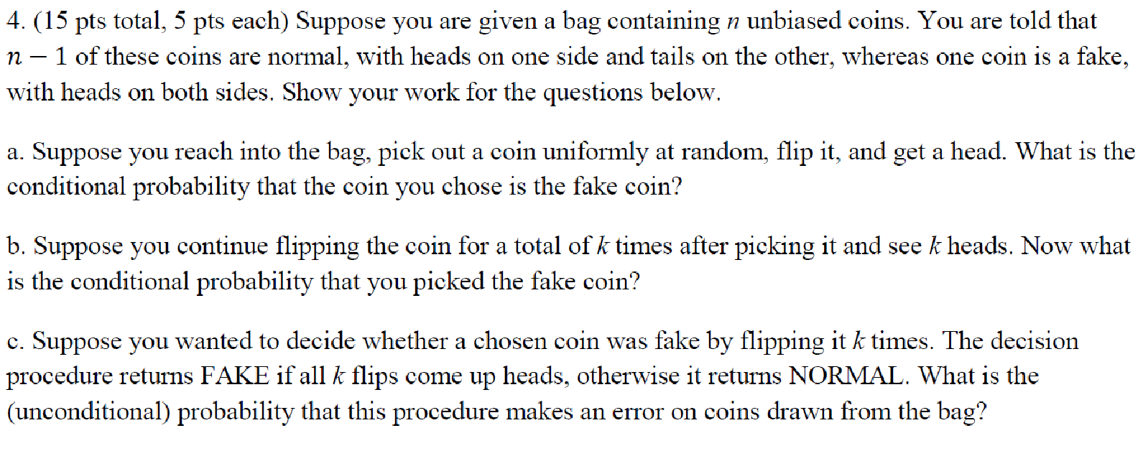
Homework Chapter 13

Slide 8
Solution
P(fake | heads) = P(heads | fake) P(fake) / P(heads) = P(heads | fake) P(fake) / [ P(heads | fake) P(fake) + P(heads | −fake) P(−fake) ] = 1 * (1/n) / [1 * (1/n) + 0.5 * (n−1) / n ] = 2 / (n+1)
P(fake | k_heads) = P(k_heads | fake) P(fake) / P(k_heads) = P(k_heads | fake) P(fake) / [ P(k_heads | fake) P(fake) + P(k_heads | −fake) P(−fake) ] = 1 * (1/n) / [1 * (1/n) + 2^{−k} * (n−1) / n ] = 2^{k} / (2^{k}+n−1)
The procedure makes an error only if a normal coin is drawn and all k flips come up heads. P(k_heads, −fake) = P(k_heads | −fake) P(−fake) = (n−1) / n2^{k}

Slide 9
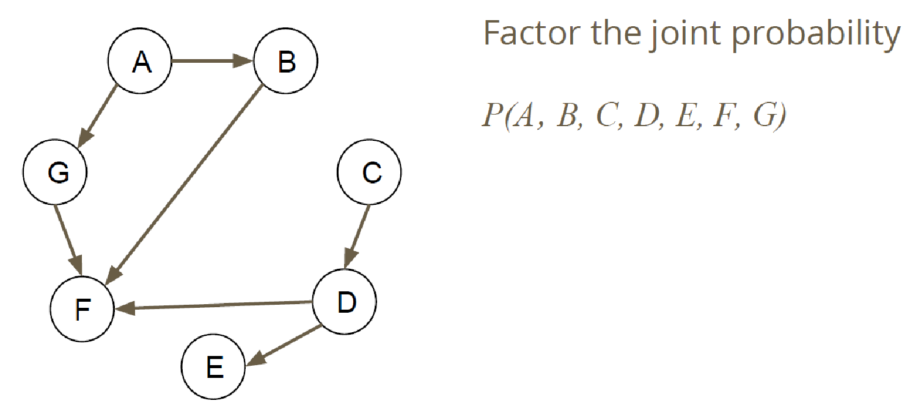
Bayesian Networks

Slide 10
Bayesian Networks

Slide 11
Bayesian Networks

Slide 12
Bayesian Networks

Slide 13
Questions?
Any other questions

