Slide 1
CS 171
Introduction to Artificial Intelligence
Discussion Session
Quiz #2 and Propositional Logic

Slide 2
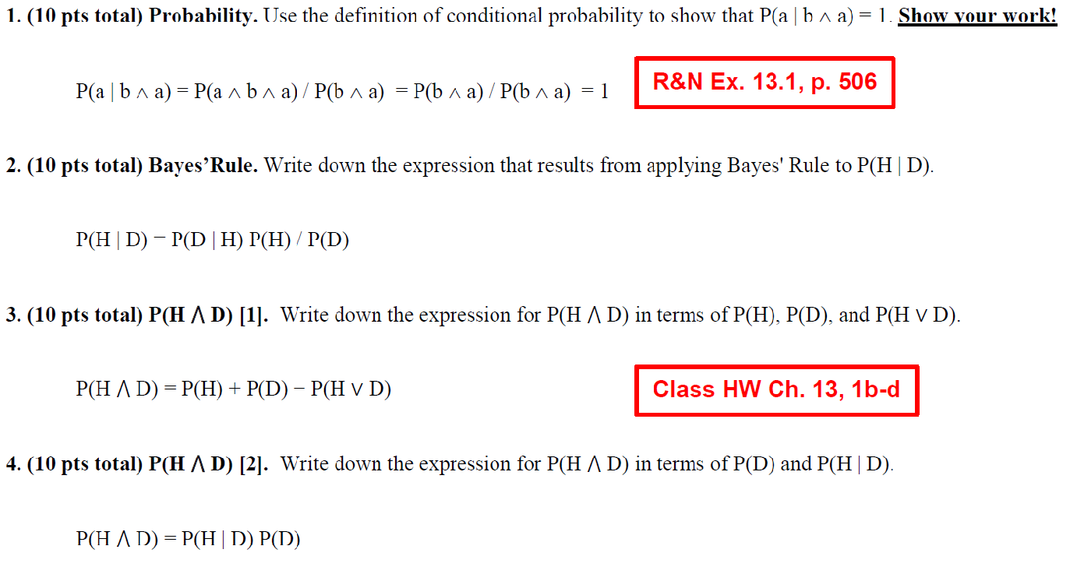

Slide 3
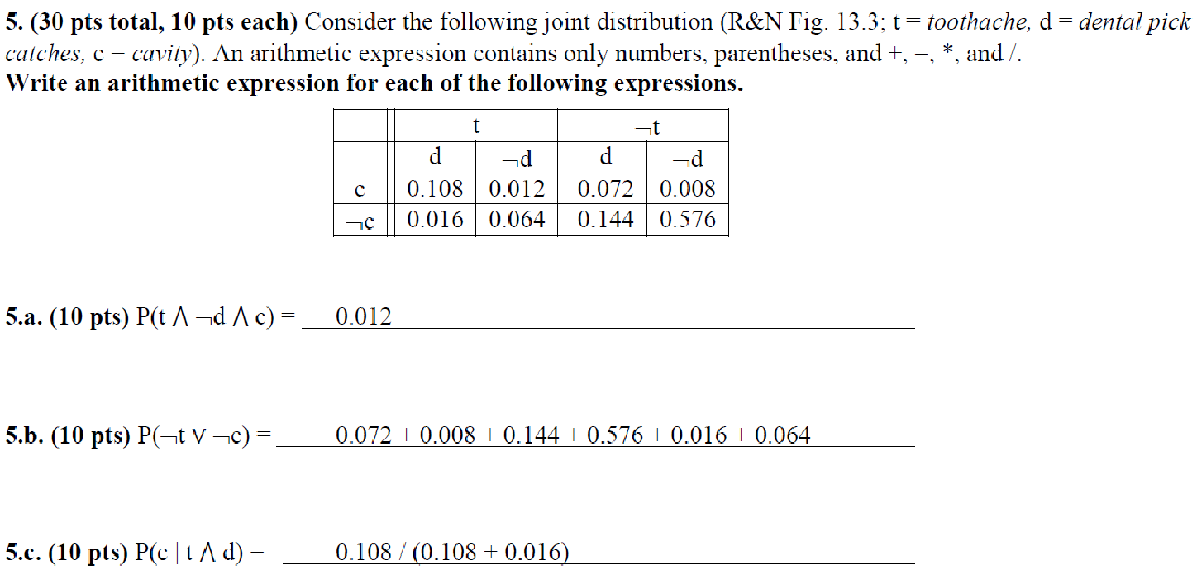

Slide 4
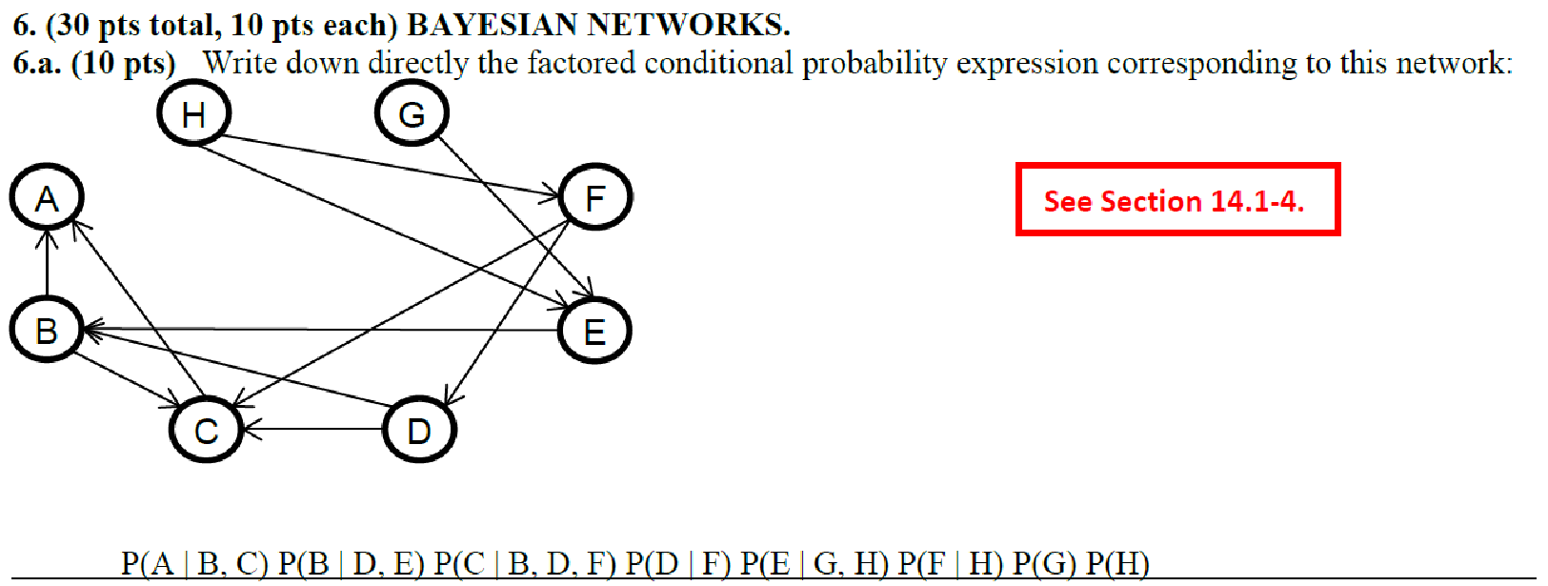

Slide 5
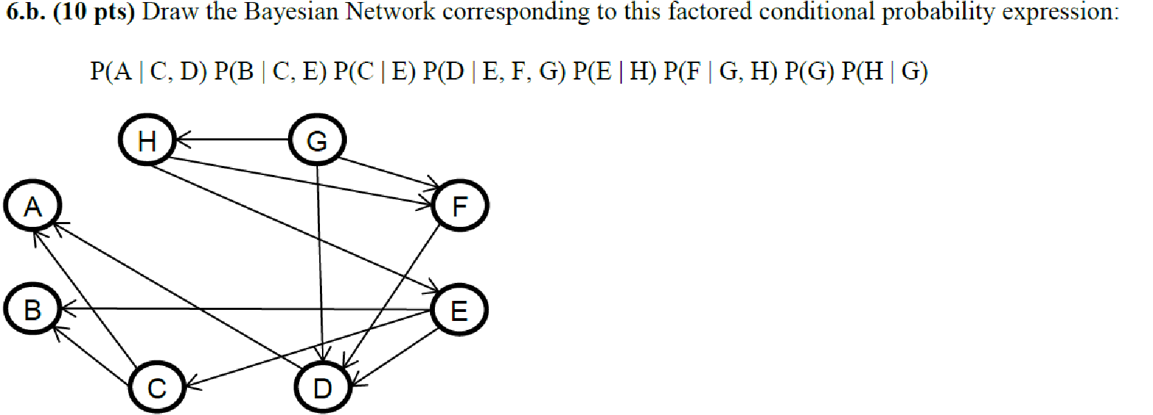

Slide 6
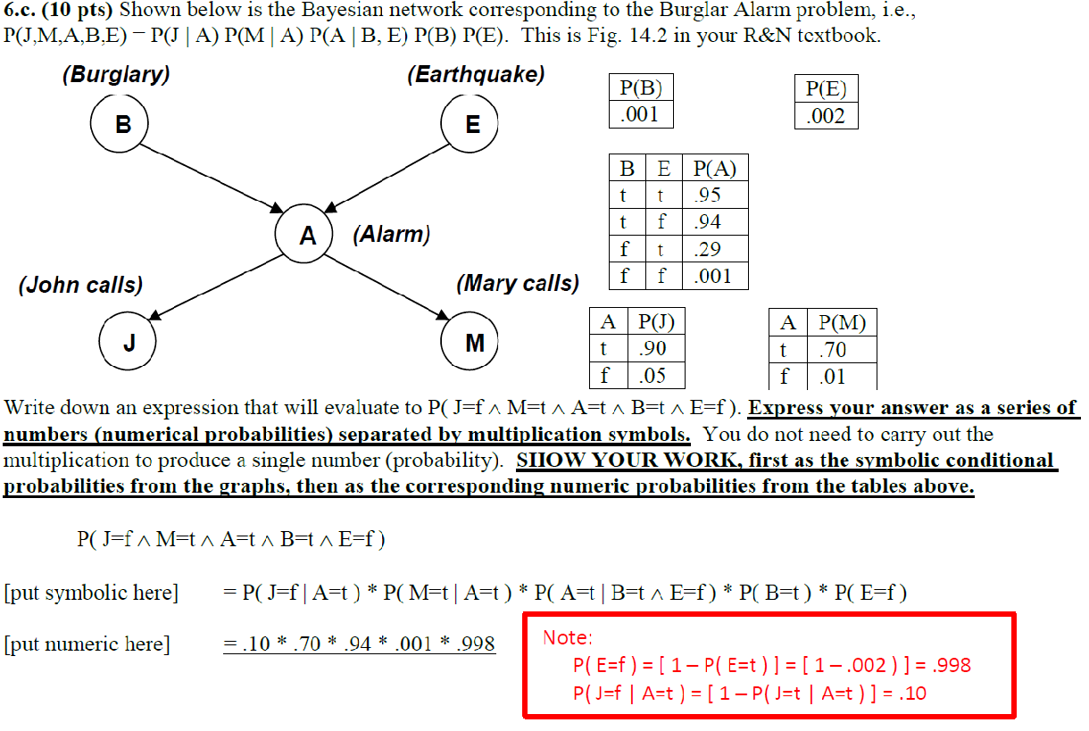

Slide 7
Sentences and Models

Slide 8
Entailment

Slide 9
Symbols and Connectives
Symbols: A proposition that can be true or false
In this example: P and Q are symbols
Connectives: negation, conjunction, disjunction, implication, biconditional

Slide 10
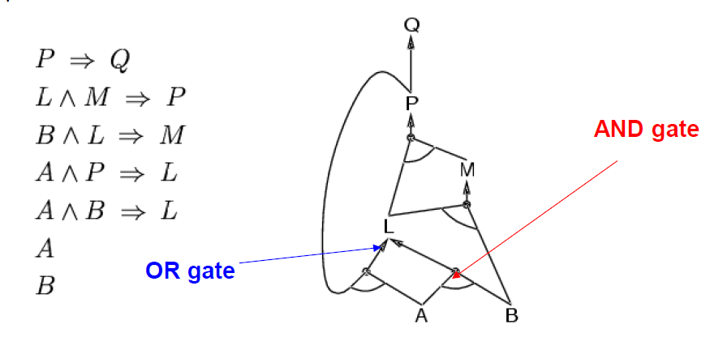
Forward Chaining
Notes:
Example from class

Slide 11
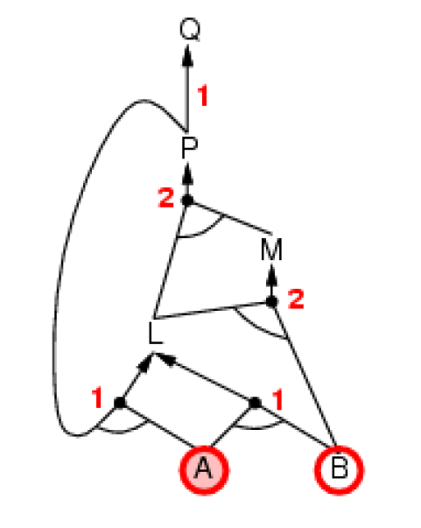
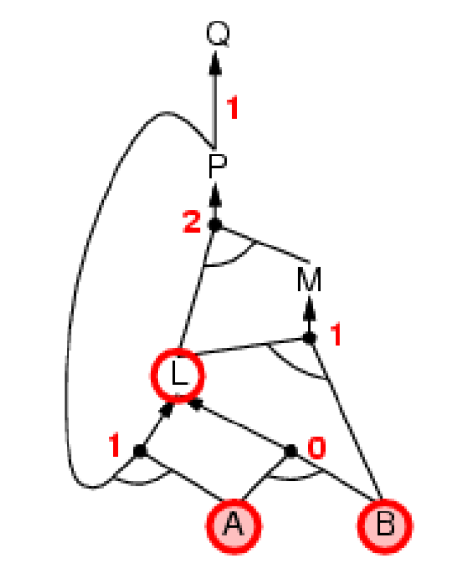
Forward Chaining

Slide 12
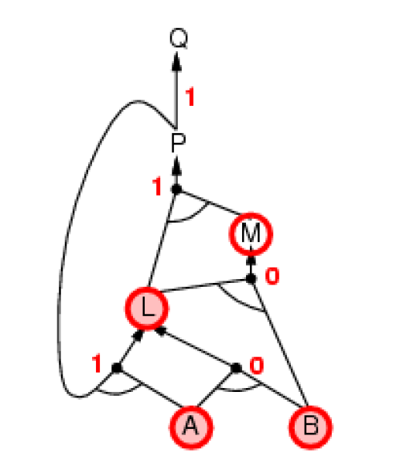
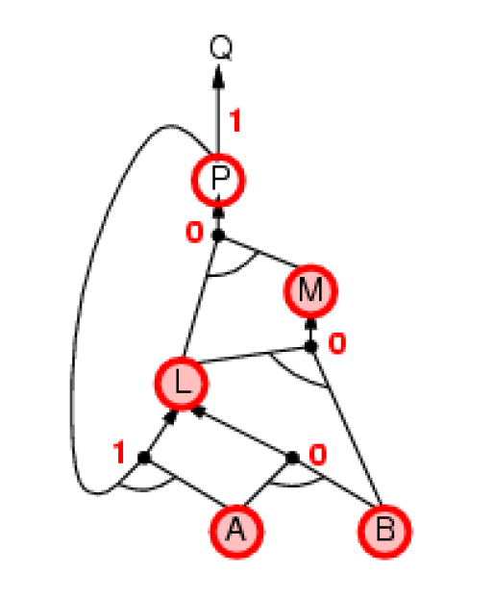
Forward Chaining

Slide 13
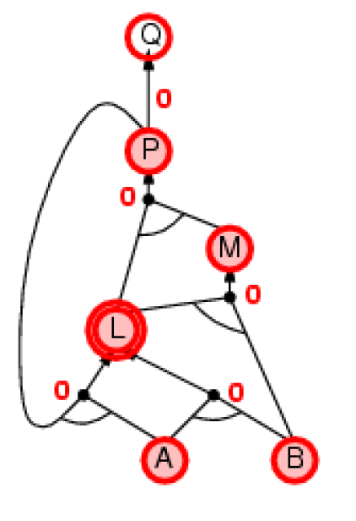
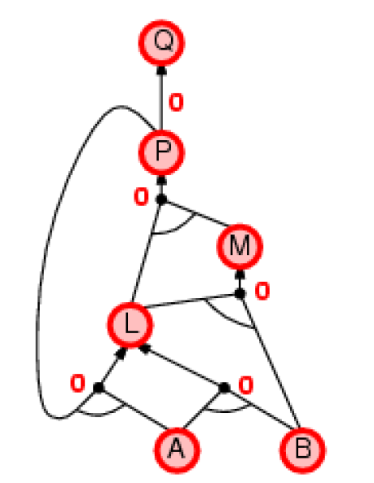
Forward Chaining

Slide 14
Trial problem
G
E ∧ F ⇒ G
C ⇒ E
B ⇒ F
A ∧ B ⇒ C
A
E
F
C
A
B

Slide 15
Solution
G
A is true.
Try B = true
A = true and B = true so C = true
B = true so F = true
C = true so E = true
E = true and F = true so G = true
E
F
C
A
B

Slide 16
Questions?

