Slide 1
CS 171
Introduction to Artificial Intelligence
Discussion Session
First Order Logic

Slide 2
Why Do We Need First-Order Logic?
Imagine a knowledgebase that describes sets
How do we add statements describing intersection?
If the world has 3 sets and integers ranging from 0 to 100
Propositional logic
$1∈{(s}_{1}∩s_{2})↔(1∈s_{1}∧1∈s_{2})$
$1∈{(s}_{1}∩s_{3})↔(1∈s_{1}∧1∈s_{3})$
$1∈{(s}_{2}∩s_{3})↔(1∈s_{2}∧1∈s_{3})$
$1∈{(s}_{2}∩s_{1})↔(1∈s_{2}∧1∈s_{1})$
…
First Order Logic
$∀x,s_{1},s_{2} x∈$ ${(s}_{1}∩s_{2})↔(x∈s_{1}∧x∈s_{2})$

Slide 3
First-Order Logic Symbols
$∀s Smelly\left(s\right)→Adjacent(Home\left(Wumpus\right),s)$
Quantifier Universal
Existential
Variable
Predicate
Returns true or false
Function
Maps a tuple of objects to an object
Constant
Objects in the world
∀ s Smelly Home Wumpus
Adjacent

Slide 4

Implication vs Conjunction
$∀x King\left(x\right)→Person(x)$
This is too strong: $∀x King\left(x\right)∧Person(x)$
$∃x Crown\left(x\right)∧OnHead\left(x,John\right)$
This is too weak: $∃x Crown\left(x\right)→OnHead\left(x,John\right)$

Slide 13
Inference
Similar to Propositional logic, we have the following tools for inference in predicate logic -
Forward chaining
Backward chaining
Resolution
First-order literals are complementary if one unifies with the negation of the other

Slide 14
Refer: Prof Lathrop’s slides

Slide 15
Refer: Prof Lathrop’s slides

Slide 18
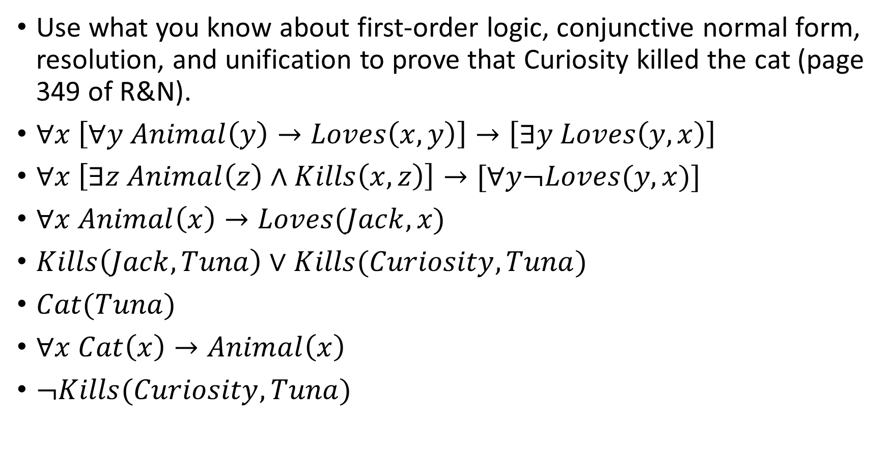
Resolution Example
Use what you know about first-order logic, conjunctive normal form, resolution, and unification to prove that Curiosity killed the cat (page 349 of R&N).
$∀x \left[∀y Animal\left(y\right)→Loves\left(x,y\right)\right]→\left[∃y Loves\left(y,x\right)\right]$
$∀x \left[∃z Animal\left(z\right)∧Kills\left(x,z\right)\right]→[∀y¬Loves(y,x)]$
$∀x Animal\left(x\right)→Loves(Jack,x)$
$Kills\left(Jack,Tuna\right)∨Kills(Curiosity,Tuna)$
$Cat(Tuna)$
$∀x Cat\left(x\right)→Animal\left(x\right)$
$¬Kills(Curiosity,Tuna)$

Slide 19
Questions?

