Slide 1
Constraint Satisfaction and Machine Learning

Slide 2
Constraint Satisfaction Problems
Variables
Domains
Constraints

Slide 3
Consistency
Node Consistency
Arc Consistency
Path Consistency
K-Consistency

Slide 4
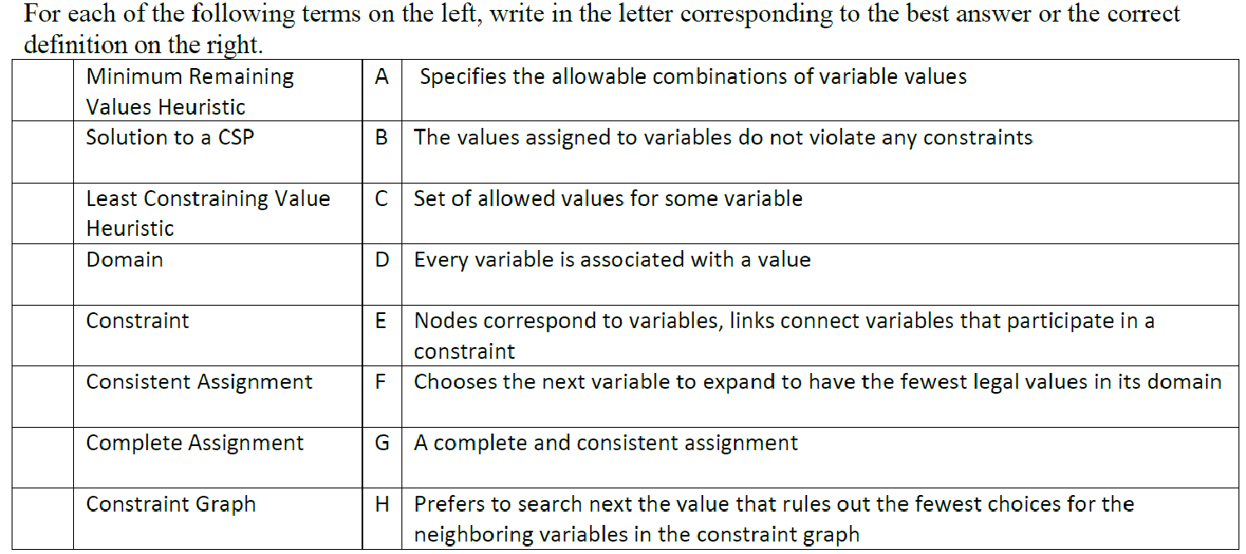
Constraint Satisfaction Concepts

Slide 5
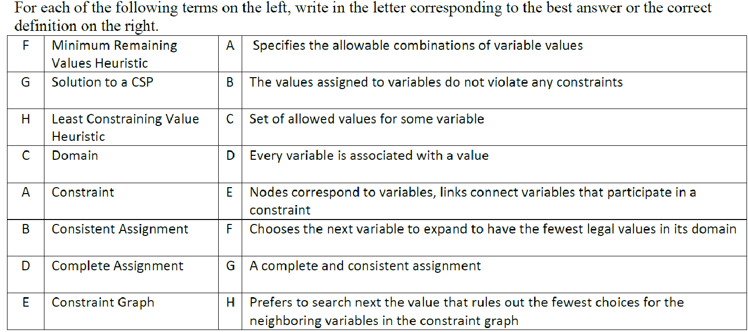
Constraint Satisfaction Concepts

Slide 6
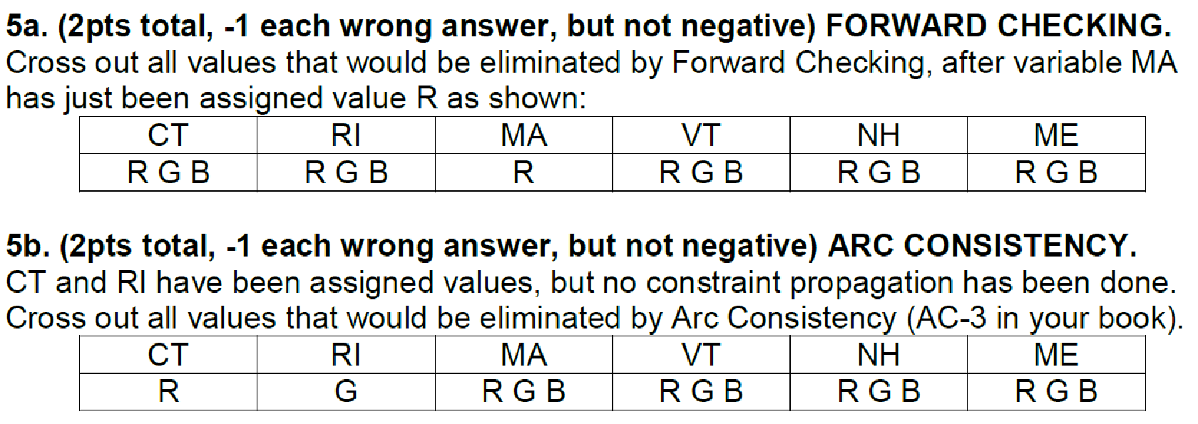

Slide 7
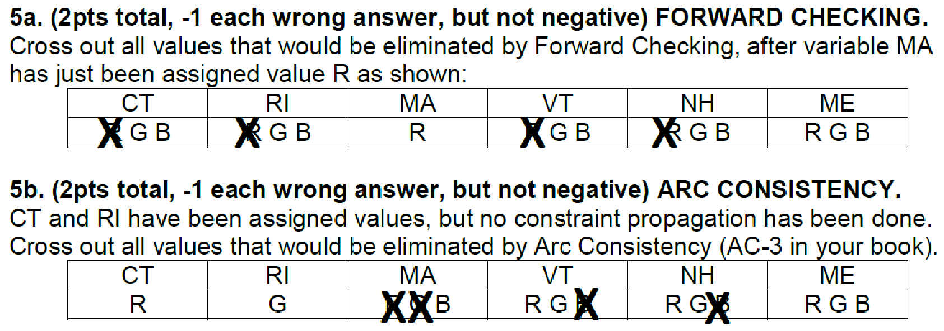

Slide 8
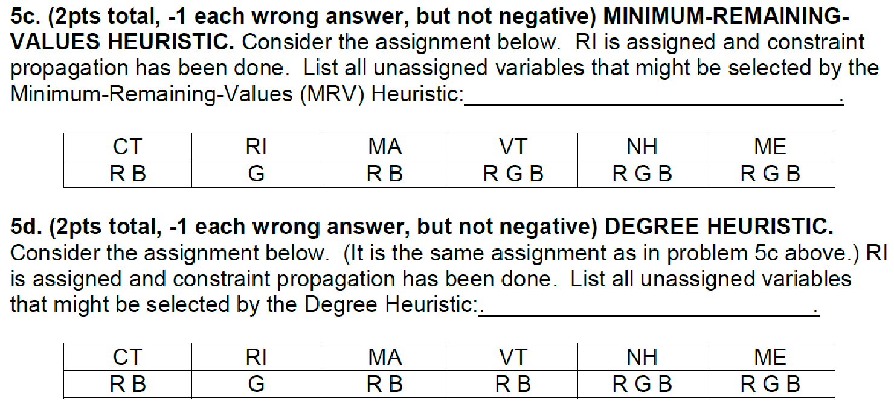

Slide 9
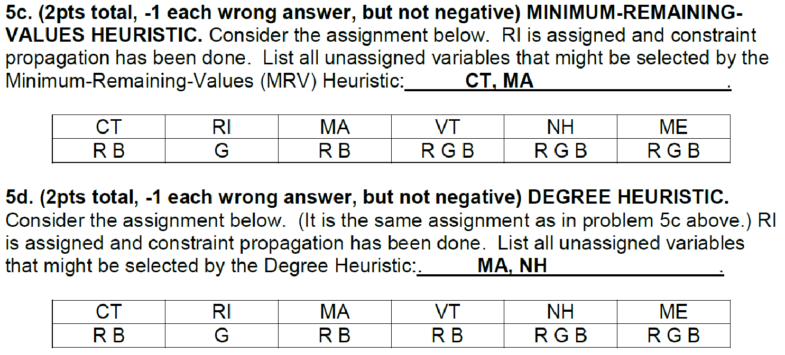

Slide 12
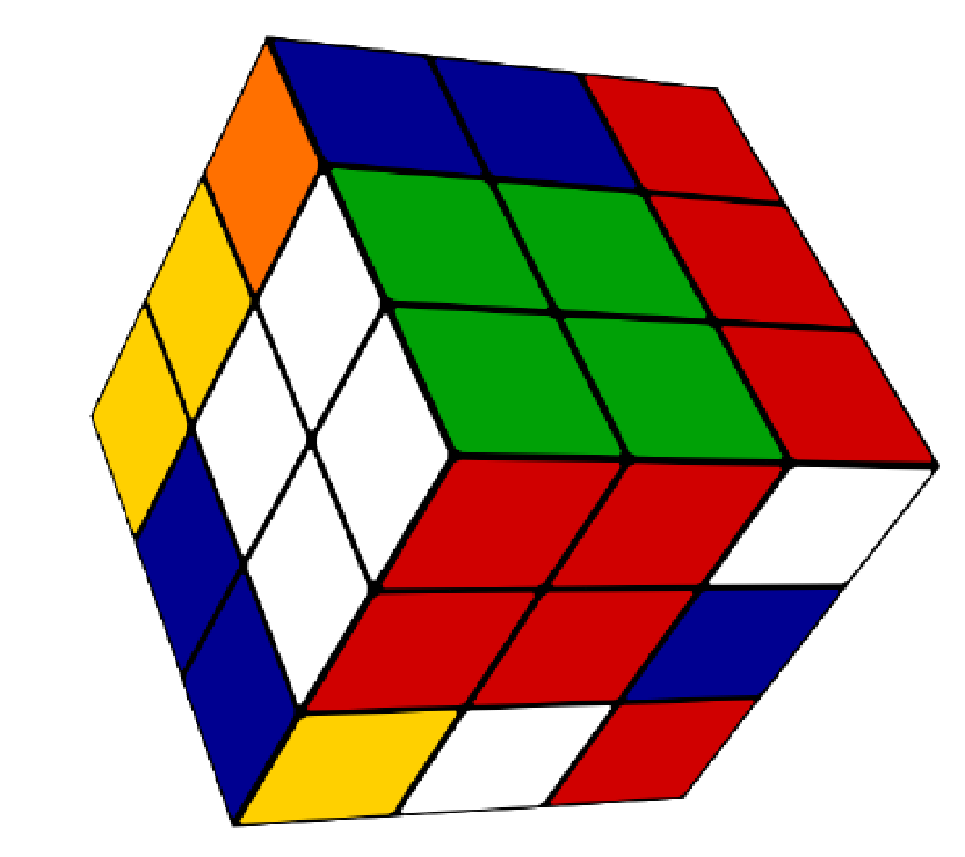
Machine Learning: Representation
How can we represent a Rubik’s Cube?

Slide 13
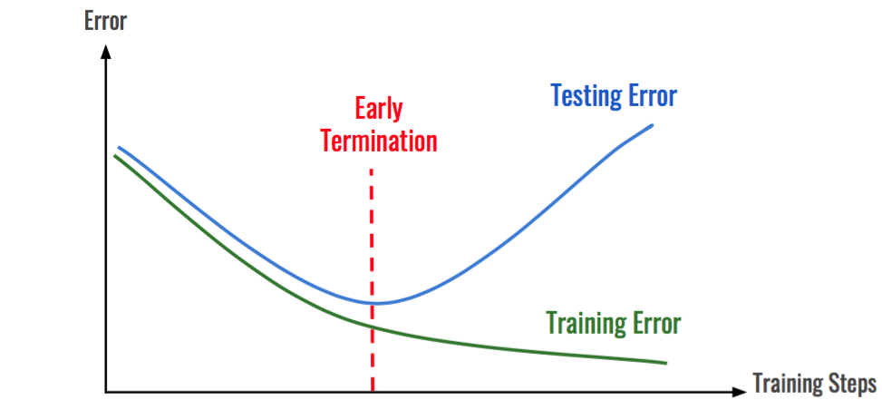
Machine Learning: Overfitting

Slide 16
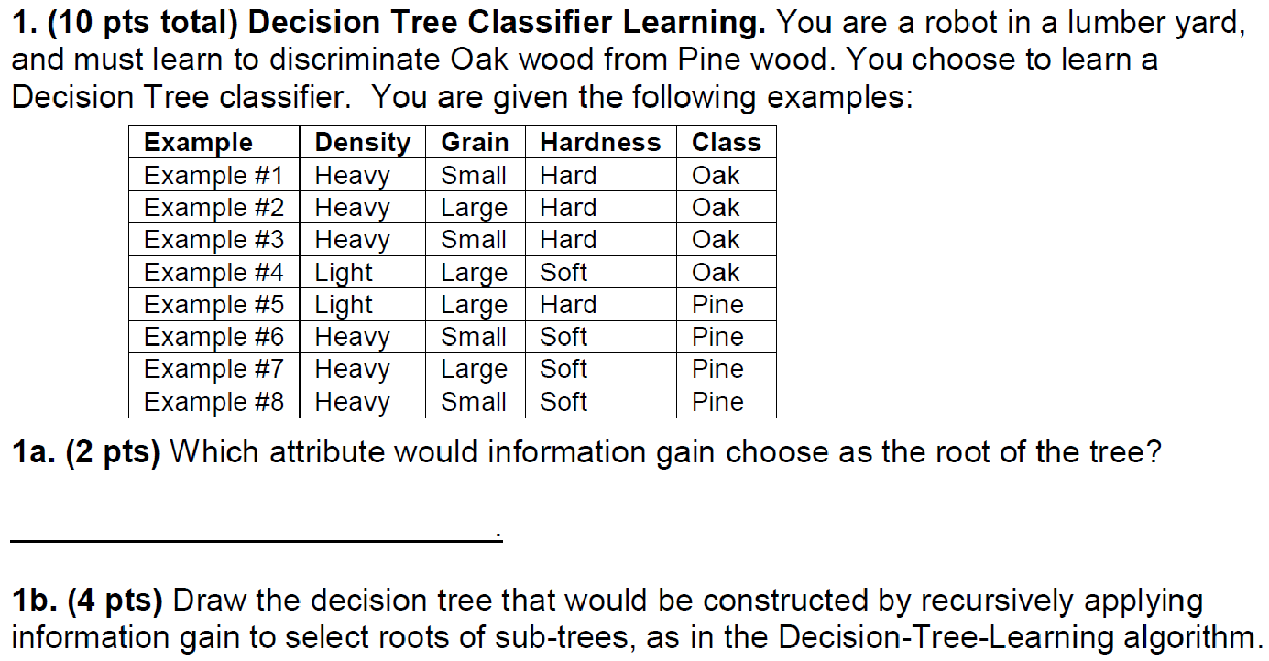

Slide 22
Point to note here - error decreases as M increases.
Question - Why?

Slide 23
Questions?

