Slide 1
Introduction to Deep Learning with Modern Day Applications
Presented by Forest Agostinelli

Slide 2
Final Exam
Tue, Dec 11, 4:00-6:00pm
PSLH-100

Slide 3
Outline
Brief Description
What can deep learning do?
Architectures
Training
Applications
Tips and Tricks
What can deep learning not do…yet?

Slide 4
Brief Description
Input
Processing
Output
Output
Processing
Connections: “Weights”
Input

Slide 5
Brief Description
Input
Processing
Output
Output
Processing Nodes: “Neurons”
Connections: “Weights”
Input

Slide 6
Brief Description
Output
Input
Processing
Output
Processing block: “Layer”
Input

Slide 7
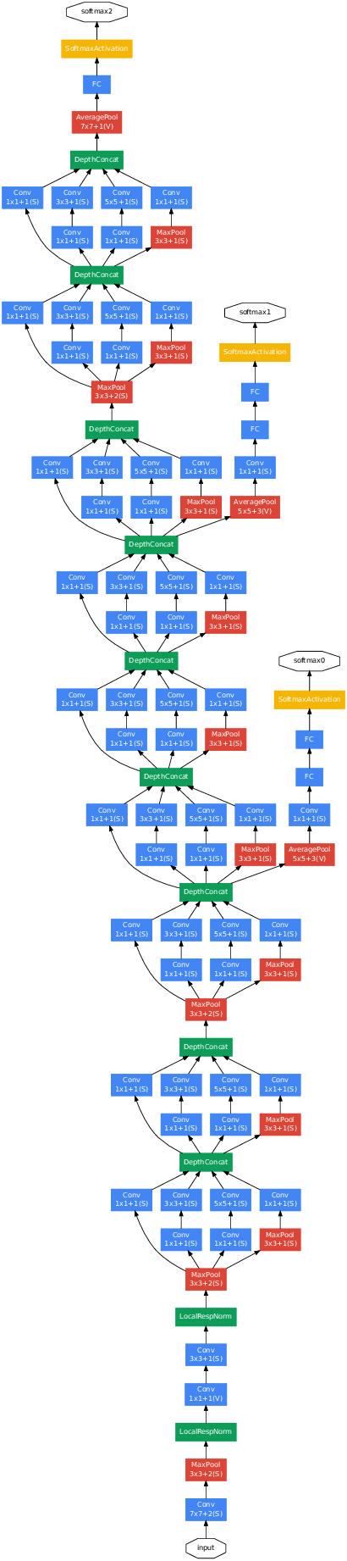
Brief Description
“Deep learning allows computational models that are composed of multiple processing layers to learn representations of data with multiple levels of abstraction.”

Slide 8
What can Deep Learning Do?
Classification
Unsupervised Learning
Denoising
Generative models
Games and Puzzles
Natural Language Processing
Sciences

Slide 9
What can Deep Learning Do?
Classification
Given an image/sound/etc. determine what class it belongs to

Slide 10
What can Deep Learning Do?
Classification
Given an image/sound/etc. determine what class it belongs to

Slide 11
What can Deep Learning Do?
Classification
Given an image/sound/etc. determine what class it belongs to

Slide 12
What can Deep Learning Do?
Classification
Given an image/sound/etc. determine what class it belongs to

Slide 13
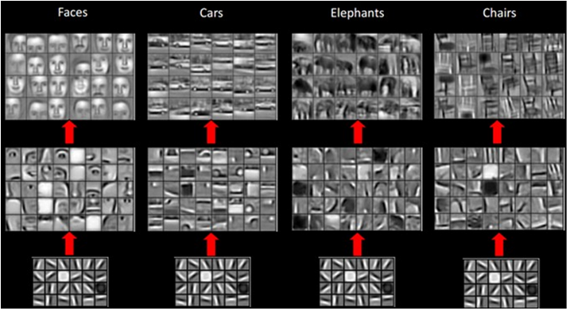
What can Deep Learning Do?
Unsupervised Learning
Build meaningful representations of unlabeled data
Layer 3
Layer 2
Layer 1

Slide 14
What can Deep Learning Do?
Unsupervised Learning
Build meaningful representations of unlabeled data
Layer 3
Layer 2
Layer 1

Slide 15
What can Deep Learning Do?
Denoising
Remove unwanted noise from data
Noisy
Denoised

Slide 16
What can Deep Learning Do?
Generative Models
“Imagine” new data that is plausibly similar to real-world data
Imagination

Slide 17
What can Deep Learning Do?
Generative Models
Use imagination to manipulate data
Interpolation

Slide 18
What can Deep Learning Do?
Generative Models
Use imagination to manipulate data
Manipulation

Slide 19
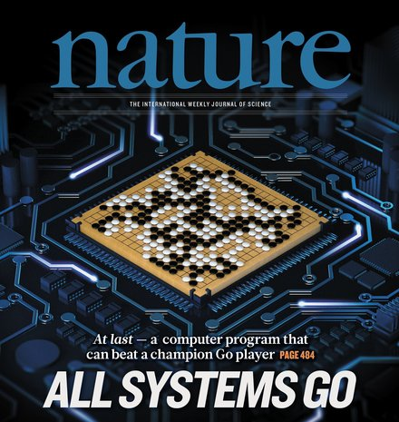
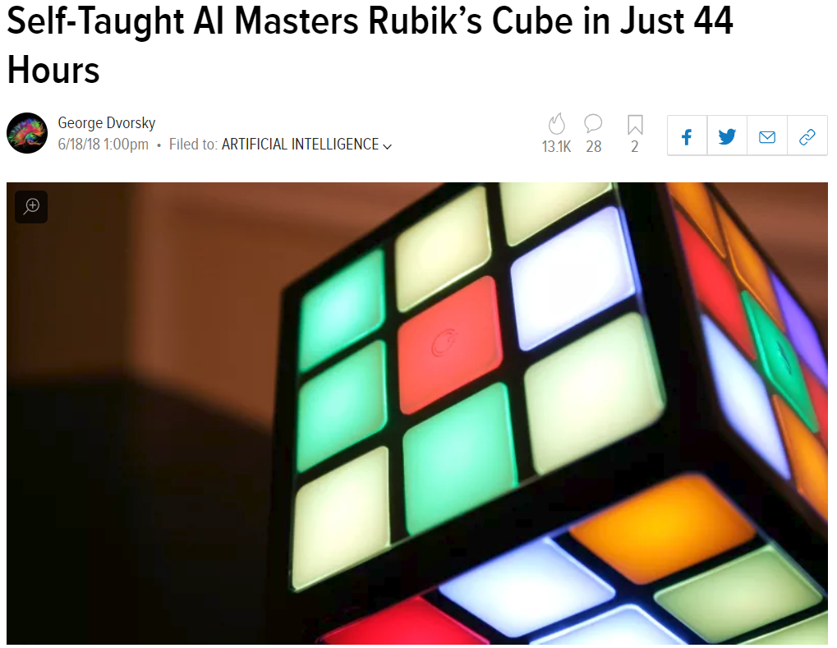
What can Deep Learning Do?
Games and Puzzles

Slide 20
What can Deep Learning Do?
Natural Language Processing
Understand sentences

Slide 21
What can Deep Learning Do?
Natural Language Processing
Understand sentences

Slide 22
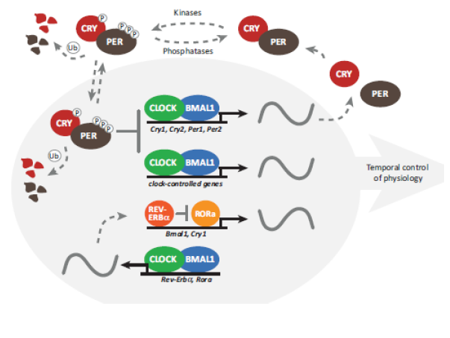
What can Deep Learning Do?
Sciences
Bioinformatics
High Energy Physics
Neuroscience

Slide 23
Architecture
Layers
  Fully Connected
  Convolutional
Activation Functions
Outputs

Slide 24
Fully Connected Layers
Connect every processing unit together
Can be used for a plethora of applications
Output
Input

Slide 25
Convolutional Layers
Convolve filters across the input.
Very effective on structured data such as images, audio, and graphs

Slide 26
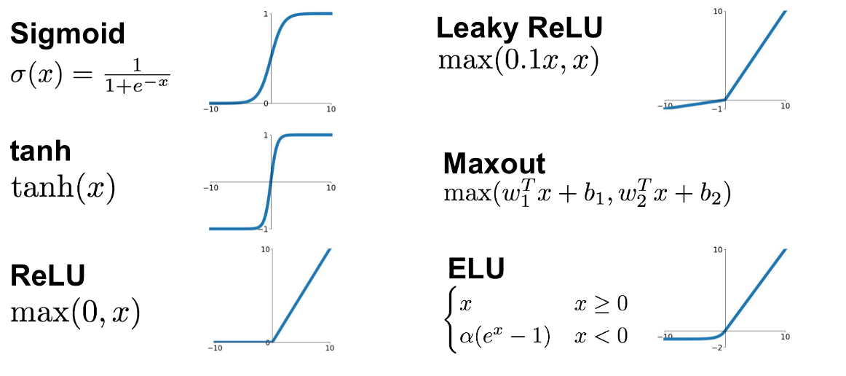
Activation Functions
We need the ability to learn non-linear functions of the input
ReLU and Sigmoid are two of the most popular activations functions.

Slide 27
Outputs
Sigmoid
  Binary classification
Softmax
  Multi-class classification
Linear
  General purpose regression

Slide 28
Training
Gradient Descent
Stochastic Gradient Descent
Overfitting/Regularization

Slide 29
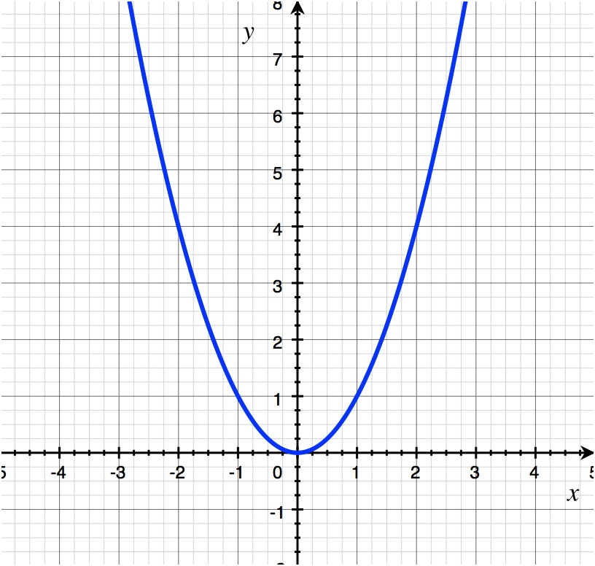
Training
Define a loss function
Adjust parameters (weights) to minimize loss
  Use gradient descent to adjust parameters
Minimized Loss

Slide 30
Stochastic Gradient Descent
Data
Compute loss
Gradient
Descent
Subset of Data

Slide 31
Stochastic Gradient Descent
Data
Compute loss
Gradient
Descent
Subset of Data

Slide 32
Stochastic Gradient Descent
Data
Compute loss
Gradient
Descent
Subset of Data

Slide 33
Stochastic Gradient Descent
Data
Compute loss
Gradient
Descent
Subset of Data

Slide 34
Overfitting/Regularization
What is overfitting?
Weight Regularization
Dropout

Slide 35
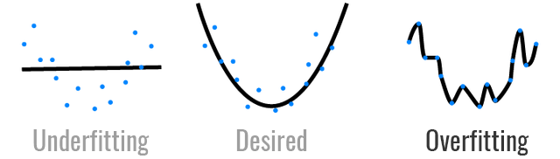
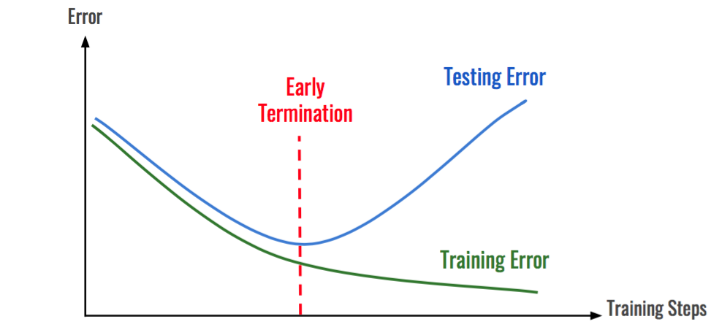
What is overfitting?

Slide 36
Weight Regularization
Make the weights less “sensitive” to input
Output
Input

Slide 37
Dropout
Randomly drop connections between neurons during training

Slide 38
Applications
High Energy Physics
Circadian Rhythms
Neuroscience
Generative Models
Reinforcement Learning

Slide 39
High Energy Physics
Detecting exotic particles (i.e. this Higgs Boson) in collision experiments is a difficult and computationally intensive task.
Decision Tree
Neural Network
Deep Neural Network

Slide 40
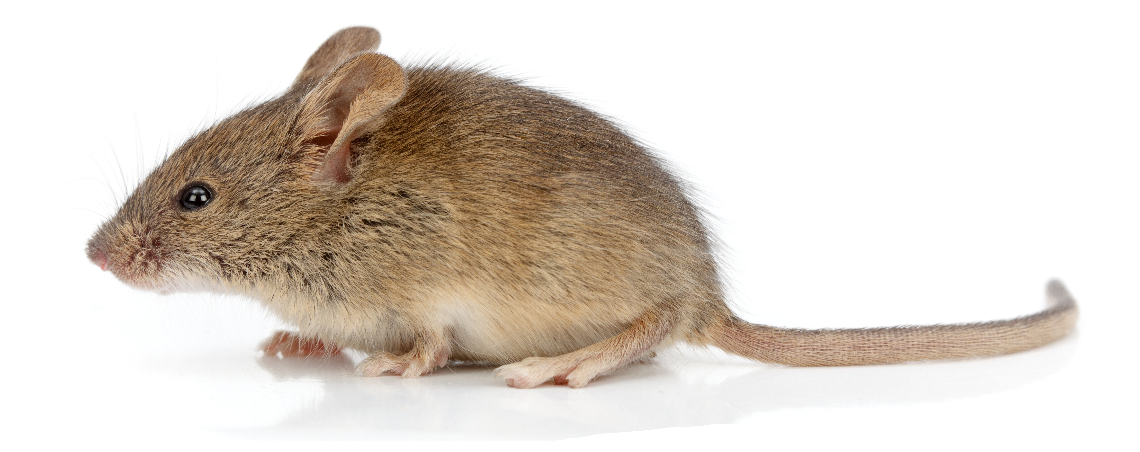

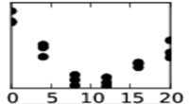
Circadian Rhythms
Differences in molecular concentration under a control condition and an experimental condition.
These measurements are often carried out at different times. But the times aren’t recorded.
However, differences could be due to the circadian rhythm instead of the experimental condition.
Control
Experimental
Control
Experimental
04:00
12:00
Control
Experimental

Slide 41
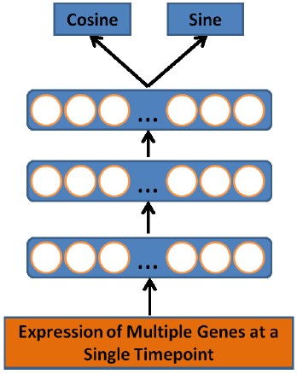
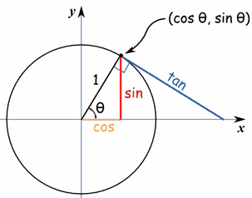



Circadian Rhythms
$$\frac{x}{\sqrt{x^{2}+y^{2}}}$$
$$\frac{y}{\sqrt{x^{2}+y^{2}}}$$
$\sin^{2}(x)$ + $\cos^{2}\left(x\right)=1$
Forces output to lie on a circular manifold.
Captures the cyclic nature of time.
Using a specialized output layer, we can train a network to predict the time of day
0
18
6
12

Slide 42
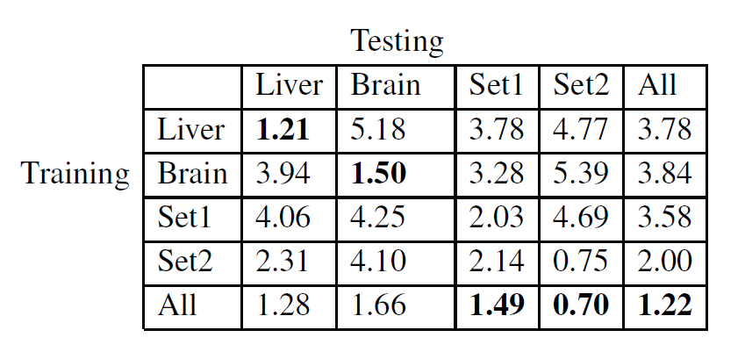
Circadian Rhythms
The resulting architecture can impute the time an experiment was carried out within 2 hours

Slide 43
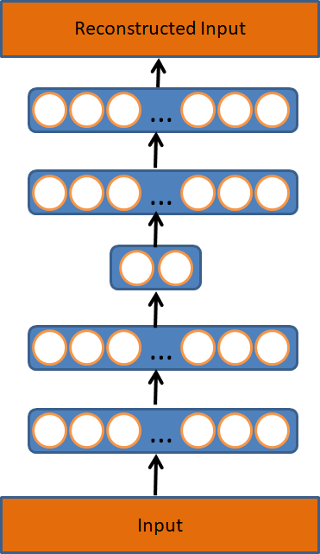
Unsupervised Learning: Autoencoders
Train a deep neural network to reproduce its input
Use a layer to force it to encode a higher level representation
Decoder
Bottleneck layer
Encoder

Slide 44
Neuroscience
We can then visualize how brain activity changes over time

Slide 45
Generative Models
Sometimes, it is beneficial to have the ability to generate realistic data
There are many methods to this, each with pros and cons
  Variational autoencoders
  Restricted Boltzmann machines
  Flow based generative models
  Generative Adversarial Networks

Slide 46
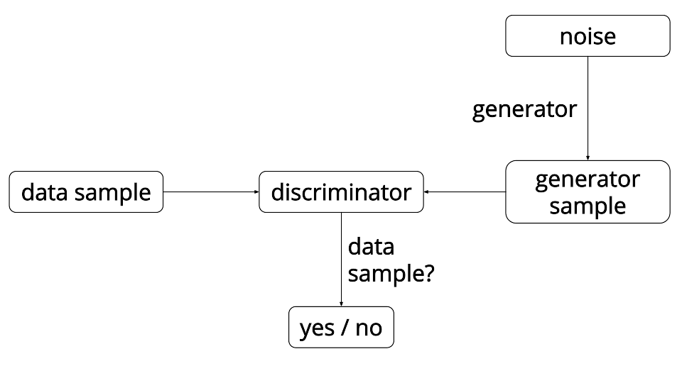
Generative Models: Generative Adversarial Networks

Slide 47
Generative Models: Generative Adversarial Networks

Slide 48
Generative Models: Generative Adversarial Networks

Slide 49
Generative Models: Generative Adversarial Networks

Slide 50
Generative Models: Generative Adversarial Networks

Slide 51
Generative Models: Generative Adversarial Networks
Generative adversarial networks have been extended to a plethora of tasks
In addition to images, synthetic audio has been created that closely mimics real people

Slide 52
Reinforcement Learning

Slide 53
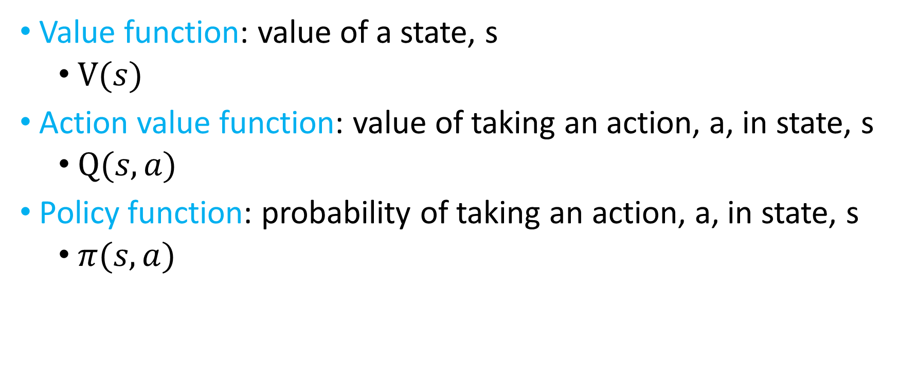
Reinforcement Learning
Value function: value of a state, s
  $V(s)$
Action value function: value of taking an action, a, in state, s
  $Q(s,a)$
Policy function: probability of taking an action, a, in state, s
  $π(s,a)$

Slide 54
Reinforcement Learning
All grey boxes can be replaced by a deep neural network

Slide 55
Reinforcement Learning

Slide 56
Tips and Tricks
Input Normalization
Learned Activation Functions
Residual Learning

Slide 57
Input Normalization
Deep neural networks are math
Data normalization is crucial to ensuring numerical stability

Slide 58
Learned Activation Functions

Slide 59
Residual Learning
Despite many advances, deep neural networks are still hard to train
Training can become more difficult as the number of layers increases
Adding skip connections allows us to train networks with hundreds of layers

Slide 60

What Can Deep Learning Not Do…Yet?
Math
  $$1+1=11$$

Slide 61
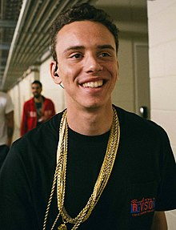
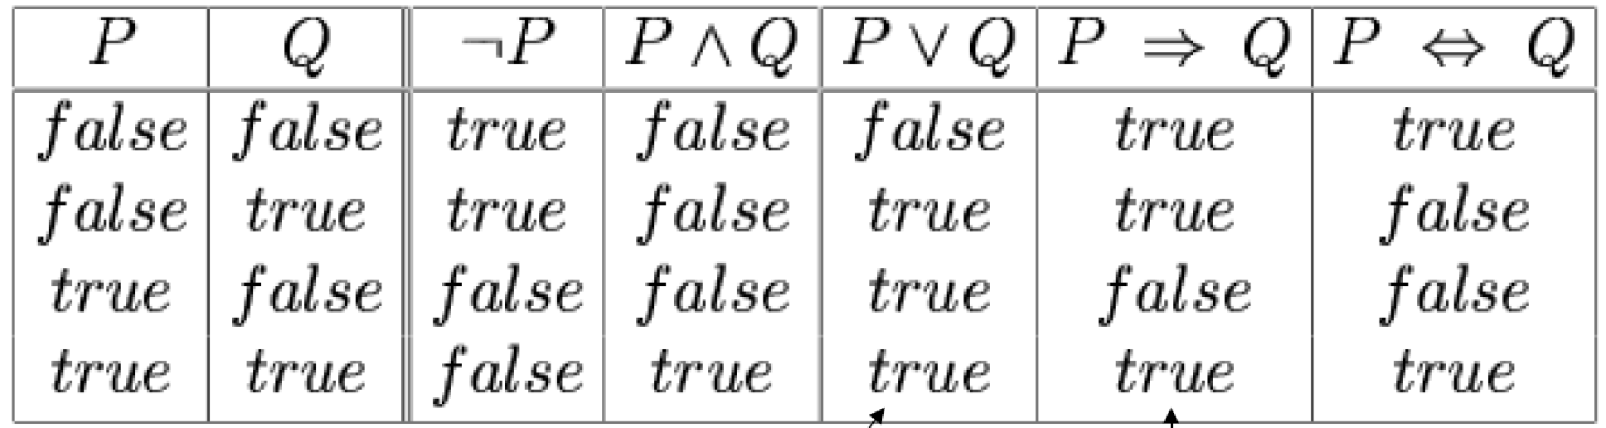
What Can Deep Learning Not Do…Yet?
Math
Logic

Slide 62
What Can Deep Learning Not Do…Yet?
Math
Logic
Explain Itself
???

Slide 63
What Can Deep Learning Not Do…Yet?
Math
Logic
Explain Itself
Theoretical Guarantees

Slide 64
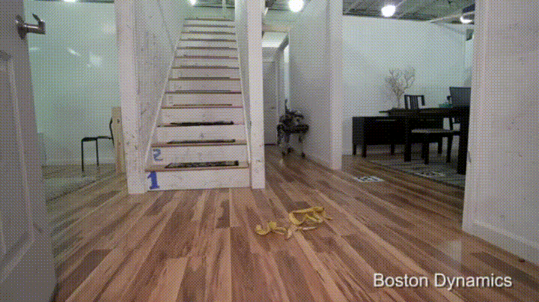
What Can Deep Learning Not Do…Yet?
Math
Logic
Explain Itself
Theoretical Guarantees
Safety Guarantees
This Photo by Unknown Author is licensed under CC BY-ND

Slide 65
Questions?

