Slide 1
Quiz #4
Final Exam Review

Slide 6
The Wumpus World Environment
Task Environment | Observable | Deterministic/Stochastic | Episodic/Sequential | Static/Dynamic | Discrete/Continuous | Agents
Wumpus World | Partially | Deterministic | Sequential | Static | Discrete | Single

Slide 7
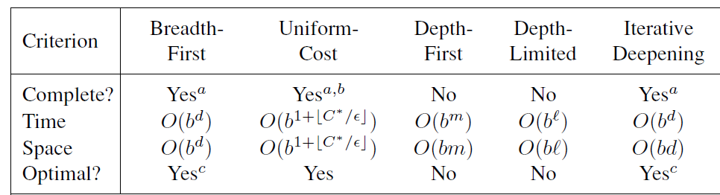
Uninformed search strategies
Section 3.4, Russell and Norvig

Slide 8
Informed search strategies
Informed search methods may have access to a heuristic function h(n) that estimates the cost of a solution from n.
The generic best-first search algorithm selects a node for expansion according to an evaluation function.
– Greedy best-first search expands nodes with minimal h(n).
It is not optimal but is often efficient.
– A∗ search expands nodes with minimal f(n) = g(n) + h(n).
A∗ is complete and optimal, provided some conditions on h(n).

Slide 9
Uniform Cost Search vs GBFS vs A*
  f(n) = h(n) + g(n)
  g(n) = path cost
  h(n) = heuristic estimate
  Q. How do you use these values to do GBF, A*, and uniform cost search?

Slide 10
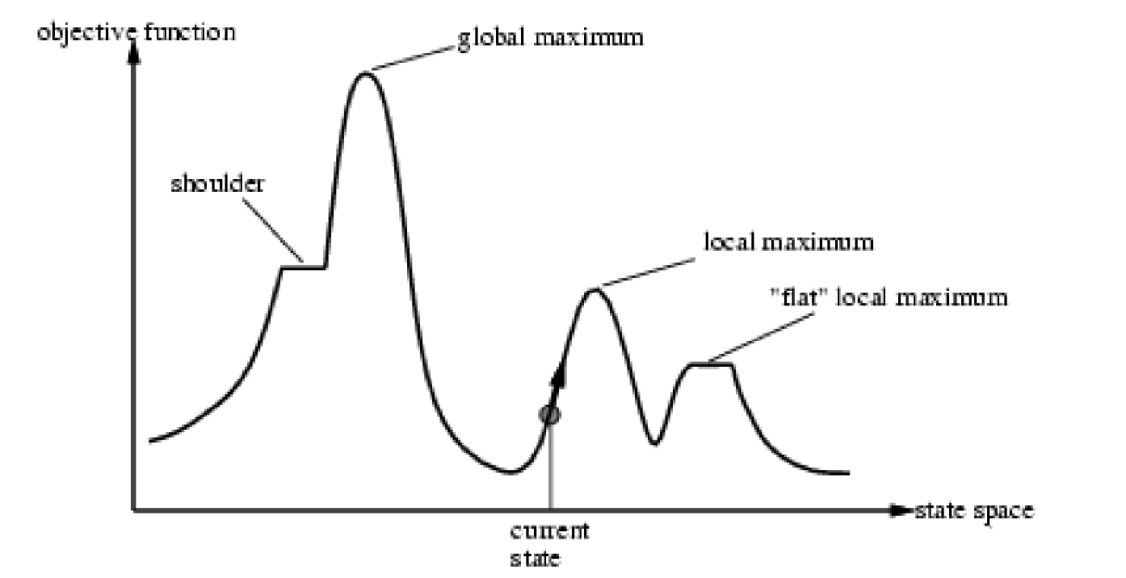
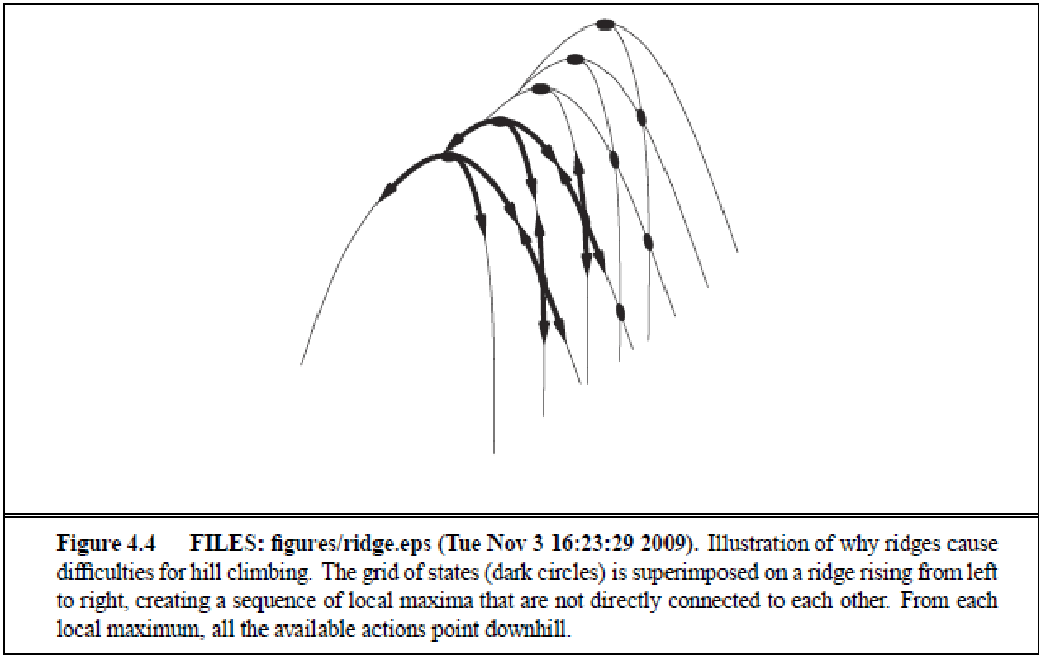
Local Search Terminology

Slide 11
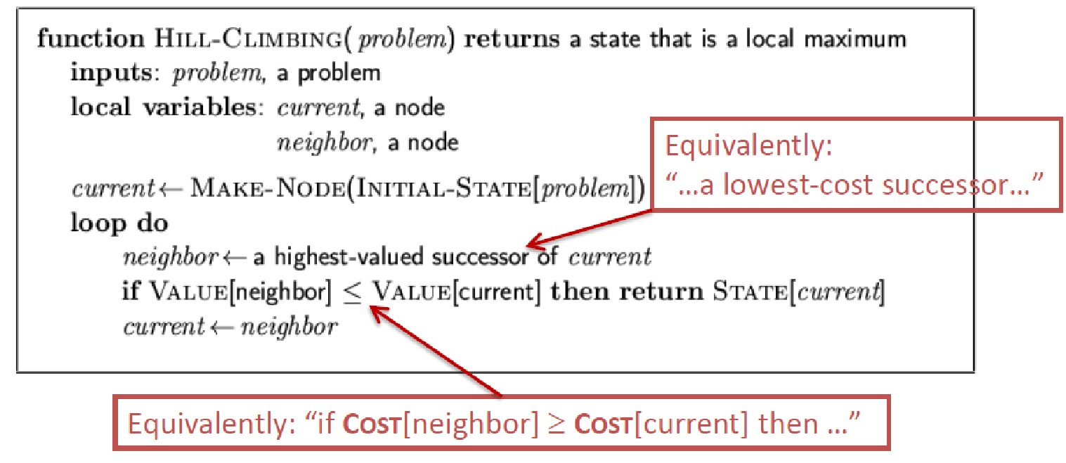
Hill Climbing Search
Gets stuck at local maxima (incomplete)

Slide 12
Hill Climbing with Random Restarts
If the search fails, restart the search from a random position
If each search has a probability p of succeeding, expected number of random restarts is 1/p

Slide 13
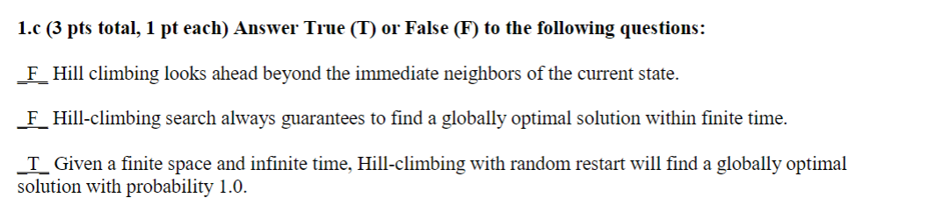
Hill-Climbing

Slide 14
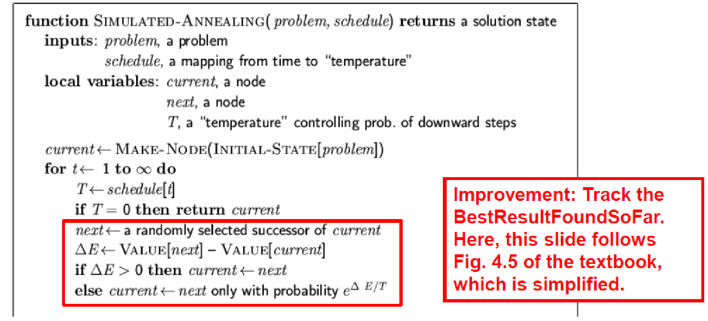
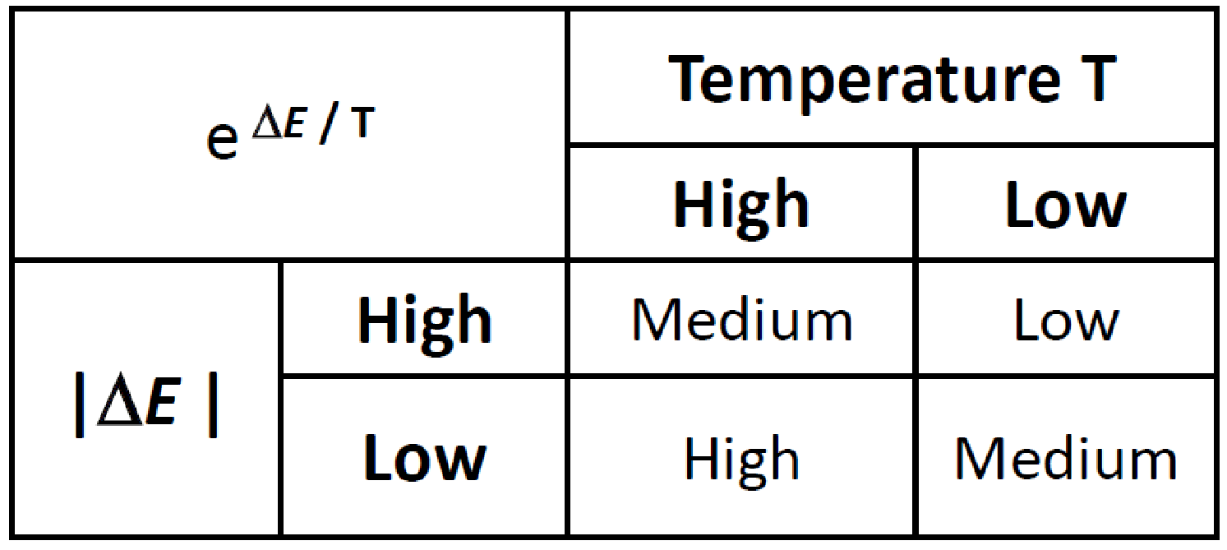
Simulated Annealing

Slide 15
Bayes Rule
P(B|A) = P(A|B)P(B)/P(A)
How do we obtain Bayes rule from the product rule?

Slide 16
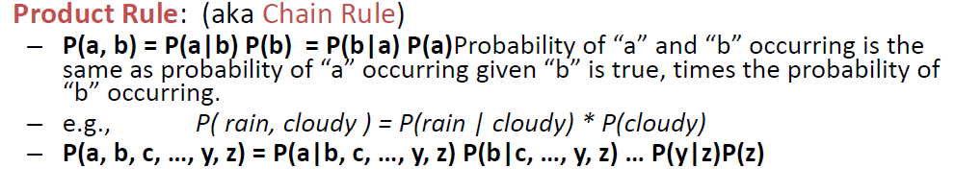
Product Rule
Ch 13 Slides - Prof Lathrop

Slide 17
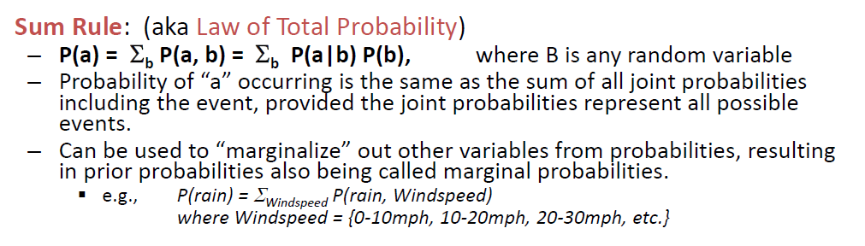
Sum Rule
Ch 13 Slides - Prof Lathrop

Slide 18
Independence
P(a,b) = P(a)P(b)
P(a|b) = P(a)
P(b|a) = P(b)

Slide 19
Conditional Independence
P(c,d|e) = P(c|e)P(d|e)
P(c|d,e) = P(c|e)
P(d|c,e) = P(d|e)

Slide 20
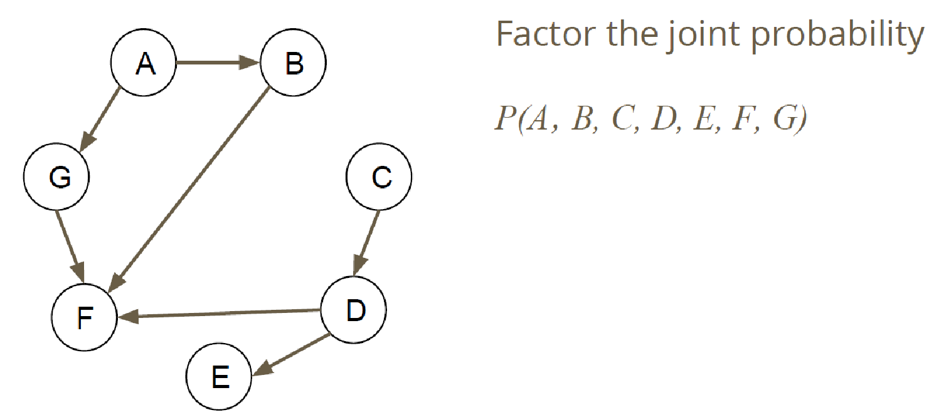
Bayesian Networks

Slide 21
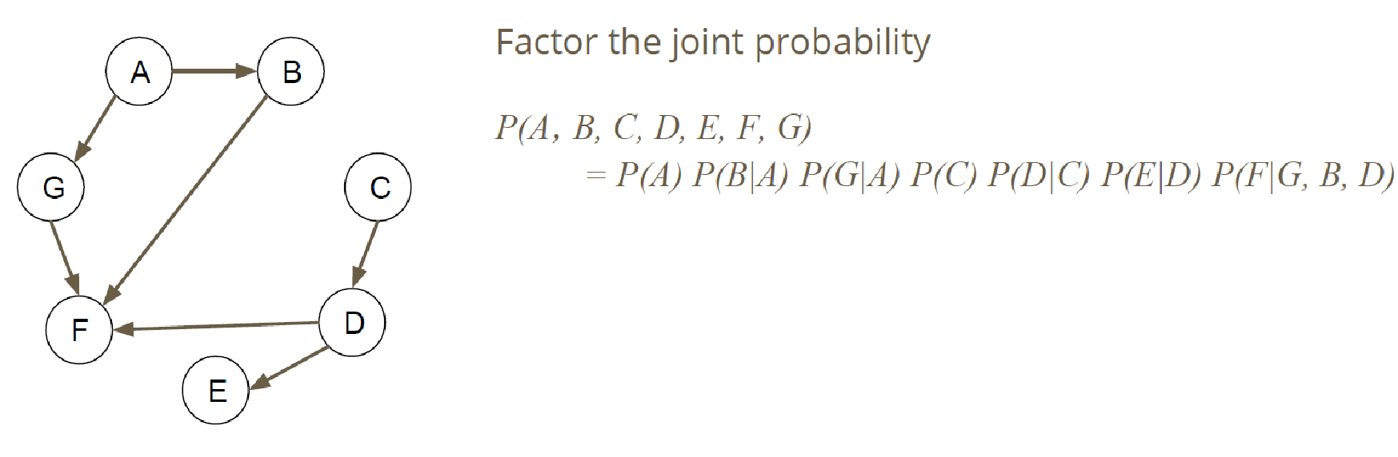
Bayesian Networks

Slide 22
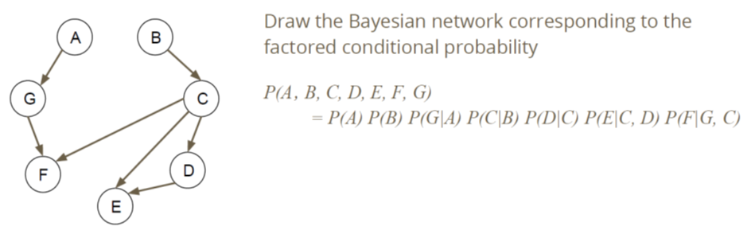
Bayesian Networks

Slide 23
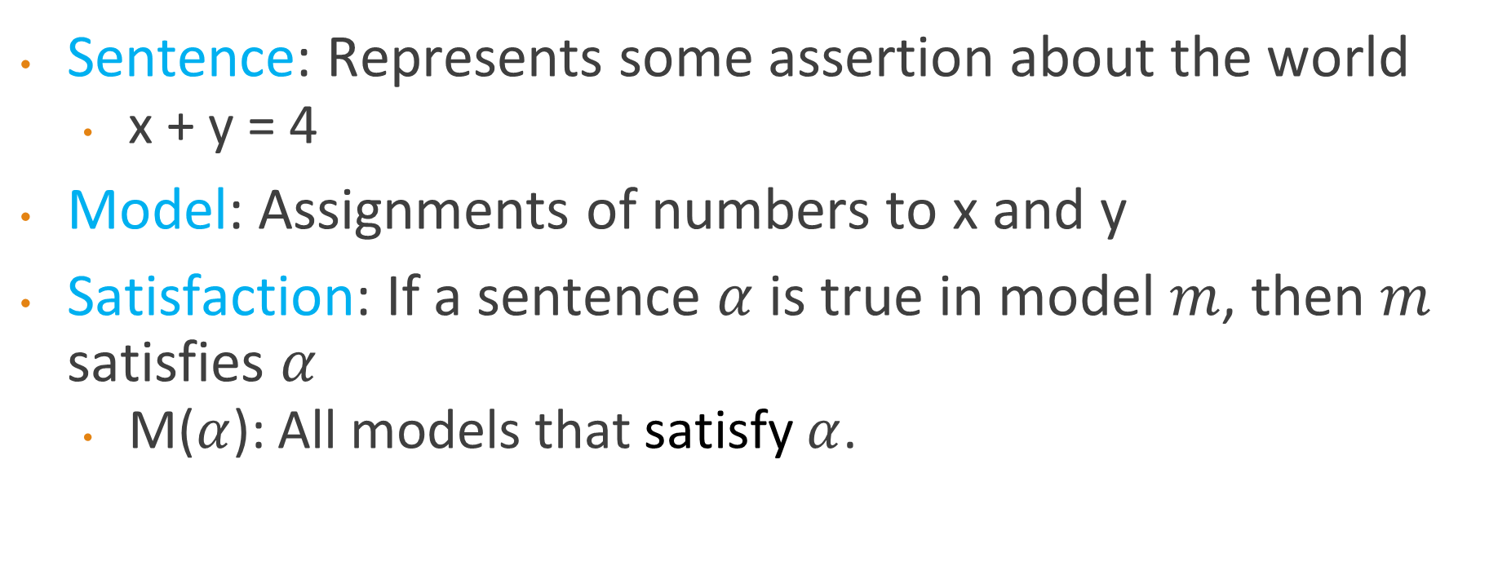
Sentences and Models

Slide 24
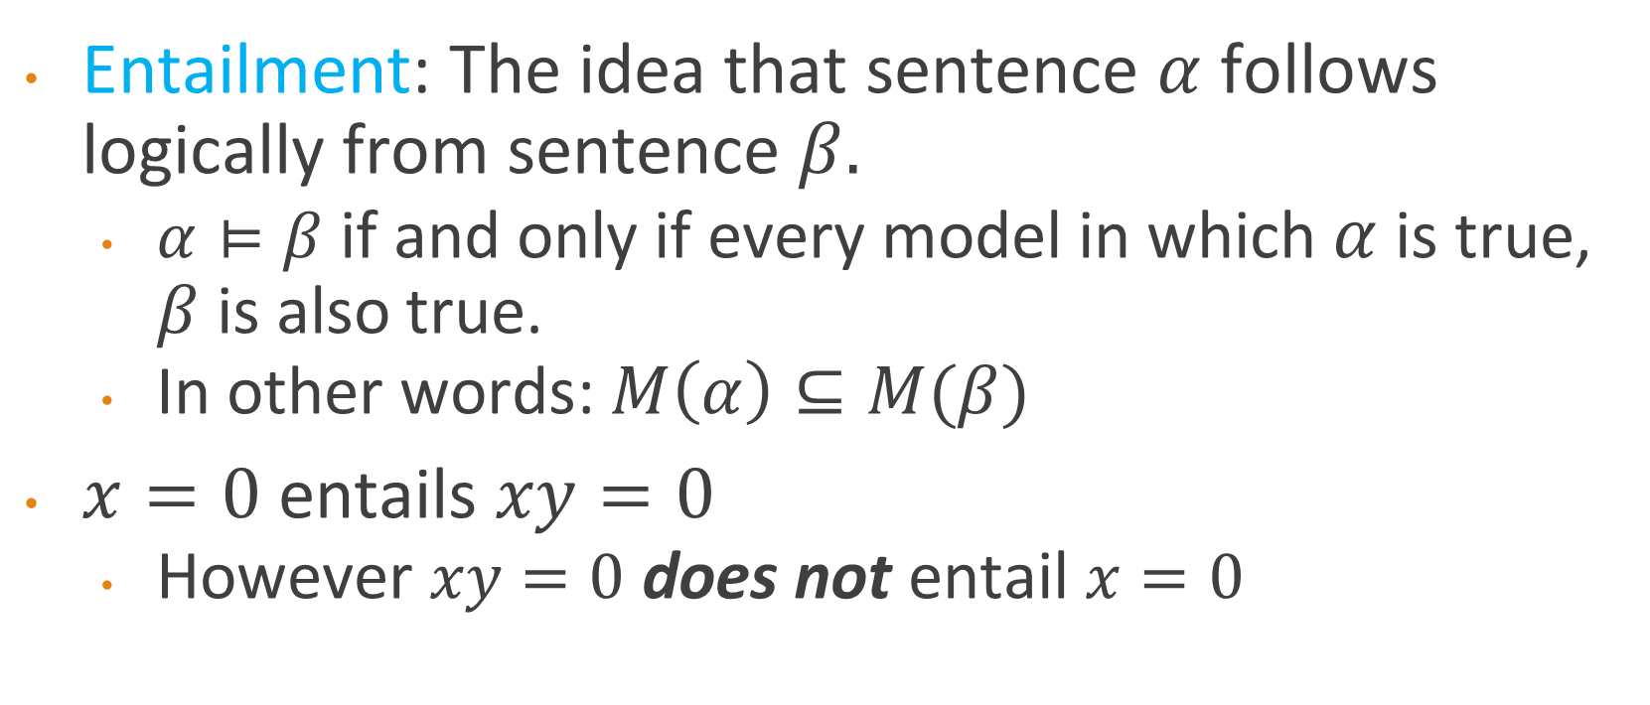
Entailment

Slide 25
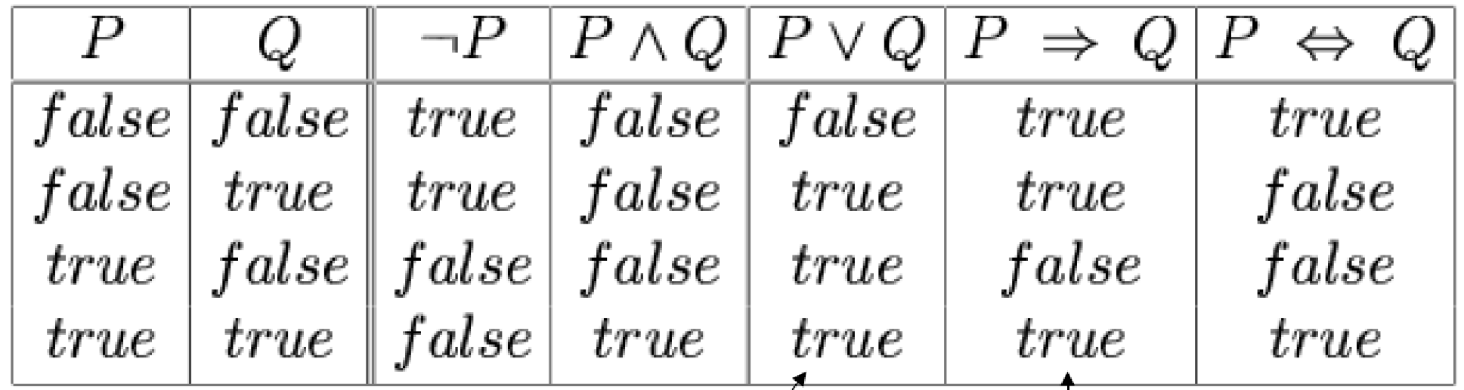
Symbols and Connectives
Symbols: A proposition that can be true or false
  In this example: P and Q are symbols
Connectives: negation, conjunction, disjunction, implication, biconditional

Slide 26
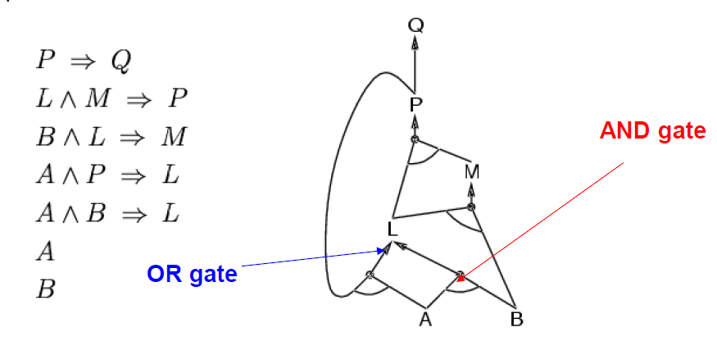
Forward Chaining
Notes:
Example from class

Slide 27
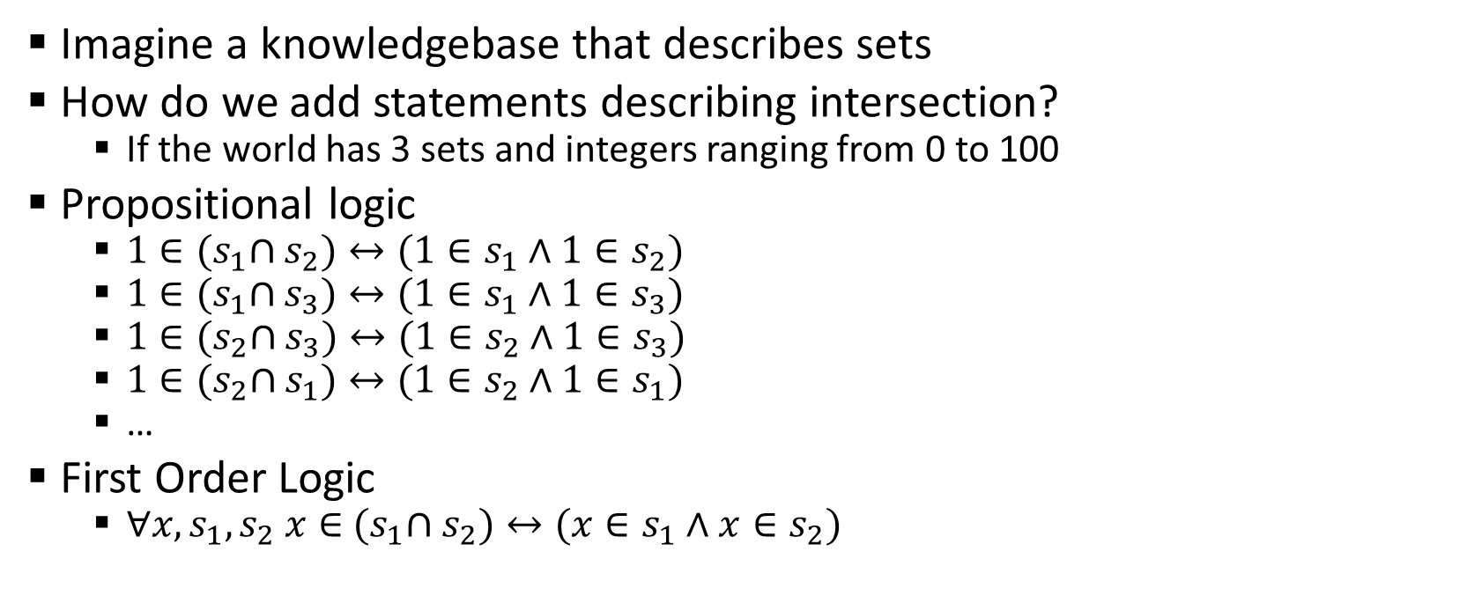
Why Do We Need First-Order Logic?
Imagine a knowledgebase that describes sets
How do we add statements describing intersection?
  If the world has 3 sets and integers ranging from 0 to 100
Propositional logic
  $1∈{(s}_{1}∩s_{2})↔(1∈s_{1}∧1∈s_{2})$
  $1∈{(s}_{1}∩s_{3})↔(1∈s_{1}∧1∈s_{3})$
  $1∈{(s}_{2}∩s_{3})↔(1∈s_{2}∧1∈s_{3})$
  $1∈{(s}_{2}∩s_{1})↔(1∈s_{2}∧1∈s_{1})$
  …
First Order Logic
  $∀x,s_{1},s_{2} x∈$ ${(s}_{1}∩s_{2})↔(x∈s_{1}∧x∈s_{2})$

Slide 28
First-Order Logic Symbols
$∀s Smelly\left(s\right)→Adjacent(Home\left(Wumpus\right),s)$
Quantifier
Universal
Existential
Variable
Predicate
Returns true or false
Function
Maps a tuple of objects to an object
Constant
Objects in the world
∀ s Smelly Home Wumpus
Adjacent

Slide 29

Implication vs Conjunction
$∀x King\left(x\right)→Person(x)$
  This is too strong: $∀x King\left(x\right)∧Person(x)$
$∃x Crown\left(x\right)∧OnHead\left(x,John\right)$
  This is too weak: $∃x Crown\left(x\right)→OnHead\left(x,John\right)$

Slide 34
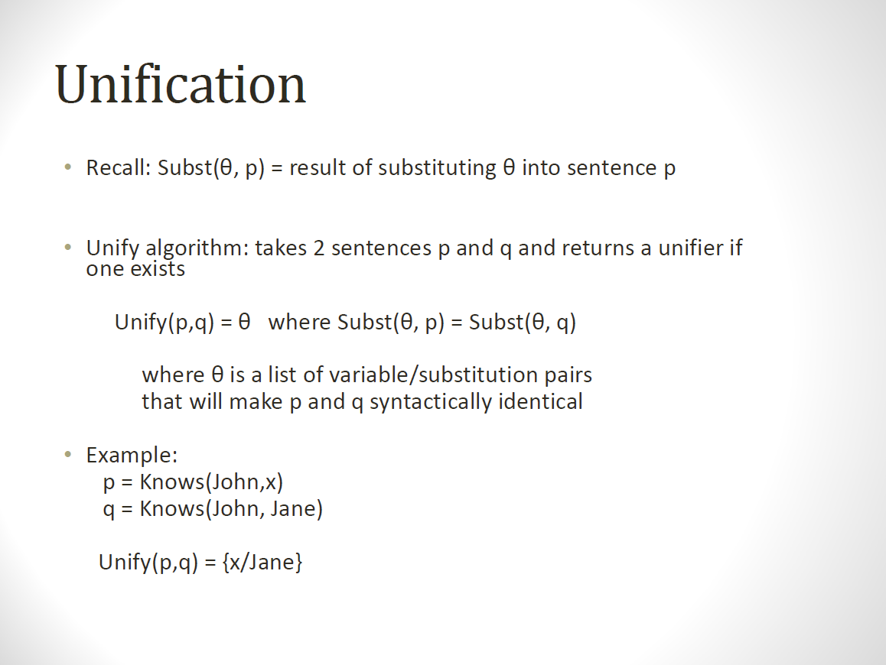
Refer: Prof Lathrop’s slides

Slide 35
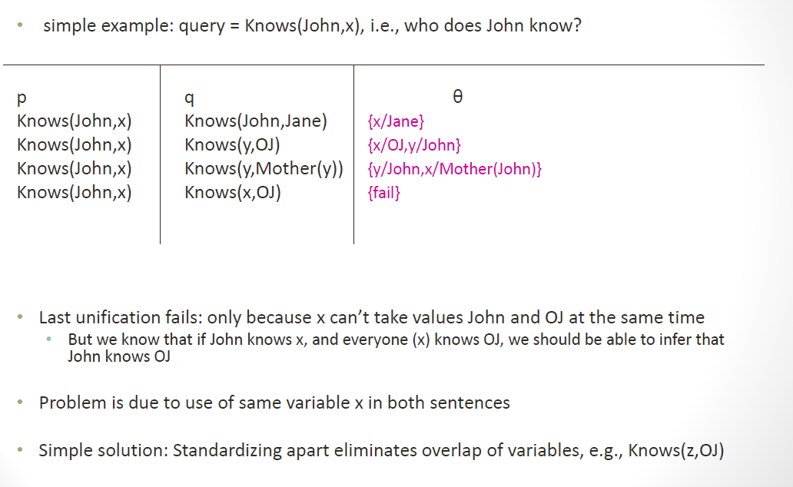
Refer: Prof Lathrop’s slides

