Slide 1
Architecture-Based Self-Protecting Software Systems
INF 221 – Software Architecture
Sam Malek

Slide 2
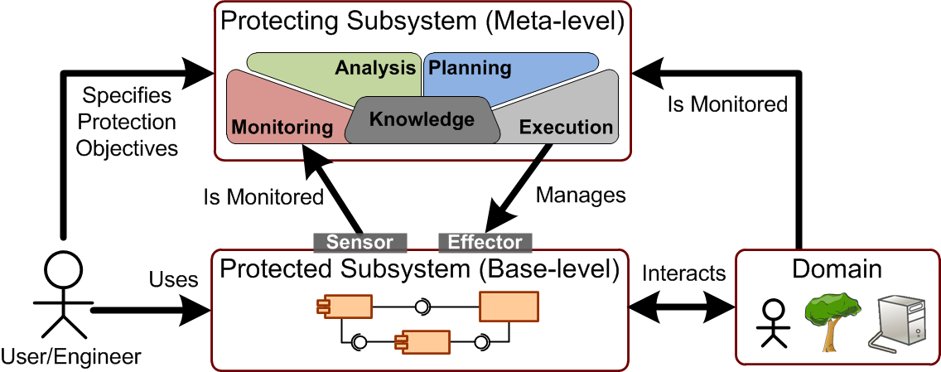
Self-Protection in the Autonomic Computing Context
Four aspects of self-management [Kephart & Chess 2003]
Self-Configuration, Self-Optimization, Self-Healing, Self-Protection
Two aspects of self-protection
(Reactive) Defend against malicious attacks and cascading failures
(Proactive) Anticipate security problems, take steps to mitigate them

Slide 3
Outline
The Case for Architecture-Based Self-Protection (ABSP)
Motivating Example
How architecture can play a role in [more advanced] security
ABSP Patterns
Protective Wrapper
Software Rejuvenation
Agreement-Based Redundancy
Implementing ABSP Patterns Using RAINBOW Framework
DoS Attack Mitigation
Concluding Remarks

Slide 4
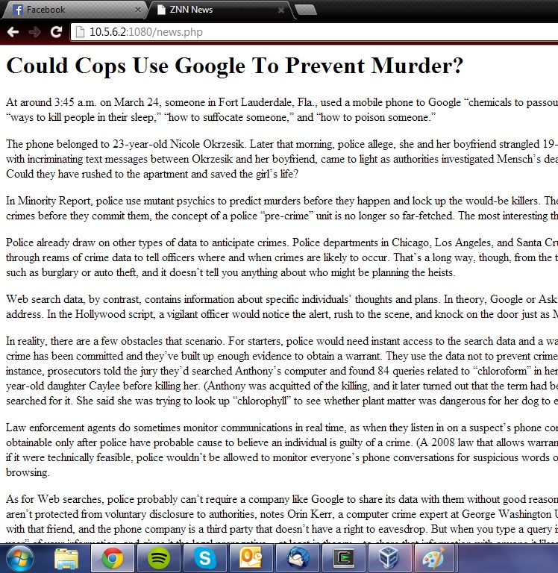
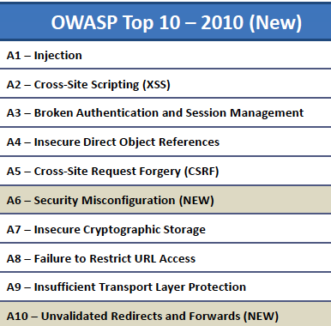
Motivating Example – Znn News Service
Web Applications Like This…
… Face Security Threats Like These

Slide 5
Conventional Web App Security
Network-based Intrusion Detection System (N-IDS)
Traffic-filtering firewall
Limitations:
Manually configured, labor intensive
Slow in adapting to changing attack vectors
Difficult to ensure testing coverage
Cannot control web user behavior
Difficult and costly to patch vulnerabilities in “legacy” applications
Web Browser
Load Balancer
Web Server 1
DB Connector
DB
Web Server 2
Host-based Intrusion Detection System
(H-IDS)
…
User
Event Bus
Access Control Lists (ACL)
Admin Console
Component
Web App Traffic
Legend
Monitoring Event
Connector
Control Event
“Offline” mechanisms:
Static code analysis
Good coding practices
Penetration testing, …

Slide 6
Architecture-based Self-Protection (ABSP)
Securing the architecture as a whole, not just the perimeter or individual layers or components
Based on machine-readable architecture models
Incorporating security goals as part of the system’s architecture properties
Making use of Autonomic Computing (AC) principles and techniques
Dynamically adapt the system at runtime in response to security threats, without necessarily modifying individual components
Web Browser
Load Balancer
Web Server 1
DB Connector
DB
Web Server 2
…
User
Event Bus
Architecture
Manager
M
A
P
E
•Structural models
•Arch. properties
BENEFITS:
Adding to “defense in depth”
Reasoning about threats globally
Defending against insider attack
Reuse potential
Dynamism

Slide 7
Outline
The Case for Architecture-Based Self-Protection (ABSP)
Motivating Example
How ABSP fills the gap in traditional protection mechanisms
ABSP Patterns
Protective Wrapper
Software Rejuvenation
Agreement-Based Redundancy
Implementing ABSP Patterns Using RAINBOW Framework
DoS Attack Mitigation
Concluding Remarks

Slide 8
ABSP Patterns
Repeatable architectural strategies and design tactics that software systems employ for self-protection purposes [Yuan and Malek, 2012]
Structural Patterns
Protective Wrapper*
Countermeasure Broker
Agreement-Based Redundancy*
Implementation Diversity
Aspect Orientation
Behavioral Patterns
Protective Recomposition
Attack Containment
Software Rejuvenation*
Reconfiguration on Reflex
Artificial Immunization
(Three described in this paper)

Slide 9
Protective Wrapper Pattern
Architecture-aware “App Guard” as protective wrapper
Architecture model augmented with additional connector and sensor/effector mechanisms
Can execute more sophisticated mitigation strategies involving multiple components
Can be effective against multiple OWASP attacks
A1 (injection)
A3 (broken authN/session mgmt)
A4 (Insecure direct obj. ref.)
A8 (Failure to restrict URL access)
HTTP
Request
Attack
Detection
Load Balancer
HTTP
Response
Policy Enforcement
Application Guard
Web Browser
Load Balancer
Web Server 1
DB Connector
4
DB
Web Server 2
…
1. Illegal access alert
User
Event Bus
Architecture
Manager
M
A
P
E
•Structural models
•Arch. properties
3. Adaptations
2. Update
model

Slide 10
Software Rejuvenation Pattern
Software Rejuvenation involves gracefully terminating then reviving an application to its “known good” state [Huang et al. 1995]
A proactive security strategy, does not depend on threat detection
Idle Server Pool
Web Server 2’
…
Web Server 1’
deactivate
activate
Active Server Pool
Web Browser
Load Balancer
Web Server 1
DB Connector
DB
Web Server 2
User
Event Bus
Architecture
Manager
M
A
P
E
•Structural models
•Arch. properties

Slide 11
Software Rejuvenation Pattern (Cont.)
The Architecture Manager periodically orchestrates seamless transition to a pristine web server instance (sequence diagram)
Although the pattern doesn’t eradicate the underlying vulnerability, it can effectively limit potential damage and restore system integrity under various OWASP attack types
A1 (injection)
A2 (XSS – non-stored type)
A5 (CSRF – non-stored type)
Architecture Manager
Load
Balancer
Web Server 1
Web Server 1’
Timer
Event
Initialize
Activate
Add server 1’ to pool
Start receiving user requests
Connect
Remove server 1 from pool
Stop receiving user requests
Disconnect
Deactivate
Gracefully terminate user sessions
Save logs
Rejuvenate
Initialize

Slide 12
Agreement-based Redundancy Pattern
Inspired by Byzantine Fault Tolerance (BFT) schemes [Castro and Liskov, 2002]
Effectively tolerate f faulty nodes with 3f + 1 replicas within a short window of vulnerability
Architectural adaptations:
“DB Guard” connector handles SQL requests from web servers using a voting / agreement-based protocol, as dictated by the Architecture Manager
N number of identical DB instances
Architecture models updated accordingly
DBCon.
DB Replica 0
DB Guard
Web Browser
Load Balancer
Web Server 1
DB Connector
DBCon.
DB
DB Replica 1
Web Server 2
DBCon.
DB Replica 2
…
Agreement Protocol
User
Event Bus
Architecture
Manager
M
A
P
E
•Structural models
•Arch. properties

Slide 13
Agreement-based Redundancy Pattern (Cont.)
SQL Injection Example:
News article search using keyword:
string kw = req.getParameter("keyword");
string query = "SELECT * FROM my_news
WHERE keyword = "’” + kw + "'";
…
Malicious input:
xyz’; DELETE FROM news; --
Resulting in two SQL statements:
SELECT * FROM my_news WHERE
keyword = ‘xyz’;
DELETE FROM news;
-- ’
Caveat: not effective for read-only type of SQL injection attacks
DB Guard
Replica 0
Replica 1
Replica 2
…
𝓡
𝓡
Property Check
Vote
𝓡 Valid
𝓡
𝓡
Vote
Result
𝓡 invalid
_
𝓡 (rollback)
Error

Slide 14
Outline
The Case for Architecture-Based Self-Protection (ABSP)
Motivating Example
How ABSP fills the gap in traditional protection mechanisms
ABSP Patterns
Protective Wrapper
Software Rejuvenation
Agreement-Based Redundancy
Implementing ABSP Patterns Using RAINBOW Framework
DoS Attack Mitigation
Concluding Remarks

Slide 15
Rainbow Framework as “Architecture Manager”
Architecture Layer
Adaptation
Manager
Strategy
Executor
Architecture
Evaluator
Model Manager
Gauges
Translation
Infrastructure
System Layer
System API
Effectors
Resource
Discovery
Probes
Target System

Slide 16
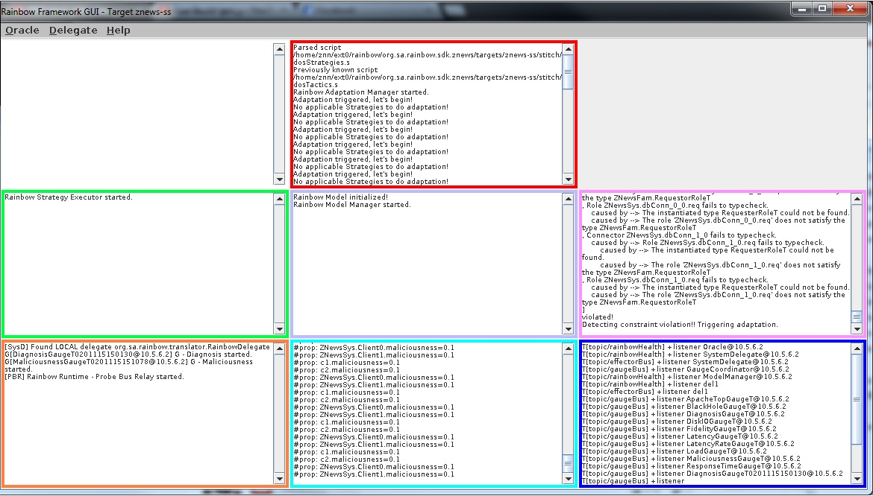
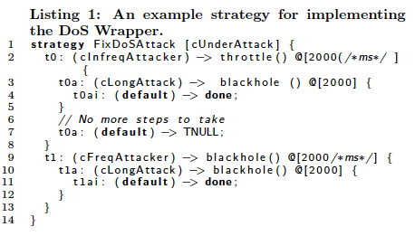
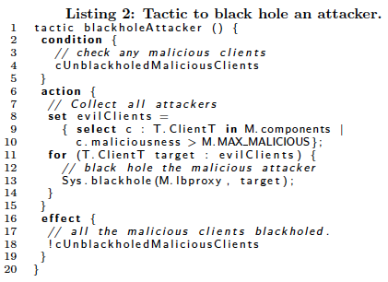
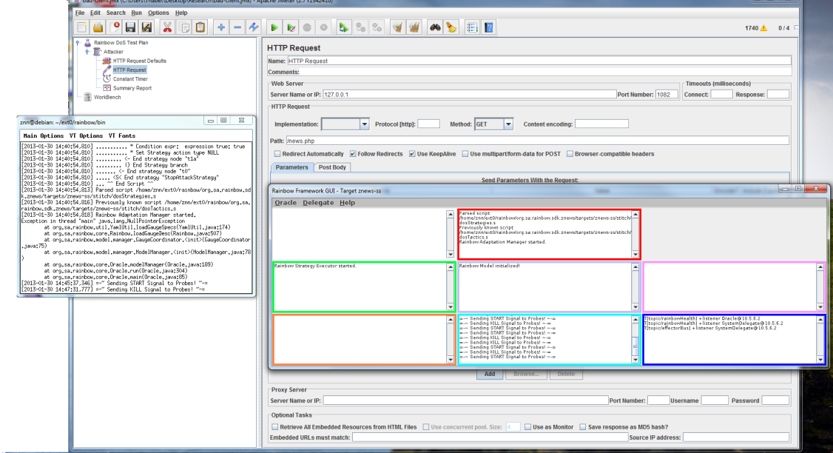
Implementing the Protective Wrapper Pattern Against Denial of Service (DoS) Attacks
d

Slide 17
Implementing the Protective Wrapper Pattern Against Denial of Service (DoS) Attacks
cFreqAttacker
cInfreqAttacker
Architecture Layer
Adaptation
Manager
Strategy
Executor
Architecture
Evaluator
Throttle vs.
Blackhole
Model Manager
Client.Maliciousness
cUnderAttack
Gauges
Translation
Infrastructure
ip-block.sh
System Layer
Client IPs
ReqFrequency
System API
Effectors
Resource
Discovery
Probes
Znn News

Slide 18
Outline
The Case for Architecture-Based Self-Protection (ABSP)
Motivating Example
How ABSP fills the gap in traditional protection mechanisms
ABSP Patterns
Protective Wrapper
Software Rejuvenation
Agreement-Based Redundancy
Implementing ABSP Patterns Using RAINBOW Framework
DoS Attack Mitigation
Concluding Remarks

Slide 19
Summary: The Role of Architecture in Software Self-Protection
Assess and reason about security globally
Separation of concern – reusable; independent evolution of security; requires no changes to application logic
Effective against insider attacks
Structural Patterns
Protective Wrapper*
Countermeasure Broker
Agreement-Based Redundancy*
Implementation Diversity
Aspect Orientation
Behavioral Patterns
Protective Recomposition
Attack Containment
Software Rejuvenation*
Reconfiguration on Reflex
Artificial Immunization

Slide 20
Research Challenges
Quantifying Security
Formulating architecture-level security metrics
Quality Attribute Tradeoffs
Security goals may be in conflict with other architecture attributes
Adaptation based on overall utility of the system
Protecting the Protector
Self-protection logic and MAPE-K components are not immune from security attacks

