Slide 1
Architecture-Based Development In Java SE 9
Negar Ghorbani
Donald Bren School of Information and Computer Science
University of California, Irvine

Slide 2
In a Software System
Software Systems’ Architecture
Conceptualized in terms of high-level constructs
E.g. software components, connectors, and their interfaces
Programming Languages
Provides low-level constructs
E.g. classes, methods, and variables
Notes:
Bridging this gap → has always been a major challenge
arch based development

Slide 3
Modularity
Simply put, modularity is a design principle that helps us to achieve:
Loose coupling between components
Clear contracts and dependencies between components
Hidden implementation using strong encapsulation
Notes:
One of the solutions : Modularity = explicit support for architectural constructs

Slide 4
Java; One Of The Most Widely Used Programming Languages
Notes:
Java as the most widely used languages, introduced modularity in its 9th version in 2017

Slide 5
Java & Modularity
Java Platform Module System
in
Java 9
Notes:
The solution “modularity” in the 9th version of Java released in Sep 2018 → JPMS

Slide 6
Life before Java 9
Java source code written in the form of Java types
Types arranged into packages
The compiled code for types and libraries packaged into JAR files
Adding all JAR files to the class path
Package A
Package B
Type1
Type2
Type3
Type4
Type5
Type6
Notes:
First, let’s review how was life before Java 9

Slide 7
Limitations, before Java 9
No boundaries for accessibility
”Public” modifier is too open!
No explicit contracts and dependencies between JARs
Weak encapsulation of elements within the JARs
Security issues
Possible runtime errors due to missing types and JARs
JAR hell
Large monolithic JDK
Deployment limitations
Access to JDK internals
Notes:
Access modifiers are quite limited
JAR hell : Multiple versions of the JARs the classpath → ClassLoader loading the first found
compilation would be successful, but the application might fail at runtime -- with the ClassNotFoundException, due to the missing JARs on the classpath at runtime.

Slide 8
What’s New in JDK 9
Modular JDK
The JDK was too big!
Divide the JDK into a set of modules
Security
Java.* modules vs. jdk.* modules
Notes:
Java 9 divides the platform into a set of modules known as platform modules
Encapsulate most of the JDK's internal APIs by default -> inaccessible at compile time,
Java.* --> standard modules : intended for use of developers
Jdk.* → non-standard modules → not intended for use of developers , typically used in the JDK itself

Slide 9
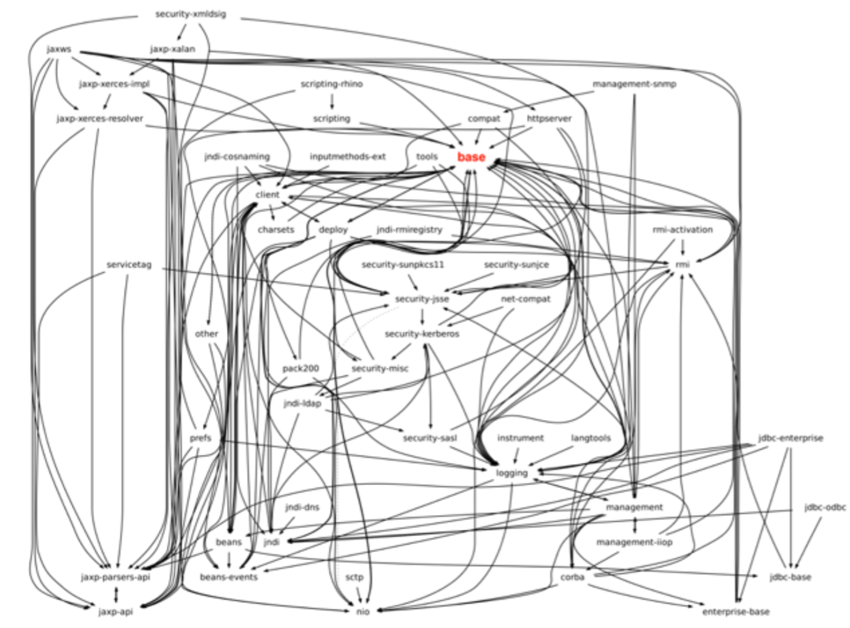
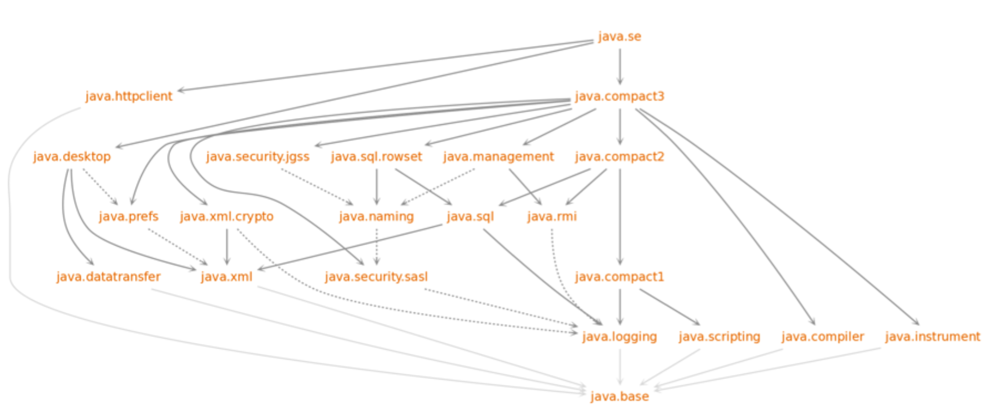
JDK Before & After 9
Notes:
Understandable
dependencies
Maintainable
Encapsulated

Slide 10
What’s New in JDK 9
Modular Source Code
Explicit Components and Connectors
Encapsulation
Security & Accessibilities
Maintainability
Notes:
Explicit
Encapsulate
Control what part of the code be accessible by which outside module
→ maintainable

Slide 11
Java Applications: 8 vs. 9
Java 8 Application
Java 9 Application
Modules
Module Descriptor
Packages
Packages
Types (Classes, Interfaces, …)
Types (Classes, Interfaces, …)
Code
Data
Resources:
XML
Properties
etc.
Code
Data
Resources:
XML
Properties
etc.

Slide 12
What’s New in JDK 9
Modular Run-Time Images
Scalable down to small devices
Deployability
Encapsulate Most Internal APIs
Notes:
Java 9 divides the platform into a set of modules known as platform modules
An implementation of a java application → may contain some or all of the platform modules → provide a scalable Java runtime
= not all applications need to load all the JDK modules → build a custom runtime image
Memory usage → scalable IOT & microservices

Slide 13
Java-9 Modules
A fundamental new kind of Java program component
A named, self describing collection of code, data, and some resources
A set of related packages and types
Module
Package 1
Package 2
Type1
Type2
Type3
Type4
Type5
Type6
Module Descriptor
Module-info.java
Data + Resources
Notes:
we TREAT modules as a fundamental new kind of Java program component.
def.
Its code → organized as a set of related packages containing types, i.e., Java classes and interfaces;
its data → includes resources and other kinds of static information.

Slide 14
Not Just a Container of Packages …
Apart from its name, a module definition contains:
A list of other modules it depends on
A list of packages that other modules can use (public APIs)
A list of packages that other modules can use via reflection
(the entire API, public and private)
A list of services it consumes
A list of implementations for services that it offers
Notes:
Contain much more info

Slide 15
Module Declaration
The module declaration’s body can be empty or may contain various module directives
module modulename {
/* A set of dependencies */
}
Notes:
As we mentioned, a module must provide a module descriptor—metadata that specifies the module’s dependencies -- defined in a file named module-info.java.
Each module declaration begins with the keyword module, followed by a unique module name and a module body enclosed in braces
Body → empty / directives : dep
The simplest possible module declaration only specifies the name of its module.

Slide 16
Module Dependencies
requires
requires transitive
module foo{
requires java.logging;
requires transitive bar;
}
Module: foo
requires transitive
Module: bar
requires
JDK Module: java.logging
Notes:
Dep → defined by Different types of directives

Slide 17
Module Dependencies
exports
exports to
module foo{
exports com.foo.utils;
exports com.foo.internal to bar;
}
exports
to
Module: foo
Module: bar
exports
com.foo.utils
com.foo.internal

Slide 18
Module Dependencies
opens
opens to
module foo{
open com.foo.network;
opens com.foo.exnet to bar;
}
opens
to
Module: foo
Module: bar
opens
com.foo.network
com.foo.exnet

Slide 19
Module Dependencies
open module
Module: foo
open module foo{
...
}
opens
com.foo.network
opens
com.foo.exnet

Slide 20
Module Dependencies
uses
provides … with …
Module: foo
uses, requires
com.foo.network
provides, requires
module foo{
requires Service;
uses com.service.Srv;
}
module bar{
requires Service;
provides com.service with
com.bar.Impl.ImplSrv;
}
com.foo.exnet
Module: foo
Module: bar
com.bar.Impl

Slide 21
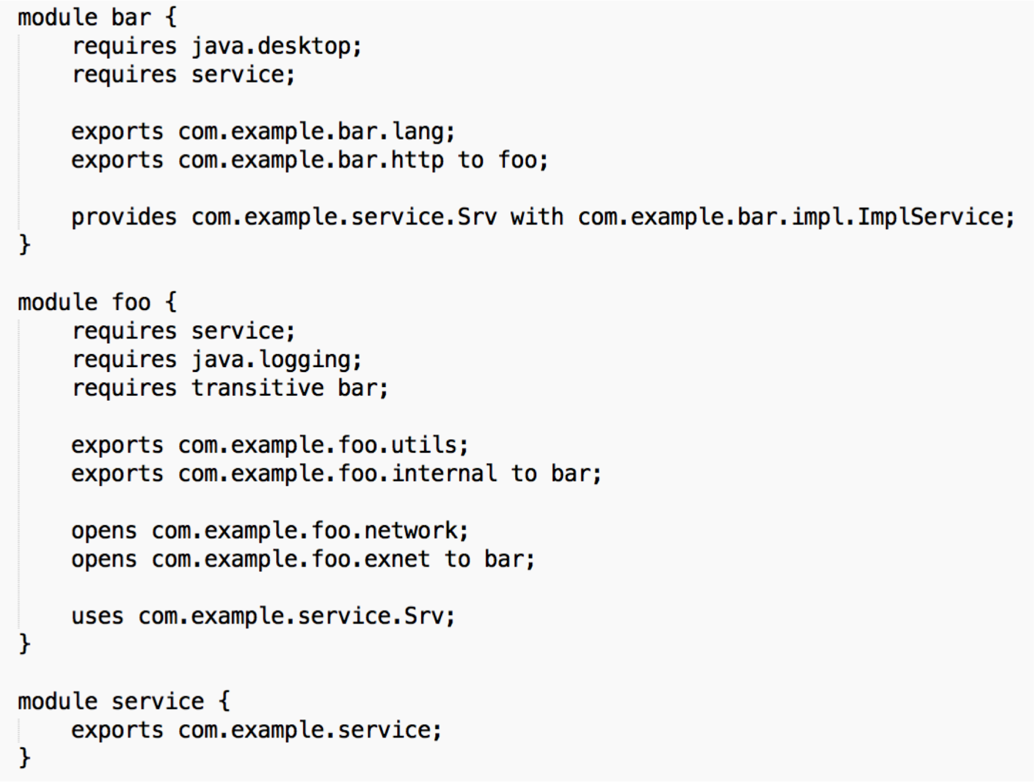
All Together

Slide 22
All Together
Module: service
uses, requires
provides, requires
com.example.service
Requires transitive
Module: foo
Module: bar
exports
exports
com.example.foo.utils
exports to
com.example.bar.lang
com.example.foo.internal
com.example.bar.http
opens
exports to
com.example.foo.network
com.example.bar.impl
opens to
com.example.foo.exnet
requires
requires
JDK Module: java.logging
JDK Module: java.desktop

Slide 23
JDK 9: Main Goals
Maintainability
Strong encapsulation of JDK and applications
Security
Manage the accessibilities to modules’ internal
Scalability & Deployability
Scalable Java platform
Custom run-time image
Memory utilization
Notes:
Reliable configuration—Modularity provides mechanisms for explicitly declaring dependencies between modules in a manner that’s recognized both at compile time and execution time. The system can walk through these dependencies to determine the subset of all modules required to support your app.
Security --- The packages in a module are accessible to other modules only if the module EXPLICITLY EXPORTS them.
Even then, another module cannot use those packages unless it EXPLICITLY states that it REQUIRES the other module’s capabilities.
improves platform security → because fewer classes are accessible to potential attackers.
Scalable Java platform—Previously, the Java platform was a monolith consisting of a massive number of packages, making it challenging to develop, maintain and evolve. It couldn’t be easily subsetted.
The platform is now modularized into ~100 modules.
You can create custom runtimes consisting of only modules you need for your apps or the devices you’re targeting.
For example, if a device does not support GUIs, you could create a runtime that does not include the GUI modules, significantly reducing the runtime’s size.

Slide 24
Migration
Steps:
Updating third-party libraries
Defining proper modules
Identifying dependencies
Compiling the application
Running the program
Resolve the possible challenges
Notes:
Jdeps or any static analysis tool

Slide 25
A Typical Application, Before Java 9
JAR
JAR
JAR
JAR
JAR
JAR
JAR
JAR
JAR
JAR
JAR
JAR
JAR
JDK

Slide 26
Migration
module
lib1
module
lib2
JAR
JAR
JAR
JAR
JAR
JAR
JAR
JAR
JAR
JAR
JAR
module java.base
module java.logging
module java.sql
module java.xml
Notes:
Modular JDK
Updated libraries (maybe not modules)
Group related packages

Slide 27
Migration
module
lib1
module
lib2
module
foo
module
bar
module
srv
module
util
module java.base
module java.logging
module java.sql
module java.xml
Notes:
Define modules
packages
name
dependencies
module-info files

Slide 28
Migration: Possible Challenges
Inappropriate Dependencies on Unsupported JDK Internal APIs
The Java Dependency Analysis Tool (JDeps)
To discover all the static library dependencies
To discover the possible usages of internal JDK APIs
To automatically generate a module descriptor for a JAR file
Replace unsupported JDK internal APIs with supported APIs
Notes:
Such as modules starting with sun and jdk → code won’t run
add-exports command-line option to break the encapsulation to make the JDK internal APIs accessible to code in other modules or to code on the classpath.

Slide 29
Migration: Possible Challenges
Cyclic Dependencies
Modules are directly or indirectly dependent on each other.
Not allowed in Java 9
Compile error
Can be solved with interfaces, service provider API
Notes:
Cyclic dependency is a relation between two or more modules and is expressed by the fact that the modules are directly or indirectly dependent on each other.
In Java 9 : isn’t allowed → compile-time error
can be solved with the help of INTERFACE to DECOUPLE the linking between modules.
This can be implemented using the Service Provider API and by applying Service consumers and Service providers.
→ Then the module should depend on the interface and not on another module.

Slide 30
Some Useful Resources
https://www.oracle.com/corporate/features/understanding-java-9-modules.html
https://books.google.com/books?id=xjy4DgAAQBAJ&lpg=PA7&ots=SqiNy3QkTx&dq=chapter%202%20The%20module%20system”%20in%20Java%209%20Revealed&pg=PA7#v=onepage&q&f=false
http://openjdk.java.net/projects/jigsaw/spec/sotms/#defining-modules
http://openjdk.java.net/projects/jigsaw/
http://openjdk.java.net/projects/jigsaw/talks/intro-modular-dev-j1-2016.pdf
http://openjdk.java.net/projects/jigsaw/talks/adv-modular-dev-j1-2016.pdf
http://openjdk.java.net/projects/jigsaw/talks/modules-and-services-j1-2016.pdf
http://openjdk.java.net/projects/jigsaw/goals-reqs/03
https://www.romexsoft.com/blog/migrate-to-java-9/

