Slide 1
Software Architectural Principles in Contemporary Mobile Software: From Conception to Practice
Sam Malek
Software Architecture
INF 221
Fall 2018

Slide 2
Evolution of mobile computing

Slide 3
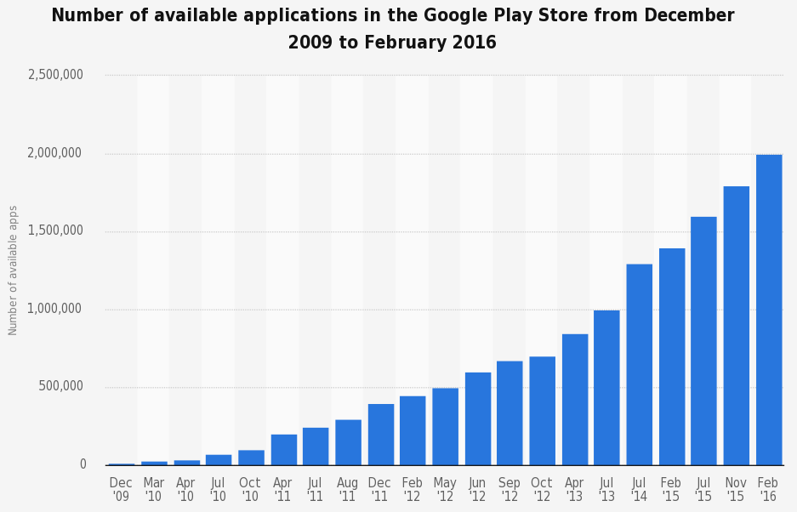
Source: Statista 2016

Slide 4
Mobile software is the future of software

Slide 5
iPhone frenzy
But mobile computing was not always like this…

Slide 6
Historical perspective on mobile devices
Highly rigid systems
Software “hacked” in low-level languages
Device shipped with a predefined set of apps
Not much customization possible
End result: consumers were not enthused

Slide 7
Mobile computing drivers
App Ecosystem: Open the platform to enable third-party developers to extend and enrich a platform through additional capabilities
Developer Productivity: To have a rich ecosystem, you need to enable creation of apps without highly specialized skills
Interoperability: Enable rich interactions among a device’s apps to give the user a feeling of an integrated software system
Security & Privacy: Interoperability among different apps should be achieved in a secure manner to protect user’s sensitive information
Resource constraints: The limited resources (e.g., energy & memory) in mobile platform pose an ever-present challenge

Slide 8
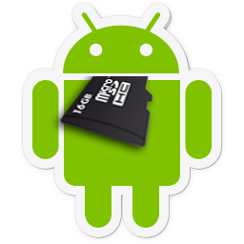
Solution: domain-specific software architectures

Slide 9
Android platform
Android platform is based on a multi-user Linux kernel
Each app is a Linux process with a unique Linux user ID
Only Android apps can run on Android
Each app runs within an instance of Android runtime environment (ART or Dalvik)
Data and resources are protected via permission system
Android Apps
Android Framework
Android Runtime
Libraries
Linux Kernel

Slide 10
APPS
Phone SMS
Android
FRMWRK
CONTENT PROVIDER
MANAGERS
VIEW SYSTEM
ACTIVITY
LOCATION
PACKAGE
NOTIFICATION
RESOURCE
TELEPHONY
WINDOW
NATIVE LIB.
Android
Runtime
AUDIO Mgr
SQLITE
WEBKIT
DALVIK
ART
LIBC
OPENGL
FREETYPE
CORE LIBRARIES
HAL
AUDIO
BLUTOOTH
CAMERA
DRM
SENSORS
…
LINUX
KERNEL
AUDIO
BLUTOOTH
CAMERA
DISPLAY
Binder (IPC)
POWER Management
…

Slide 11
Android apps
Android provides a rich application development framework (ADF)
Two types of Apps
Platform Apps
Phone, Browser, Alarm, etc.
3rd party Apps
Facebook, Twitter, Expedia, etc.

Slide 12
Role of architecture
Software architecture plays a significant role in the development of modern mobile software
Software architectural support in Android plays a key role in its meteoric rise and success
ADF provides support for the realization of software architectural elements
Components
Connectors
Events (messages)
Configurations
Architectural styles

Slide 13
Architectural principles in Android
Software Architecture Building Blocks
Hierarchical (De)composition
Architectural Design Styles

Slide 14
Architectural principles in Android
Software Architecture Building Blocks
Hierarchical (De)composition
Architectural Design Styles

Slide 15
Architectural building blocks
Software architectural design is the process of conceptualizing a software system in terms of its architectural elements
The design idioms and elements a developer employs to decompose a system into its constituents
The paper describes how many of the same constructs devised by the software-architecture community for desktop applications have found their way into Android

Slide 16
Architectural building blocks: Components
Components are the basic building blocks of Android Apps.
Android provides four types of components:
Activity
Service
Content Provider
Broadcast Receiver

Slide 17
Activity
A single Activity defines a single viewable screen
The actions, not the layout
An email app may have several activities; one shows a list of emails, another to compose an email, and another for reading emails
Although activities in one app work together to achieve the app’s main functionality, they are independent
Other apps can start any activity in the email app (if the email app allows it)
Photo app can start “Compose Email” activity of an email app to send an image

Slide 18
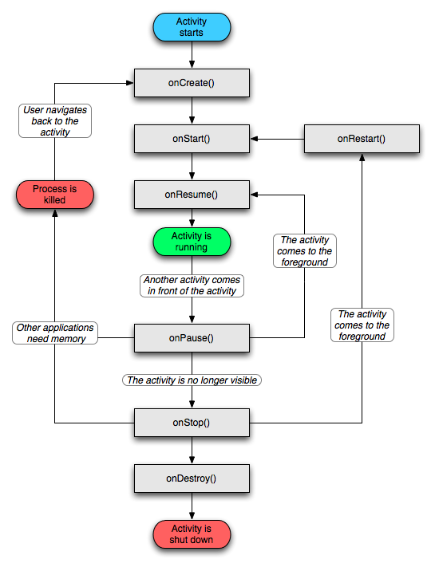
Activity lifecycle
An activity has a structured life cycle
Different events in the life of an Activity happen, either via the user touching buttons or programmatically, putting the Activity in different states

Slide 19
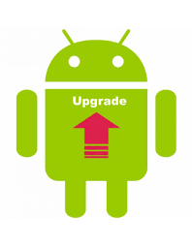
Service
Runs in the background to perform long-running operations
A service might upgrade the app, download an attachment, or play music
A service does not provide a user interface.

Slide 20
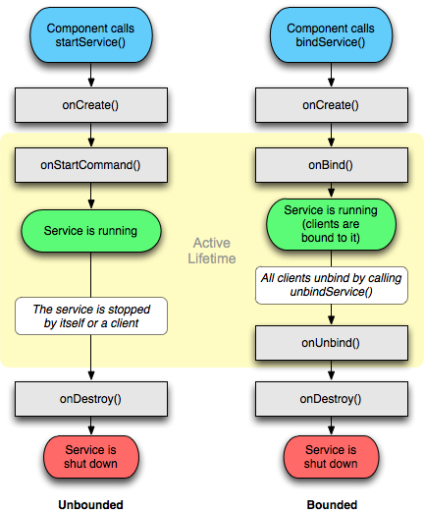
Service lifecycle

Slide 21
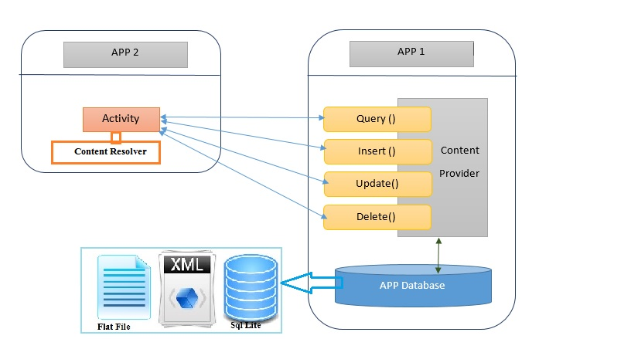
Content provider
Manages access to a structured set of data (file system, SQLite database, web, or any other persistent storage)
Content provider allows other apps to query or even modify the data.

Slide 22
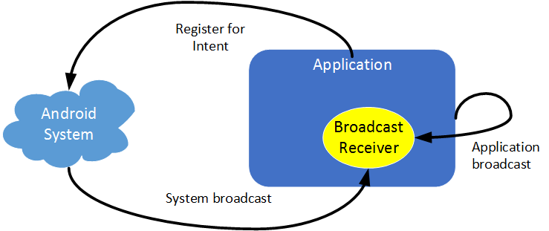
Broadcast receiver
Component that responds to system-wide broadcast announcements
Many broadcast actions originate from the system, such as Low Battery signal
Apps can also initiate broadcasts to notify other apps
Broadcast is intended to do very minimal work or start a service to do long-running work

Slide 23
Android apps

Slide 24
Architectural building blocks: Events/Messages
Intent
Android’s message object consisting of a payload as well as meta-data
It can be used to start an Activity, bind to a Service, or send a broadcast
Consists of 5 types of information
Action: (mandatory) describes the type of action (e.g., view, send) to be performed
Name: (optional) the name of Android component that should handle this Intent
Data: (optional) specifies the type of data (e.g., URI, MIME) that should be acted on
Category: (optional) string containing information about the kind of component (e.g., browsable, launcher) that should handle the Intent
Extras: (optional) key-value pairs for carrying the Intent’s payload
Flags: (optional) instructions for Android as to how the Intent should be used to launch an activity

Slide 25
Architectural building blocks: Interfaces/Ports
Intent Filters represent the interfaces/ports of components
Used by Android OS to determine the set of Activities, Services, and Broadcast Receivers that can handle an Intent
Android matches the information specified in an Intent filter against information contained in an Intent
<activity android:name=".CustomActivity" android:label="@string/app_name">
<intent-filter> <action android:name="android.intent.action.VIEW" /> <action android:name="com.example.My Application.LAUNCH" /> <category android:name="android.intent.category.DEFAULT" /> <data android:scheme="http" /> </intent-filter>
</activity>

Slide 26
Architectural building blocks: Connectors
Connectors allow different components to communicate with one another using a variety of mechanisms
Android provides four type of connectors:
Explicit message-based: The target component is specified in the Intent
Implicit message-based: The meta-data of an Intent (e.g., action, data) is matched against Intent Filters
Data access: Provides an interface for adding, removing, updating, and querying the stored data in a Content Provider
Remote procedure call (RPC): provides IPC through method-invocation interaction using stubs

Slide 27
Architectural building blocks: Configuration
Every application must have a XML-based manifest file in its root directory
The manifest file is akin to the concept of architectural description languages (ADL) – we will cover this later in the class
Presents information about each app to the Android runtime environment to be able to execute/manage the app
Among other things, the manifest file has the following information:
Defines the the Java package that uniquely identifies the App
Lists the components that comprise the app
Describes the component’s interfaces, e.g., which Intent message they can handle
Describes the required permissions that the app needs to be able to access protected APIs and other apps
Declares the permissions that other apps are required to have in order to interact with the app’s component

Slide 28
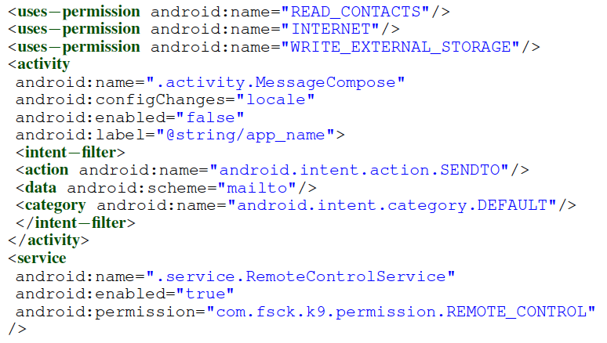
Part of a manifest file
App’s permissions
Specification of an Activity component
Specification of a Service component

Slide 29
Architectural principles in Android
Software Architecture Building Blocks
Hierarchical (De)composition
Architectural Design Styles

Slide 30
Hierarchical (de)composition
An approach to mitigate the complexity of architecture
The key to achieving the hierarchies in architecture is the ability to mask the interfaces of the lower-level components through granular higher-level components
Generally, composition can be achieved in two ways:
Behavioral: services are orchestrated using a work-flow language (e.g., BPEL) to realize a higher-level service known as composite service – as in the Service Oriented Architecture
Structural: a component at one layer of abstraction may itself consist of an internal architecture with lower-level component

Slide 31
Hierarchical (de)composition in Android
Android follows a structural approach
A mobile software system is built in terms of apps
Apps are in turn built in terms of components
Finally, Activity components are built in terms of Fragments -- sub-activity components used to manage a part of UI

Slide 32
Architectural principles in Android
Software Architecture Building Blocks
Hierarchical (De)composition
Architectural Design Styles

Slide 33
Architectural styles
Android supports five types of architectural styles
Message-based explicit invocation
Message-based implicit-invocation
Publish-subscribe style
Shared state
Distributed objects

Slide 34
1. Message-based explicit invocation style
Components communicate directly using Intent messages
The Intent explicitly identifies the name of the recipient component
It reduces the communication overhead and unnecessary computation
Activity firstActivity
Activity secondActivity
Intent i = new Intent(FirstActivity.this, SecondActivity.class);
startActivity(i);

Slide 35
2. Message-based implicit invocation style
Components communicate using Intent messages that are not tagged with the intended recipients
Attributes of the Intent are matched against the Intent Filters defined by each component
Android Runtime Environment
Activity firstActivity
Activity secondActivity
Intent read1=new Intent(); read1.setAction(android.content.Intent.ACTION_VIEW); read1.setData(ContactsContract.Contacts.CONTENT_URI); startActivity(read1);

Slide 36
3. Publish-subscribe style
Specialization of implicit invocation style
Broadcast receivers are leveraged to dispatch messages to multiple receiving components and receive Intents from other components
Activity firstActivity
1. Subscribe
BroadcastReceiver firstReceiver
2. Publish
Android Runtime Environment
Service batteryService
2. Publish
BroadcastReceiver secondReceiver
1. Subscribe
Intent intent = new Intent(); intent.setAction("com.tutorialspoint.CUSTOM_INTENT"); sendBroadcast(intent);

Slide 37
4. Shared state (blackboard) style
Multiple components communicate through a shared data store
Content provider allows data to be accessed/modified in an expedient manner
A data-access connector accessible through Android’s ContentResolver class provides the interface to the Content Providers
Activity firstActivity
ContentProvider myContent
insert
update
Service batteryService
delete
query

Slide 38
5. Distributed objects Style
Objects in a distributed system communicate through RPC
Components can leverage the Android Interface Definition Language (AIDL) to specify the interface through which they can communicate
AIDL specifies the interface of the Service that can be accessed
A Stub class is created through which the interface can be accessed as if it was local
Process
Process
C
Cs
Ss
S
Process
middleware
call
C
S
call
call
return
return
return

Slide 39
K-9 mail client app

Slide 40
Recovered architecture of K-9 mail client

