Slide 1
Detection and Repair of Architectural Inconsistencies in Java
Negar Ghorbani
Donald Bren School of Information and Computer Science
University of California, Irvine

Slide 2
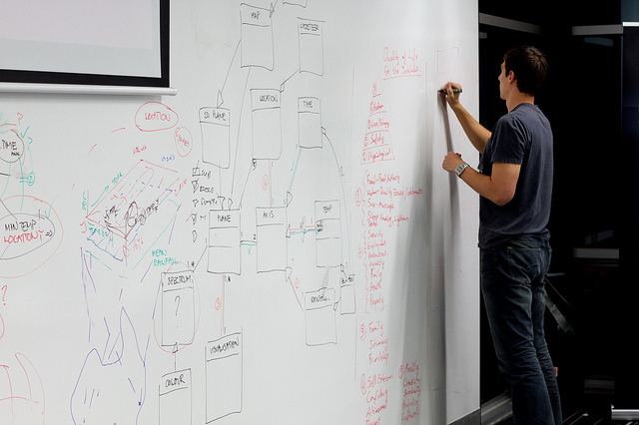
Software Architecture
The principal design decisions employed in the system’s construction
Notes:
comprises the principal design decisions
Although every system has an architecture → not explicitly documented

Slide 3
Software Components
One of the key design decisions
How to decompose a software system into components
A software component is an architectural entity
Encapsulates a subset of the system’s functionality and data
Has explicitly defined dependencies
Restricts access via an explicitly defined interface
Notes:
which
With
that

Slide 4
Prescriptive vs. Descriptive Architecture
Prescriptive Architecture
Captures the design decisions made prior to the system’s construction
As-intended
Descriptive Architecture
Describes how the system has been built
As-implemented
Notes:
A system’s prescriptive architecture captures the design decisions made prior to the system’s construction
– It is the as-conceived or as-intended architecture
A system’s descriptive architecture describes how the system has been built
– It is the as-implemented or as-realized architecture

Slide 5
Architectural Inconsistency
Prescriptive Architecture
As-Intended
Descriptive Architecture
As-Implemented
Notes:
Ideally
Reality
Arch inconsistency
example

Slide 6
Architectural Inconsistencies Matter
Determines
The Level of Access
Packaging for Deployment
Results in Security and Performance Consequences
Affects Maintenance
Notes:
architecture is the primary determinant of a software system’s key properties

Slide 7
In The Literature
Bridging the gap between software architecture and implementation
Manual or semi-automatic
The drastic change in the context of Java
Explicit support for component-based development
Software components (modules)
Dependencies
Notes:
Variety → addressing
Re-visit→ recent drastic
Provides
Introduces notions
Possible → resolve arch incon more accurately

Slide 8
Our Objective
Detect the architectural inconsistencies within Java application
Repair the identified inconsistencies
Notes:
Specifically in java

Slide 9
Outline
Background and Motivation
Java Platform Module System: Introduction
Inconsistent Module Dependencies in Java
DARCY: Automatic Detection and Repair of Architectural Inconsistencies
Evaluation
Conclusion and Future Work
Notes:
So far
To discuss the architectural inconsistencies in this context, I am going to first explain the new java module system, in more depth.

Slide 10
Java; One Of The Most Widely Used Programming Languages
Notes:
arguably the most popular PL (in the past 2 decades)

Slide 11
The Change
Java Platform Module System
First Instance of Encapsulation of Modules
Rich Software Architectural Interfaces
in
Java 9
Notes:
Good news
…

Slide 12
What’s New in JPMS
Modular Source Code
Modular JDK
Encapsulate Most Internal APIs
Modular Run-Time Image
Notes:
Source code is modularized - with EXPLICIT SUPPORT for defining software components and their dependencies.
Developers can CONTROL what part of the code be accessible by which outside module
Before: Large MONOLITH → Java 9 DIVIDES the platform into a set of modules known as platform modules
Encapsulate most of the JDK's internal APIs by default -> INACCESSIBLE at compile time,
An IMPLEMENTATION of a java application → MAY CONTAIN some / all of the platform modules
provide a CUSTOM Java runtime image → only needed → memory usage & scalable

Slide 13
Java Applications: 8 vs. 9
9
Java 8 Application
Modules
Module Descriptor
Packages
Types (Classes, Interfaces, …)
Code
Data
Resources:
XML
Properties
etc.
Notes:
Code & data & resources including some static info → types
→packages
9: additional layer + descriptor : dependencies

Slide 14
A Java Application
App.java
java.logging.x
java.desktop.y
Notes:
contains

Slide 15
A Java Application
App.java
java.logging.x
java.desktop.y

Slide 16
A Java Application
App.java
com.service
com.foo.utils
com.foo.internal
com.bar.lang
com.foo.exnet
com.bar.impl
com.bar.http
com.foo.network
java.logging.x
java.desktop.y

Slide 17
A Java Application
App.java
Module: service
com.service
Module: foo
Module: bar
com.foo.utils
com.foo.internal
com.bar.lang
com.foo.exnet
com.bar.impl
com.bar.http
com.foo.network
JDK Module: java.logging
JDK Module: java.desktop
Notes:
Bunch of modules → represent components with some dep

Slide 18
Java Module
A fundamental new kind of Java program component
A named, self describing collection of code, data, and some resources
A set of related packages and types
Module
Package 1
Package 2
Type1
Type2
Type3
Type4
Type5
Type6
Module Descriptor
Module-info.java
Data + Resources
Notes:
we TREAT modules as a fundamental new kind of Java program component.
def.
Each module has a descriptor file, module-info.java, which the declaration

Slide 19
Module Declaration
The module declaration’s body can be empty or may contain various module directives
module modulename {
/* A set of dependencies */
}
Notes:
Starts with the keyword module and followed by a unique modulename and a body
body can be EMPTY or contain a set of dep → specifies EXPOSURE / NEEDS ACCESS TO

Slide 20
Module Dependencies
requires
exports
Module Directives
opens
uses
provides
Notes:
A module body can utilize COMBINATIONS OF 5 module directives → to specify module dependencies
These directives include … → explain one by one with example

Slide 21
Module Dependencies
requires
A list of modules it depends on
module foo{
requires java.logging;
requires transitive bar;}
Module Directives
Module: foo
requires transitive
Module: bar
requires
JDK Module: java.logging

Slide 22
Module Dependencies
requires
A list of modules it depends on
exports
module foo{
exports com.foo.utils;
exports com.foo.internal to bar;}
A list of packages other modules can use
Module Directives
exports
to
Module: foo
Module: bar
exports
com.foo.utils
com.foo.internal
Notes:
specifies one of the module’s packages WHOSE public & protected types should be accessible to code in all other modules

Slide 23
Module Dependencies
requires
A list of modules it depends on
exports
A list of packages other modules can use
module foo{
opens com.foo.network;
opens com.foo.exnet to bar;}
open module foo{
...
}
Module Directives
opens
A list of packages other modules can use via reflection
opens
to
Module: foo
Module: foo
Module: bar
opens
opens
com.foo.network
com.foo.network
opens
com.foo.exnet
com.foo.internal
Notes:
indicates a specific package’s public, protected and even private types → accessible at runtime via reflection
---------
Open the entire module

Slide 24
Module Dependencies
requires
A list of modules it depends on
exports
A list of packages other modules can use
Module: Service
module foo{
requires Service;
uses com.service.Srv; }
module bar{
requires Service;
provides com.service.Srv with
com.bar.Impl.ImplSrv; }
Module Directives
opens
com.service.Srv
A list of packages other modules can use via reflection
uses, requires
uses
provides, requires
A list of services it consumes
Module: foo
Module: bar
provides
A list of implementations for services it offers
com.bar.Impl

Slide 25
All Together
Module: service
uses, requires
provides, requires
com.example.service
Requires transitive
Module: foo
Module: bar
exports
exports to
exports
com.example.foo.utils
com.example.bar.lang
com.example.foo.internal
com.example.bar.http
opens
exports to
com.example.foo.network
com.example.bar.impl
opens to
com.example.foo.exnet
requires
requires
JDK Module: java.logging
JDK Module: java.desktop
Notes:
This is how a java app looks like
Modules – packages – different types of dependencies

Slide 26
Outline
Background and Motivation
Java Platform Module System: Introduction
Inconsistent Module Dependencies in Java
DARCY: Automatic Detection and Repair of Architectural Inconsistencies
Evaluation
Conclusion and Future Work
Notes:
With this drastic change of providing arch support in the mainstream PL → architectural inconsistencies???
I’m going to discuss architectural inconsistencies in this context in terms of inconsistent module dependencies

Slide 27
Modules in JPMS
Module: foo
Explicit Specification
Software Components
Dependencies
module-info file
module-info.java
com.foo.utils
com.foo.network
module foo {
requires java.logging;
exports com.foo.utils;
opens com.foo.network;}
Notes:
Using Java’s module system, the developer
explicitly specifies the system’s components (i.e., modules in Java)
as well as → the specific nature of their dependencies → in a file called module-info.
For instance the figure

Slide 28
However,
No Mechanism to Ensure Consistency
Prescriptive Architecture
Module-info file
Descriptive Architecture
Module Implementation
Architectural Inconsistencies
Notes:
does not provide any mechanism to ensure
the prescriptive architecture specified in the module-info file -- is in fact consistent with –
the descriptive architecture of the implemented software
→ result in architectural inconsistencies

Slide 29
Inconsistent Module Dependencies
Insufficiently specified dependencies are checked by the Java platform
Compile error
But, excess dependencies are not handled by Java
Exposes, more than necessary
Requires, more than needed
Notes:
In specifying dependencies between modules :
Insufficiently specified dependencies -- already checked -- Java platform.
e.g., a module attempts to use a package it does not have a requires directive for → compile
However, excess dependencies, where a module EITHER
(1) exposes more of its internals than are used OR
(2) requires internals of other modules that it never uses

Slide 30
Inconsistent Module Dependencies: Example
Module: foo
Module: bar
module-info file
module-info file
com.foo.utils
com.bar.lang
com.foo.network
JDK Module
java.logging
JDK Module
java.desktop
module foo {
requires java.logging;
exports com.foo.utils;
opens com.foo.network;}
module bar {
requires foo;
requires java.logging;
exports com.bar.lang; }

Slide 31
Potential Consequences
Security
Excessive exports and opens
Exposing the internal of a module more than it needs
Increase Attack Surface
Due to granting unnecessary access
Notes:
Excessively exposing the internals of a module →
can result in errors or security issues arising in the module → due to granting

Slide 32
Potential Consequences
Encapsulation and Maintenance
Requiring unneeded functionalities of other modules
Increase complexity
Compromises encapsulation
Decreases maintainability

Slide 33
Potential Consequences
Software Bloat and Scalability
Requiring unneeded modules, especially from JDK
Memory utilization
Increase the size of the custom runtime-image
May result in software bloat
Compromises scalability and deployment

Slide 34
Inconsistent Module Dependencies: Types
Inconsistent Requires Dependency
Inconsistent JDK Requires Dependency
Inconsistent Requires Transitive Dependency
Inconsistent Exports/Exports To Dependency
Inconsistent Provides With Dependency
Inconsistent Uses Dependency
Inconsistent Open Modifier
Inconsistent Opens/Opens To Dependency
Notes:
FORMALLY SPECIFIED 8 types of inconsistent dependencies -- that MAY ARISE when using JPMS
Due to time constraints …

Slide 35
Inconsistent Requires Dependency
$$Req\left({ m}_{1},{ m}_{2}\right) \text{∧} \left(∄{ p}_{1}∈{ m}_{1},{ p}_{2}∈{ m}_{2}:Dep \left({ p}_{1},{ p}_{2}\right)\right)$$
Module foo
Module bar
Encapsulation and Maintenance
Software Bloat and Scalability
Module foo{
requires bar;
}
Module bar{
…
}
Notes:
Recall requires

Slide 36
Inconsistent Exports Dependency
$$Exp\left({ m}_{1},{ p}_{1}\right) \text{∧} \left(∀p∉{ m}_{1} :¬Dep \left(p,{ p}_{1}\right)\right)$$
Module foo
Module $m$
Security
Encapsulation and Maintenance
Module foo{
exports foo.util;
}
Module m{
...
}
package foo.util
Package p
Notes:
Recall exports

Slide 37
Inconsistent Opens Dependency
$$Opens\left(m,p\right) \text{∧} \left(∀ p^{′}∉m :¬ReflDep\left(p′,p\right)\right)$$
Module foo
Module $m$
Security
Encapsulation and Maintenance
Module foo {
opens foo.internal;
}
Module m{
...
}
package foo.internal
Reflective Access
Package p’
Notes:
Recall open
Bigger security threat

Slide 38
Outline
Background and Motivation
Java Platform Module System: Introduction
Inconsistent Module Dependencies in Java
DARCY: Automatic Detection and Repair of Architectural Inconsistencies
Evaluation
Conclusion and Future Work
Notes:
After introducing various types of inconsistent dependencies
I’m going to describe how we LEVERAGE these definitions to DESIGN and IMPLEMENT DARCY

Slide 39
Darcy: Automatic Detection and Repair of Architectural Inconsistencies in Java
38
Notes:
Automatic technique for

Slide 40
Darcy: Automatic Detection and Repair of Architectural Inconsistencies in Java
Darcy
Detection
Repair
Module-Info Scanner
Java Inconsistency Analysis
Inconsistent Dependencies
Java Application
Specified
Dependencies
Actual Dependencies
Transformed Java Application
Module-info Transformer
Java Reflection Analysis
Class Dependency Analysis
ServiceLoader Usage Analysis
39
Notes:
high-level overview of DARCY → comprised of two phases, Detection and Repair.
The detection phase : takes a Java application as INPUT and identifies any INSTANCEs of the 8 inconsistent dependencies
The repair phase : takes the RESULTS of the detection phase as INPUT and TRANSFORM the module descriptor file to repair.

Slide 41
Darcy: Automatic Detection and Repair of Architectural Inconsistencies in Java
Darcy
Detection
Repair
Module-Info Scanner
Java Inconsistency Analysis
Inconsistent Dependencies
Java Application
Specified
Dependencies
Actual Dependencies
Transformed Java Application
Module-info Transformer
Java Reflection Analysis
Class Dependency Analysis
ServiceLoader Usage Analysis
40
Notes:
In a more detailed view:
To identify ACTUAL dependencies of an input Java application, Darcy RELIES on static analysis, REPRESENTED as Class Dependency Analysis in the Figure.

Slide 42
Class Dependency Analysis: Classycle[1]
Package A
uses
Package B
Package C
uses
uses
uses
Package D
41
[1] F.-J. Elmer, “Classycle: Analysing Tools for Java Class and Package Dependencies,” How Classycle works, 2012.
Notes:
In the implementation of DARCY, we LEVERAGED CLASSYCLE for Class Dependency Analysis.
Classycle: explores class files → Complete report : All dep → src → class & pckg

Slide 43
Darcy: Automatic Detection and Repair of Architectural Inconsistencies
Darcy
Detection
Repair
Module-Info Scanner
Java Inconsistency Analysis
Inconsistent Dependencies
Java Application
Specified
Dependencies
Actual Dependencies
Transformed Java Application
Module-info Transformer
Java Reflection Analysis
Class Dependency Analysis
ServiceLoader Usage Analysis
42
Notes:
next, Java Reflection Analysis→ identifies usage of reflection in the input application.

Slide 44
Java Reflection Analysis
Leverages custom static analysis
Implemented using Soot framework
Identifies usage of reflection in the input application
Backward analysis
43
Notes:
Reflective invocation of a method, occurs in three stages:
a class with the method of interest is obtained : ClassLoader → load NetClass
(2) the method of interest to be invoked is identified :→ getAddress retrieved
(3) the method of interest is actually invoked.
backward→ identifying all reflective calls → follows the use-def chain the invoked method instance → to identify all possible definitions of the method
For actual : type open

Slide 45
Darcy: Automatic Detection and Repair of Architectural Inconsistencies
Darcy
Detection
Repair
Module-Info Scanner
Java Inconsistency Analysis
Inconsistent Dependencies
Java Application
Specified
Dependencies
Actual Dependencies
Transformed Java Application
Module-info Transformer
Java Reflection Analysis
Class Dependency Analysis
ServiceLoader Usage Analysis
44
Notes:
Extracting the actual dependencies of type uses → implemented ServiceLoader Usage Analysis

Slide 46
ServiceLoader Usage Analysis
Leverages custom static analysis
Implemented using Soot framework
Extracting actual dependencies of type uses
Identifies usage of java.util.ServiceLoader
Backward Analysis
45
Notes:
Recall
purpose of consuming a service class → obtains a ServiceLoader for MyService → loads providers of MyService.
A service loader can LOCATE and INSTANCIATE ALL providers of the given service : using the iterator
Example :the service provider with the getService method is desired
leverages a custom static analysis using the Soot framework → to identify usage of java.util.ServiceLoader in the input application
= actual dependencies of type uses
Which shows : type uses

Slide 47
Darcy: Automatic Detection and Repair of Architectural Inconsistencies
Darcy
Detection
Repair
Module-Info Scanner
Java Inconsistency Analysis
Inconsistent Dependencies
Java Application
Specified
Dependencies
Actual Dependencies
Transformed Java Application
Module-info Transformer
Java Reflection Analysis
Class Dependency Analysis
ServiceLoader Usage Analysis
46
Notes:
The results of the class dependency analysis
the TRACES of any actual usage of reflection
the TRACES of any actual usage of a service
are stored in Actual Dependencies, which is a database component

Slide 48
Darcy: Automatic Detection and Repair of Architectural Inconsistencies
Darcy
Detection
Repair
Module-Info Scanner
Java Inconsistency Analysis
Inconsistent Dependencies
Java Application
Specified
Dependencies
Actual Dependencies
Transformed Java Application
Module-info Transformer
Java Reflection Analysis
Class Dependency Analysis
ServiceLoader Usage Analysis
47
Notes:
For extracting a prescriptive architecture → developed Module-Info Scanner
examines all module-info.java files within the input Java application → extracts all specified dependencies which are defined at the package level.

Slide 49
Darcy: Automatic Detection and Repair of Architectural Inconsistencies
Darcy
Detection
Repair
Module-Info Scanner
Java Inconsistency Analysis
Inconsistent Dependencies
Java Application
Specified
Dependencies
Actual Dependencies
Transformed Java Application
Module-info Transformer
Java Reflection Analysis
Class Dependency Analysis
ServiceLoader Usage Analysis
48
Notes:
The collected information of specified dependencies

Slide 50
Darcy: Automatic Detection and Repair of Architectural Inconsistencies
Darcy
Detection
Repair
Module-Info Scanner
Java Inconsistency Analysis
Inconsistent Dependencies
Java Application
Specified
Dependencies
Actual Dependencies
Transformed Java Application
Module-info Transformer
Java Reflection Analysis
Class Dependency Analysis
ServiceLoader Usage Analysis
49
Notes:
main goal → identify ALL EXISTING INSTANCES of inconsistency scenarios previously described.

Slide 51
Java Inconsistency Analysis
Explores actual and specified dependencies
Identifies all types of inconsistency scenarios
Reports
The identified architectural inconsistency
The modules affected
The specific directives involved
Java Inconsistency Analysis
Specified
Dependencies
Actual Dependencies
50
Notes:
For each directive in a module-info.java file → Java Inconsistency Analysis EXPLORES actual and specified dependencies, stored in their respective database components,
→ to identify any OCCURANCE of an inconsistent dependency.
If MATCHING INSTANCE found → REPORTS : identified inconsistency , modules affected , specific directives

Slide 52
Darcy: Automatic Detection and Repair of Architectural Inconsistencies
Darcy
Detection
Repair
Module-Info Scanner
Java Inconsistency Analysis
Inconsistent Dependencies
Java Application
Specified
Dependencies
Actual Dependencies
Transformed Java Application
Module-info Transformer
Java Reflection Analysis
Class Dependency Analysis
ServiceLoader Usage Analysis
51
Notes:
The RESULTS of the detection phase including the TYPE and DETAILS of identified inconsistencies.
stored → used in the repair phase.

Slide 53
Darcy: Automatic Detection and Repair of Architectural Inconsistencies
Darcy
Detection
Repair
Module-Info Scanner
Java Inconsistency Analysis
Inconsistent Dependencies
Java Application
Specified
Dependencies
Actual Dependencies
Transformed Java Application
Module-info Transformer
Java Reflection Analysis
Class Dependency Analysis
ServiceLoader Usage Analysis
52
Notes:
To repair inconsistent dependencies → developed the Module-Info Transformer component

Slide 54
Module-Info Transformer
Deletes or Modifies the dependencies defined in module-info files
Generated a customized parser using ANTLR
Checks the records of the detected inconsistent dependencies
module foo {
opens pckg1 to bar;
opens pckg2 to util, bar;
…
}
module foo {
exports foo.internal ;
}
module foo {
}
module foo {
requires transitive bar;
}
Module foo {
requires bar;
}
open module foo {
…
}
53
Notes:
Inconsistencies found in the previous phase are ALL UNNECESSARILLY
→ Therefore, Module-Info Transformer : needs to DELETE or MODIFY those inconsistent dependencies specified in the module-info files.
For purpose → leveraged ANTLR : generated a customized parser using Java-9 grammar → so that we can modify it to check the records of
As a result, Depending on type : delete/modify the corresponding line
Most of the cases

Slide 55
Darcy: Automatic Detection and Repair of Architectural Inconsistencies
Darcy
Detection
Repair
Module-Info Scanner
Java Inconsistency Analysis
Inconsistent Dependencies
Java Application
Specified
Dependencies
Actual Dependencies
Transformed Java Application
Module-info Transformer
Java Reflection Analysis
Class Dependency Analysis
ServiceLoader Usage Analysis
54

Slide 56
Darcy: Automatic Detection and Repair of Architectural Inconsistencies
Darcy
Detection
Repair
Module-Info Scanner
Java Inconsistency Analysis
Inconsistent Dependencies
Java Application
Specified
Dependencies
Actual Dependencies
Transformed Java Application
Module-info Transformer
Java Reflection Analysis
Class Dependency Analysis
ServiceLoader Usage Analysis
55
Notes:
In certain situations, the user may DISAGREE with the way it repairs and modifies the specified dependencies
because DARCY is not AWARE of the architect’s or developer’s INTENTIONS.
For example : develop a library and export some packages for further needs or even allow other modules to reflectively access the internals
Darcy WARNS (potential threats caused by) & allows → override DARCY prior to application of repairs.

Slide 57
Outline
Background and Motivation
Java Platform Module System: Introduction
Inconsistent Module Dependencies in Java
DARCY: Automatic Detection and Repair of Architectural Inconsistencies
Evaluation
Conclusion and Future Work
Notes:
After explaining the implementation of Darcy → the experimental evaluation of darcy

Slide 58
Evaluation
RQ1: Pervasiveness
RQ2: Correctness
RQ3: Security
RQ4: Encapsulation
RQ5: Software Bloat
RQ6: Performance
57
Notes:
To assess the effectiveness of Darcy→ study 6 research questions

Slide 59
RQ1: How pervasive are inconsistent, architectural dependencies in practice?
Notes:
to study this RQ ...

Slide 60
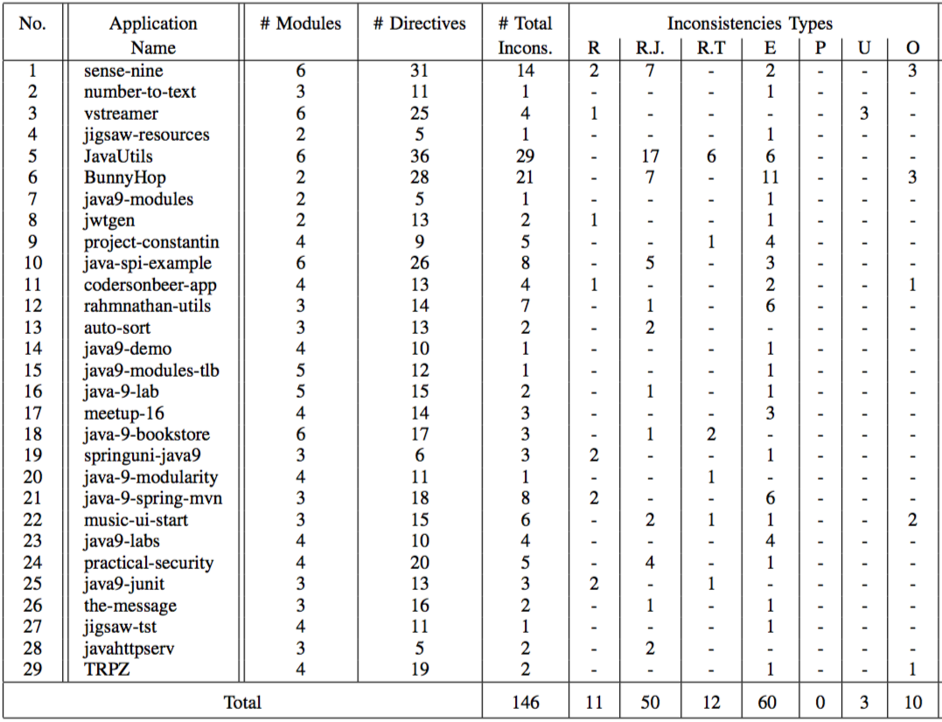
RQ1: Pervasiveness
In 76% of applications
29 out of 38
146 inconsistencies
Exports (to)
Most Frequent
Requires JDK
Most frequent among requires inconsistencies
Provides
Most infrequent
Notes:
Pervasiveness 38
table
High freq export
Among reqs
none – provide & only one -- uses : but cover → risky & may appear
LOC: [avg 9K] [Max 175K]

Slide 61
Evaluation
RQ1: Pervasiveness
RQ2: Correctness
RQ3: Security
RQ4: Encapsulation
RQ5: Software Bloat
RQ6: Performance
Notes:
To assess the effectiveness of Darcy→ study 6 research questions

Slide 62
RQ2: How accurate is DARCY at detecting inconsistent, architectural dependencies and repairing them?

Slide 63
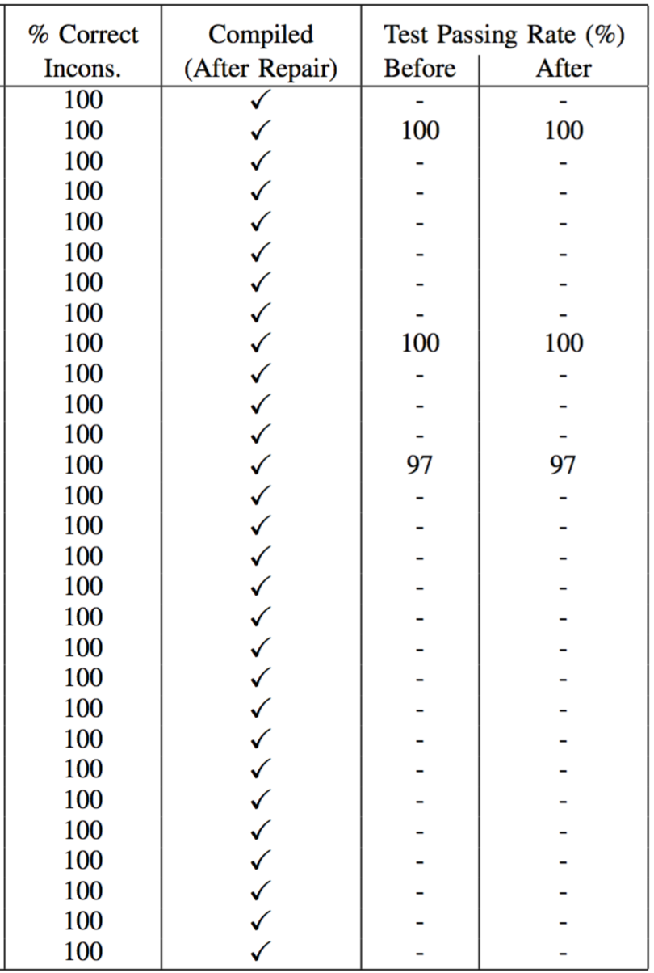
RQ2: Correctness
Manually checked all detected inconsistencies
All were true
Successfully compiled after the repair
Darcy’s ability to correctly repair
Without introducing unexpected behavior
Same test passing rate
For those applications with test suite
Notes:
Pervasiveness 38
table
exp & req
High freq export
Among reqs
none – provide & only one -- uses : but cover → risky & may appear
assess whether Darcy can ACCURATELY detect → manually
Compiled → shows Darcy’s ability to CORRECTLY repair WITHOUT introducing any unexpected behavior → also test passing rate

Slide 64
Evaluation
RQ1: Pervasiveness
RQ2: Correctness
RQ3: Security
RQ4: Encapsulation
RQ5: Software Bloat
RQ6: Performance
Notes:
To assess the effectiveness of Darcy→ study 6 research questions

Slide 65
RQ3: To what extent does DARCY reduce the attack surface of Java modules?

Slide 66
RQ3: Security
Attack surface of Java-9 applications
Reflects the likelihood of resources being used in security attacks
Number of packages that are accessible from outside their module
Exposed by exports(to) and opens(to)
Measured the number of exposed packages before and after Darcy
Notes:
Leveraged : Attack surface = collection of points → sys res
REFLECTS → likelihood
In the context → main res = module → #pckgs exposed by exp & open

Slide 67
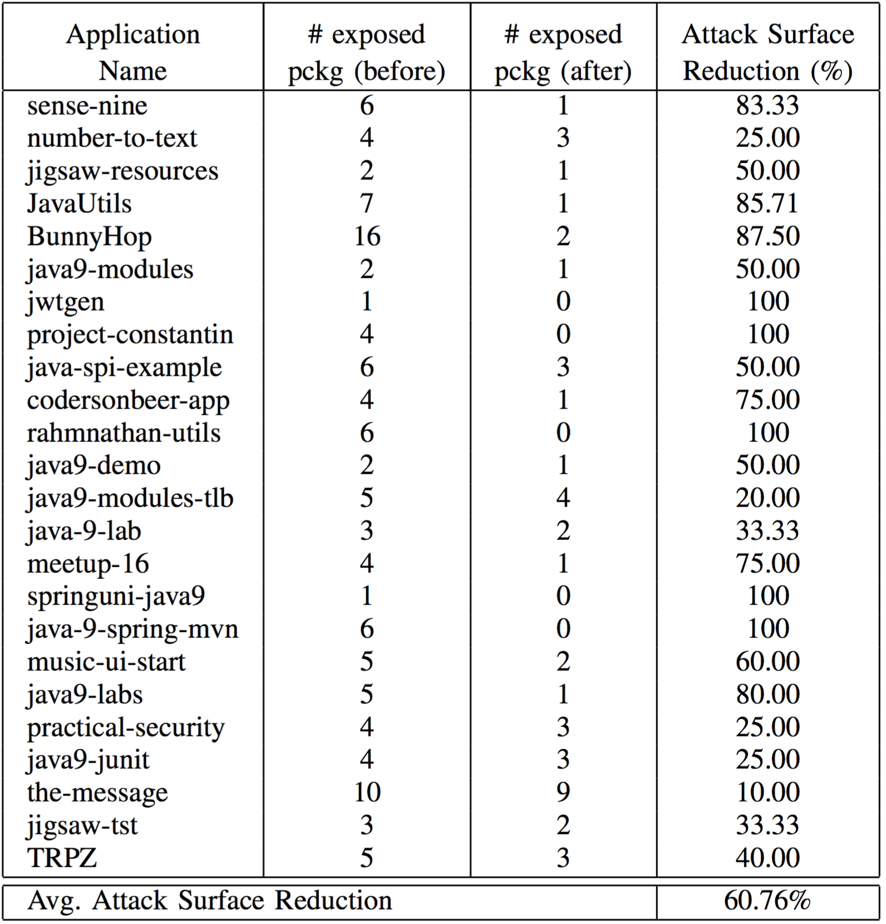
RQ3: Security
Reduce attack surface in 24 out of 29 applications
By avg. of 60.76%
Notes:
Was able to

Slide 68
Evaluation
RQ1: Pervasiveness
RQ2: Correctness
RQ3: Security
RQ4: Encapsulation
RQ5: Software Bloat
RQ6: Performance
Notes:
To assess the effectiveness of Darcy→ study 6 research questions

Slide 69
RQ4: To what extent does DARCY enhance encapsulation of Java modules?

Slide 70
RQ4: Encapsulation
Measured two metrics from an extensive investigation by Bouwers et al.[1]
Ratio of Coupling (RoC)
Number of existing dependencies to all possible dependencies
Ideally a low value
Normalized Component Dependency (NCD)
Sum of all outgoing dependencies to the total number of modules
Ideally a low value
[1] E. Bouwers, A. van Deursen, and J. Visser, “Quantifying the encapsulation of implemented software architectures,” in Software Maintenance and Evolution (ICSME), 2014 IEEE International Conference on. IEEE, 2014, pp. 211–220.
Notes:
For this purpose→ leveraged two metric : selected from an extensive investigation by → quantification
Roc : measures coupling
low = only small part of all possible actually utilized → less likely that FAULTS , FAILURES, or ERRORS : introduced by CHANGES -> PROPAGATE across modules.
NCD
Low = indicating lower coupling and better encapsulation.

Slide 71
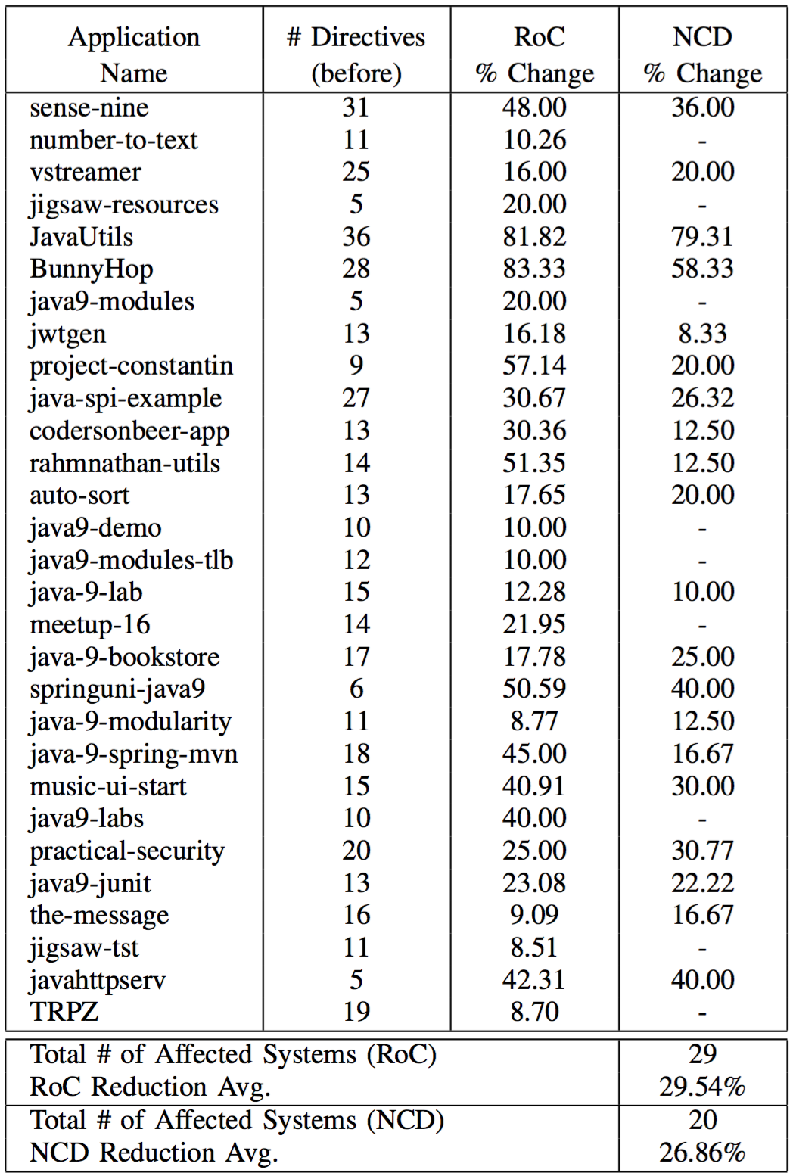
RQ4: Encapsulation
Reduce RoC in 29 applications
By avg. of 29.5%
Up to 83%
Reduce NCD in 20 applications
By avg. of 26.8%
Up to 79%
Notes:
Was able to reduce …

Slide 72
Evaluation
RQ1: Pervasiveness
RQ2: Correctness
RQ3: Security
RQ4: Encapsulation
RQ5: Software Bloat
RQ6: Performance
Notes:
To assess the effectiveness of Darcy→ study 6 research questions

Slide 73
RQ5: To what extent does DARCY reduce the size of runtime memory?

Slide 74
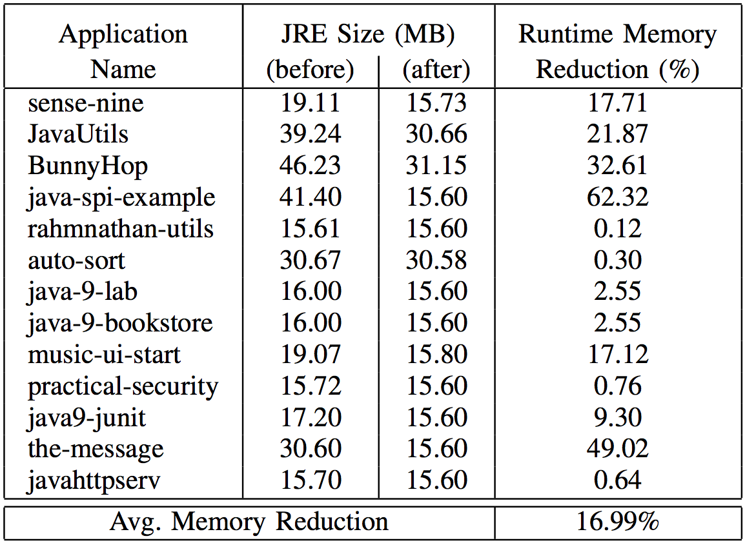
RQ5: Software Bloat
Measured the runtime memory, before and after Darcy’s repair
Runtime memory reduction in 15 applications
Avg. 17%
Up to 62%
Notes:
To answer : measured
Table : shows reduction of software bloat IN TEMRS OF runtime memory size
Results -> particularly SUBSTANTIAL for deployment and scalability goals in microservices or IoT devices that contain very little memory.

Slide 75
Evaluation
RQ1: Pervasiveness
RQ2: Correctness
RQ3: Security
RQ4: Encapsulation
RQ5: Software Bloat
RQ6: Performance
Notes:
To assess the effectiveness of Darcy→ study 6 research questions

Slide 76
RQ6: What is DARCY’s runtime efficiency in terms of execution time?

Slide 77
RQ6: Performance
Execution time for each component:
Notes:
Table : describes the average execution times
the execution time is DOMINATED by Classycle.
on AVG → under 9 seconds

Slide 78
Outline
Background and Motivation
Java Platform Module System: Introduction
Inconsistent Module Dependencies in Java
DARCY: Automatic Detection and Repair of Architectural Inconsistencies
Evaluation
Conclusion and Future Work

Slide 79
Conclusion
Formally defined 8 types of architectural inconsistencies in Java 9
Introduced Darcy
Effectively detect and robustly repair architectural inconsistencies in Java
Results in
Significant reduction of attack security
Enhancement of encapsulation
Reduction of memory usage
Future Work
A plug-in for Java IDEs
Migration to JPMS
Quality Assurance and Integration Testing
Thank You
78
Notes:
Formally 8
Introduce Darcy : leverage def & custom static → effectively & robustly
Results in …
Also ORACLE
In the future:
It can be expanded to : vis & pIug in
We aim to extend the idea to generate integration test plans for the dep

Slide 80
Backup Slides

Slide 81
Related Work
Bridging the gap between architecture and implementation
Focusing on the descriptive architecture
Reverse engineering
Software clustering to determine the components
Obtaining the descriptive and prescriptive architecture
Followed by checking their conformance
Reflexion Method
Providing architectural constructs in the code
Forward engineering (e.g. code generation)
Round-trip engineering (both forward and reverse)

Slide 82
Threats to Validity
False positive or negative of static analyses
Miss some inconsistencies in the detection
Report false inconsistencies
The selection and number of Java applications in the dataset
Comprehensiveness of the identified inconsistencies

Slide 83
Inconsistent JDK Requires Dependency
$$Req\left({ m}_{1},{ m}_{jdk}\right) \text{∧}$$
$$\left(∄{ p}_{1}∈{ m}_{1},{ p}_{2}∈{ m}_{jdk}:Dep \left({ p}_{1},{ p}_{2}\right)\right)$$
Module foo
module foo{
requires ${ m}_{jdk}$;
}
JDK Module
$${ m}_{jdk}$$
Notes:
Recall requires

Slide 84
Inconsistent Requires Transitive Dependency
$$ReqTransitive\left({ m}_{1},{ m}_{2}\right) \text{∧}$$
$$\left(∀ m:Req\left(m, { m}_{1}\right),∀{ p∈m,∀ p}_{2}∈{ m}_{2}:¬Dep \left(p,{ p}_{2}\right)\right)$$
Module m
Module foo
Module bar
module m{
requires foo;
}
module foo{
requires transitive bar;
}
module bar{
…
}
Notes:
Recall requires

Slide 85
Inconsistent Exports To Dependency
$$ExpTo\left({ m}_{1},{ p}_{1},M\right) \text{∧} \left(∀ p∈M:¬Dep \left({p, p}_{1}\right)\right)$$
Module foo
Module bar
module foo{
exports foo.util to bar; }
module bar{
...
}
package foo.util
Package p
Notes:
Recall

Slide 86
Inconsistent Provides With Dependency
$$ProvidesWith\left(m,s,E\right) \text{∧} \left(∀ m^{′}≠m:¬Uses\left(m′,s\right)\right)$$
Module foo
Module m
module foo{
provides com.service with foo.srv.ImplSrv;
}
module bar{
uses com.service;
… }
package foo.srv
Class ImplSrv
Notes:
Recall

Slide 87
Inconsistent Uses Dependency
$$Uses\left(m,s\right) \text{∧} \left(∀ c∈m:¬LoadService \left(c,s\right)\right)$$
Module foo
Module service
module foo{
requires com.service;
uses com.service; }
java.util.ServiceLoader
module service{…}
Service Class
LoadService
com.service
Notes:
Recall

Slide 88
Inconsistent Open Modifier Dependency
$$Open\left(m\right) \text{∧} \left(∃p∈m:∀p^{′}∉m:¬ReflDep\left(p^{′},p\right)\right)$$
Module foo
Module m’
open module foo{
...
}
Module m’{
…
}
Package p
Reflective Access
Package p’
Notes:
Recall

Slide 89
Inconsistent Opens To Dependency
$$OpensTo\left(m,p,M\right) \text{∧}\left(∀ p∈M:¬ReflDep \left(p^{′},p\right)\right)$$
Module foo
Module bar
module foo{
opens foo.util to bar; }
Module bar{
…
}
package foo.util
Reflective Access
Package p’
Notes:
Recall

