Slide 1
Lecture 19 – Translation
Translation steps
  Initiation
  Elongation
  Termination
Translational quality control and error correction.
Antibiotic inhibitors of protein synthesis

Slide 2
Learning Goals
Be able to describe the initiation, elongation and termination steps of translation and the protein factors that participate in these steps.
Be able to diagram the mechanism of peptide bond formation.
Be able to describe how the ribosome proof reads the codon-anticodon base pairing.
Be able to describe how antibiotic inhibitors of protein synthesis inhibit different steps of translation.

Slide 3
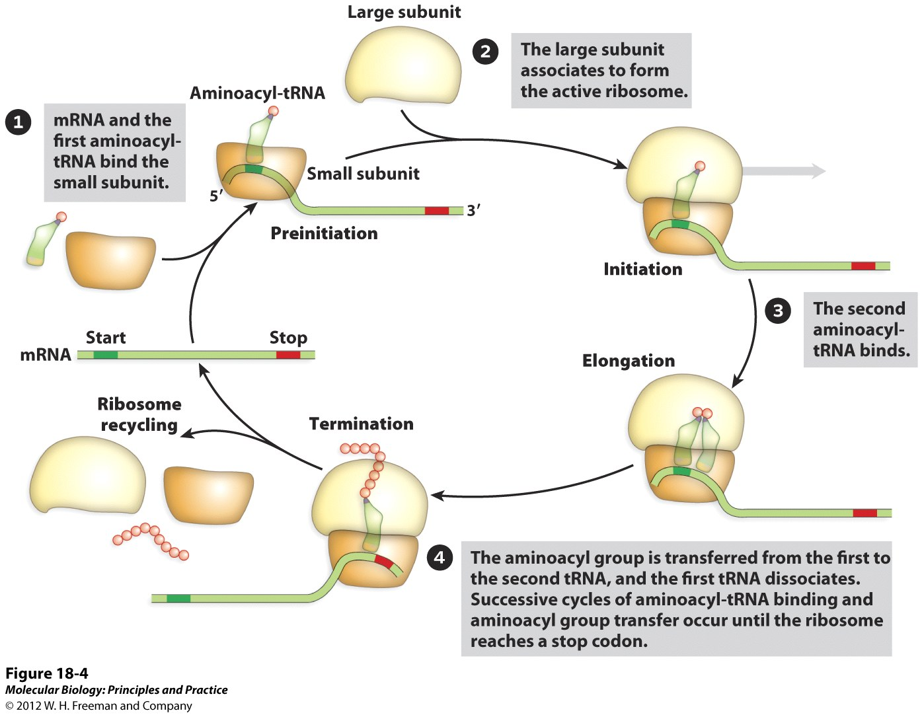
Overview of Translation

Slide 4
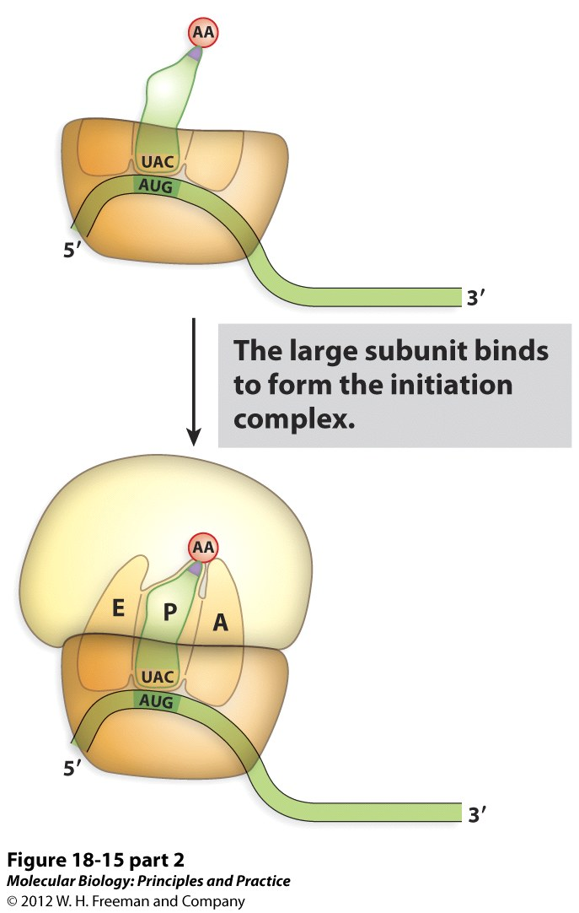
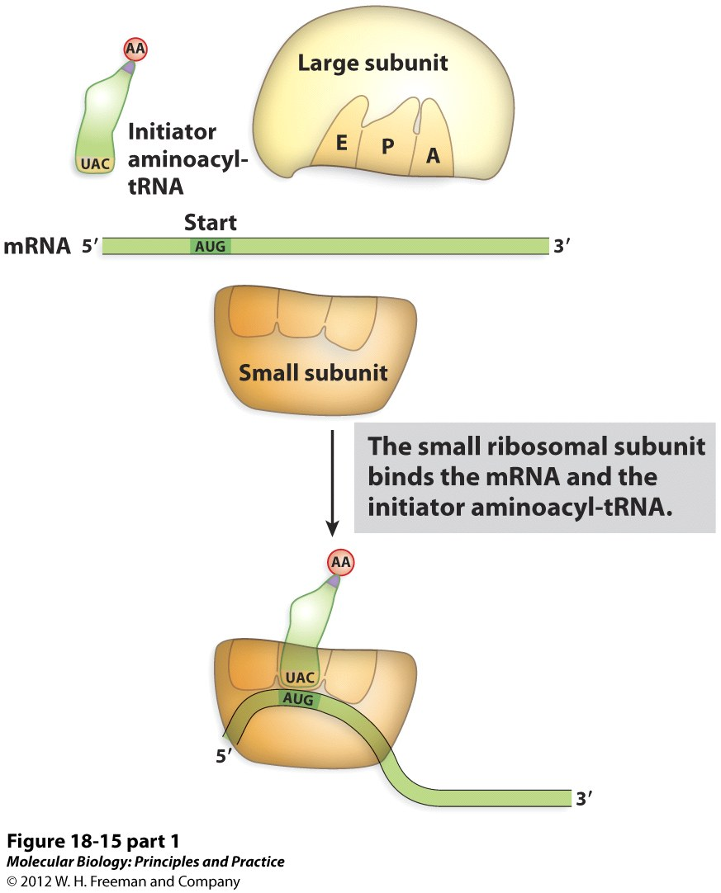
Overview of Translation Initiation

Slide 5
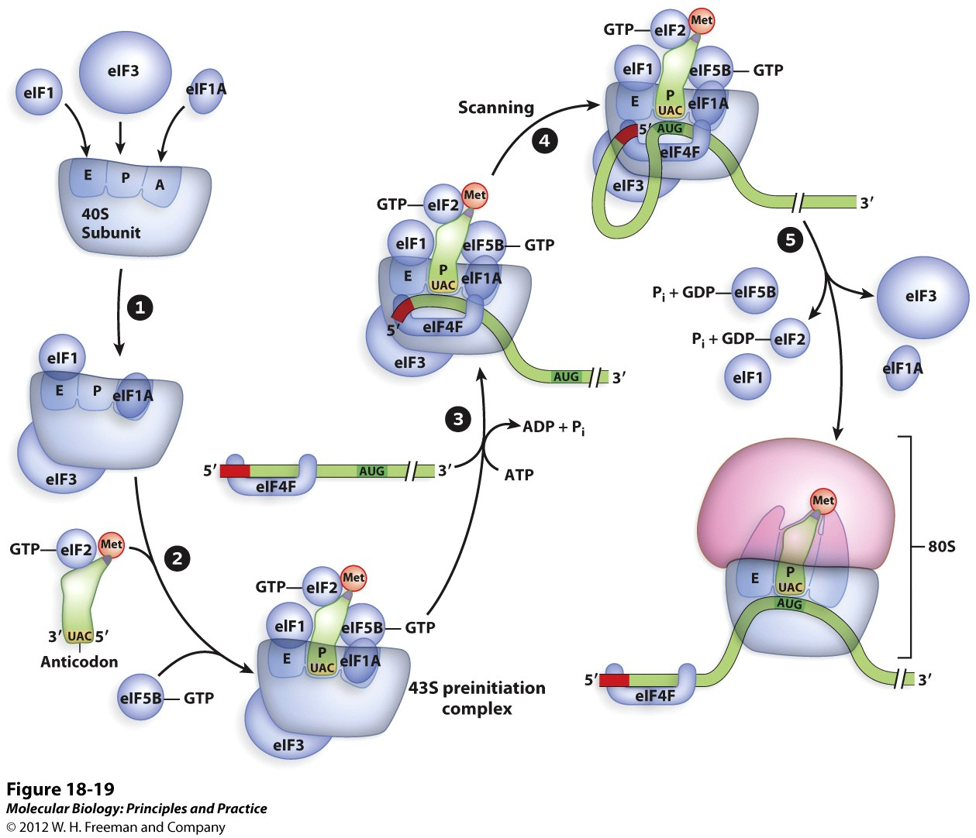
Regulation of Translation Initiation
Initiation Factors
Provide structural support
Recruit various translation factors
Utilize GTP/ATP

Slide 6
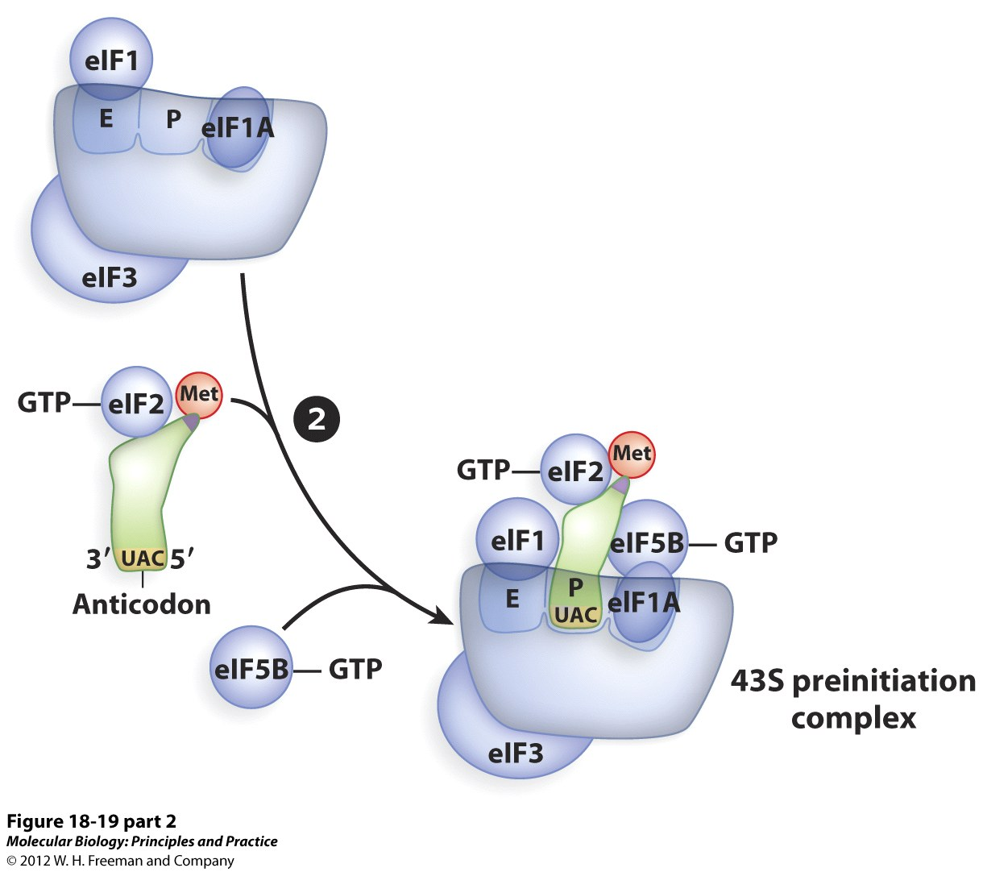
Regulation of Translation Initiation
Initiator Met-tRNA_{i}
Contains 1st AA of new protein
Structurally distinct from other tRNA – diff nucleotide sequence
Only initiator Met-tRNA can bind to initiation factors . All other AA-tRNAs bind to elongation factors.
Only tRNA anticodon that is decoded in the P site of ribosome.

Slide 7
Regulation of Translation Initiation
eIF2-GTP binds to Met-tRNA_{i}
Following preinitiation complex formation – GTP hydrolysis
Must recycle GDP➔GTP for a new round of initiation

Slide 8
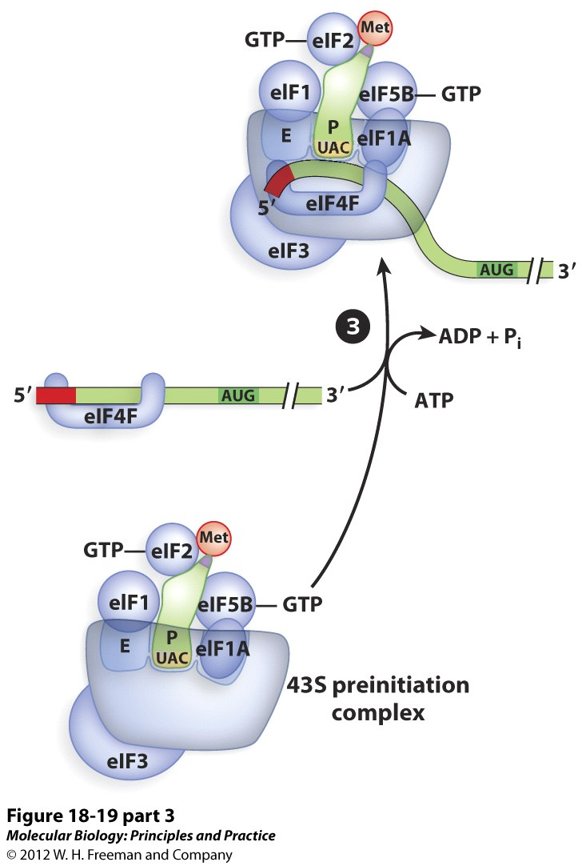
Regulation of Translation Initiation
mRNA – 5’ cap
Connects mRNA and initiation factors

Slide 9
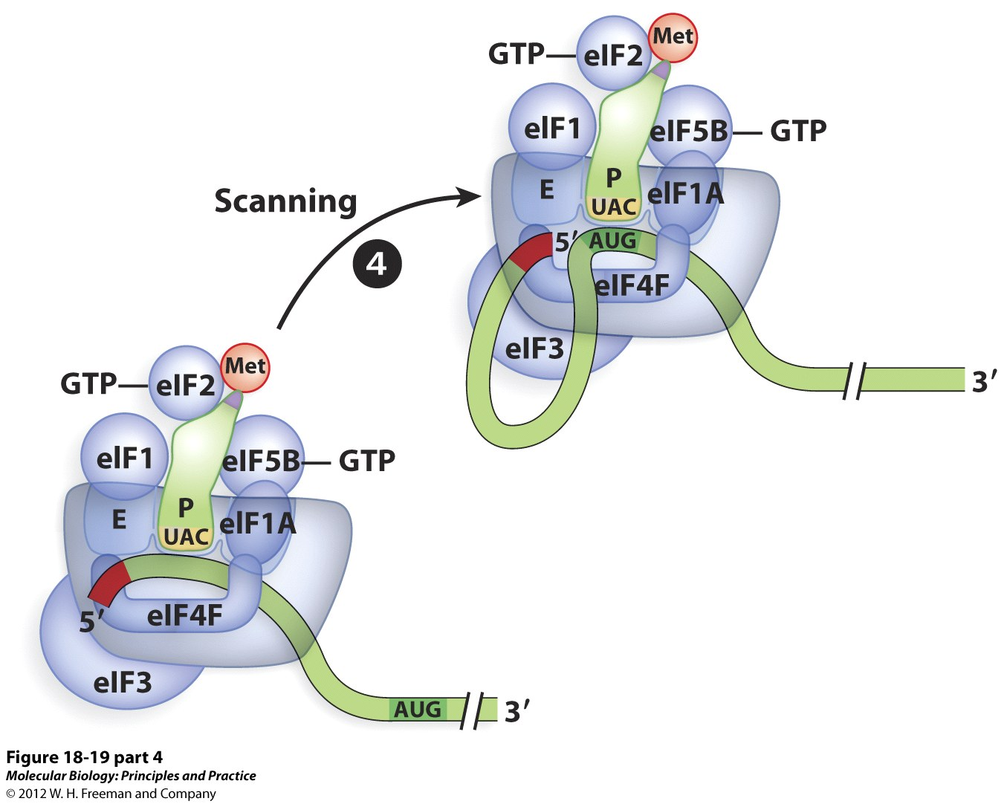
Regulation of Translation Initiation
mRNA - Kozak Sequence
Establishes reading frame
rRNA binds to mRNA through base pairing

Slide 10
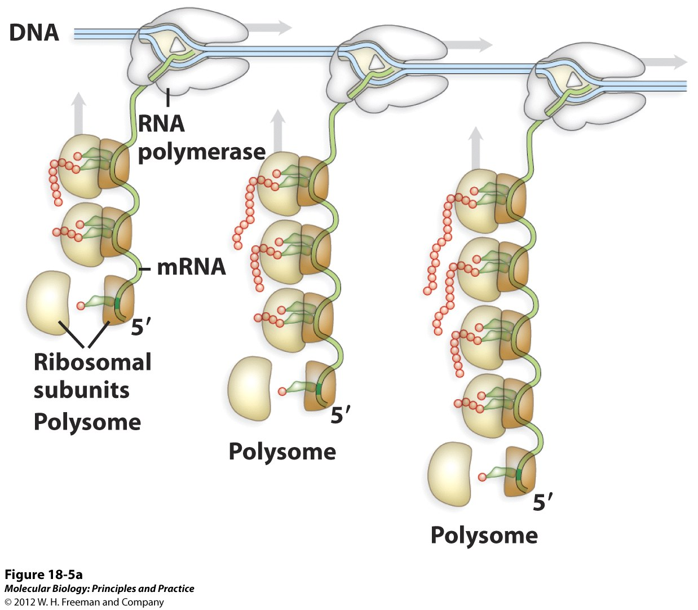
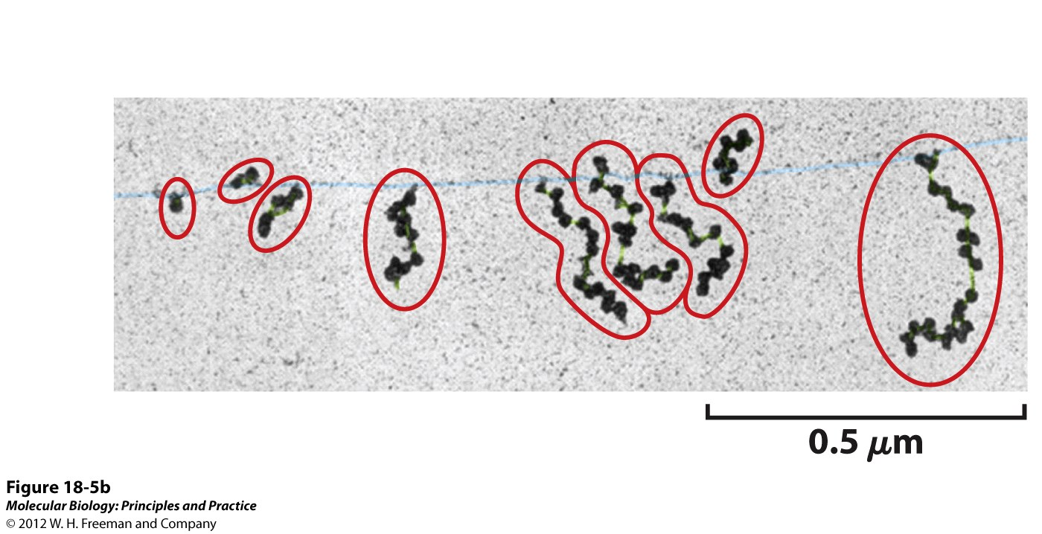
Polysomes: Multiple ribosomes translating the same mRNA
As soon as a ribosome initiates translation on an mRNA, it moves toward the 3’ end, exposing the initiation site for another ribosome to begin translating the protein.
At the same time, the RNA polymerase continues to elongate the mRNA by adding new bases to the 3’ end.

Slide 11
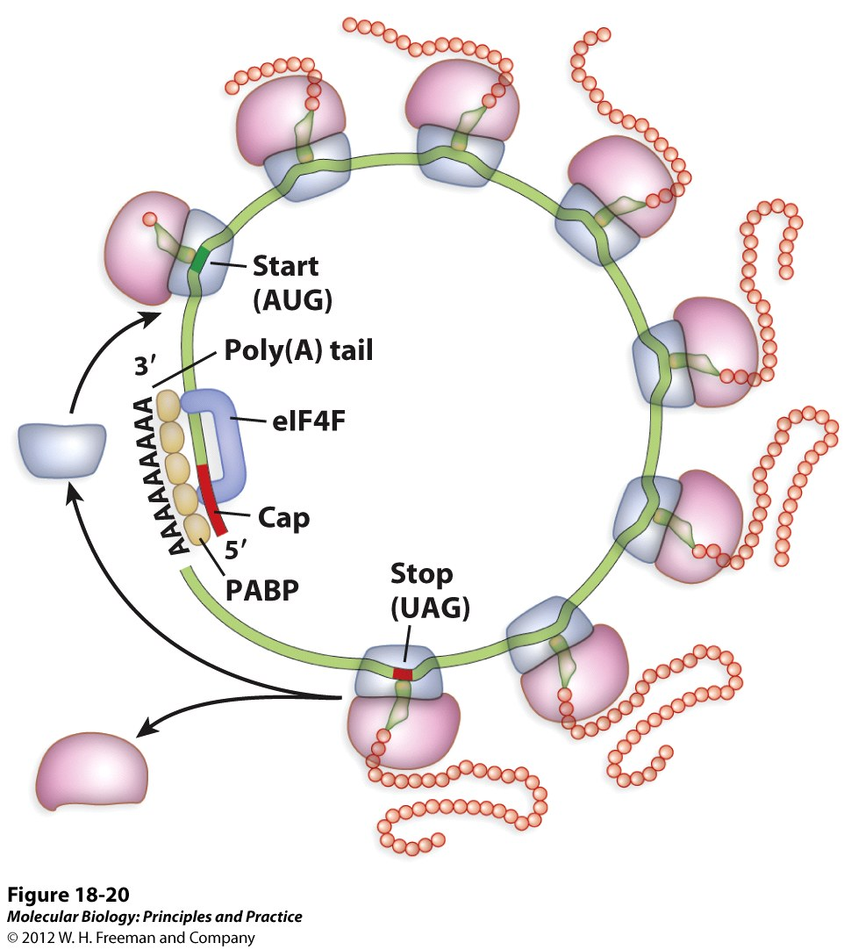
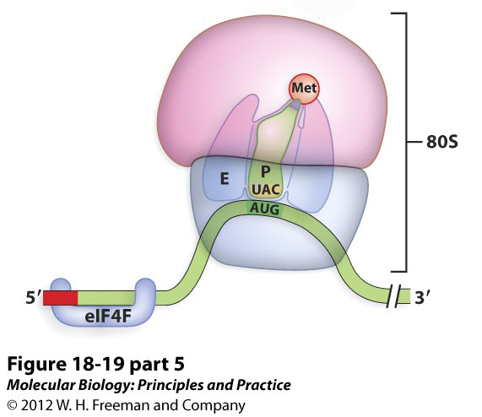
Translation Initiation Complete
Polysome formation –
5’ cap and poly A tail dep

Slide 12
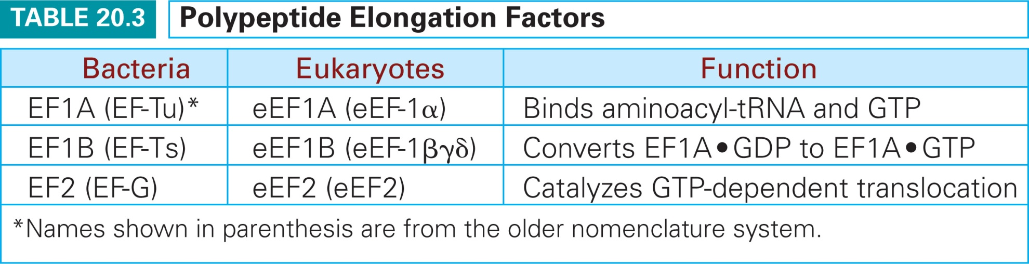
Elongation factors are required for chain elongation

Slide 13
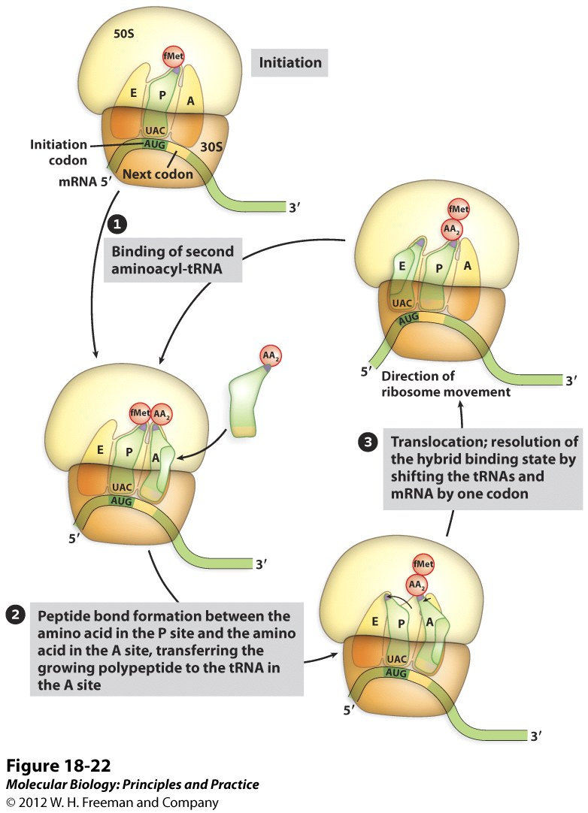
Overview of Translation Elongation
Eukaryotic/Prokaryotic elongation steps similar
(different participating factor names)
All tRNAs used for elongation are delivered to the ribosomes in a complex with GTP and EF1A / eEF1A (EF-Tu for bacteria in old nomenclateure), known as a Ternary Complex.

Slide 14
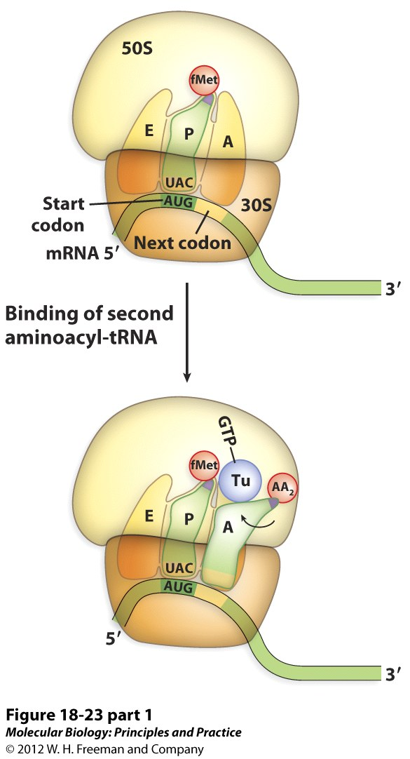
Translation Elongation: Decoding
Aminoacyl-tRNA binding, also known as “decoding”
Mediated by codon/
anti-codon binding
tRNA is brought to the ribosome by EF1A / eEF1A and is released w/GTP hydrolysis if the anticodon matches the codon.

Slide 15
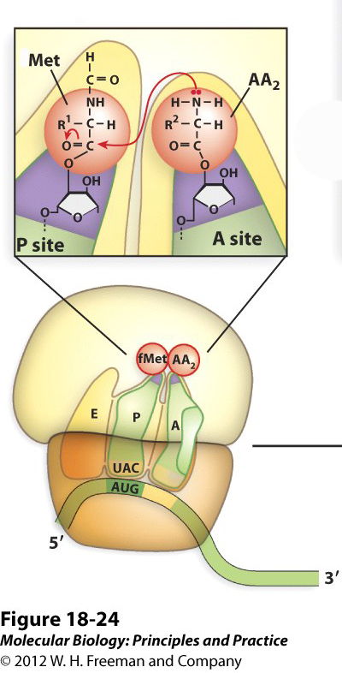
Translation Elongation: Peptide Bond Formation
Peptide Bond formation
The growing polypeptide is covalently attached to the tRNA in the P site, which is why P stands for “peptidyl” site.
An amino acid is covalently attached to the tRNA in the A site, which is why A stands for “aminoacyl” site.

Slide 16
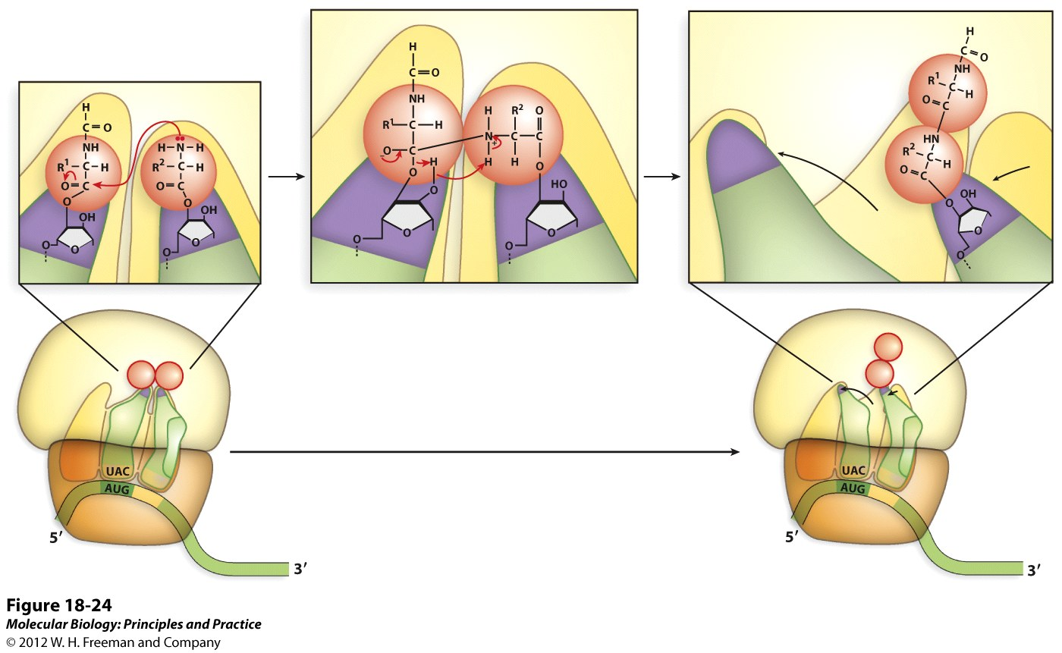
Translation Elongation: Peptide Bond Formation
After peptide bond formation, the acceptor stem ends of the tRNA move over by one site to the E and P sites of the 50S subunit. The anticodon ends do not move at this point.

Slide 17
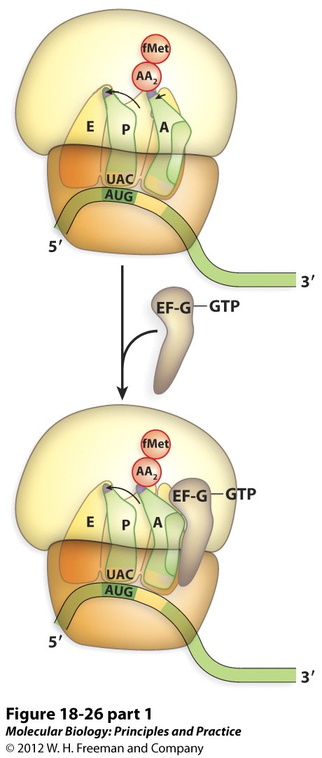
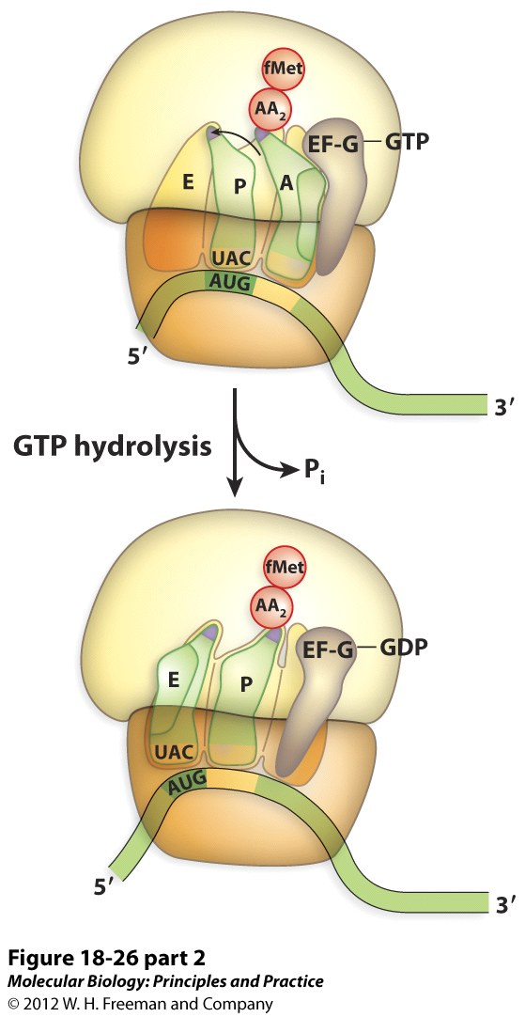
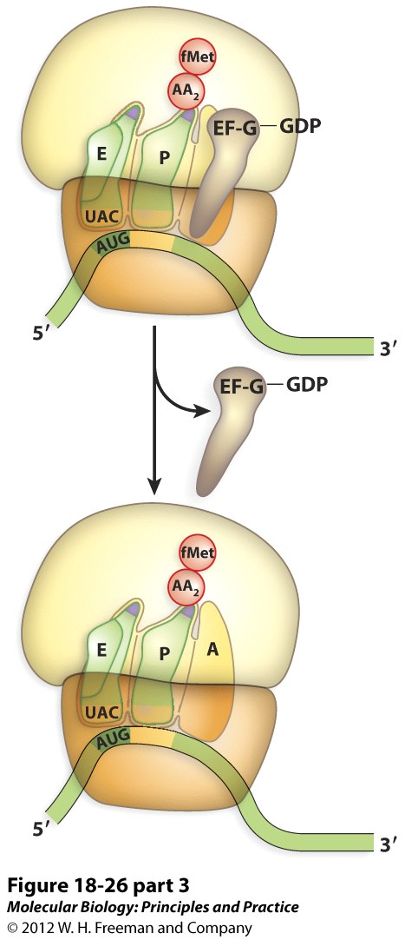
Translation Elongation
During translocation, GTP hydrolysis on EF2 / eEF2 causes the anticodon ends of the tRNAs and the mRNA to move over by one codon on the 30S subunit. The acceptor ends do not move.
And the 3 steps of elongation repeat for each codon…

Slide 18
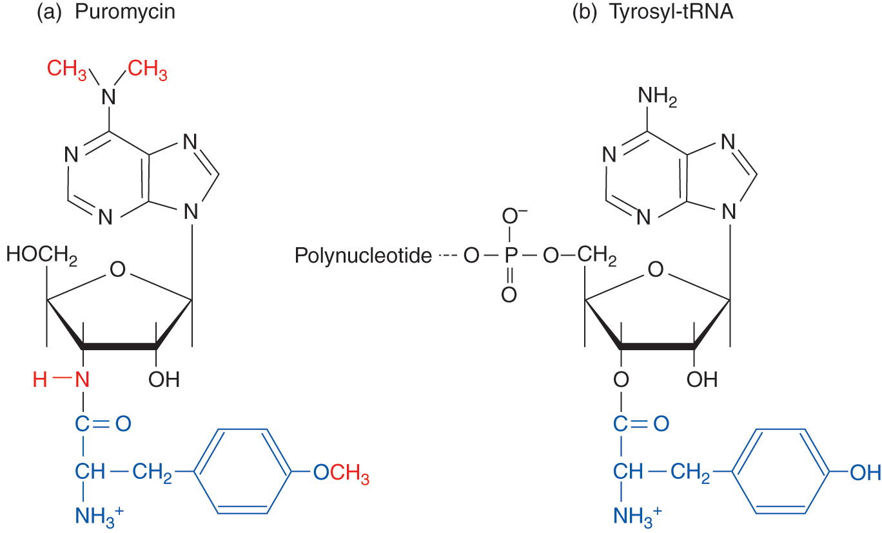
Puromycin is an antibiotic that inhibits protein synthesis.
Puromycin is an A site substrate and AA-tRNA mimic. In the presence of puromycin, the nacent chain will be added to puromycin and released from the ribosome.
Figure 20.29

Slide 19
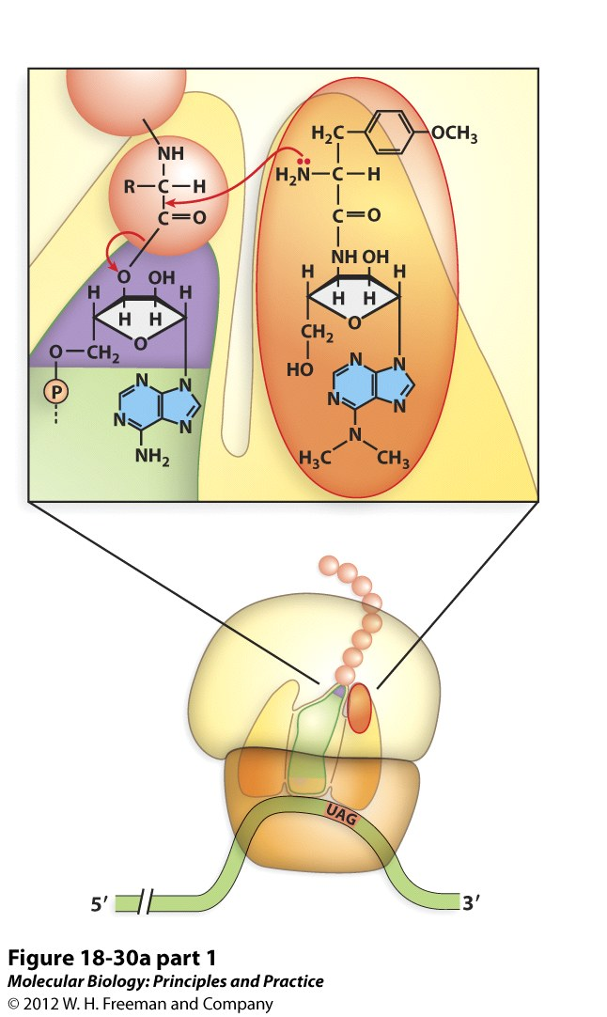
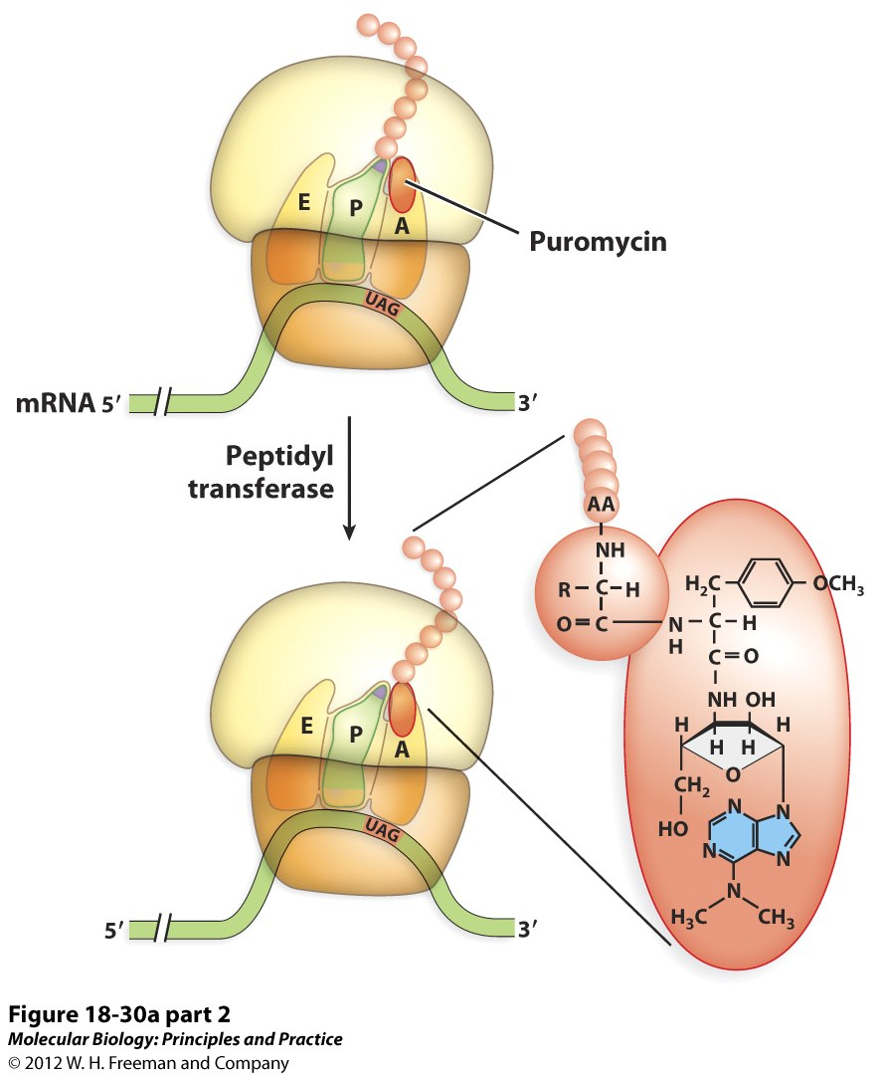
Puromycin causes premature termination and release of the growing polypeptide.
Puromycin is a “molecular mimic” of the 3’ end of the AA-tRNA

Slide 20
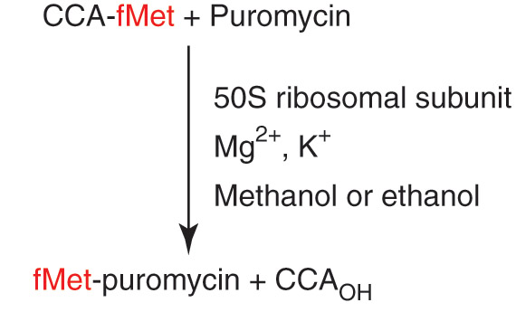
The fragment assay for peptidyl transferase activity shows that rRNA alone has peptidyltransferase activity.
CCA-fMet is a P site substrate and initiator tRNA mimic. A peptide bond will be catalyzed between the carboxyl of Fmet and puromycin by peptidyl transferase.
The purified ribosomal RNA has no protein, showing that rRNA alone can catalyze peptide bond formation.

Slide 21
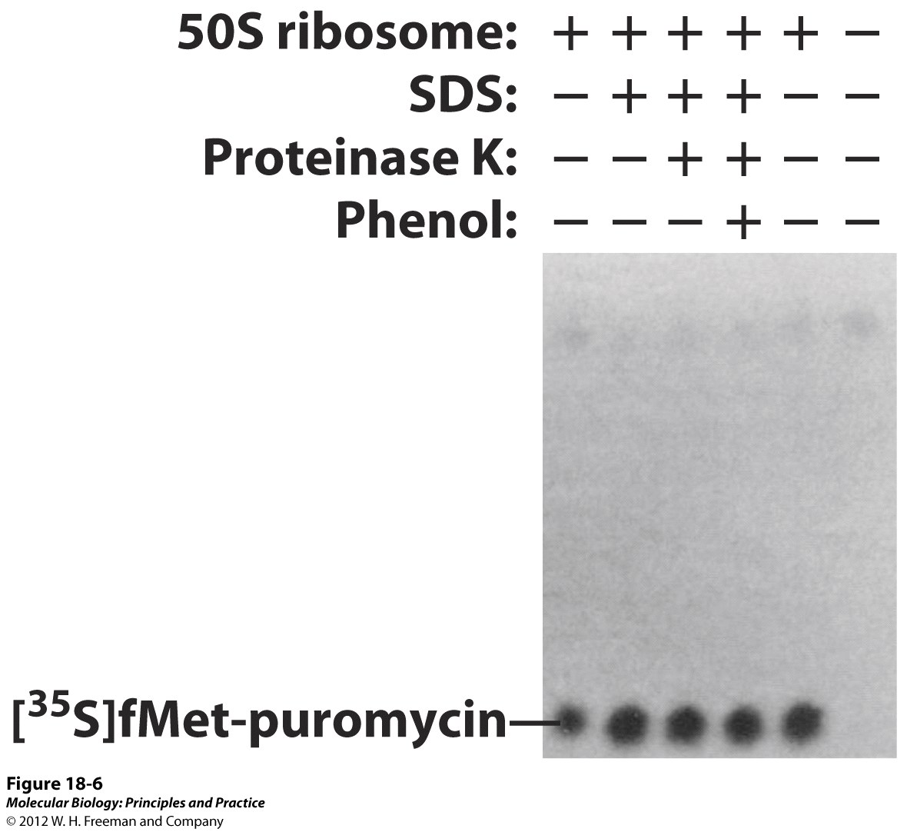
The catalytic active site of the ribosome is RNA
The catalytic activity of the 50S subunit is resistant to SDS, proteinase K and phenol, treatments that either remove or destroy protein.
The P site substrate, CCA-fMet and the A site substrate, puromycin are mixed with 50S subunits and the product separated by electrophoresis.
Noller, H.F., 1992 Science 256:1416.

Slide 22
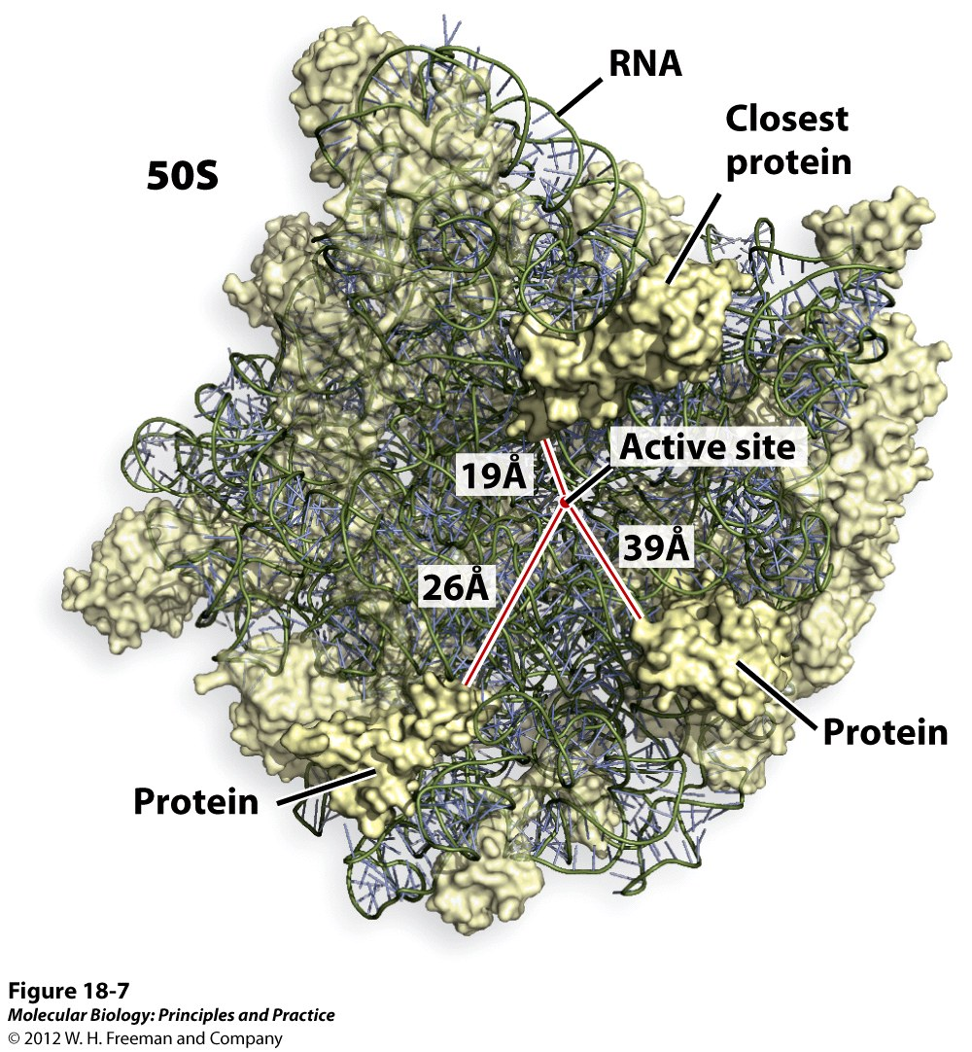
The structure of the 50S subunit confirms that there is no protein near the active site for peptide bond formation.

Slide 23
Antibiotic inhibition of protein synthesis
Antibiotics: inhibitors of cell growth (cytostatic) or cell survival (cytotoxic).
Derived from fungi or bacteria (they likely produce it to combat competitors for limited resources in nature).
Streptomycin: Inhibits initiation by blocking the binding of fMet-IF2. (Also causes misreading of codons.)
Chloramphenicol: Inhibits peptidyl transferase.
Tetracycline: Inhibits elongation by blocking delivery of AA-tRNA to A site.
Erythromycin: Inhibits elongation by blocking translocation.
Streptomycin
Chloramphenicol
(Don’t confuse with antibodies!)
Tetracycline
Erythromycin

Slide 24
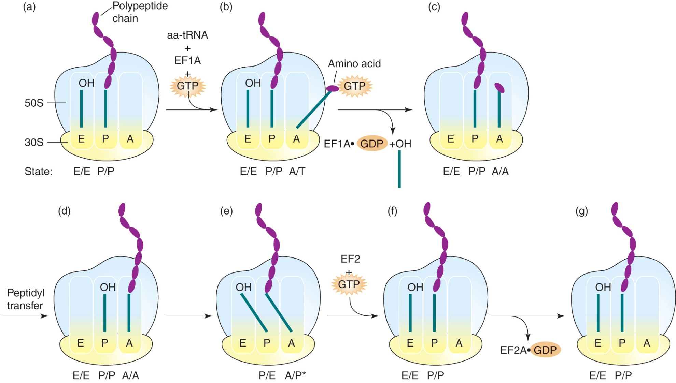
The hybrid-states translocation model for movement of tRNAs in the ribosome
Figure 20.36
Adapted from Noller, H. F., et al., FEBS Lett. 514 (2002): 11-16.

Slide 26
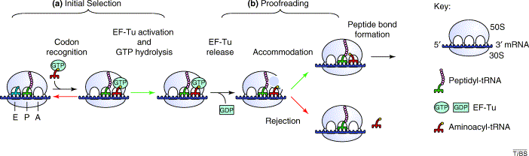
The ribosome proofreads codon-anticodon base pairing at the decoding step of the elongation cycle.
Base pairing correct = Accommodation and peptide bond formation.
Base pairing incorrect = Rejection and removal of incorrect tRNA.
Ogle, J., et al. TIBS 2003 28:259

Slide 27
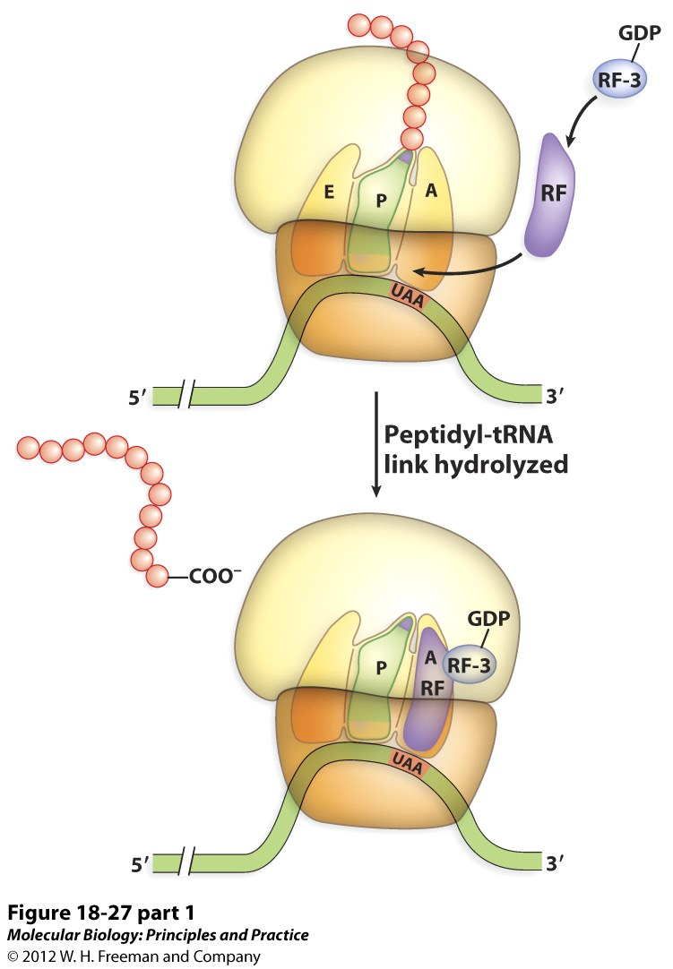
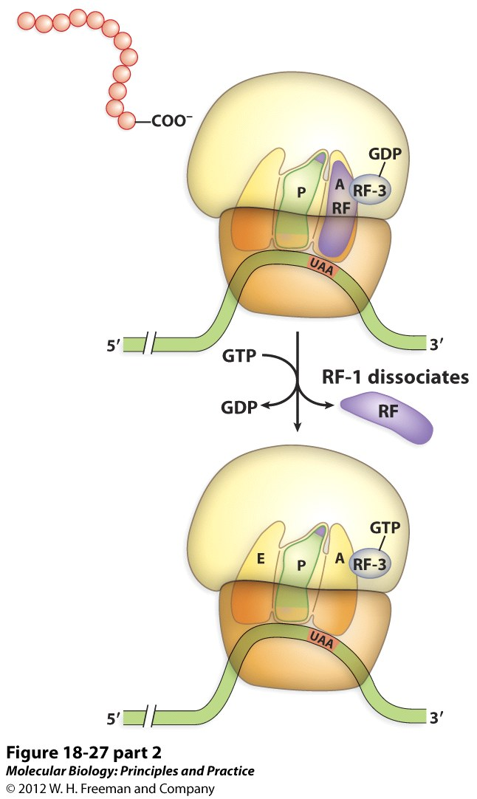
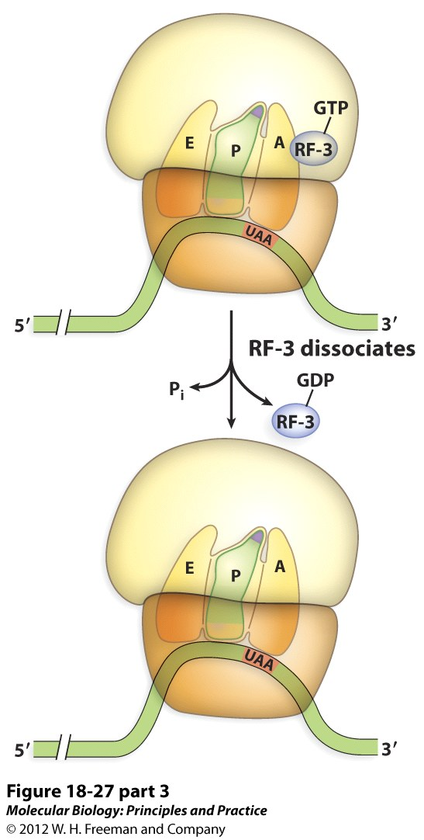
Translation Termination

Slide 28
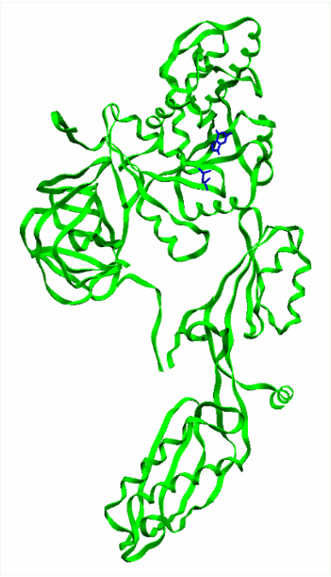
Molecular mimicry of EF-G and EF-Tu:AAtRNA

Slide 29
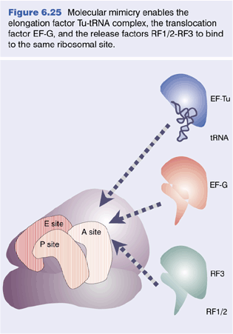
Release factors are also structurally similar to EF-1A-AAtRNA and EF-2 and bind to the same site.

Slide 30
Energetics of prokaryotic protein synthesis
Energy cost for a prokaryotic protein:
What maintains fidelity of protein synthesis?

Slide 31
Puromycin causes premature termination and release of the growing polypeptide.
Puromycin is a “molecular mimic” of the 3’ end of the AA-tRNA

Slide 32
Antibiotic inhibition of protein synthesis
Antibiotics: inhibitors of cell growth (cytostatic) or cell survival (cytotoxic).
Derived from fungi or bacteria (they likely produce it to combat competitors for limited resources in nature).
Streptomycin: Inhibits initiation by blocking the binding of fMet-IF2. (Also causes misreading of codons.)
Chloramphenicol: Inhibits peptidyl transferase.
Tetracycline: Inhibits elongation by blocking delivery of AA-tRNA to A site.
Erythromycin: Inhibits elongation by blocking translocation.
Streptomycin
Chloramphenicol
(Don’t confuse with antibodies!)
Tetracycline
Erythromycin

Slide 33
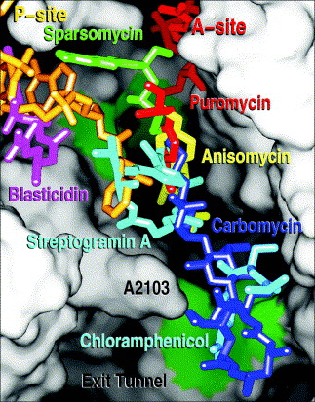
Peptide bond formation inhibitors
The positions of seven antibiotics and A-site (red) plus P-site (yellow) substrates bound to the peptidyl transferase center. The ribosome has been split open to reveal the lumen of the exit tunnel and adjacent regions of the peptidyl transferase site. The sites to which each of the antibiotics bind are all different, but there is extensive overlap

