Slide 1
Lecture 11 – Prokaryotic Transcription
Transcription Basics
RNA polymerase
Promoters
Transcription factors
Transcription
Initiation
Elongation
Termination

Slide 2
Learning Goals
Be able to list the similarities and differences between DNA replication and transcription.
Be able to draw out the mechanism of RNA synthesis
Be able to describe the basic regulatory factors involved in transcription initiation and termination

Slide 3
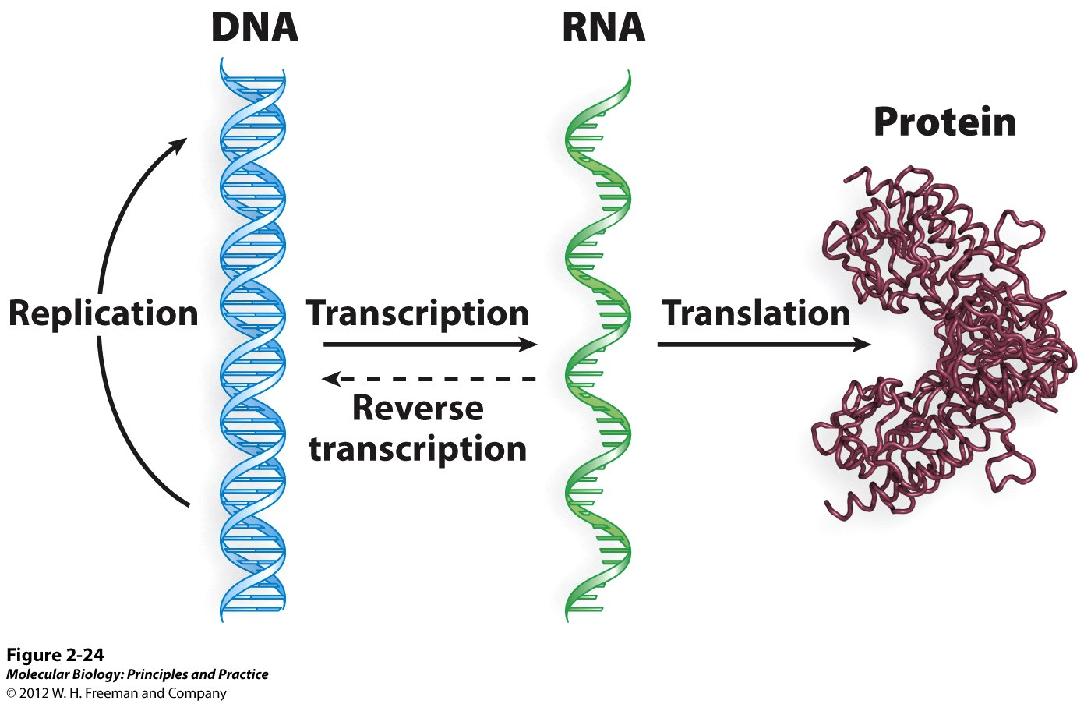
Central Dogma

Slide 4
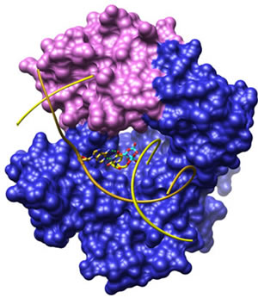
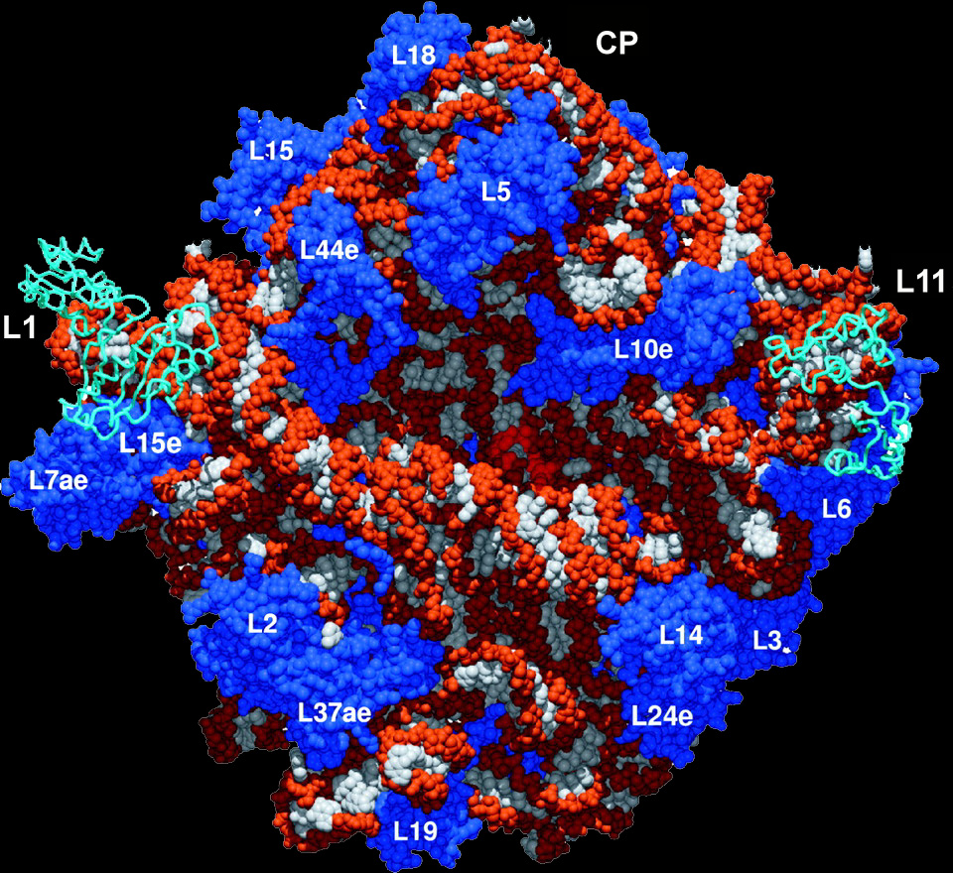
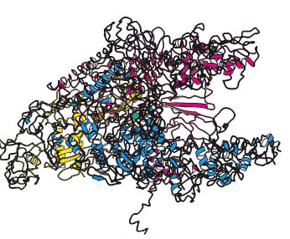
The Central Dogma is the Engine of Evolution
DNA polymerase
(replication)
RNA polymerase
(transcription)
Ribosome
(translation)

Slide 5
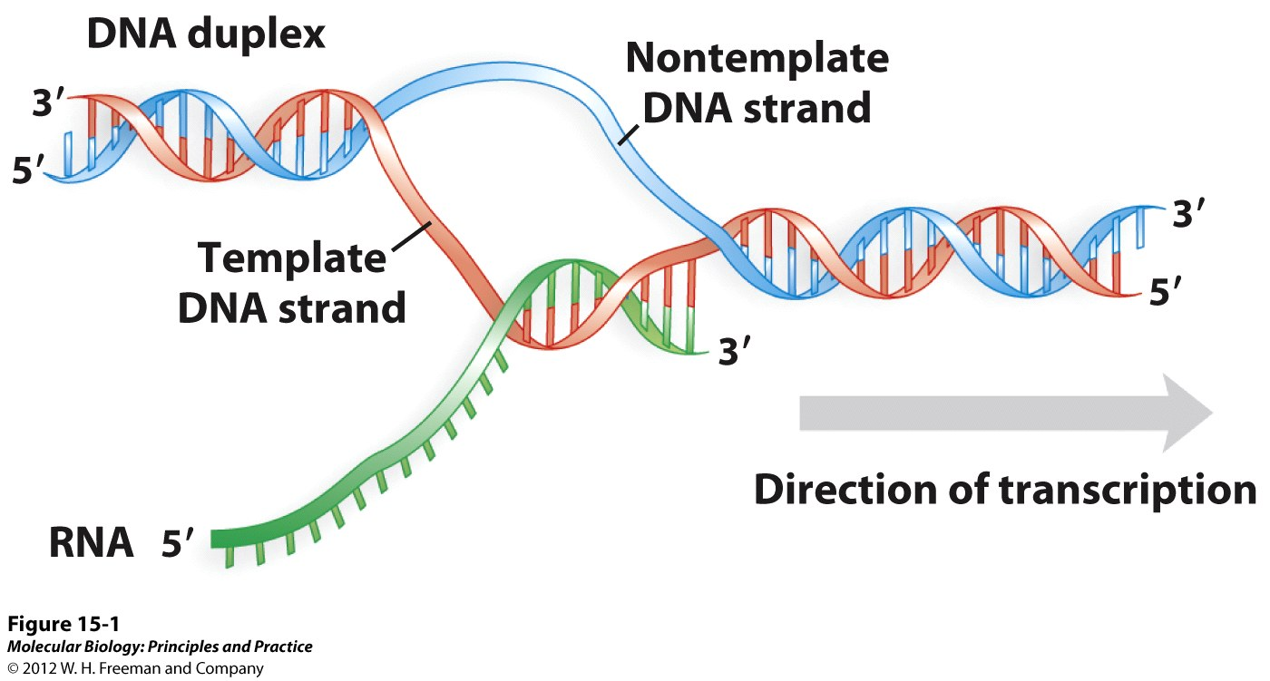

Slide 6
Transcription and DNA Replication
Simlarities
DNA as a template
Synthesis of a complementary strand
Same mechanism of phosphodiester bond formation (directionality)
Differences
Txn is selective
Only 1 strand used as template
Txn does not require a primer (why?)
Txn more error prone (no 3’ to 5’ exonuclease on RNA pol)

Slide 7
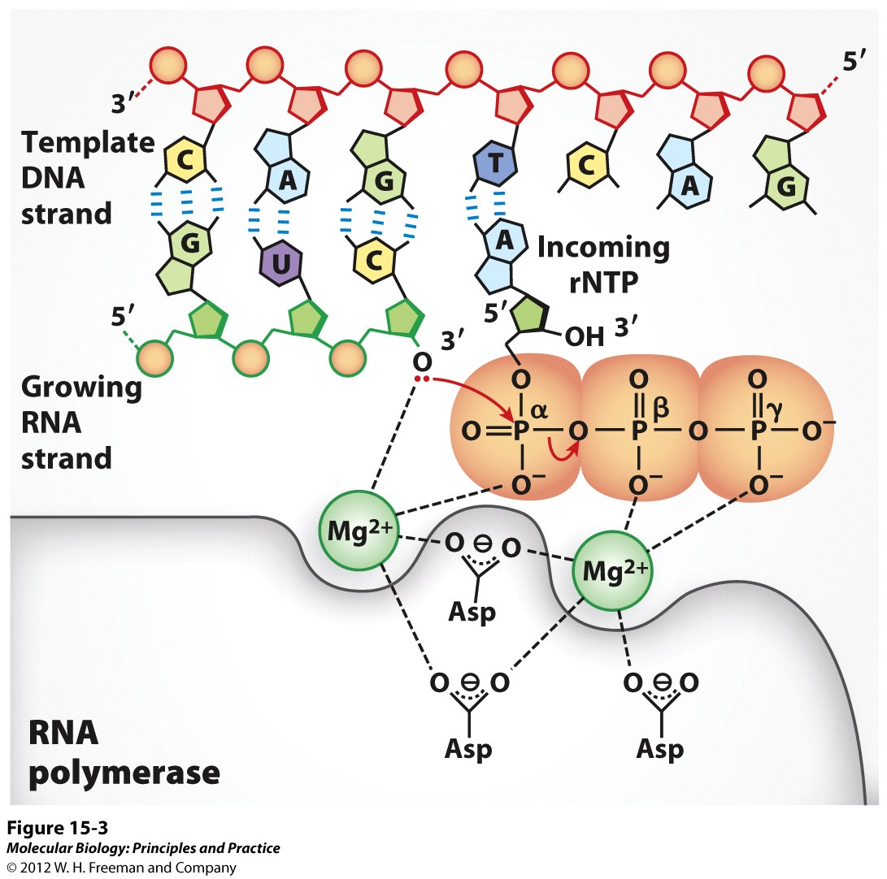
Mechanism of Transcription

Slide 9
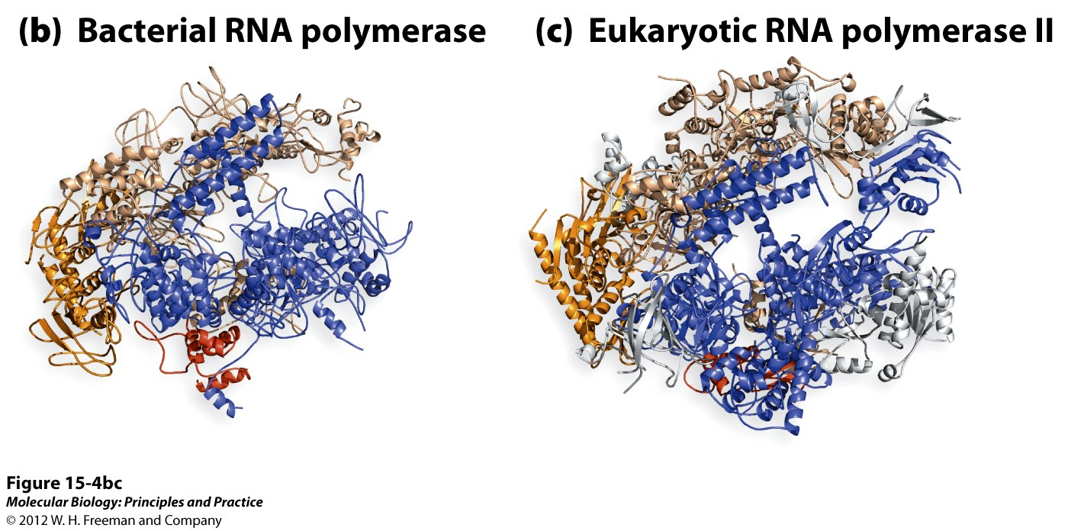

Slide 10
The coding strand of the DNA has the same sequence as the RNA transcription product, except U in the RNA substitutes for T in DNA.

Slide 11
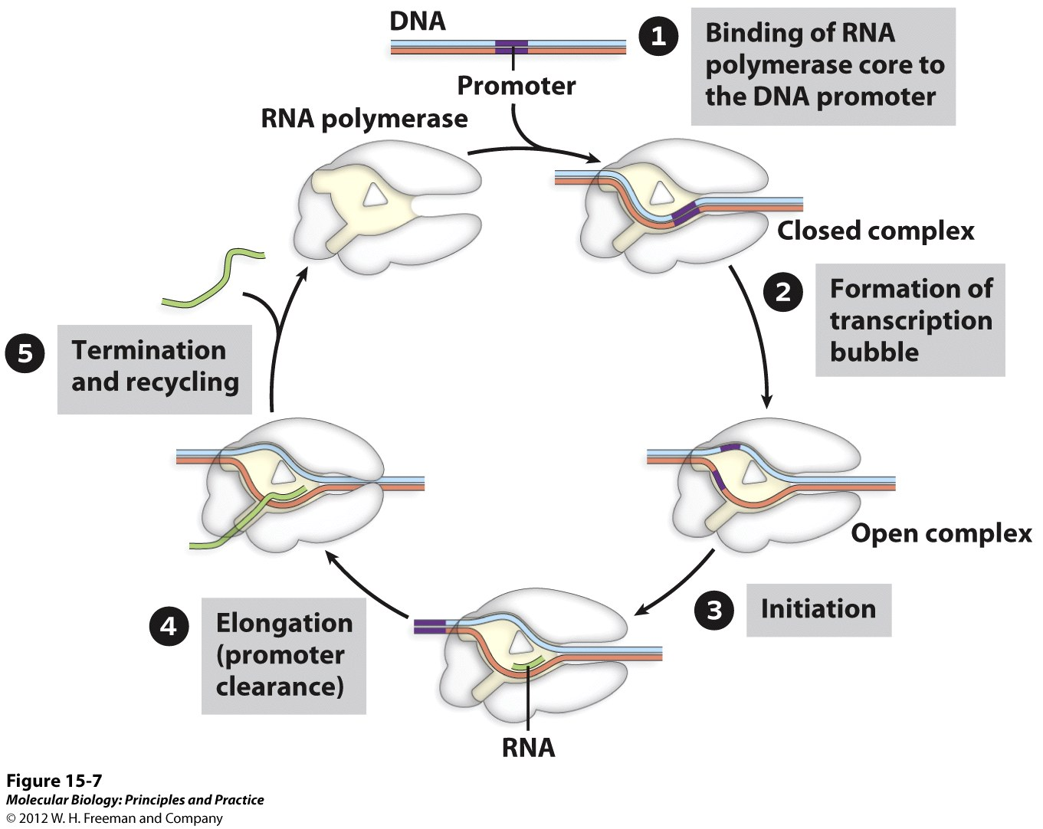
Transcription – Brief Overview

Slide 12
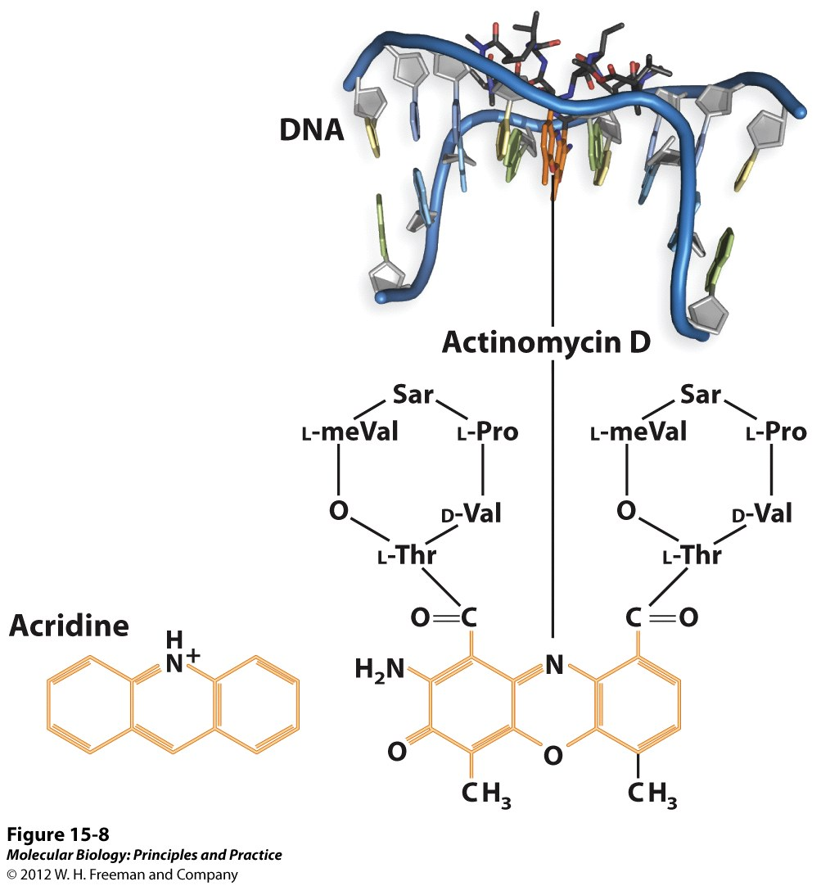
Antibiotic inhibitors of transcription.

Slide 13
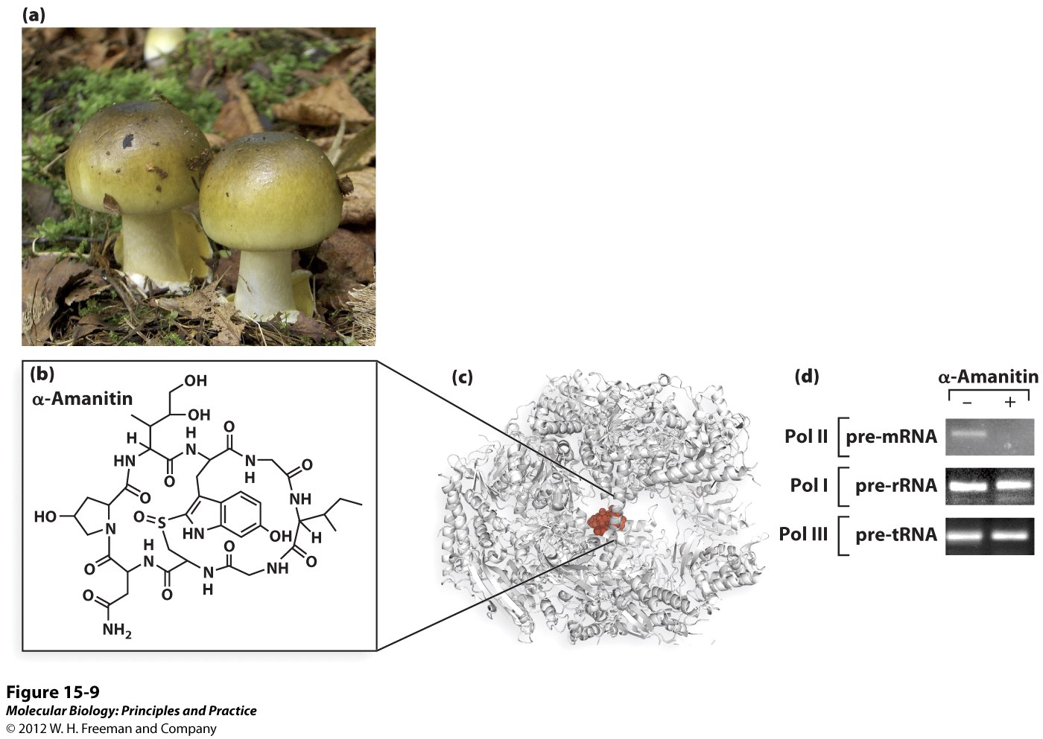
Antibiotic inhibitors of transcription.

Slide 14
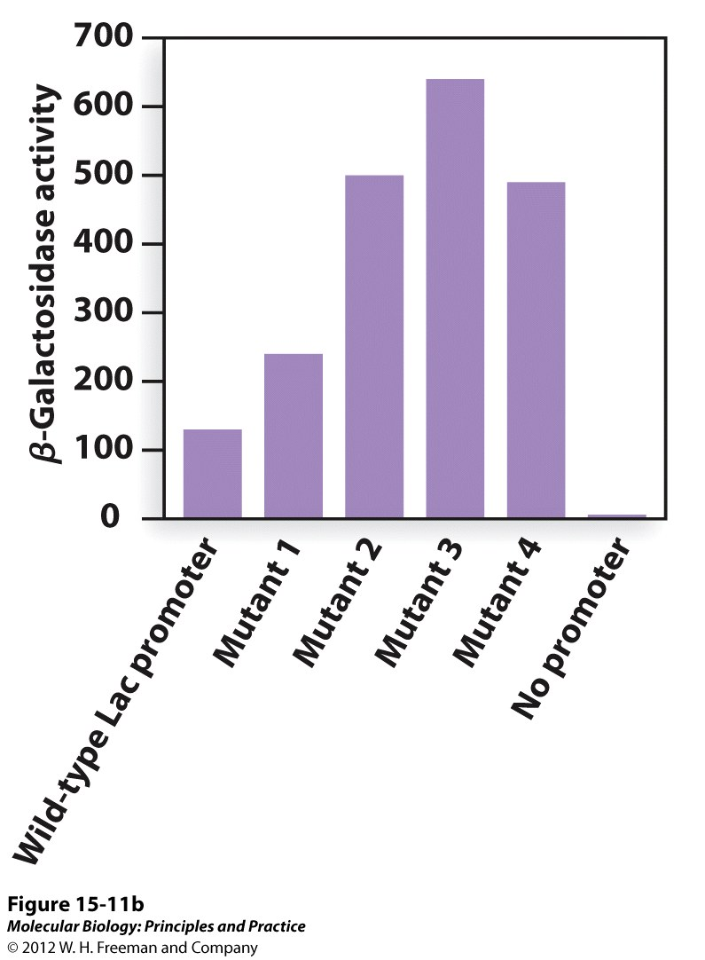
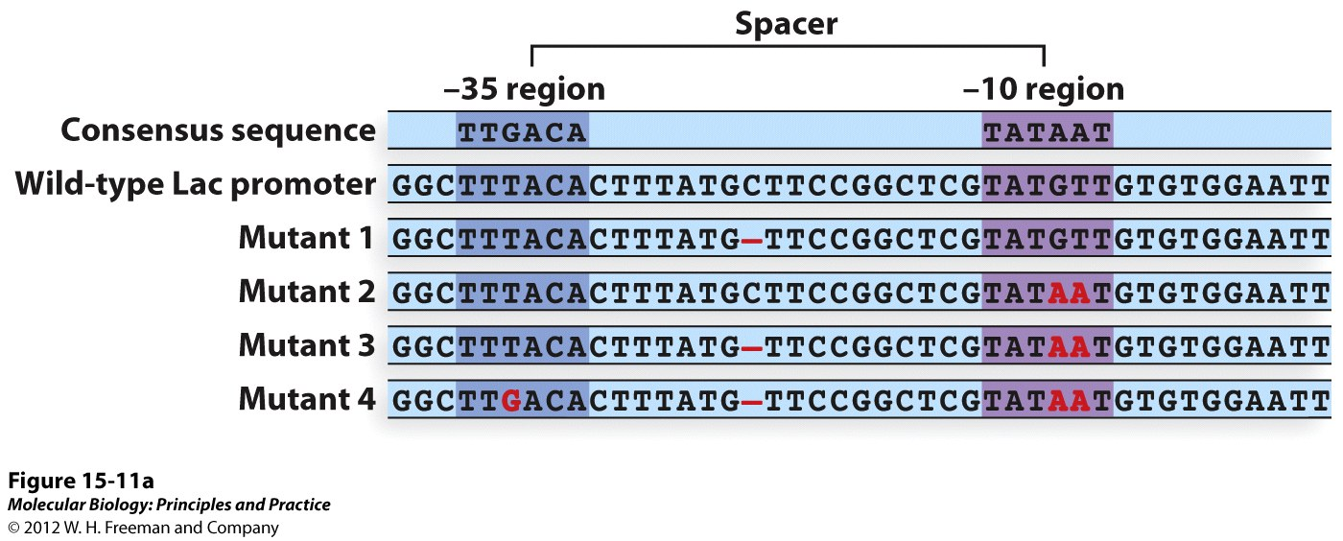
Transcription Initiation - promoters
Consensus sequence – important!

Slide 15
Transcription Initiation – Txn Factors
RNA polymerase has intrinsic affinities for different promoters
But additional proteins (txn factors) can increase/decrease this affinity

Slide 16
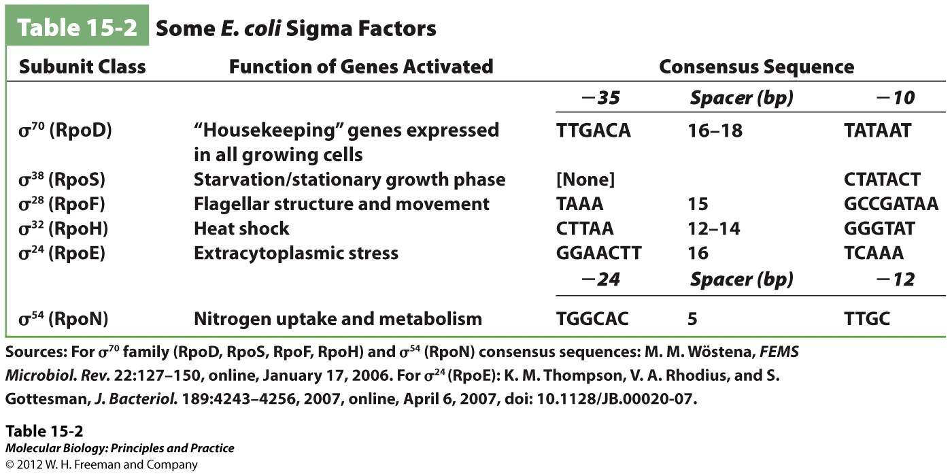
Bacterial RNA polymerase uses “sigma factors” to distinguish different classes of promoters.

Slide 17
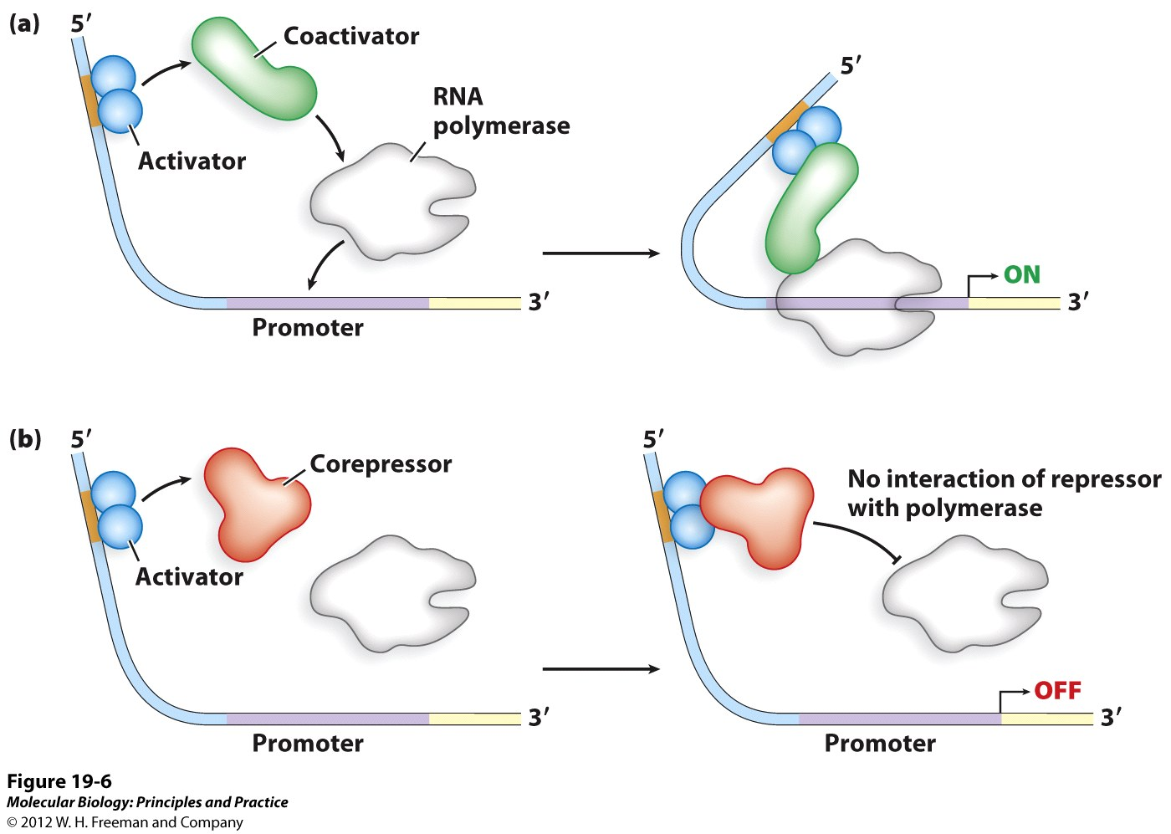
Transcription Initiation – Txn Factors
Txn factors can be activators or repressors

Slide 18
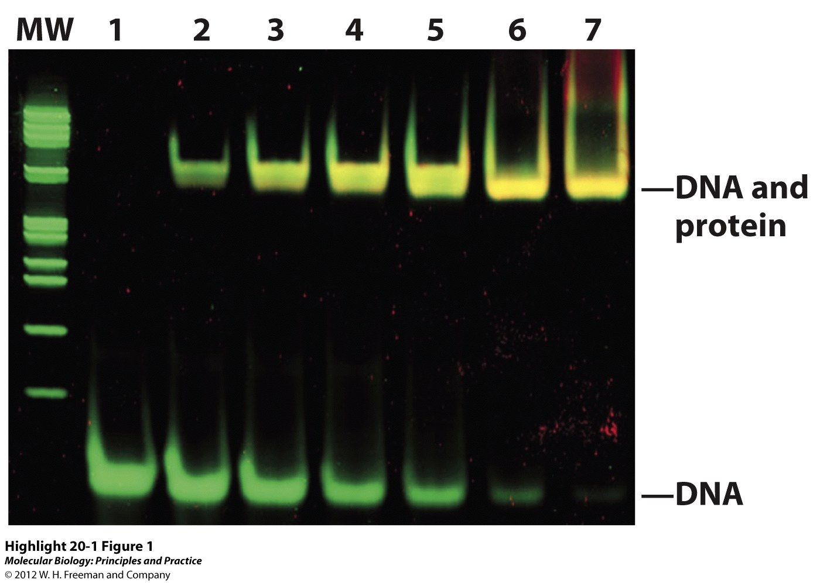
Transcription Initiation – Txn factors
How to identify transcription factors?
One characteristic – does the protein bind to a regulatory region of the DNA?
ElectrophoreticMobility
Shift
Assay – (EMSA) How does it work?

Slide 19
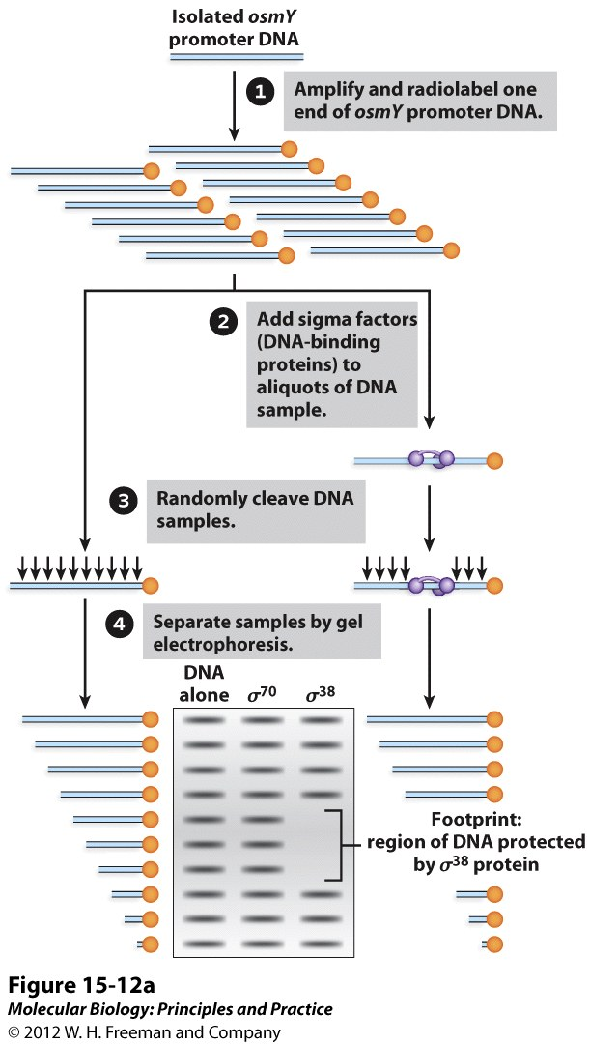
Transcription Initiation – Txn factors
IDing Txn factors
DNA footprinting - How does it work?
Which σ factor (txn factor) binds to the osmY promoter?
Neither
σ³⁸
σ⁷⁰
Both

Slide 20
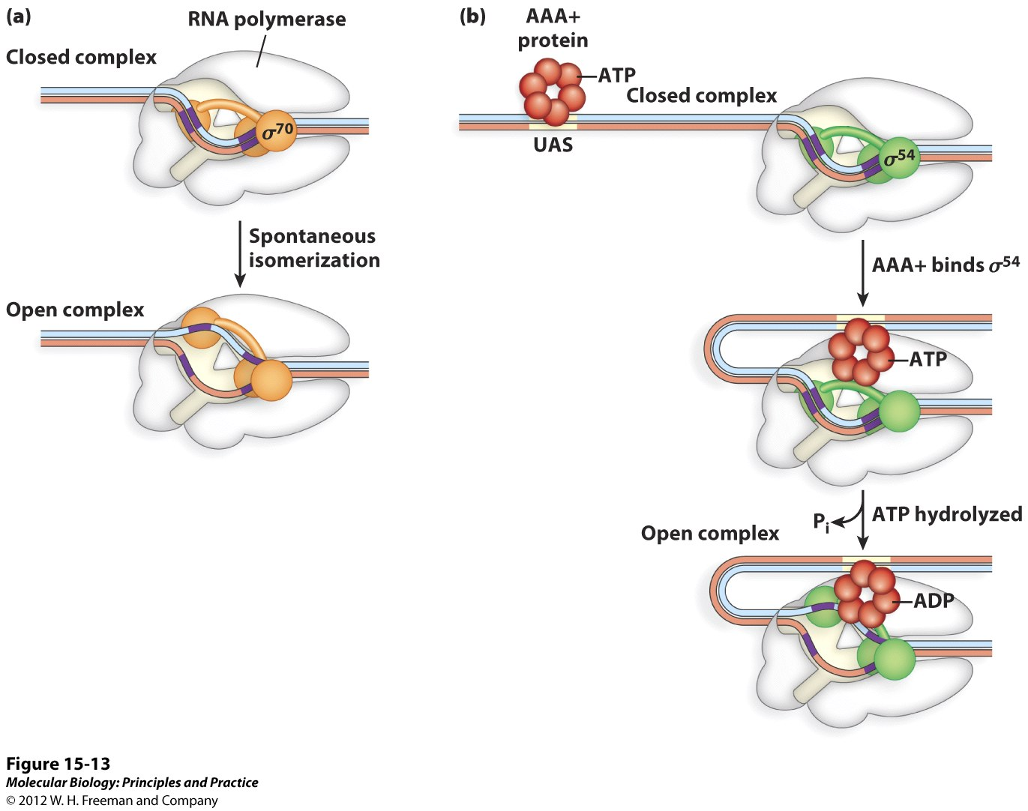
Sigma factors induce the formation of the open complex by 2 different mechanisms.
All sigma factors except sigma54 directly induce complex opening.
Sigma54 requires the help of a AAA-ATPase.

Slide 21
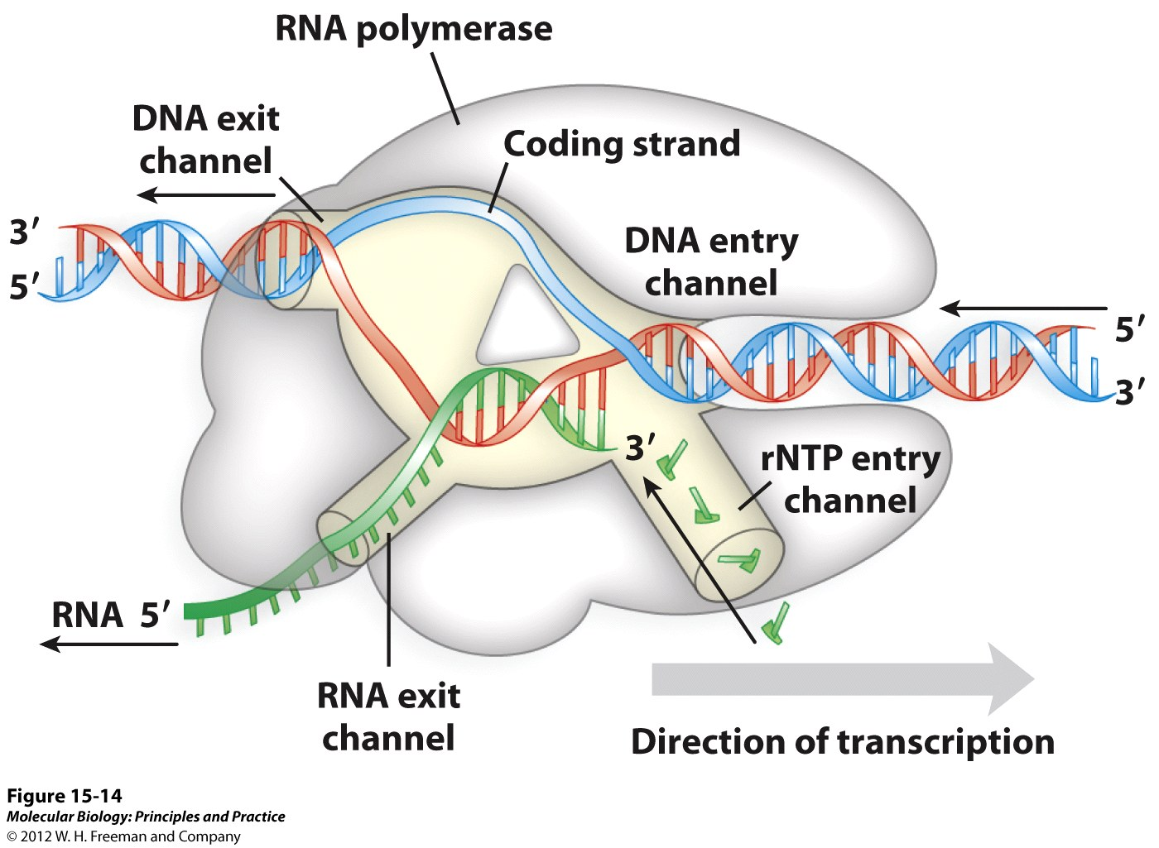
4 distinct channels allow the entry and exit of the template, precursor nucleotide triphosphates and the transcript product.

Slide 22
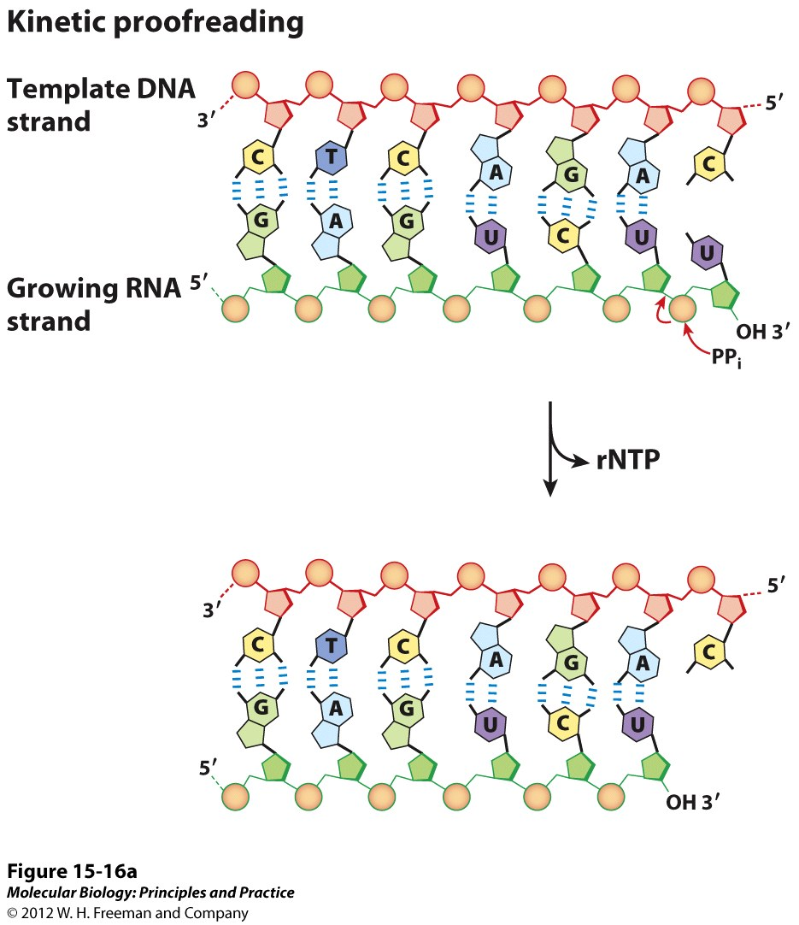
2 Types of proofreading by RNA polymerase.
In kinetic proof reading, RNA polymerase stalls after a mismatched base is incorporated. This allows time for pyrophosphorolysis to remove the incorrect base.

Slide 23
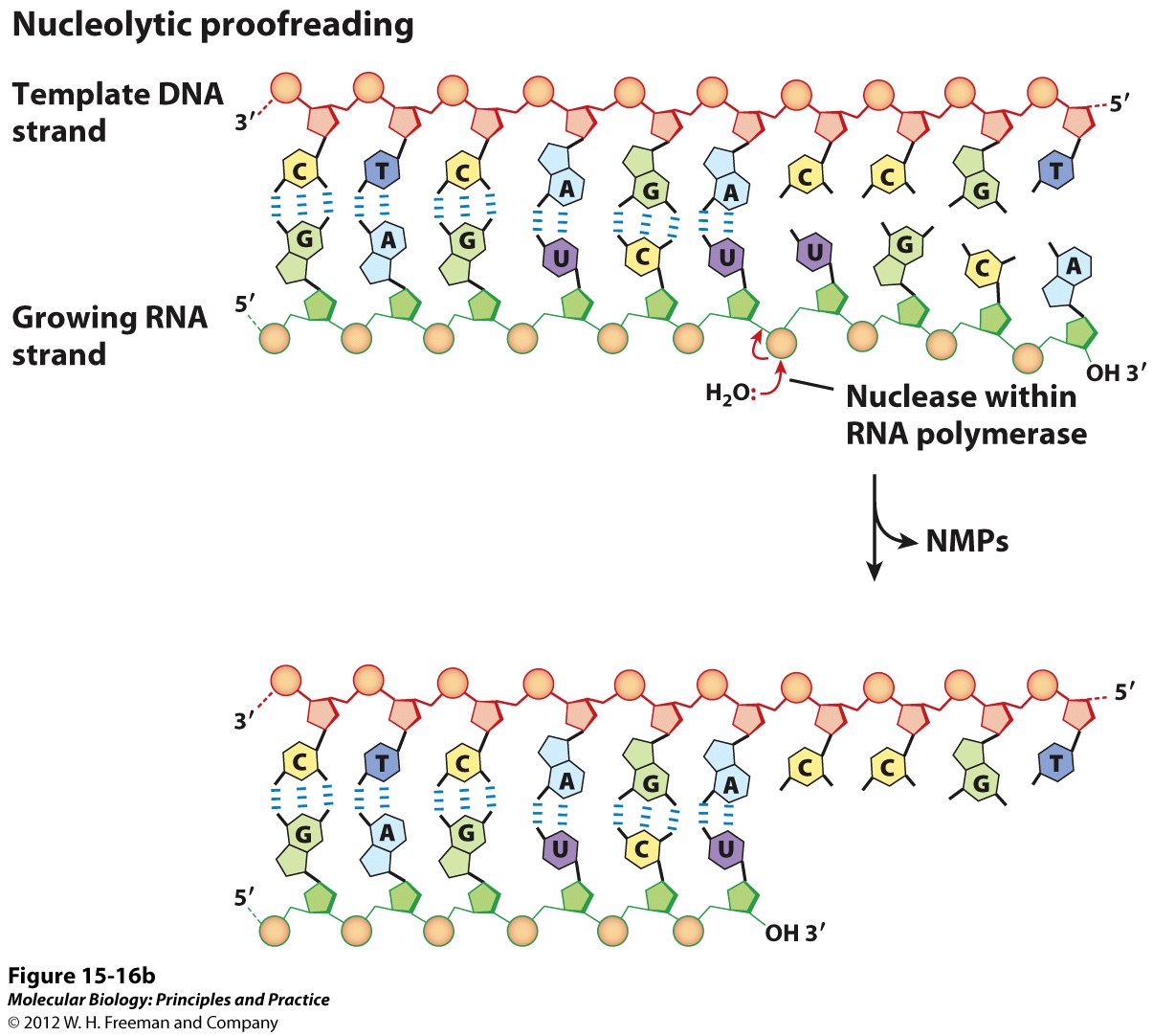
2 Types of proofreading by RNA polymerase.
Nucleolytic proof reading occurs when kinetic proof reading has failed and additional nucleotides are added after the incorrect base. In this case, the polymerase back tracks to remove the nucleotides up to and including the incorrect one and then resumes transcription.

Slide 24
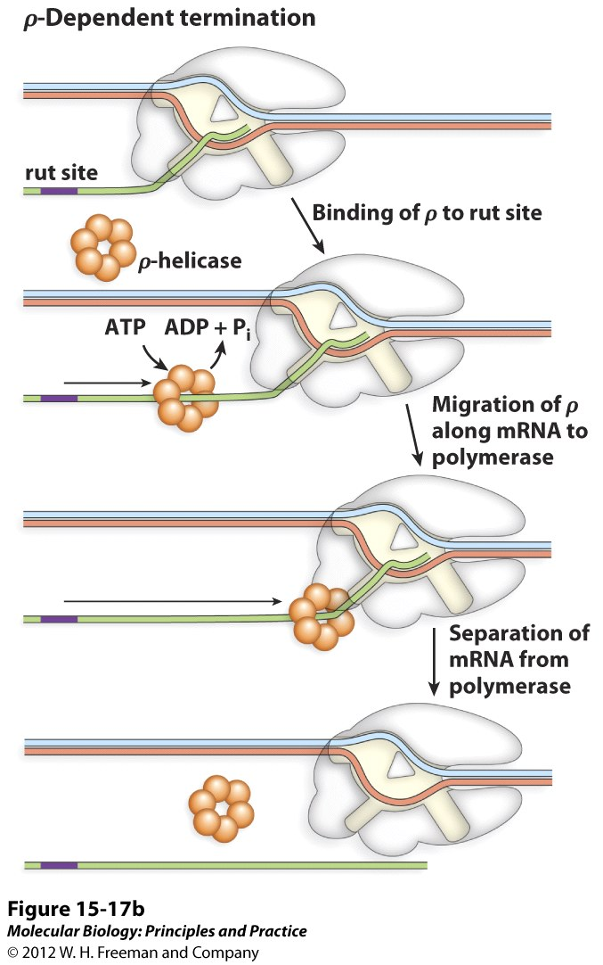
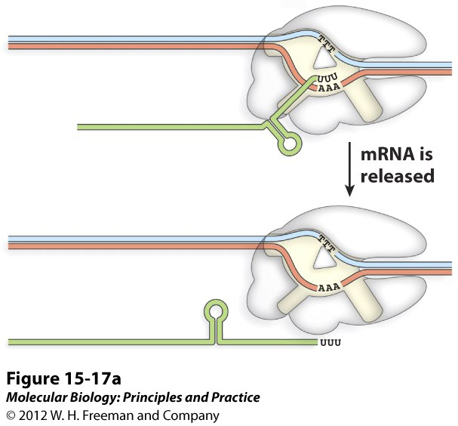
Transcription Termination
Sequence dependent

