Slide 1
Lecture 12 – Cis-Trans Gene Regulation and Eukaryotic Transcription
Prokaryotic Transcription Regulation.
Lac Operon and Cis-Trans Gene Regulation.
Eukaryotic versus Prokaryotic Transcription
Eukaryotic Transcription Factors.

Slide 2
Learning Goals
Be able to list the differences between operon and non-operon gene expression
Be able to explain cis and trans gene regulation in the context of merodiploids
Be able to distinguish which aspects of the transcription process are unique or shared between eukaryotes and prokaryotes
Be able to explain how transcription factors bind to DNA in terms of DNA/protein structure

Slide 3
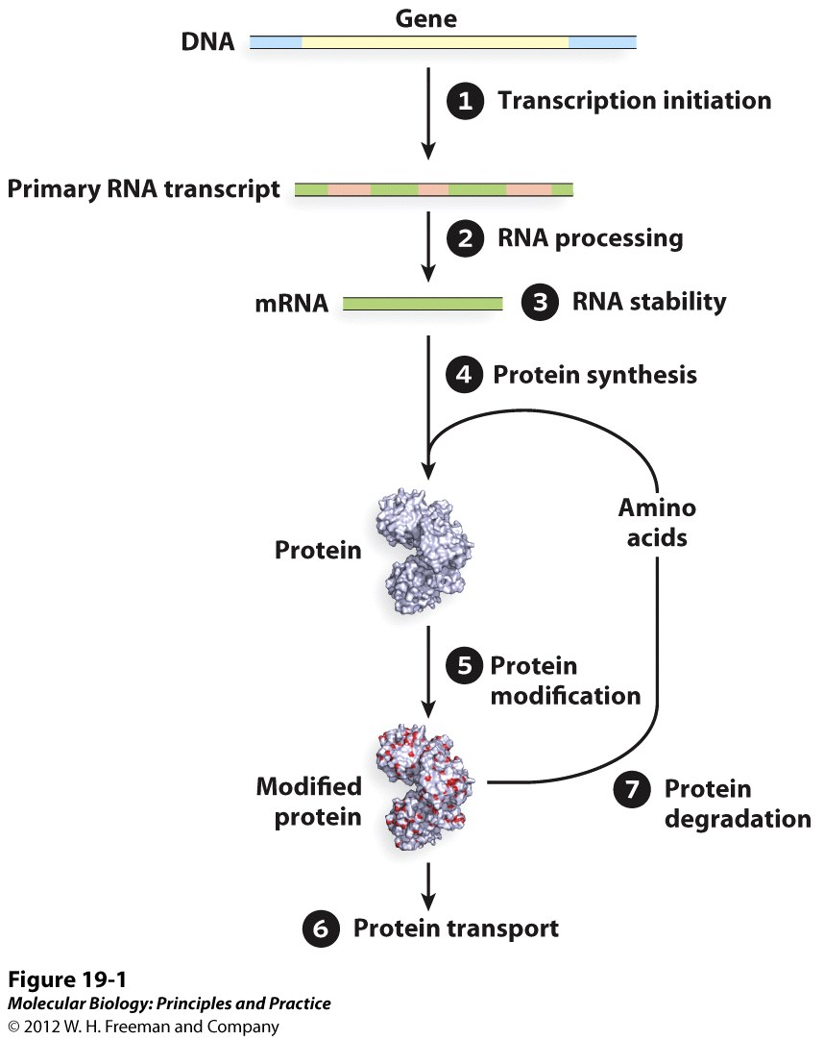
Regulation of Gene Expression.

Slide 4
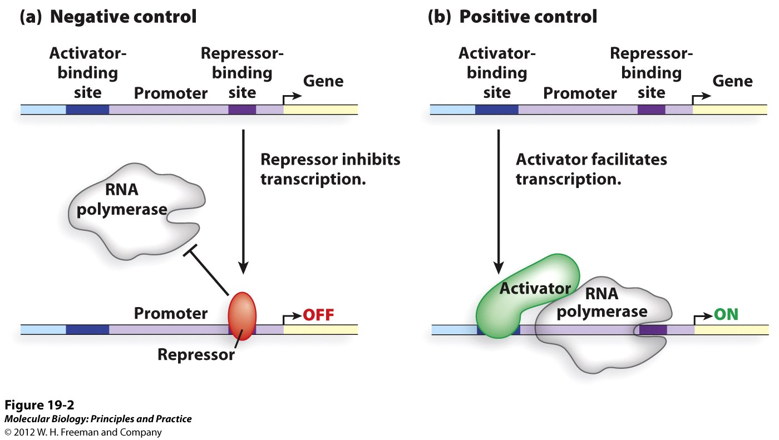
Negative and Positive Regulation

Slide 5
Prokaryotic Transcription Regulation
Adv of operons
Only requires initiation at 1 promoter
Genes w/ similar function regulated similarly
Disadv of operons
Promoter mutation could eliminate txn at all genes
Less flexibility w/ gene expression for operon genes

Slide 6
Lac operon
Galactoside Permease
Lac repressor
β-galactosidase
Operator – LacR binding site
Thiogalactoside transacetylase

Slide 7
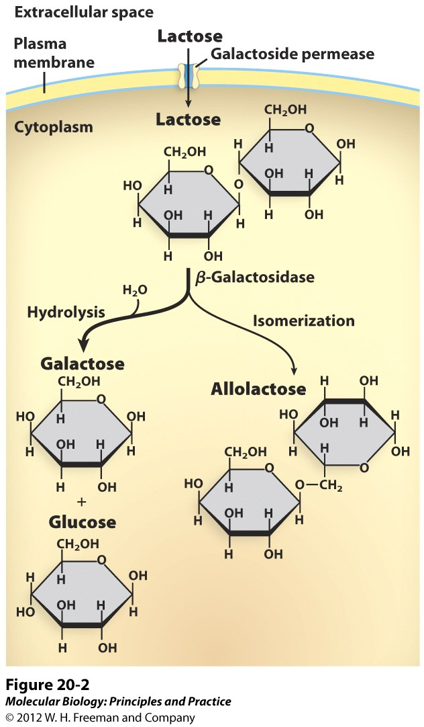
Lac operon

Slide 8
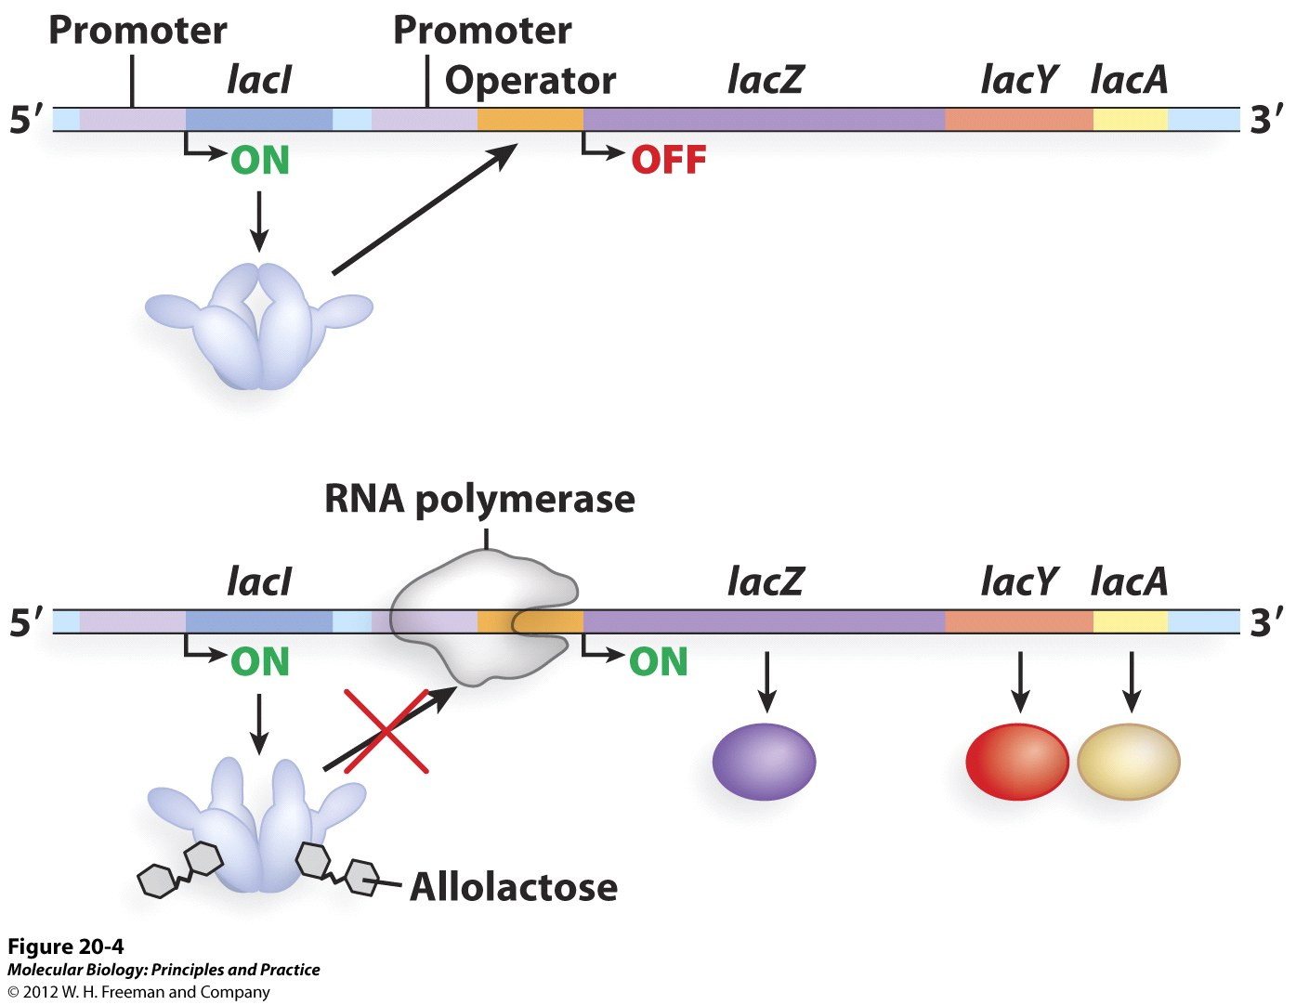
Lac operon

Slide 9
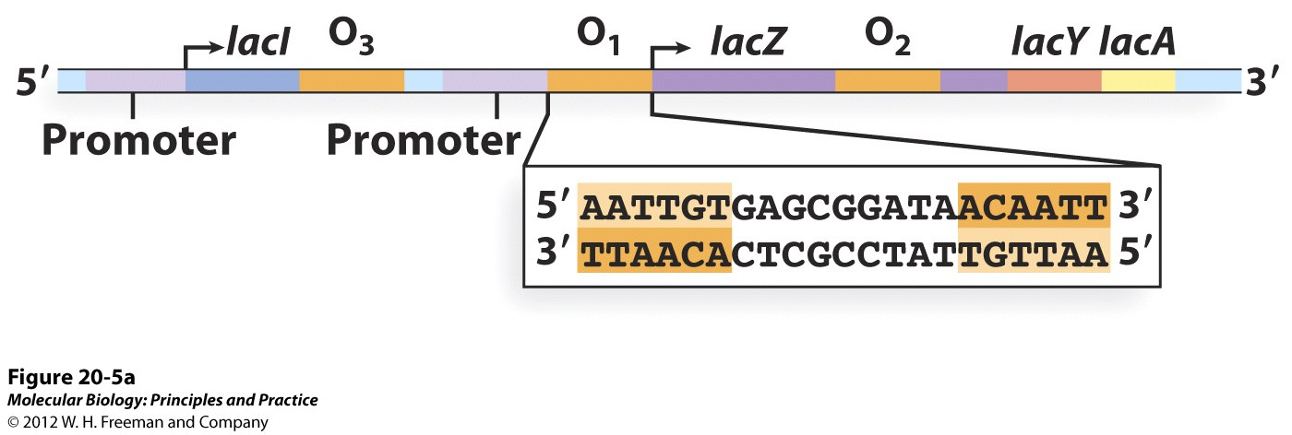
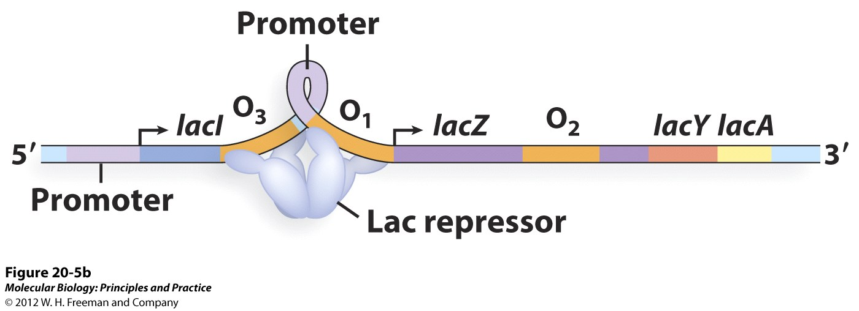
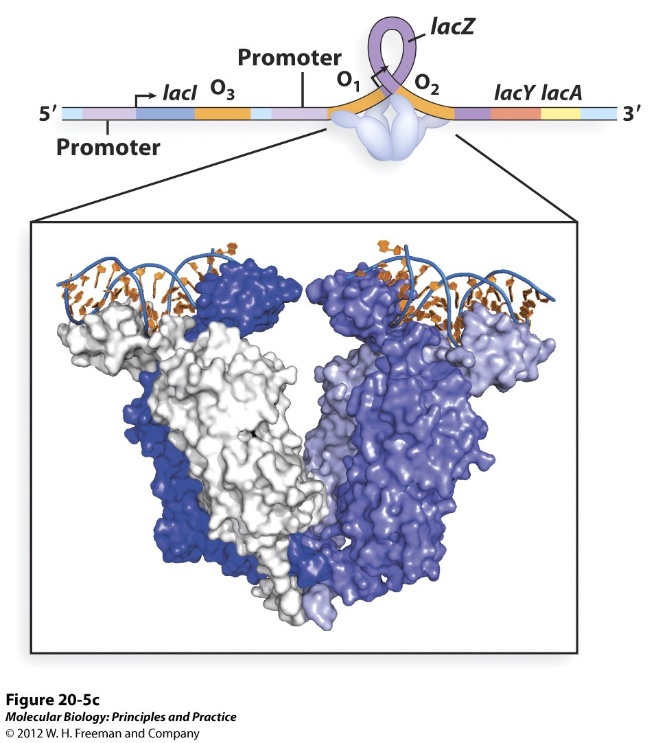
Lac operon
How does the lac repressor repress transcription?

Slide 10
Cis vs. Trans Gene Regulation
Cis acting elements – Sequences on the same strand of DNA adjacent to protein coding genes.
Trans acting factors – Diffusible factors that bind to cis sequences. Typically protein transcription factors.

Slide 11
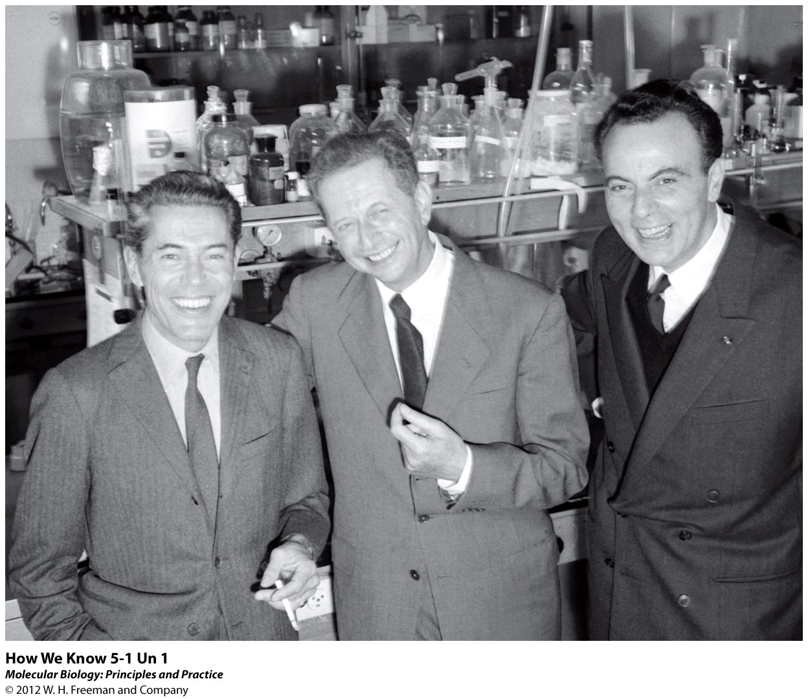
Cis vs. Trans Gene Regulation
Merodiploid analysis
Jacques Monod
Francois Jacob
Normally - haploid
Lac Operon
Lac Operon
Merodiploid
(partial diploid)
Lac Operon

Slide 12
Cis vs. Trans Gene Regulation
Mutations in either the Lac repressor or operator make transcription of lacZ, Y and A constitutive (always on).

Slide 13
Cis vs. Trans Gene Regulation
Combining the LacI mutant with wt causes the expression of LacZ, Y and A to be turned off on both the mutant and wt chromosome.

Slide 14
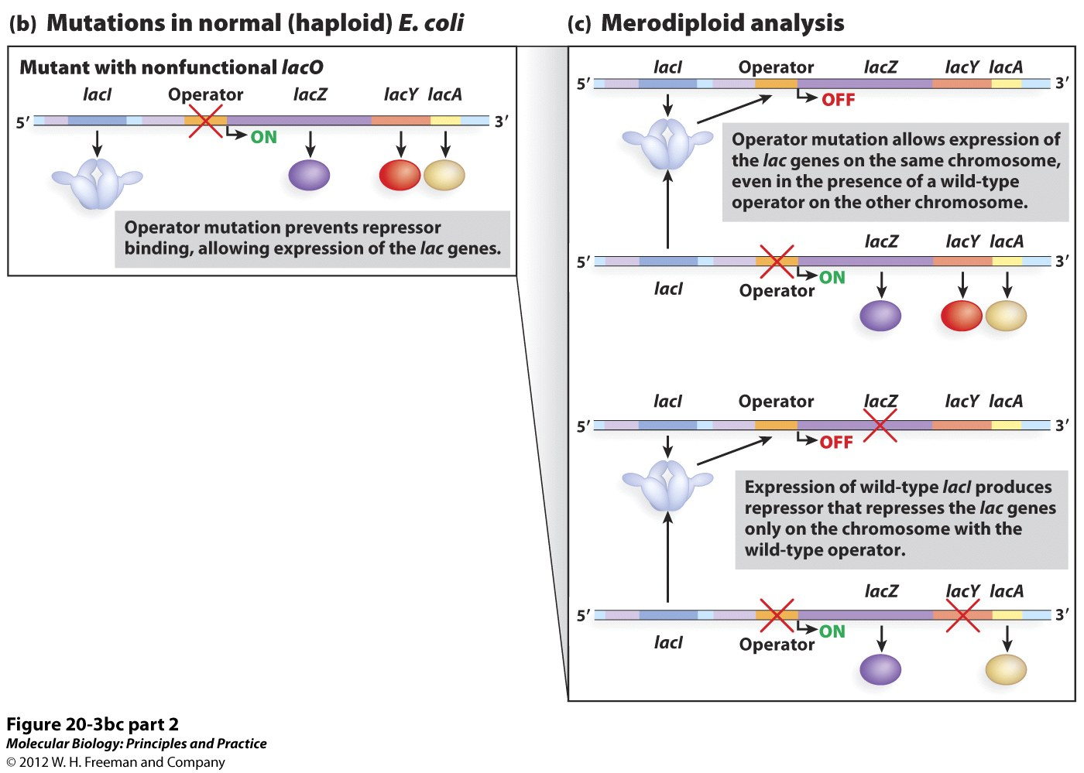
Cis vs. Trans Gene Regulation
Combining a lac operator mutant with wt results in constitutive expression of Lac genes, but only those on the same DNA strand as the operator mutation.

Slide 15
Cis vs. Trans Gene Regulation
Merodiploid analysis
Wild type
lacI mutant
In this merodiploid grown in lactose free media, we will observe:
No lac operon expression
Expression of the genes only on the wild type lac operon
Expression of the genes only on the mutant lac operon
Expression of the genes on both lac operons

Slide 16
Cis vs. Trans Gene Regulation
Merodiploid analysis
lacZ mutant
Operator, lacY mutant
In this merodiploid grown in lactose free media, we will observe:
No lac operon expression
Expression of lacY and lacA only
Expression of lacZ and lacA only
Expression of all genes of the lac operon

Slide 17
Cis vs. Trans Gene Regulation
The lac repressor is an example of a:
Cis- acting element
Trans-acting element
The operator is an example of a:
Cis-acting element
Trans-acting element

Slide 18
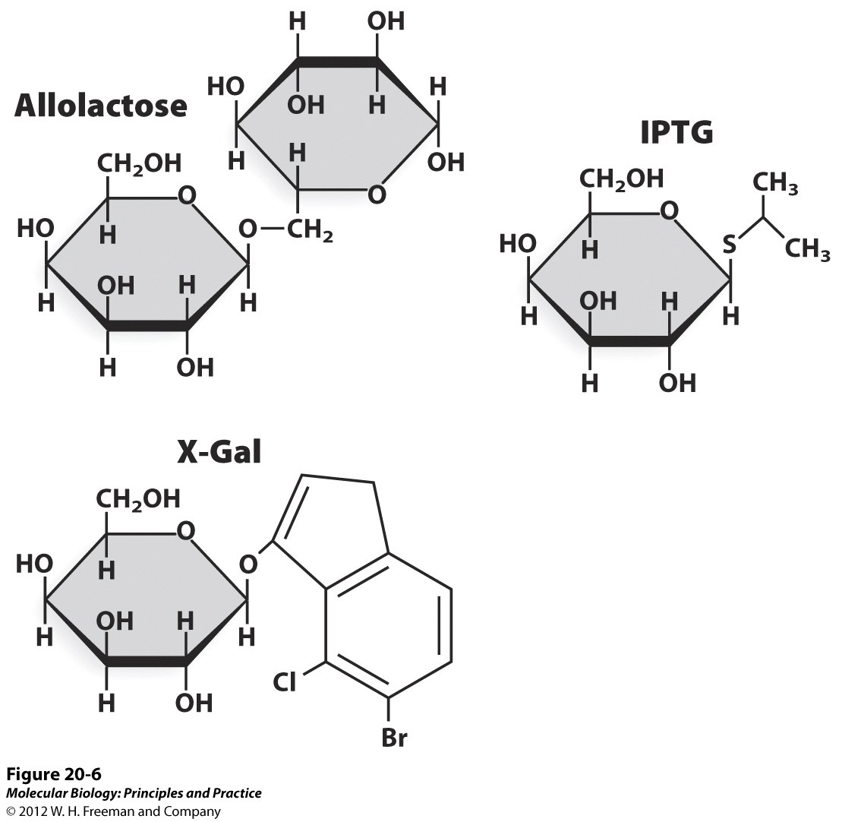
Beta Galactosidase can be used as a “reporter gene”.
X-Gal turns a blue color when it is cleaved by ß galactosidase into X (which is blue) and Gal.

Slide 19
Differences between Prokaryotic and Eukaryotic Transcription
Prokaryotic
Eukaryotic
Genes organized in operons
One gene, one promoter
One RNA polymerase
3 RNA polymerases
Cis sequences generally near txn start site
Cis sequences often far from txn start site
One type of general txn factor (σ factor)
Multiple general txn factors
DNA not associated with protein
DNA packaged as chromatin

Slide 20
Eukaryotes have 3 different RNA polymerases

Slide 21
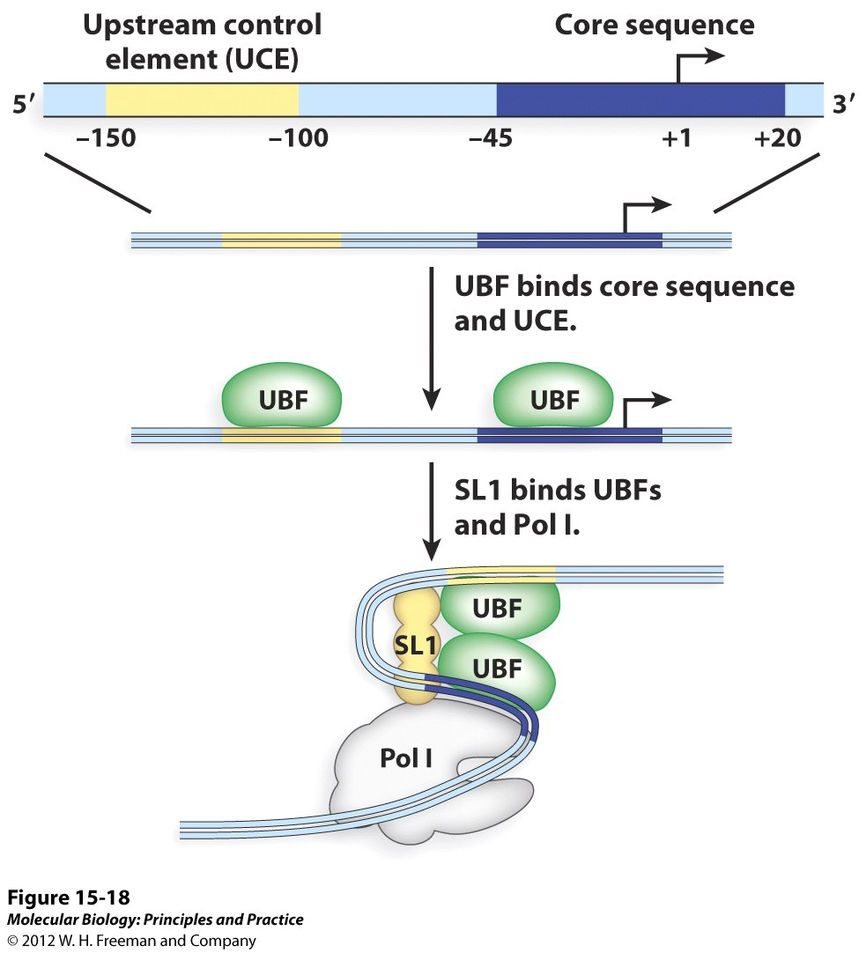
Pol I binds an unique promoter
UBF:
Upstream
Binding
Factor
SL1
Selectivity
Factor 1

Slide 22
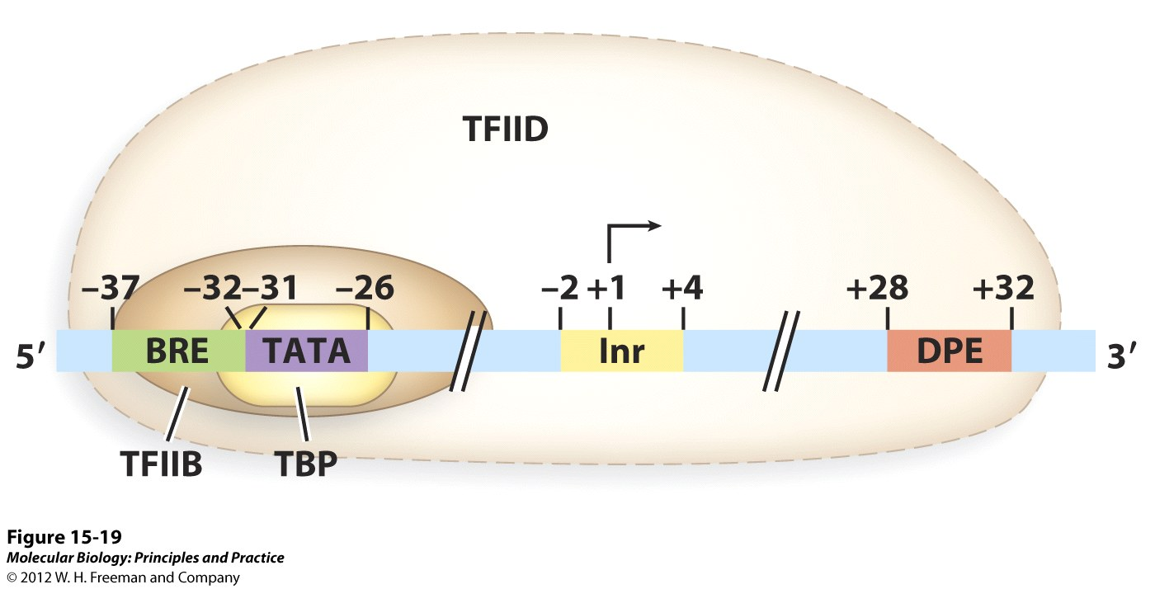
The Pol II promoter
TBP:
TATA
Binding
Protein
BRE:
TFIIB
Response
Element
Inr:
Initiator
Sequence
DPE:
Downstream
Promotor
Element

Slide 23
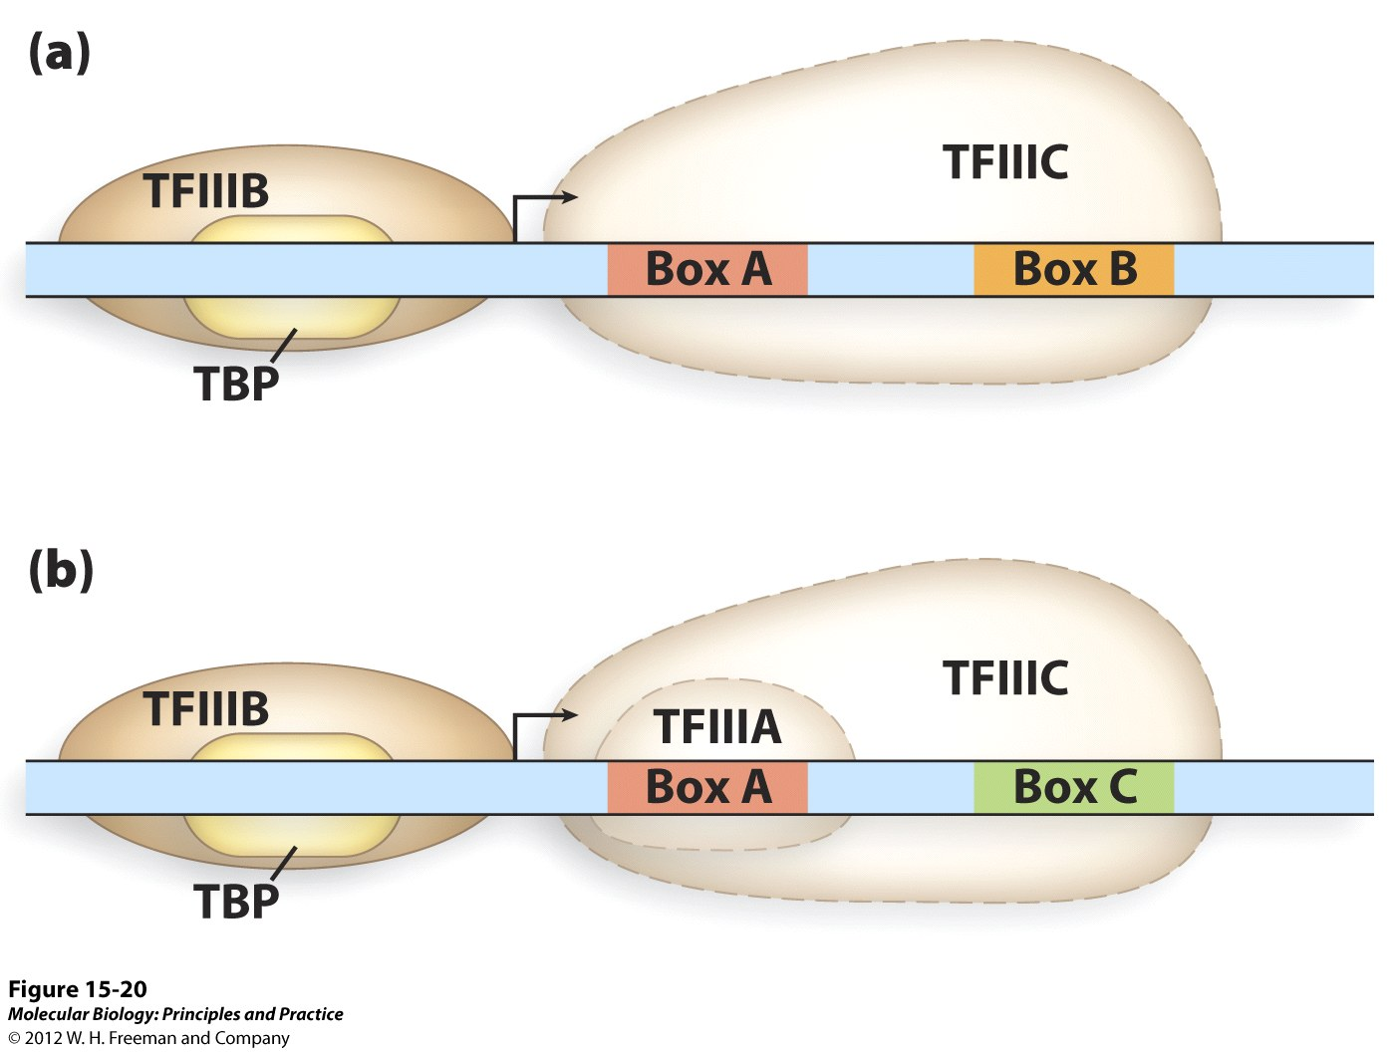
The Pol III promoter

Slide 24
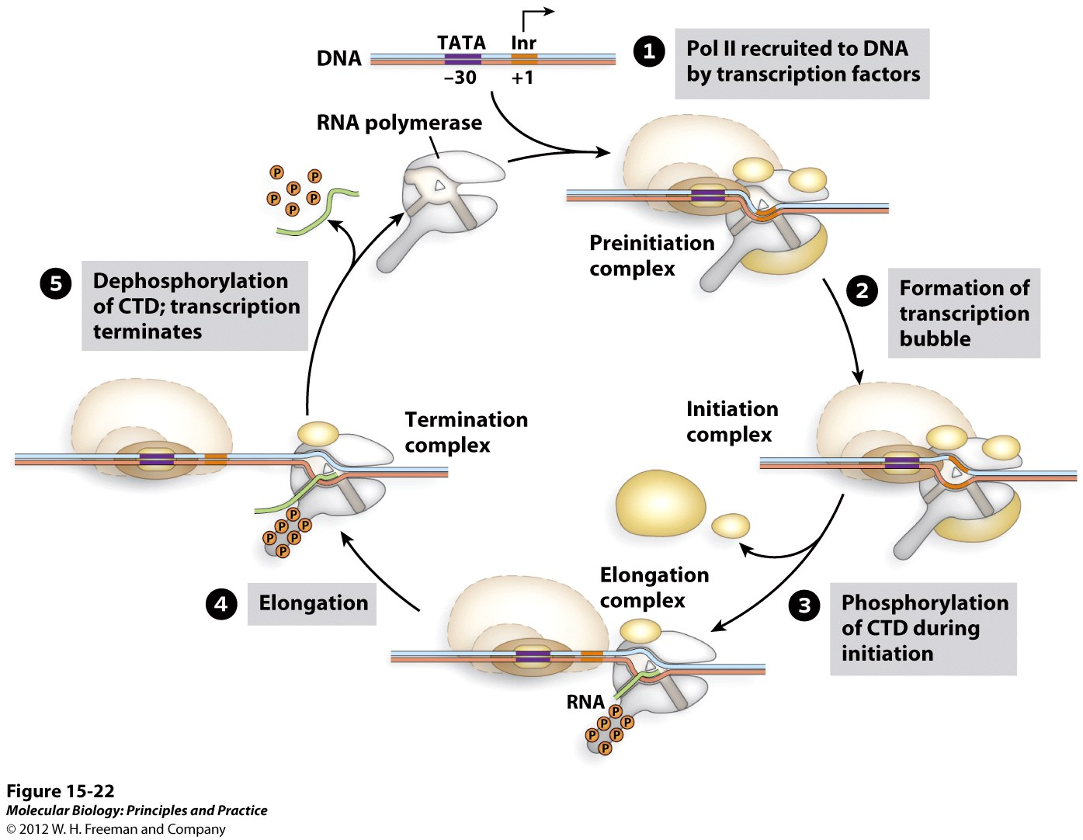
Eukaryotic Transcription

Slide 25
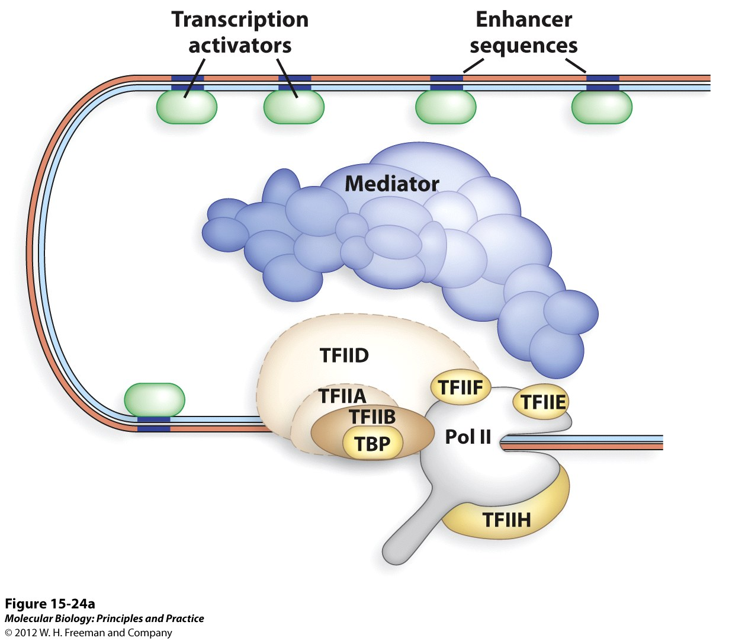
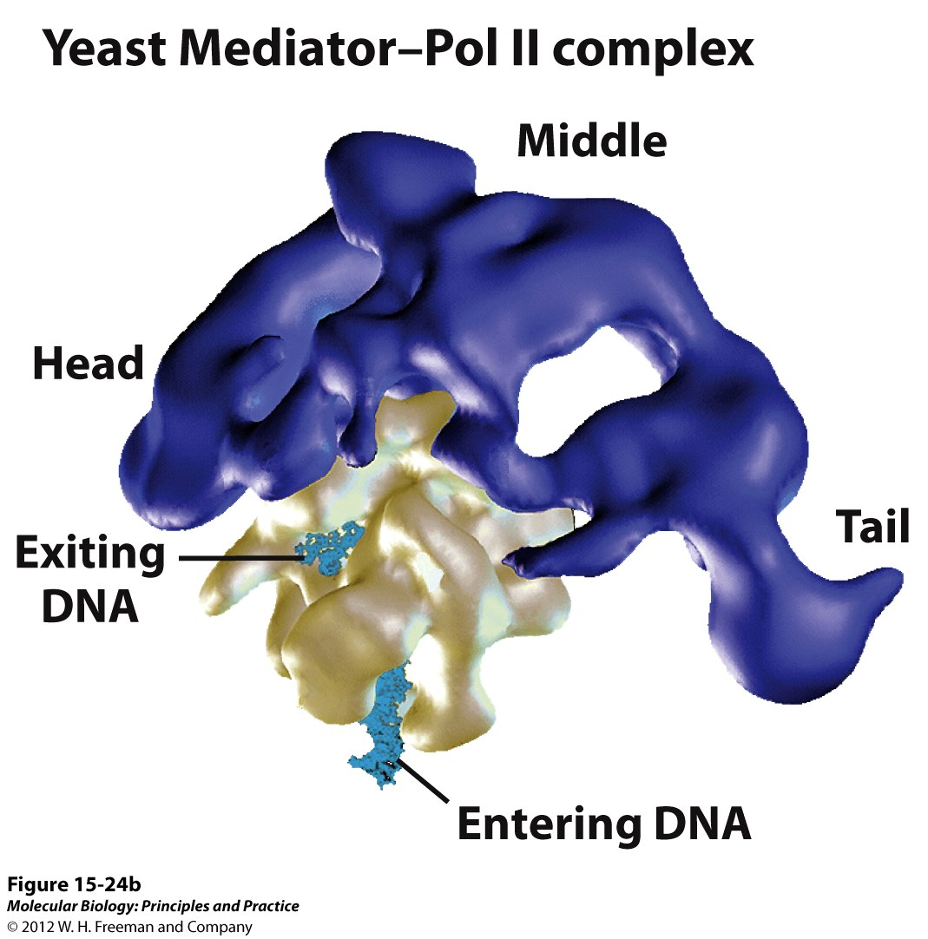
Eukaryotic Transcription Initiation
Interaction between txn factors, RNA pol and cis sequences

