Slide 1
Lecture 16 –Complementation, gene mapping and the effect of mutations on proteins
Complementation.
II. Genetic mapping by recombination to localize the site of a mutation.
III. Biochemical basis of mutation.
IV. Effect of mutations on protein structure and function.

Slide 2
Learning Goals
Be able to analyze the results of a complementation test and determine how many different genes are represented in the set of mutant strains.
Be able to diagram an experiment to determine where in the metabolic pathway the mutation blocks function.
Understand the biochemical basis of mutation, the type of mutagens that cause them and their effect on the protein product encoded by a gene.
Understand how the examination of frame shift mutations led to the elucidation of how the genetic code is read in non-overlapping triplets from a fixed starting point.

Slide 3
Complementation
Beadle and Tatum used “complementation” tests to demonstrate that more than one gene might be involved in producing an observable trait. (Biosynthesis)
Complementation answers two questions:
1. Do mutations in two independently isolated colonies or strains with the same phenotype occur in the same gene or do they occur in different genes?
2. How many genes are involved in a biosynthetic pathway?
The two independent mutant strains are halploid. Only 1 copy of each gene.
To do the complementation test, you make a diploid from the two mutant strains. One genome from each strain.

Slide 4
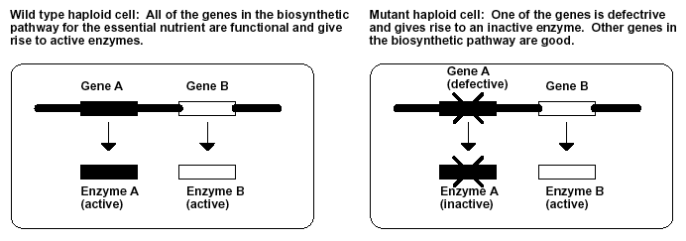
Producing mutants strains…
These will grow on minimal media
(e.g. prototrophic).
These will grow on rich media, but will not grow on replica plate that lacks the nutrient that cannot be synthesized (e.g. auxotrophic).

Slide 5
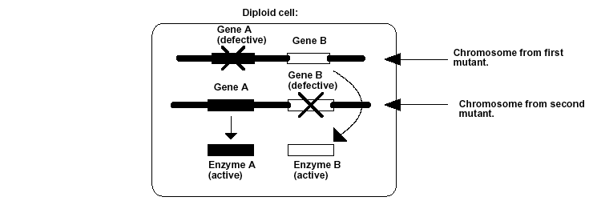
Diploid complementation…
“Good” copy of gene is present on other chromosome, so protein produced from this gene can complement in “trans.” If two single mutants are mated, we can determine if the same gene is mutated in both by looking for complementation.
This is the functional equivalent of “merodiploid” formation in bacteria. In fungi and yeast, mating produces diploids. If the mutations on the two chromosomes are in different genes, the diploid will grow in the absence of the nutrient.

Slide 6
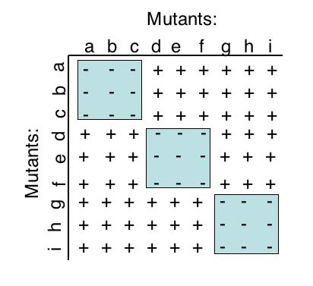
Complementation testing… an example
How do you read this?
Each “+” or “-” refers to growth of cells on minimal media.
In this test, we have nine mutants that were identified in haploid screens. Here, they are mated with each other (and themselves) to get diploid mold cells.
If a combination (e.g. a x b) cannot grow on minimal media, the mutants are in the same complementation group.
Complementation “groups”
In this example, there are three complementation groups, thus three genes!

Slide 7
What does complementation tell us?
One gene codes for one protein
The number of genes that need to operate in a pathway.
How do you know for certain you have all of the genes in a particular biosynthetic pathway?

Slide 8
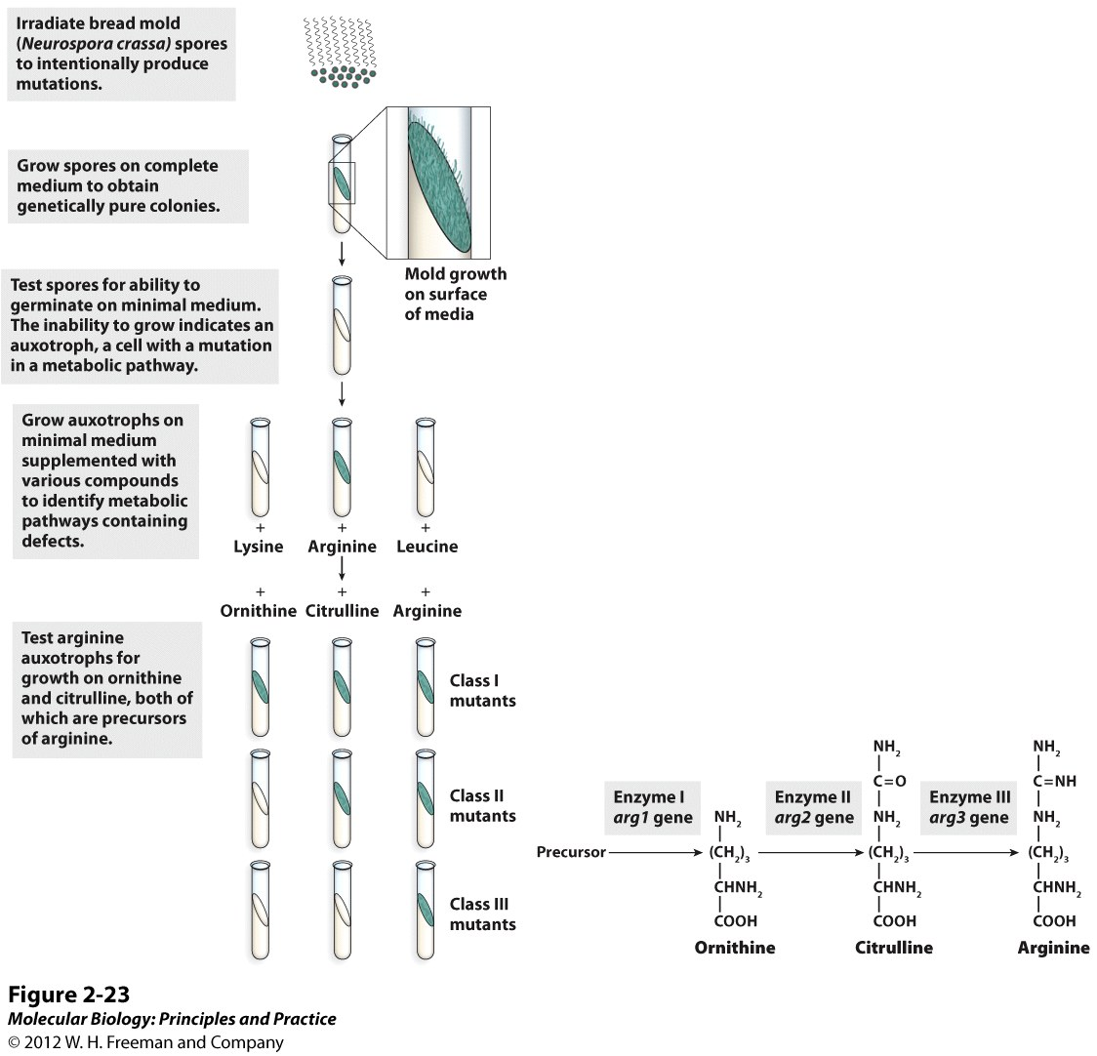
Each complementation group defines the set of mutant strains that contain the same defective enzyme in a pathway to make a required nutrient. The identity of the defective enzyme and the order of action of the enzymes in the pathway can be determined by addition of precursors and intermediate compounds in the pathway.

Slide 9
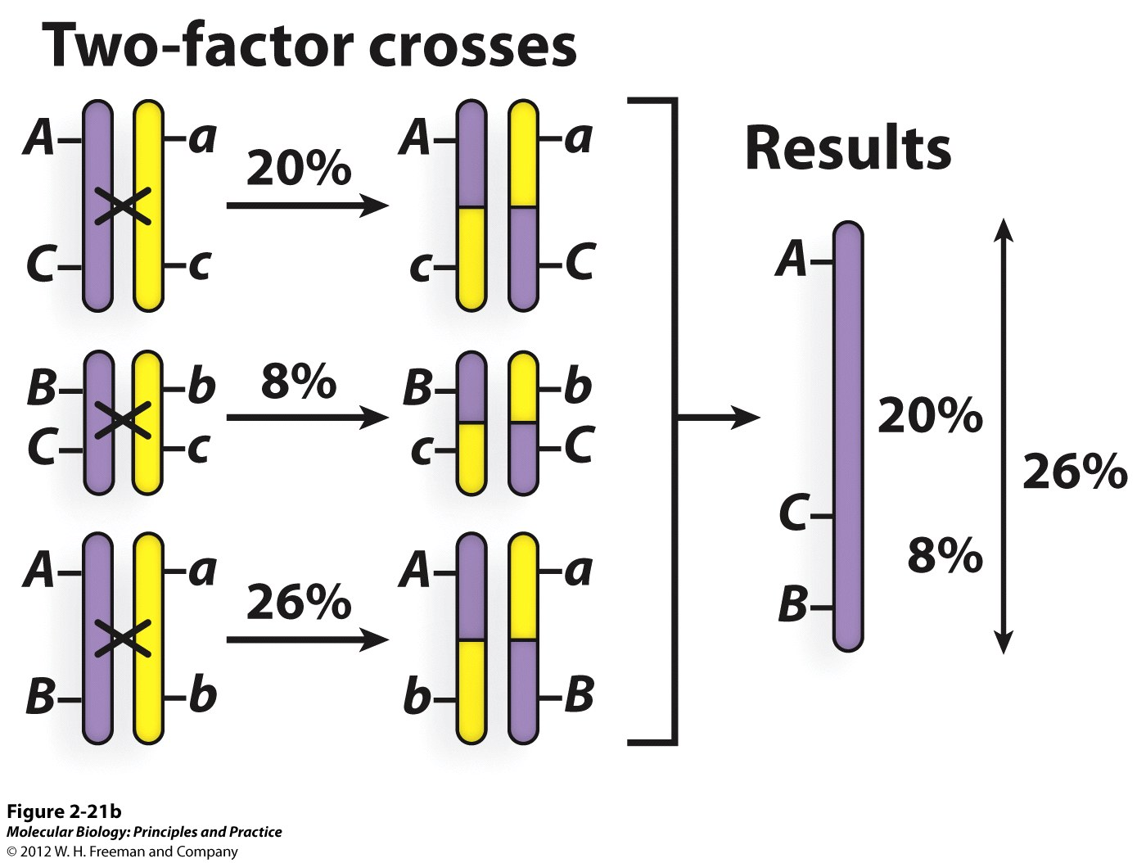
Recombination mapping can reveal the order and distances between genes on a chromosome.
Recombination frequency increases with increasing distance between genes.

Slide 10
Genetic mapping by recombination frequency
The farther away the two mutations are, the more likely that recombination will occur between them. The frequency of recombination is proportional to the distance between the two sites or loci. Most scientists were using recombination to map the entire genome. Seymour Benzer had a different idea: Use recombination to map a single gene.

Slide 11
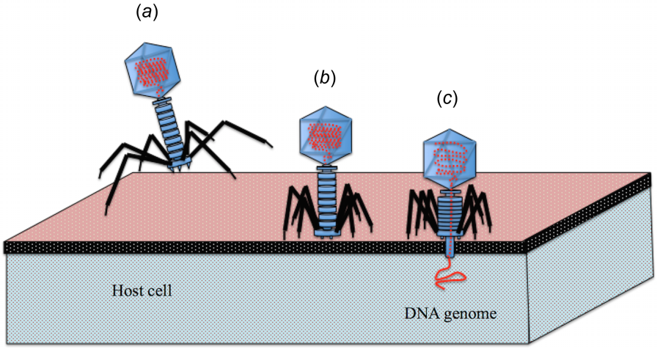
Seymour Benzer and T4 bacteriophage genetics
The advantage to using bacteriophage as a genetic organism is that you can screen for hundreds of mutations in a single gene and do rapid recombination analysis and detect very low recombination frequencies.

Slide 12
Seymour Benzer and T4 bacteriophage genetics
Benzer examined recombination frequency between two mutations in a single gene.
Summary of Benzer’s findings:
The lowest recombination frequency corresponded to a single base pair of DNA, so genetic analysis could be used to study changes as fine as a single base pair.
The map of a gene is linear. The recombination frequencies are additive.
Most mutations behave like points on a map.
Some mutations behave like a segment of the map is missing or deleted.
Benzer’s studies explained the biochemical basis of mutation and how the genetic code is read.

Slide 13
Biochemical basis of mutation
Single base substitutions: nitrous acid, etc. Can easily revert back to wildtype.
Silent - change in codon does not lead to change in peptide sequence, due to codon degeneracy.
Missense - change of single AA; some effect protein function more than others.
Nonsense - introduction of “Stop” codon, early chain termination.
Frameshift mutants: base intercalators (acridine), cause polymerase to insert or delete single nucleotide at random positions. Alters reading frame, leading to early termination. Reversions less frequent, usually by second frameshift nearby.
Deletion mutants: can behave like frameshifts if deletions of two or more bases occurs. Sometimes, large blocks of genetic material are missing.

Slide 14
Spontaneous reversion frequent.
Spontaneous reversion extremely rare.
Spontaneous reversion extremely rare, if at all.

Slide 15
Spontaneous reversion frequent.
Spontaneous reversion extremely rare.
Spontaneous reversion extremely rare, if at all.

Slide 16
Crick and Brenner: Reversion of T4 rII frameshift mutants
Used profalvin as a mutagen to cause frameshift mutations (1 bp deletions and insertions).
Results: Mutants fell into two groups based on whether they could give wild type phenotype recombinants (+ and -). If they tried to complement a + with another +, it would not work. But, if they crossed a + with a - type, the mutants would work. Why?
Interpretation: The two classes correspond to insertions or deletions of a single base.
Frameshift mutations have an extremely low reversion rate back to the wild type sequence

Slide 17
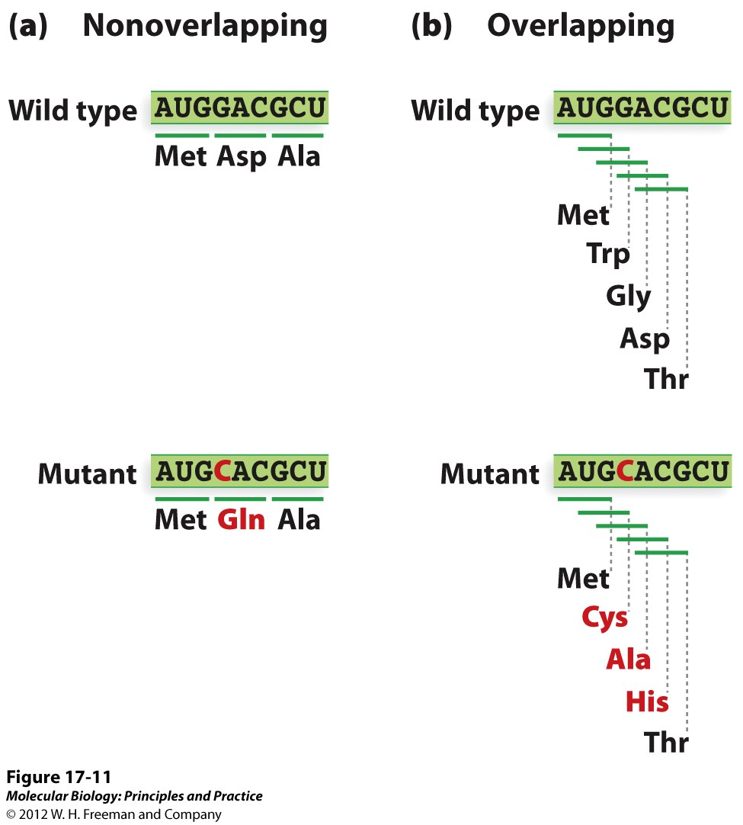
How is the code read? Crick and Brenner
The behavior of frameshift mutations showed that the genetic code is read in non-overlapping triplets from a fixed starting point, however there were other competing models that were ruled out.
Overlapping triplets. Hypothesizes a 1:1 ratio between nucleotides and amino acids, but also predicts that a single nucleotide substitution would change the identity of 3 amino acids because i t would alter 3 adjacent codons.
One nucleotide serves as a “comma” to indicate the reading frame and codon identity.

Slide 18
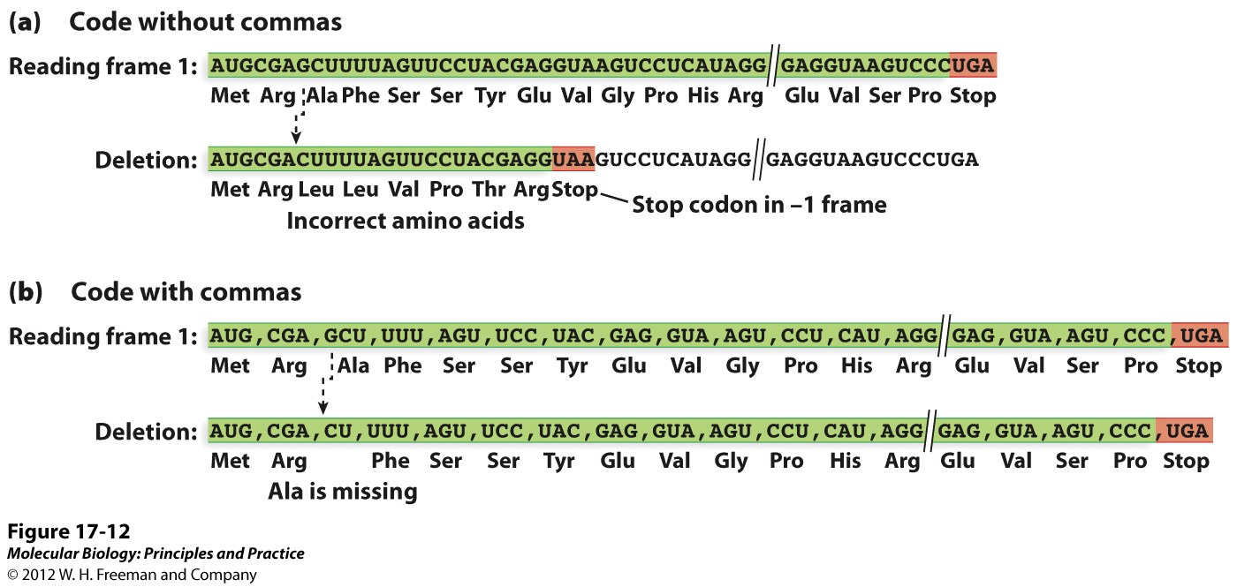
The effect of frameshift mutations reveals how the genetic code is read.
The code with commas predicts that a single deletion will delete a single amino acid, while the code without commas predicts that a single deletion will change the meaning of all of the codons after the point of mutation.

Slide 19
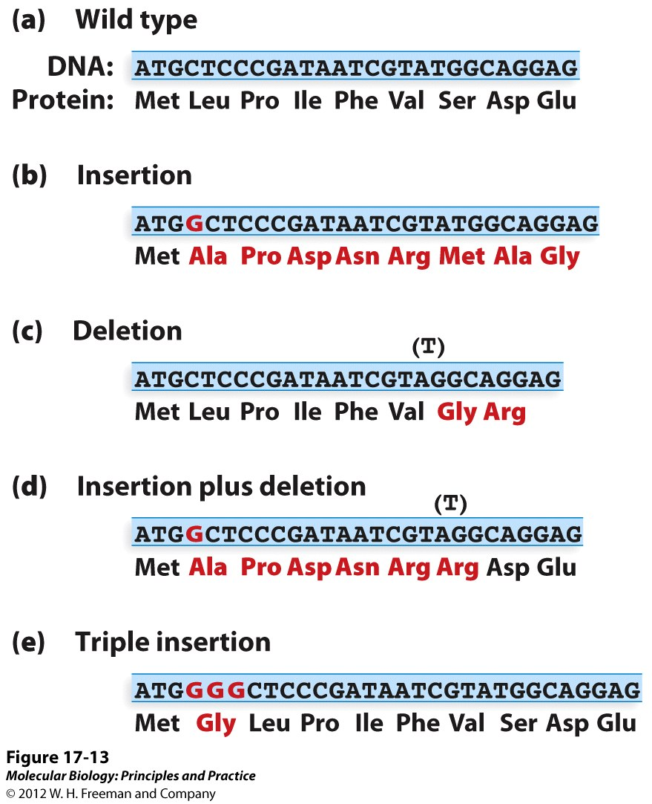
Is the code read in triplets?
Three insertions of 3 deletions within a short segment of DNA restores the reading frame. This tells us that:
There is no punctuation of the code
The codons are 3 bp long

Slide 20
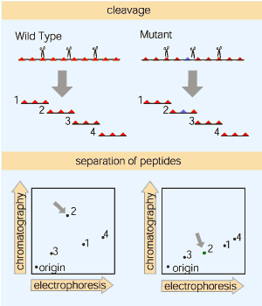
Colinearity between DNA and protein sequence…
Linear relationship between “codons” (DNA) and AAs (proteins).
Charles Yanofsky: Used peptide fingerprinting to establish colinearity of trpA gene and TrpA protein in E. coli
Peptide “finger-printing” (Vernon Ingram)

Slide 21
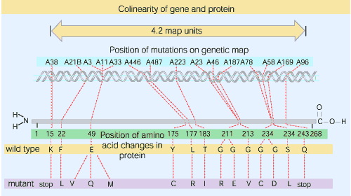
Co-linearity of the E.coli trpA gene and TrpA protein
Yanofsky’s map of the E. coli trpA gene and gene-product.
Experimental approach: developed fine structure map of trp A gene using phage “pairwise transduction crosses” of missense mutants. Then, did peptide fingerprinting of resulting mutant proteins to establish location of mutation.
Outcome: the farther apart two mutations were in map units, the more amino acids there were in protein. Subsequently sequenced the entire protein and demonstrated colinearity existed across all of the sequence.

