Slide 1
Lecture 17: The genetic code and codon-anticodon base pairing.
Learning Objectives:
Be able to describe the different approaches to breaking the code and their advantages and disadvantages.
Understand how the identity of start and stop codons was discovered.
Be able to describe the “wobble rules” for codon – anticodon base pairing and which wobble base pairs must be used in particular codons.
Be able to calculate the minimum number of tRNAs necessary to support protein synthesis.

Slide 2
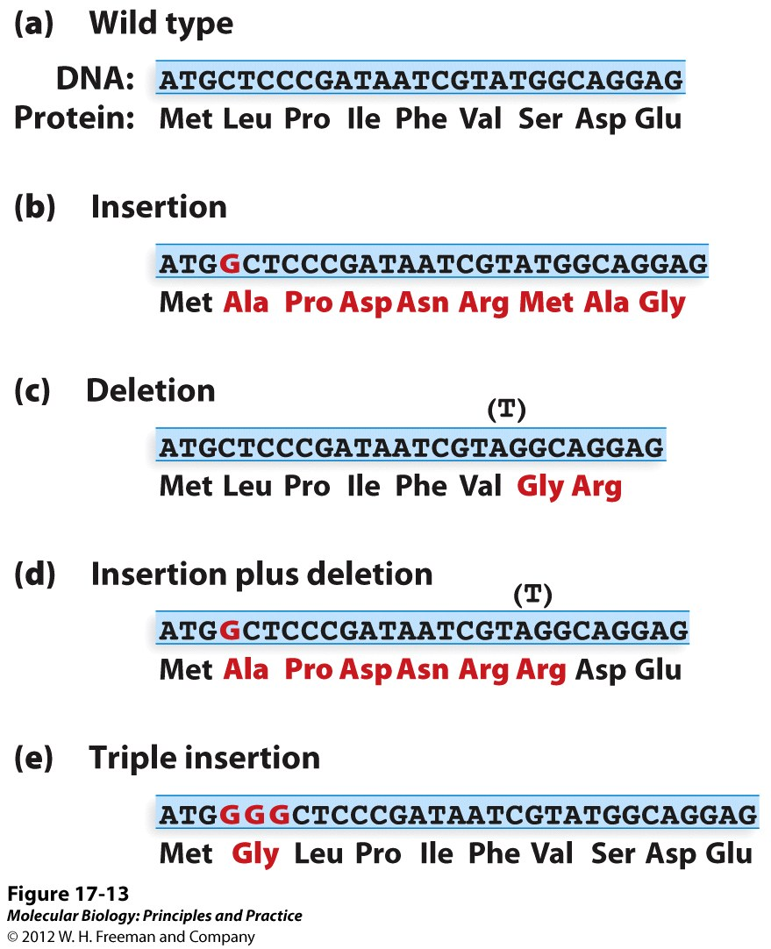
Is the code read in triplets?
For a single insertion or deletion, the sequence is changed from the point of the mutation and eventually runs into a stop codon.
For an insertion plus deletion (or insertion plus deletion), the sequence is altered at the point of the first mutation and restored to wt sequence by the second mutation.
Three insertions of 3 deletions within a short segment of DNA restores the reading frame. This tells us that:
There is no punctuation of the code
The codons are 3 bp long

Slide 3
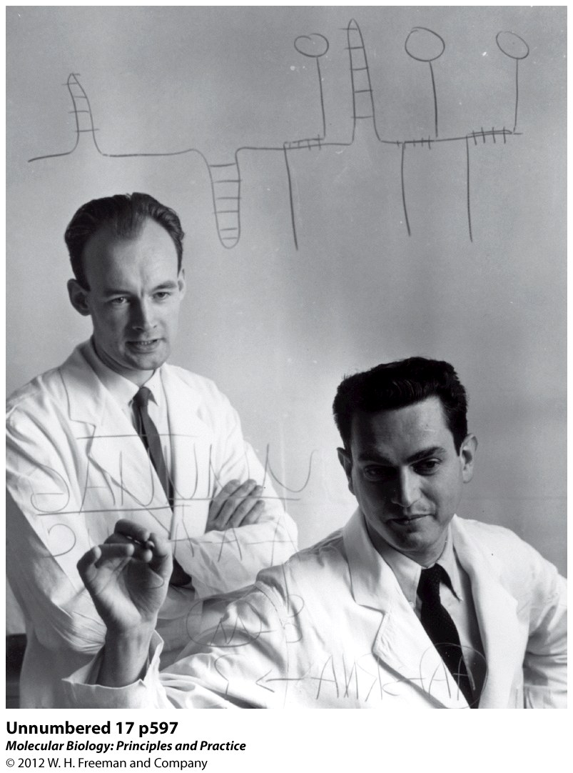
Breaking the code
Marshall Nirenberg (Nobel Prize, 1968) (right) and Heinrich Matthei (left) developed a “cell free” system for synthesizing protein in response to an added synthetic mRNA molecule.
Break open bacterial cells. This allows the externally synthesized mRNA access to the ribosomes and other machinery that translates mRNA into protein.
Destroy DNA with DNAse. This prevents the synthesis of endogenous mRNA so that there is no protein synthesis unless exogenous mRNA is added.
Add synthetic mRNA and a radioactive amino acid (1 AA for each of 20 tubes).

Slide 4
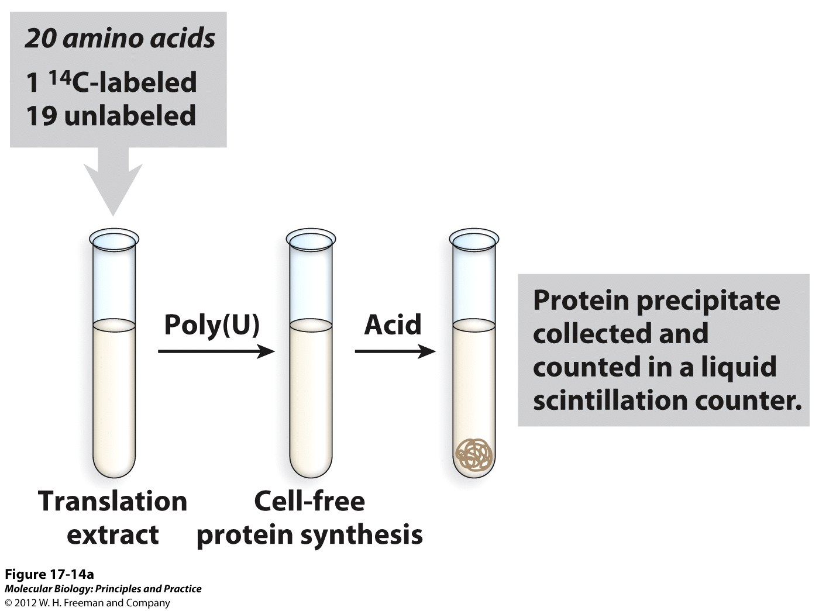
Breaking the code
The reason why 20 different radioactive amino acids are used each in a separate tube along with the synthetic mRNA is that it allows the researcher rapidly determine which of the AAs have been polymerized into protein. The polymerized AAs are precipitated by TCA under conditions where the free amino acid remains soluble.
(Trichloro acetic acid)
Radioactive amino acids that have been incorporated into a protein polymer are precipitated by TCA. Unincorporated amino acids remain soluble.

Slide 5
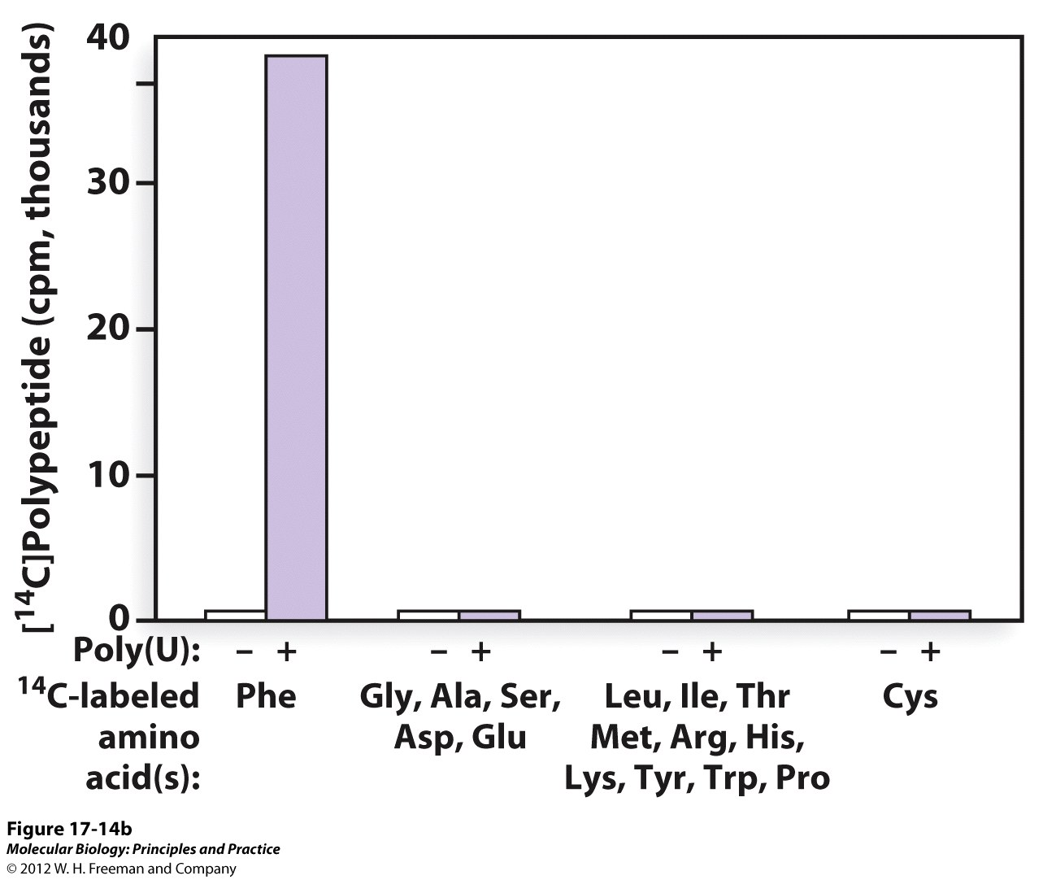
Breaking the code

Slide 6
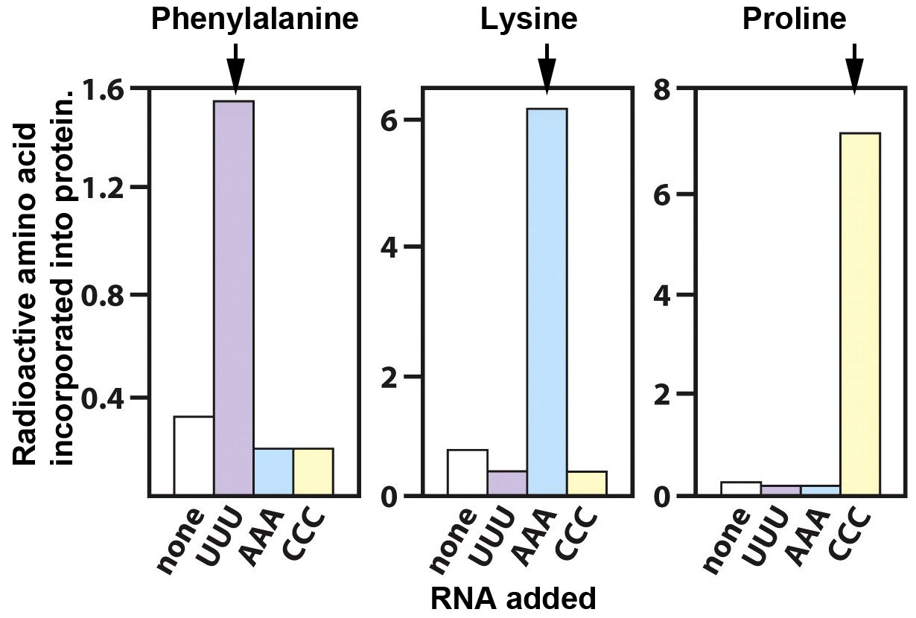
Breaking the code
Poly G didn’t work. It forms a triple helix that is not translated.

Slide 7
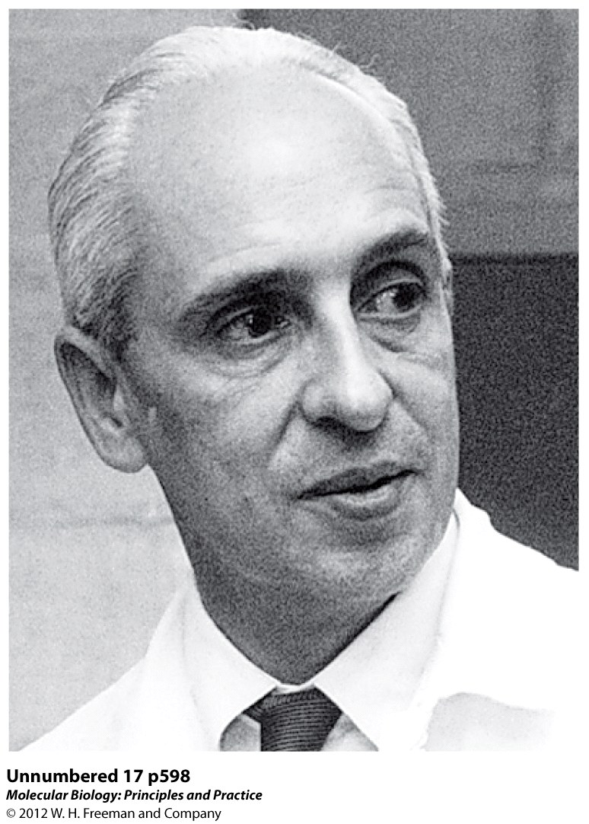
Breaking the code
Severo Ochoa won the Nobel Prize in 1959 for the discovery of polynucleotide phosphorylase, an enzyme that can make RNA polymer from nucleotide diphosphates.
RNA + Pi NDP
They originally thought that this enzyme was RNA polymerase, but this was a mistake and the enzyme made RNA of random sequences in a template independent fashion.
This is how the poly U, poly A, poly C and poly G was made for the first series of experiments on breaking the code.

Slide 8
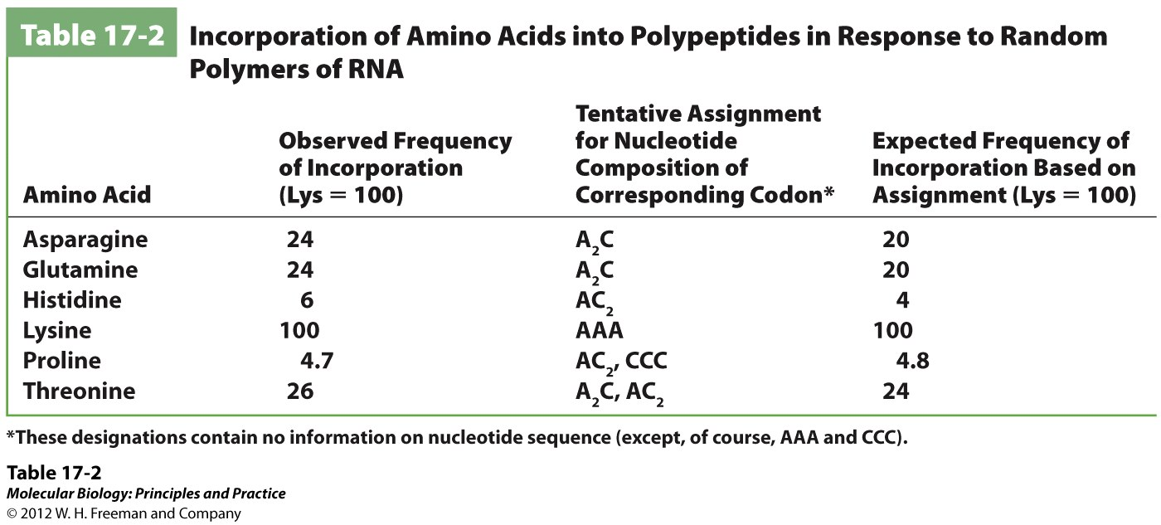
Breaking the code
In order to decypher more codons, Ochoa made random copolymers of two nucleotides at a ratio of 5:1. The results of translating these random copolymers gives the codon composition for each amino acid incorporated, but NOT the sequence.
Knowing the codon composition helps, but we need some way of knowing the sequence.

Slide 9
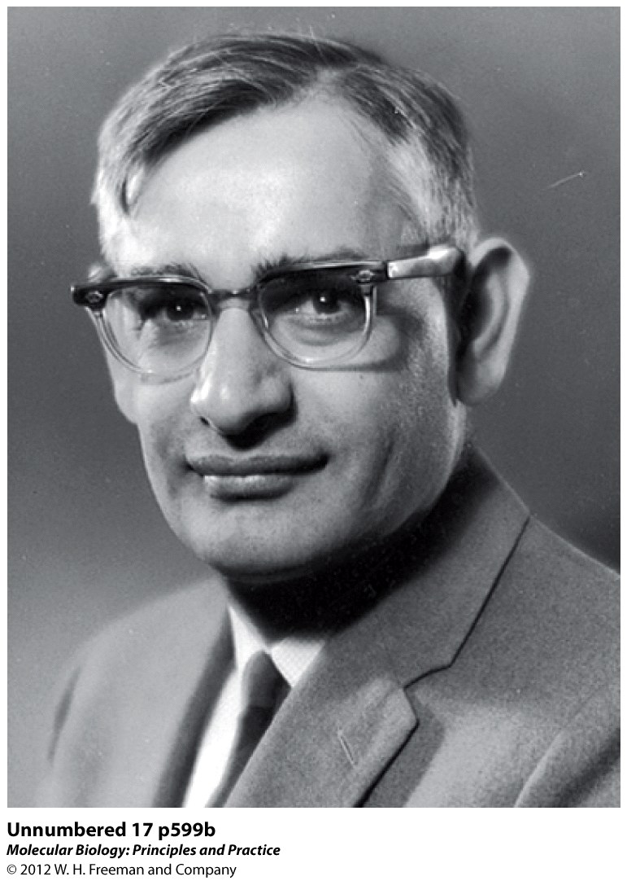
Breaking the code
What about more complex codons with two or more different nucleotides with a known sequence instead of random?
Har Gobind Khorana (Nobel Prize, 1968), chemically synthesized di, tri and tetra nucleotides and then polymerized them into long synthetic mRNAs
Repeating dinucleotide (AC)_{n} ACACACACAC
Repeating Trinucleotide (AAC) _{n} AACAACAACAAC
Repeating tetranucleotide (AGUA) _{n} AGUAAGUAAGUAAGUA

Slide 10
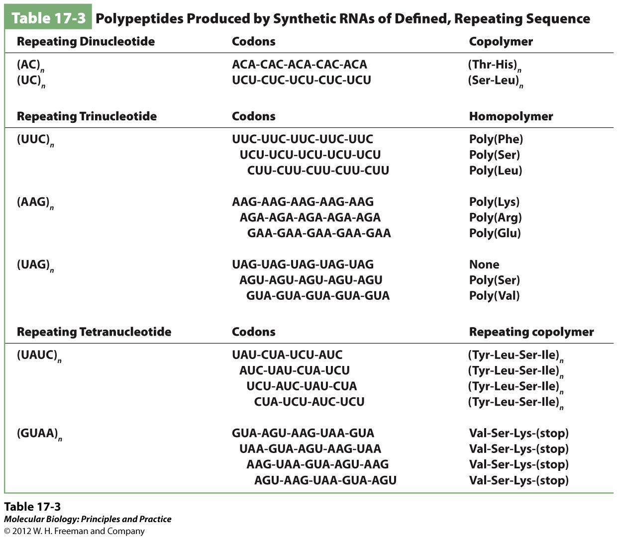

Slide 11
Limitations on the interpretation of results
Example: Repeating dinucleotides (AC)n
But, you don’t know which codon = specific AA because it could be:
Example: Repeating trinucleotides (AAC)n
Note: homopolymers are made.
Again, You don’t know which possible codon corresponded to which AA. But note that Thr is obtained with both AC and AAC polymers:
Only one codon is in common between the repeating dinucleotide and trinucleotide, so ACA is the codon for Thr and therefore that CAC codes for His.

Slide 12
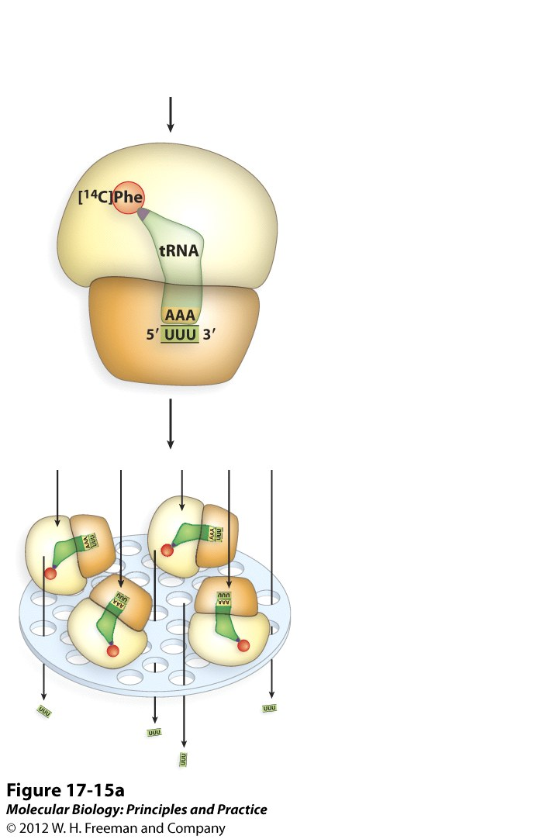
The filter binding assay… completing the code
Nirenberg and Leder pushed along the pace of elucidating the code using a different approach: Filter binding assay.
They synthesized tri-nucleotides. Incubated ribosomes with 20 different radioactive aminoacyl-tRNAs and the trinucleotide. If the codon in trinucleotide corresponds to specific “anti-codon” of tRNA, both will stick to ribosome. The ribosome is big, so if reaction mix is forced thru filter, it and anything bound to it will stick; all others flow through. This removed the ambiguity because with a trinucleotide only a single codon is possible.
1968 Nobel Prize => Khorana and Nirenberg

Slide 13
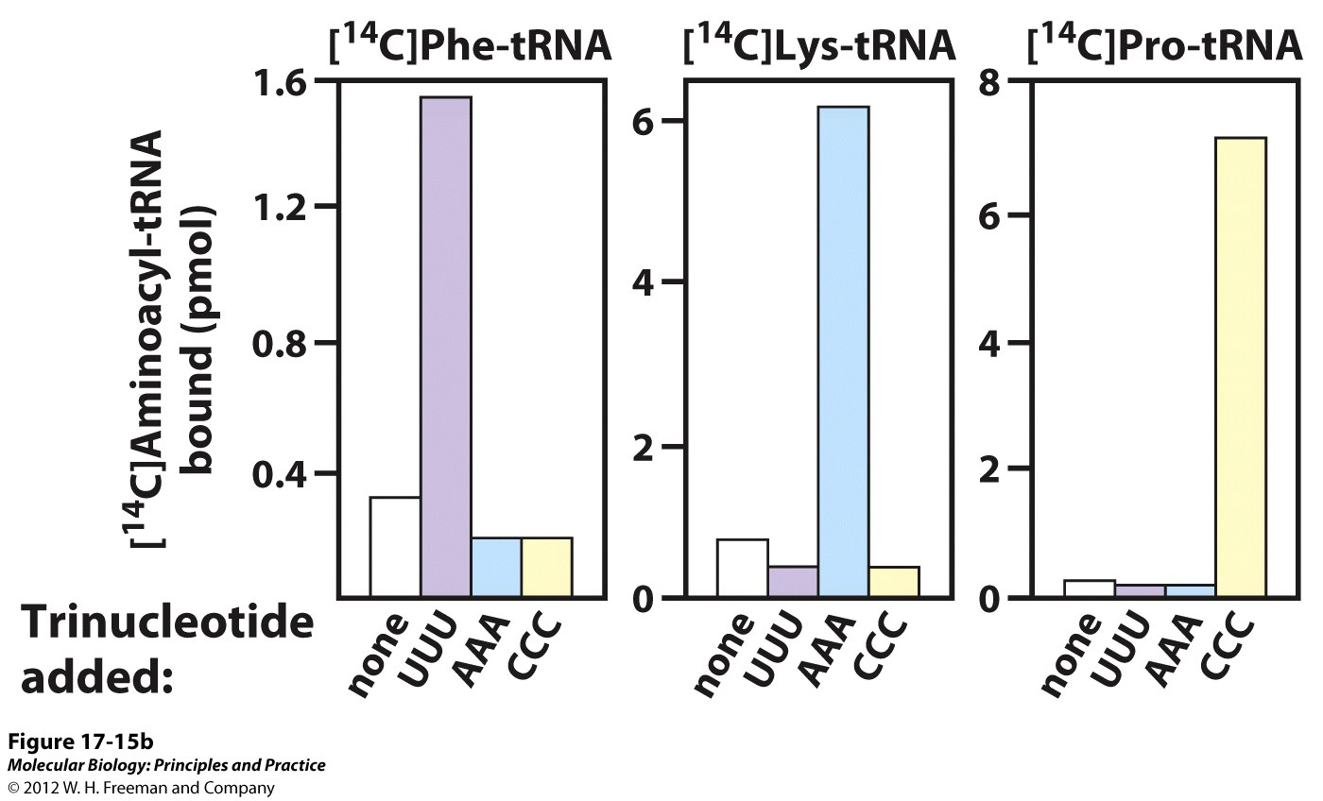
The filter binding assay… completing the code
A single trinucleotide would cause one and only one aminoacyl-tRNA to bind to the ribosome. 61 out of 64 possible codons could be decoded this way.

Slide 14
Start codons
Sanger: n-Formyl-Met tRNA
Filter-binding work: Met = AUG
Note: eukaryotes, start = Met not F-Met!
In prokaryotes, always F-Met, but is usually deformylated in mature protein.
Sometimes, GUG, AUU and UUG can act as Start, but in these rare cases, first AA is N-formyl-Met!

Slide 15
Stop codons
No aa-tRNA bound to the ribosome for UGA, UAA or UAG trinucleotides found in the filter-binding assays! Brenner postulated these might be Stop codons… (1965)
Solution: Translate repeating tetranucleotide that contains one of the 3 codons that do not code for an amino acid.
Example: AGUAAGUAAGUAAGUA
2 peptide products: Val-Ser-Lys and Ser-Lys
Since only a tripeptide an dipeptide were made, then UAA specifies stop or termination of peptide synthesis.
GUA AGU AAG UAA
Val Ser Lys Stop

Slide 16
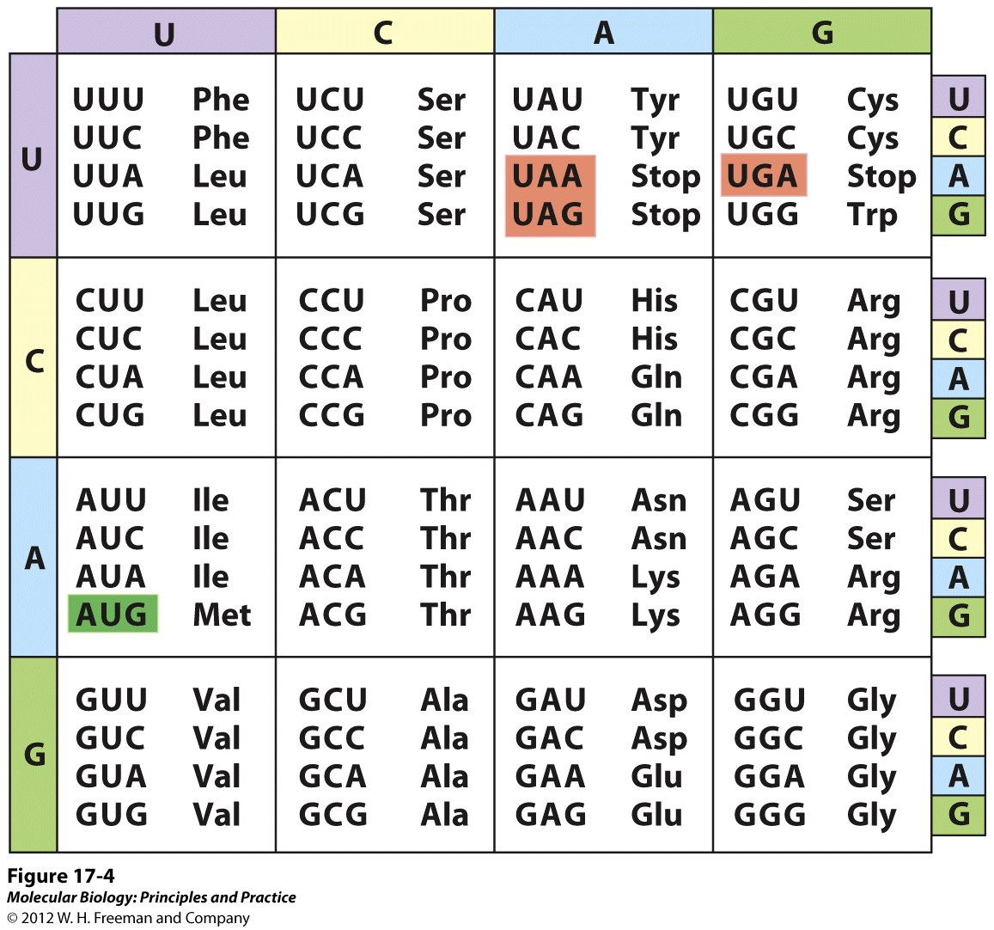
The “universal” genetic code
1. 61 = AAs
1 = Start
3 = Stop
(Why only 1 Start, 3 Stops?)
Degenerate
XXU or XXC always = same AA
Sub. at 3rd base changes AA in only 8/16 cases, so changes here often “silent”.
5. Single base subs tend to sub similar AAs

Slide 17
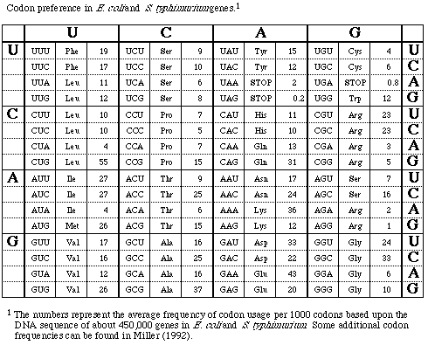
Codon Bias

Slide 18
Decoding the Genetic code by tRNAs
The simplest situation would be one tRNA for each codon.
However, it is more conceptually complex leading to a mechanistically simpler situation using fewer tRNAs and the enzymes that add the proper amino acid to them.
Third base degeneracy exists. That is the 3’ base of a codon has relatively less influence on the identity of the amino acid.
Poly U binds all Phe-tRNAs although UUC is a Phe codon (Nirenberg). This implies that there is only one tRNA for Phe.
Conversely a single yeast Ala-tRNA binds GCU, GCC and GCA codons (Robert Holley, 1965). This shows that a single tRNA can read more than 1 codon
How does this work?

Slide 19
The wobble hypothesis…
Crick hypothesized that third base degeneracy was due to alternative base pairing in the 3rd base of the codon and the tRNA anti-codon.
He called this “wobble” because at the 3rd position of the codon (and the 1st base of the anti-codon) there is some physical flexibility in the tRNA anticodon loop; might be room for other types of “non-canonical” pairing.
Inosines found at the 1st base of the anticodon are particularly “wobbly” and can bind with A, C or U. (A->I post-transcriptionally via deamination of A). U can base pair with G and G can base pair with U at the 3rd position of the codon.

Slide 20
Wobble rules
Wobble base pairing only occurs between the last (3’) position of the codon and the first (5’) position of the anticodon (refered to as the “wobble” position).
In addition to standard Watson-Crick base pairs, G can pair with U and U can pair with G.
3. A in the first position of the anticodon is converted to I. I in the anticodon can pair with A,U or C. (I only occurs in the tRNA, not the mRNA).

Slide 21
Wobble base pairings
From the anticodon side:
1st pos anticodon 3rd pos codon
If C then G
If G then C & U
If U then A & G
If I then C, A & U
From the codon side:
3rd pos of codon 1st pos of anticodon
If C then G & I
If A then U & I
If G then C & U
If U then A, G & I

Slide 22
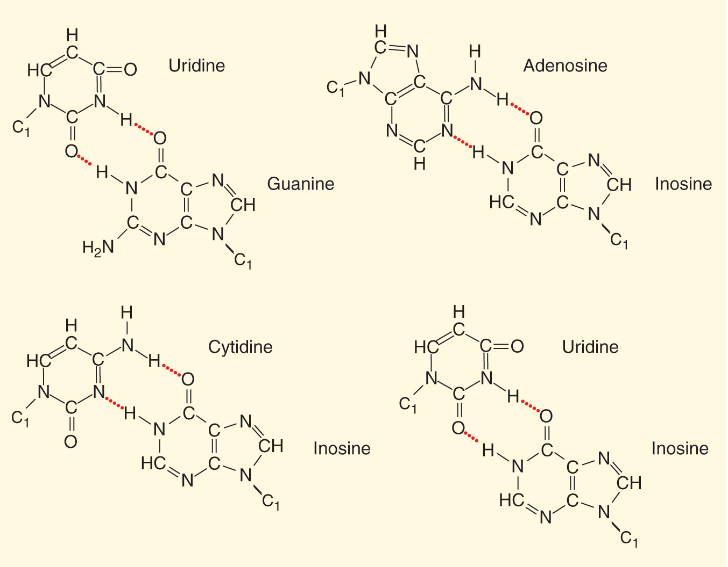
Additional “wobble” base pairings in tRNA-mRNA recognition.

Slide 23
Why have wobble?
Don’t need as many tRNA genes. Only need 32 tRNAs to cover the 61 sense codons. (NOTE: most cells have more than 32 tRNA species; in some cases, different cognate tRNAs even have the same anticodon sequence!)
Non-canonical base-pairing in one base provides weaker interaction between anti-codon and codon. Less stable interaction allows higher rate of protein synthesis.

Slide 24
Dangers of wobble
Since a single tRNA can respond to more than one codon, one tRNA could in theory bind to codons for two different amino acids.
Ex: Serine (one anticodon for Ser is UCG)
Codon (5’-3’): AGC AGU
Anticodon (3’-5’): UCG UCG (wobble)
AA: Ser Ser
A hypothetical example: anticodon UCA. Of course, UCA can base-pair with a codon specified by AGU. The UCA anticodon would be converted to UCI post-transcriptionally…
Deamination
Wobble allows UCI to pair with 3 codons
Codon: AGU AGU AGC AGU AGA
Anticodon: UCA => UCI UCI UCI UCI
AA: Ser Ser Ser Ser Arg
Other codon:anticodon pairing due to wobble
Due to wobble (and deamination), a UCA could also pair with AGA and insert the wrong AA (Arg instead of Ser). This would be bad. For this reason, UCA/UCI anticodon does not exist. Arg is covered by UCU due to the wobble rules (and Ser is covered by UCG, and others).

