Slide 1
Lecture 18: tRNA and initiation of protein synthesis.
Needs 10 more minutes of content. Use pages 587-88 and 626-7.
Minimum number of tRNAs required.
Aminoacylation of tRNAs.
Double seive mechanism for correct amino acylation of tRNA.
Ribosome structure.
Initiation sites on mRNA.

Slide 2
Learning Goals
Needs about 10 more minutes of content, like on tRNA structure and base modifications.
Be able to explain the reasoning for minimum number of tRNAs necessary for protein synthesis.
Understand the mechanism of the addition of the correct amino acid to the correct tRNA.
Be able to explain how aminoacyl synthetases recognize the correct tRNAs and reject all others.
Be able to describe the ribosome subunits and tRNA binding sites on ribosomes.
Be able to describe initiation sites for protein synthesis on Prokaryotic and Eukaryotic mRNAs

Slide 3
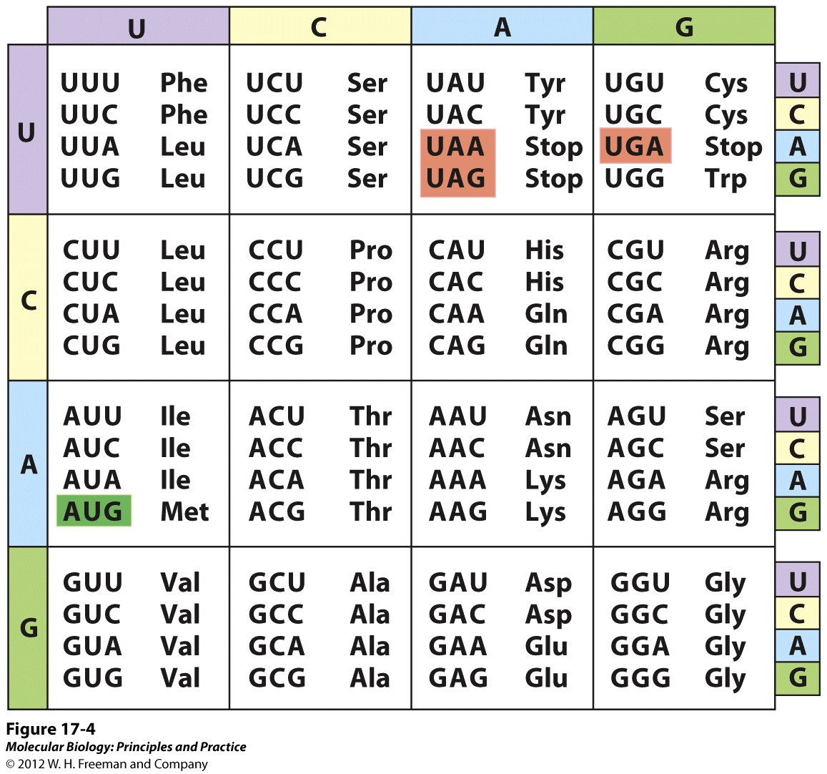
Minimum number of tRNAs
Reasoning:
Only two tRNAs are need to decode most of the 16 blocks of 4 codons that vary only in their 3’ position. Therefore 32 tRNAs would be needed. However for the block that encode tyrosine, the bottom 2 codons are stop codons, so they don’t have a tRNA, so only 31 needed.
You need two tRNAs for methionine because 1 is used only for initiation and the other is used only for elongation. Therefore 32 is the minimum necessary.

Slide 4
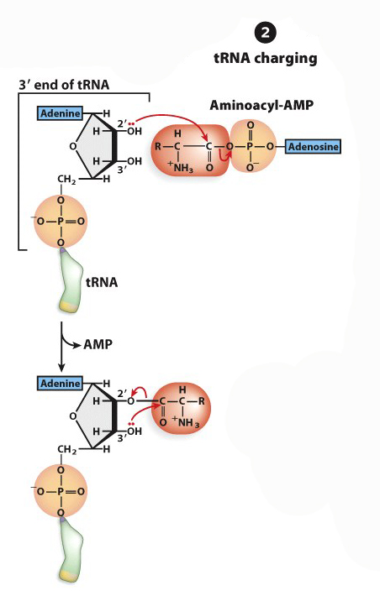
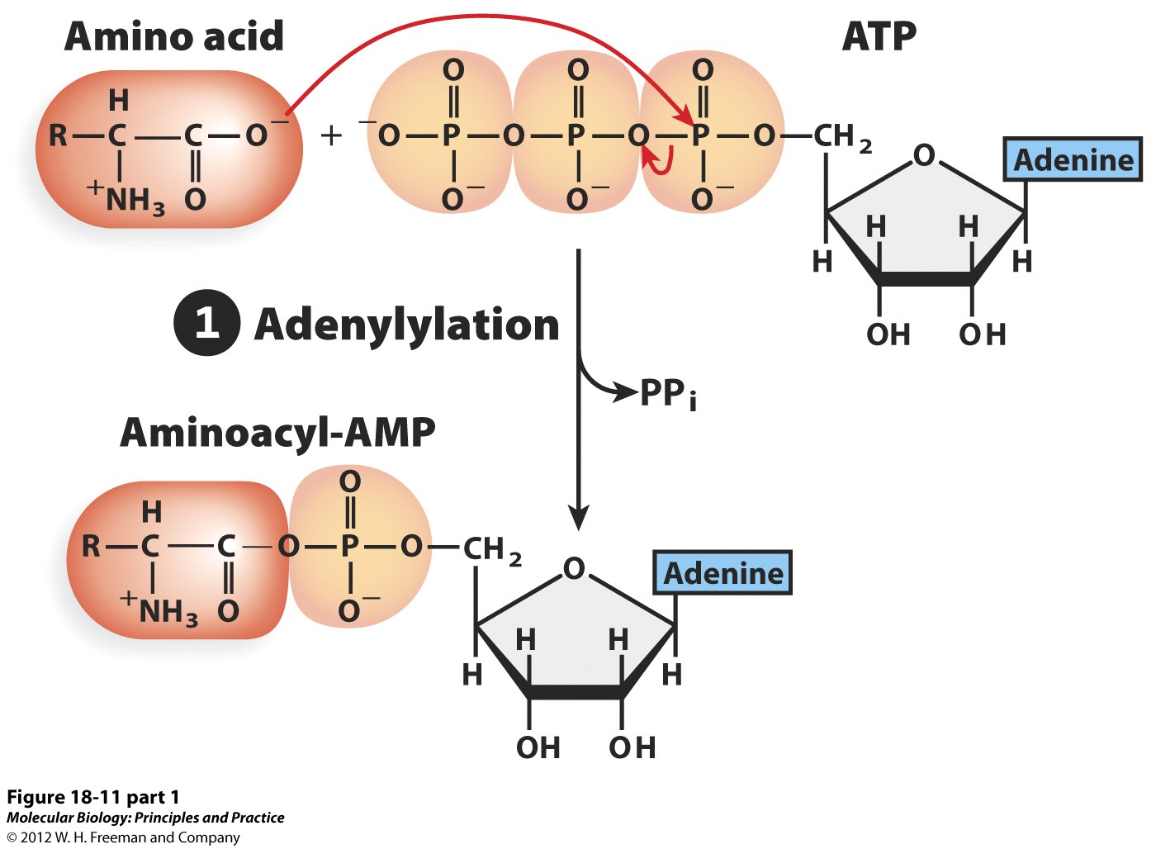
tRNA Activation
How to match the correct tRNA and AA?
  Aminoacyl-tRNA synthetase

Slide 5
The ribosome does not check if the correct amino acid is on a tRNA.
When Cys on a cys-tRNA is chemically converted to Alanine by reductive desulfurization, Alanine will be inserted at Cys codons, proving that the ribosome does not check the identity of the amino acid and tRNA.

Slide 6
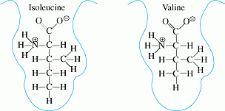
Aminoacyl-tRNA synthetases: the “second genetic code”
As described earlier, ribosomes don’t provide the specificity, the aminoacyl-tRNA synthetases do. They only produce the correct combinations of amino acid and tRNA by specifically recognizing the correct amino acid and tRNA. These specific recognition mechanisms are called the second genetic code because without the correct combination of amino acid and tRNA, the genetic code could not be translated properly.
Isoleucine and Valine are very similar, but Valine is slightly smaller.

Slide 7
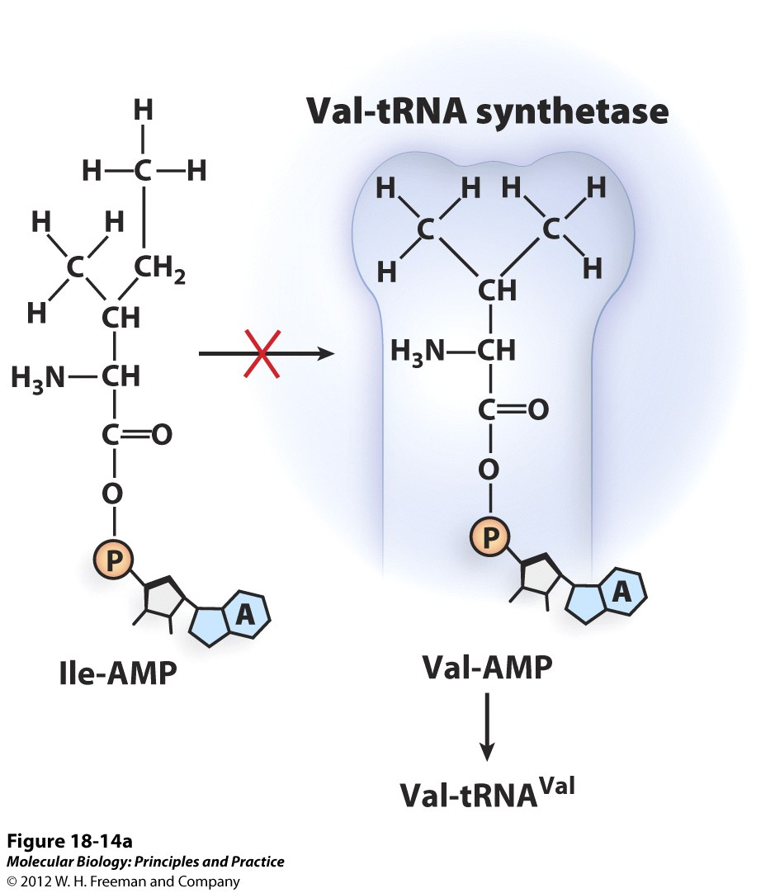
AA-tRNA proofreading
How to match the correct tRNA and AA?
  Aminoacyl-tRNA synthetase
  Depends on interactions
  between tRNA nucleotides
  and AA
Amino acid binding site
-If AA too big – doesn’t fit
-If AA is too small - fits

Slide 8
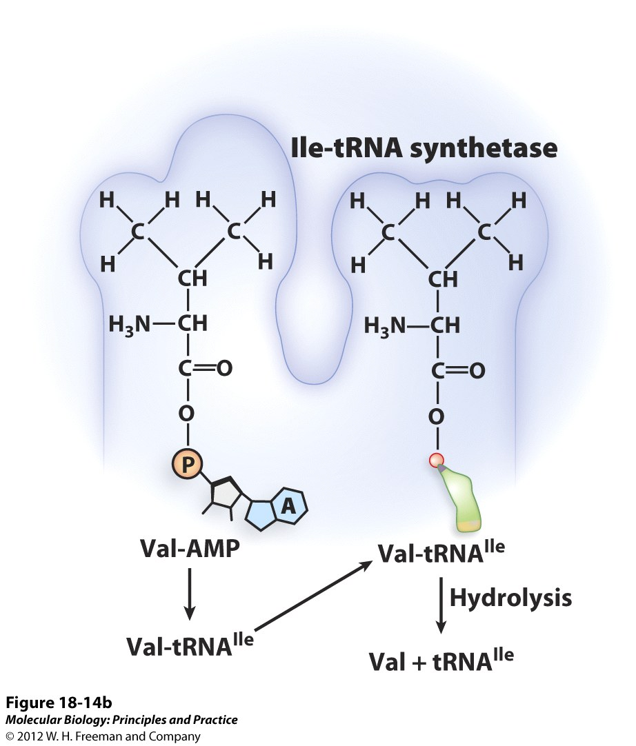
AA-tRNA proofreading
How to match the correct tRNA and AA?
  Aminoacyl-tRNA synthetase
Proofreading site
-Correct AA – doesn’t fit
-If AA is too small – fits and is removed

Slide 9
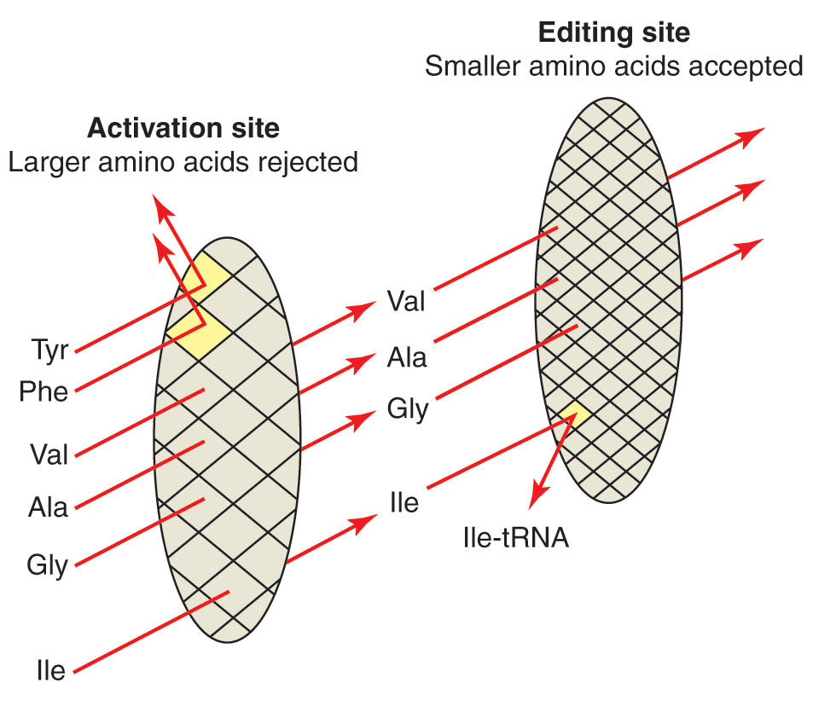
Double sieve mechanism
AA-AMPs that are too small are hydrolyzed
Only correct AA and tRNA combination is released from the synthetase.

Slide 10
tRNA recognition by tRNA synthetases…
Since there are only 20 AA-tRNA synthetases, there must be a way for each tRNA synthetase to discriminate each of its cognate tRNAs from the wrong (non-cognate) ones.
A set of sequence elements is conserved between cognate tRNAs.
The recognition motifs are not always contained within the anticodon.
It is this specificity that constitutes the “second genetic code.” Thus, the second genetic code is an operational code based on the combination of structural and sequence features in the cognate tRNAs. The first genetic code is a set of invariant rules based on primary sequence.

Slide 11
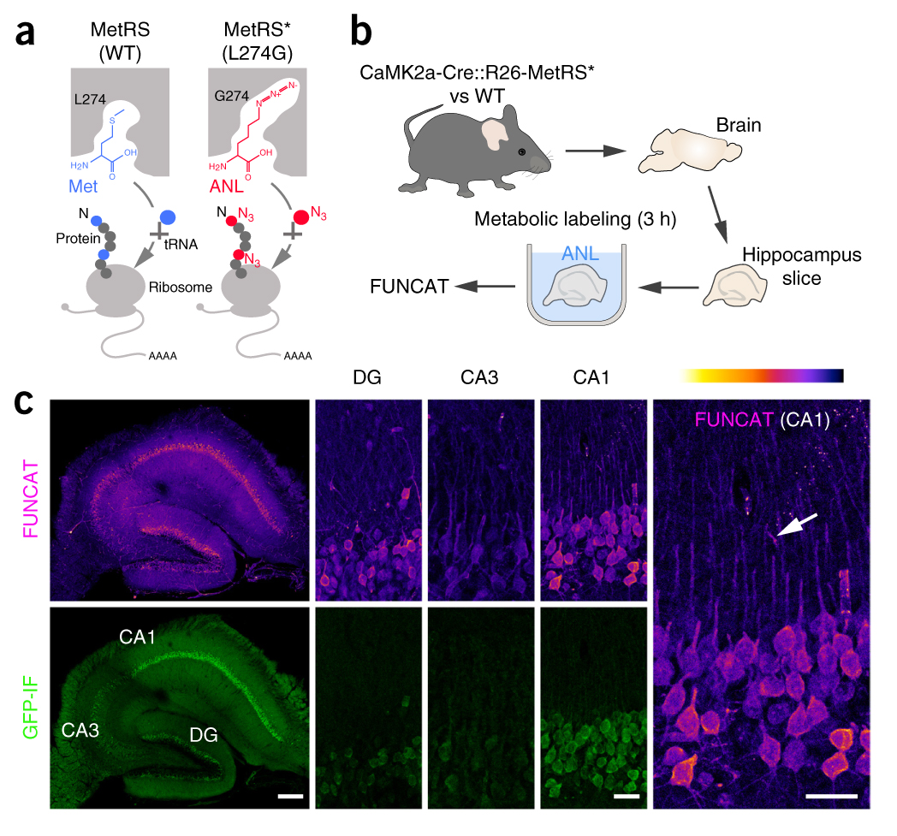
Synthetic Biology and Bio-orthogonal Non-Cannonical amino acid tagging (BONCAT):
Mutations in Met-AAS allow the loading of non-cannonical AAs on tRNAs and their incorporation into protein in specific cell types.
Mutation of a single amino acid (L274) to G allows the AAS (MetRS*) to use azidonorleucine (ANL) as a substrate and transfer it to Met-tRNA. This incorporates some ANL into proteins at Met codons. The Azido group (N3) allows unique “click” chemistry to detect (FUNCAT) and purify ANL tagged proteins.
By using specific “Cre drivers”, the MetRS* can be expressed only in specific cell types to allow the analysis of their proteomes.
Alvarez-Castelao, et al., Nature Biotechnology 2017 35:1196

Slide 12
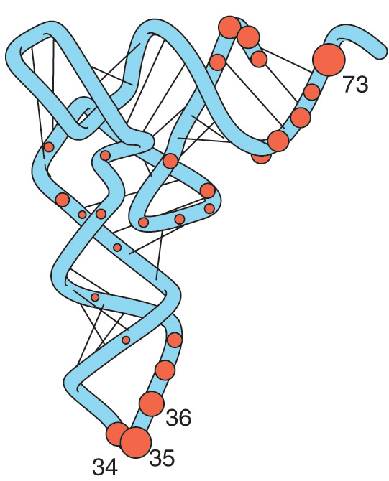
Aminoacyl-tRNA synthetases can distinguish between tRNAs
The “Identity nucleotides” recognized by the specific synthetases are shown as orange circles. The size of the circle is proportional to the frequency of the identity nucleotide at a given position. These nucleotides make contact the synthetase enzyme.
Figure 19.23
Adapted from Giege, R., Sissler, M., and Florentz, C., Nucleic Acids Res. 26 (1998): 5017-5035.

Slide 13
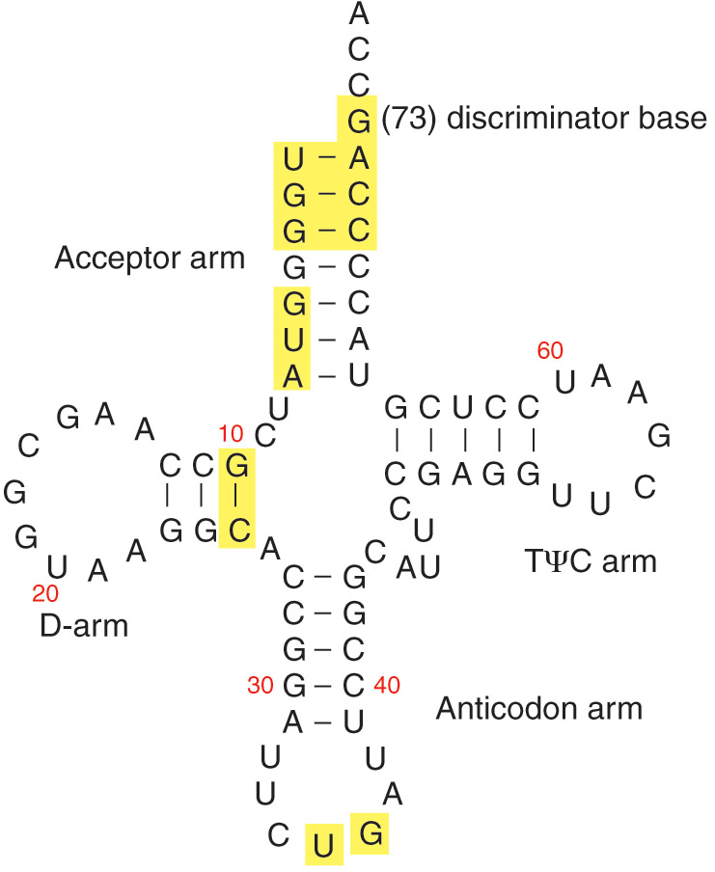
tRNA^{Gln} has identity elements in its acceptor, anticodon, and D-arms
Figure 19.27
Adapted from Ibba, M., Hong, K. -W., and Söll, D., Genes Cells 1 (1996): 421-427.

Slide 14
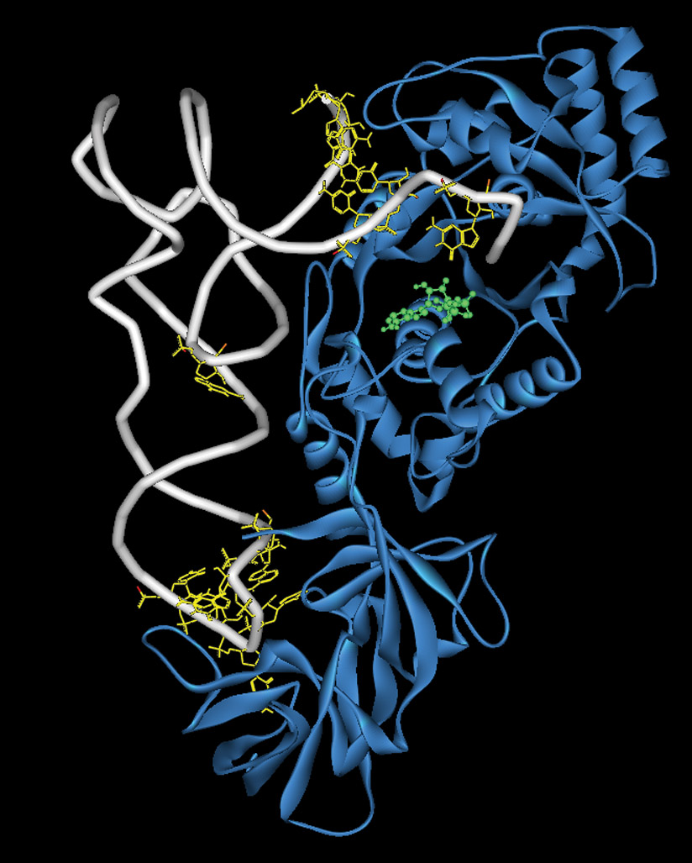
The identity elements of tRNA^{Gln} make contact with its synthetase
Figure 19.28
Protein Data Bank ID: 1QRS. Arnez, J. G., and Steitz, T. A., Biochemistry 35 (1996): 14725-14733.

Slide 15
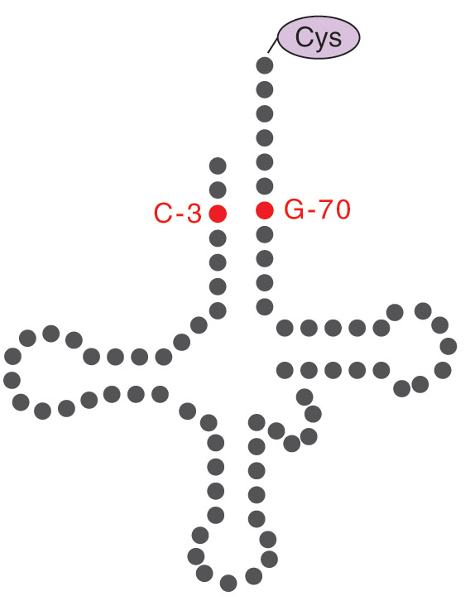
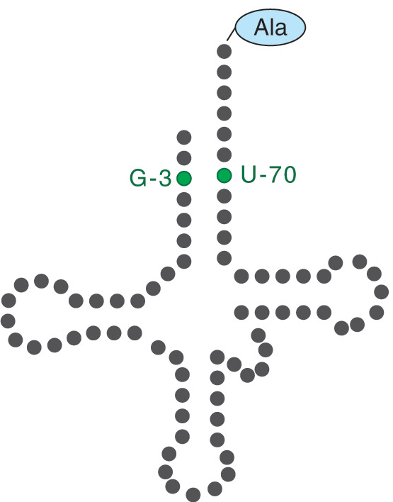
A G3:U70 mutation in tRNA^{Cys} converts it to tRNA^{Ala}
Figure 19.25

Slide 16
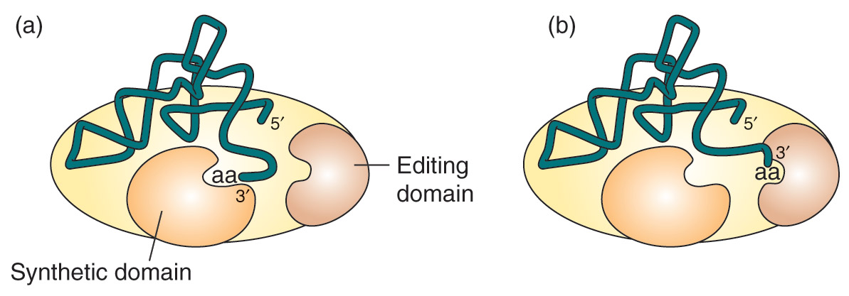
The structural basis for post-transfer editing
The synthetase “double checks” the AA-tRNA combination for correctness prior to releasing it.
If the “incorrect” AA is transferred to a “correct” tRNA, the amino acid is hydrolyzed from the end of the tRNA before it is released from the synthetase.
Figure 19.22
Adapted from Silvian, L. F., Wang, J., and Steitz, T. A., Science 285 (1999): 1074-1077.

Slide 17


Slide 18
Structure of prokaryotic 50S large ribosomal subunit
Proteins (L1, etc) and rRNAs (5S, 23S)

Slide 19
23S rRNA structure
The structure of the 23S rRNA (grey) from Haloarcula marismortui. Ribosomal proteins are shown in yellow. Catalysis occurs in the center of this structure (denoted by the star). This perspective is that from the 30S subunit.
Of note: There is no protein in the center where catalysis takes place. Peptidyl transfer is a ribozyme!

Slide 20
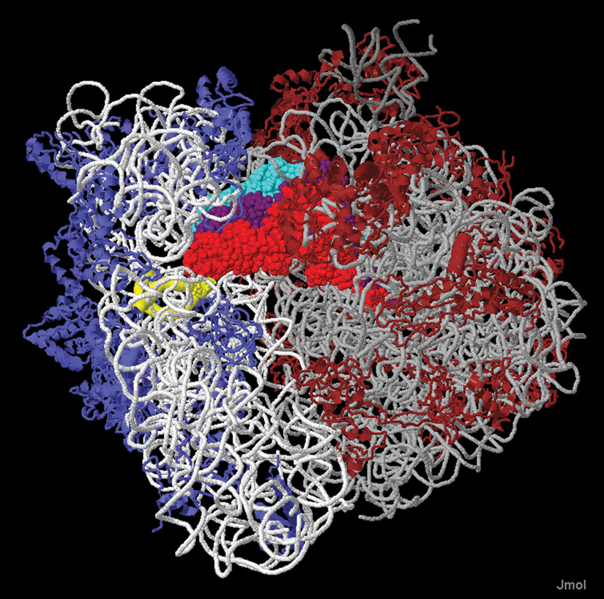
The ribosome has three tRNA binding sites
Red, purple, light blue: 3 tRNAs
Figure 20.5
Reproduced from Explorable visualizations of the ribosome by Wayne Decatur, UMASS Amherst (http://people.biochem.umass.edu/fournierlab/3dmodmap/tt3dmodsribe55/index.htm). Structure rendered from Protein Data Bank ID: 1JGO and 1GIY. Yusupova, G. Z., et al., Cell 106 (2001): 233-241. Yusupova, M. M., et al., Science 292 (2001): 883-896.

Slide 21
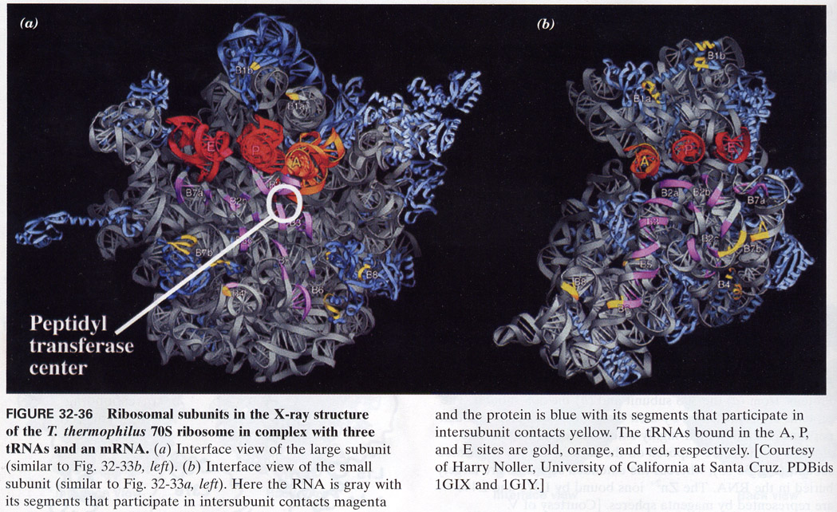
X-Ray crystal structure of 70S ribosome
Note the A, P and E sites. Half of the site is in the 30S and half is in the 50S subunit. The peptidyl-transferase reaction occurs between the A and P sites on the 50S subunit.

Slide 22
How does the ribosome know where to start translation?
Prokaryotic mRNAs are “polycistronic” (operons!):
AUG codons specifiy both N-formyl-Met at the Start as well as internal Met. How does the ribosome know which ones to initiate translation on? A sequence on the mRNA adjacent to the start codon base pairs with the 3’ end of the 30S ribosomal RNA.
Shine-Dalgarno sequence:
5’-AGGAGGU-3’

Slide 23
Eukaryotic translation initiation codons
Eukaryotic mRNA is not polycistronic. Also, no Shine-Dalgarno sequence.
Factors that determine if an AUG is Start or Met:
The initiation codon is usually the first AUG encountered from the 5’ end.
A Kozak sequence is the consensus observed in many translated eukaryotic mRNAs around the Start codon. It is:
(A/G)NNAUG(A/G)
(-3) (+4)
AUG codons with C or U at +4 are not efficient initiation sites.

