Slide 1
Lecture 13 – Transcriptional Regulation and Chromatin
Combinatorial control of of gene expression.
Transcription factor structure.
Txn Factor Modularity - Yeast 2 Hybrid
Protein-Protein interactions
Immunoprecipitation
Western blot
DNA Packaging and Transcription
Types of Modifications
Acetylation
Methylation

Slide 2
Learning Goals
Be able to diagram a Eukaryotic regulatory region that displays combinatorial control.
Be able to cartoon a yeast 2 hybrid experiment to identify what proteins interact with a protein of interest
Be able to cartoon an immunoprecipitation experiment and draw conclusions from IP data
Be able to explain how condensation of chromatin affects transcription. Know the means by which the cell alters chromatin condensation.

Slide 3
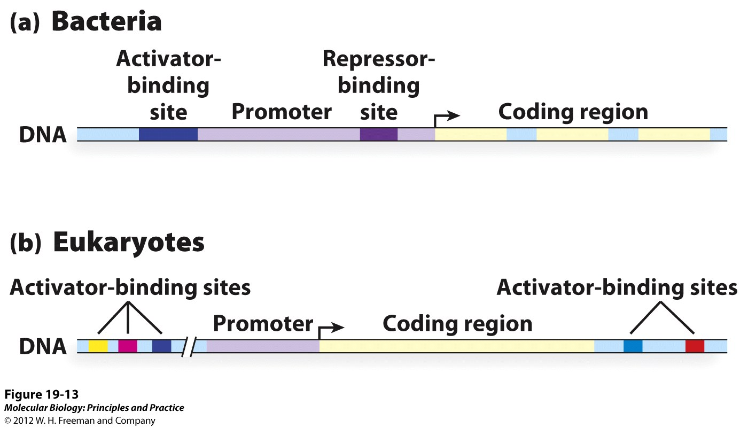
Combinatorial Control in Gene Regulation.
Eukaryotic promoters usually contain binding sites for multiple transcription factors that all contribute to gene regulation.

Slide 4
Combinatorial Control in Gene Regulation.
The same regulatory proteins and DNA binding sites are used in different combinations to differentially regulate many genes. This provides a greater complexity and finer control to gene expression and utilizes a smaller number of factors to regulate more genes.

Slide 5
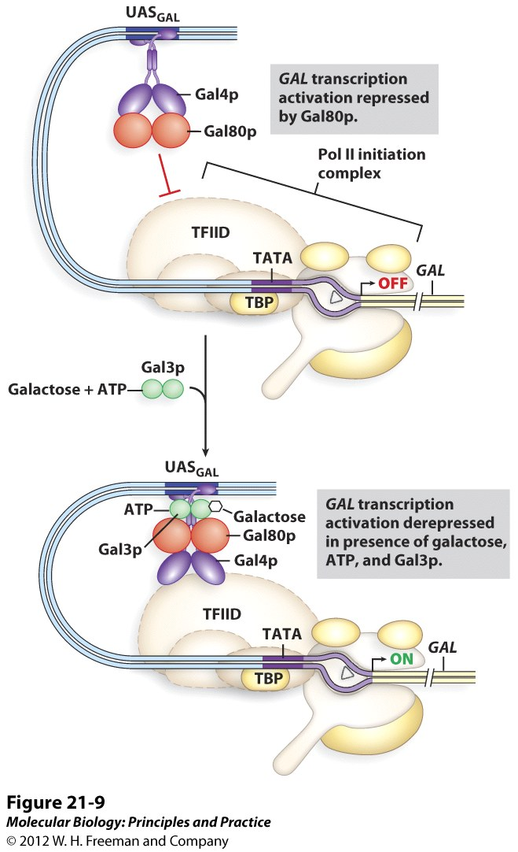
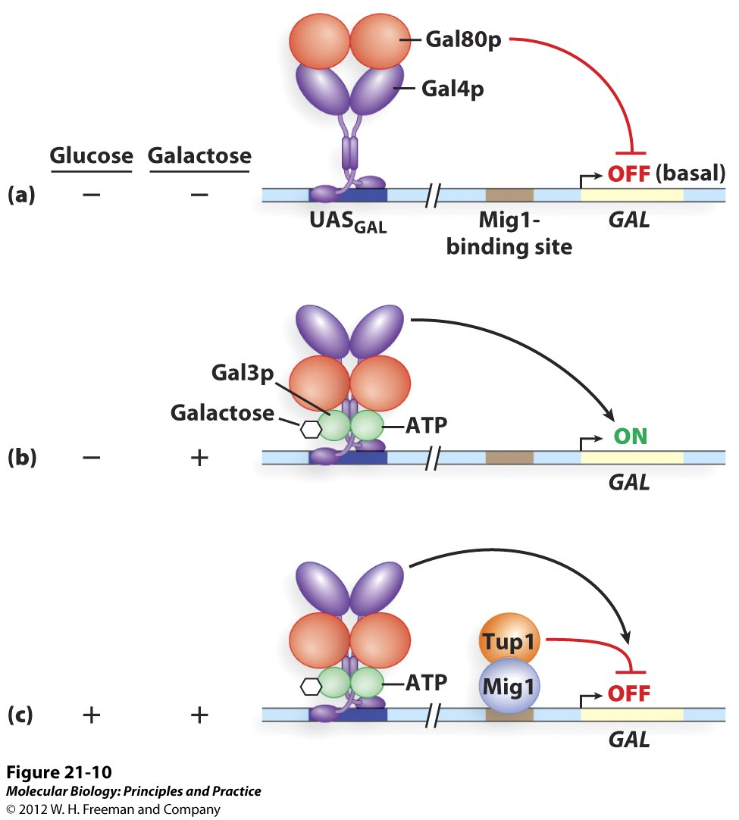
Combinatorial Control of GAL Gene Expression.

Slide 6
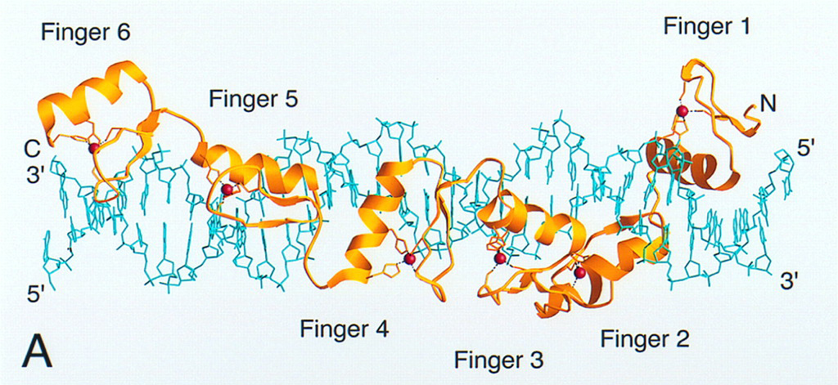
Txn Factors bind specifically to DNA
TFIIIA Transcription Factor complex

Slide 7
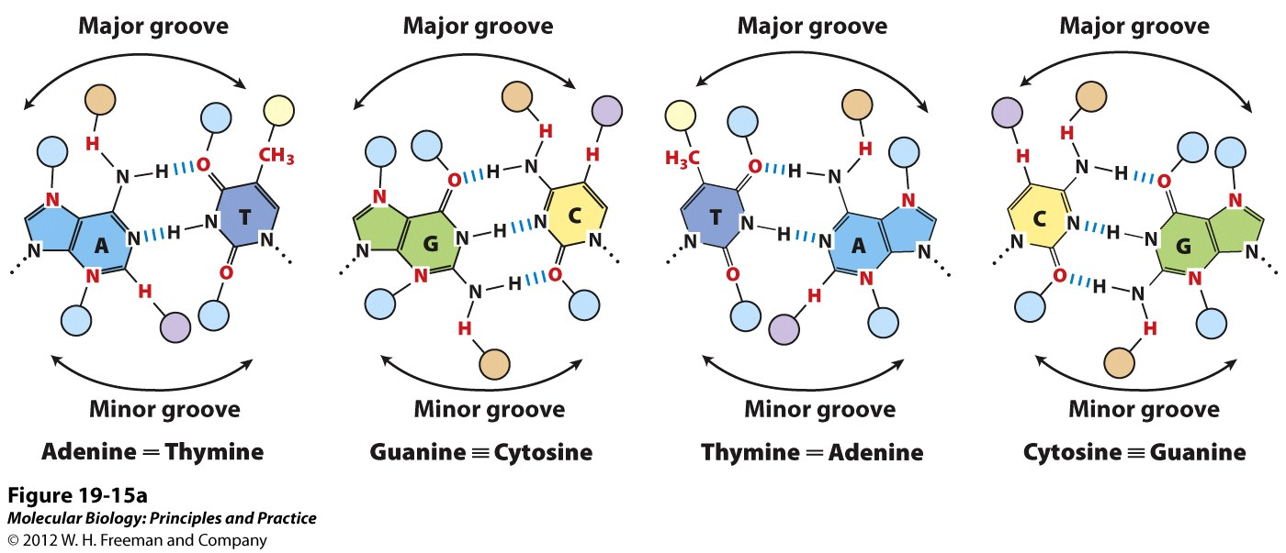
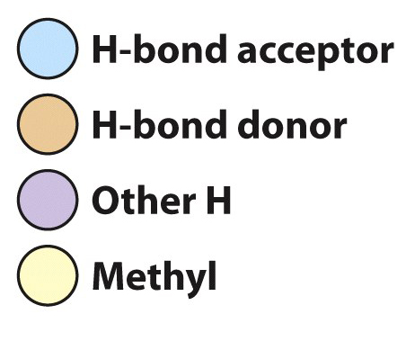
Txn Factors recognize unique atomic features of the base pairs in the major and minor grooves.

Slide 8
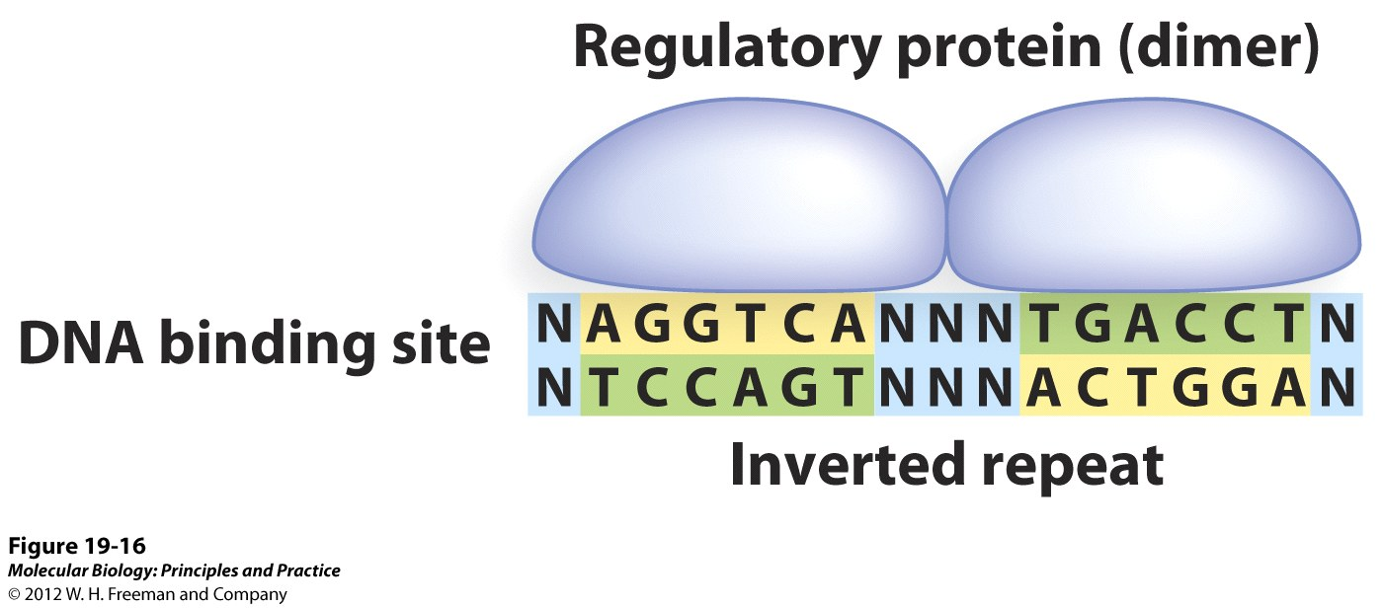
Txn factors typically to function as dimers

Slide 9
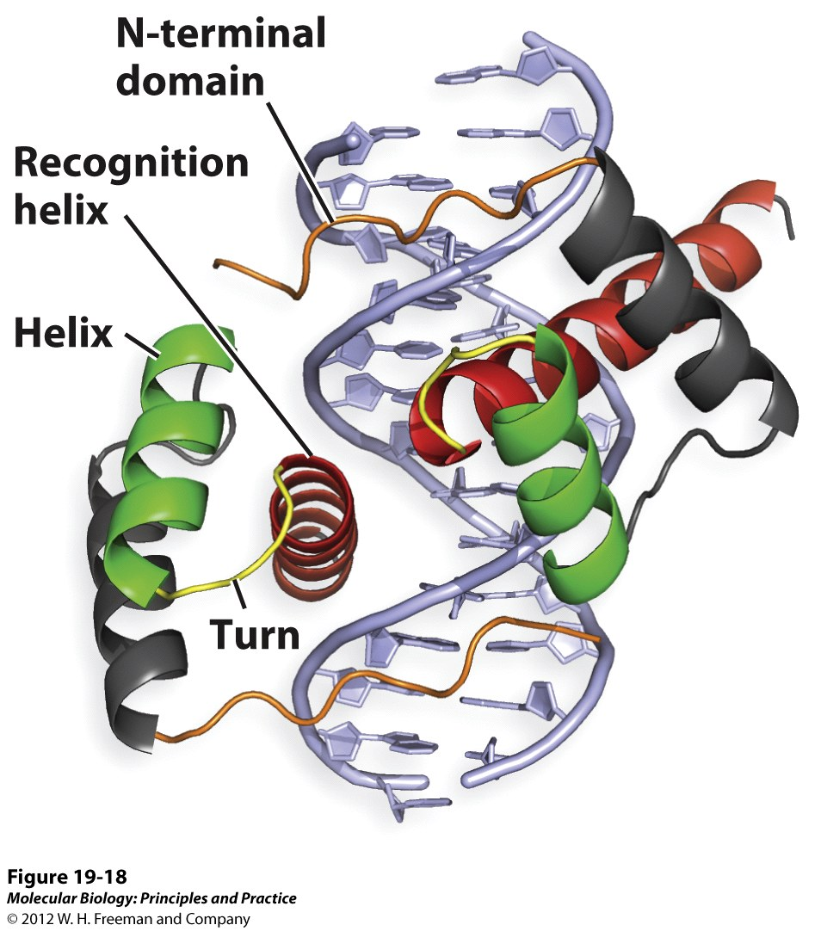
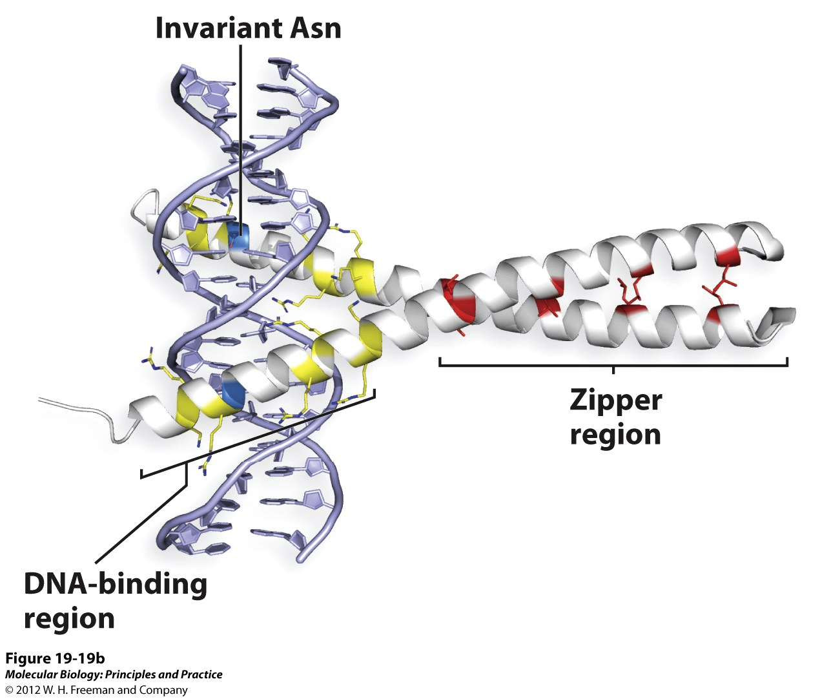
Txn Factors belong to different protein structure families.
1. Homeodomain Motif
2. Leucine Zipper Motif

Slide 10
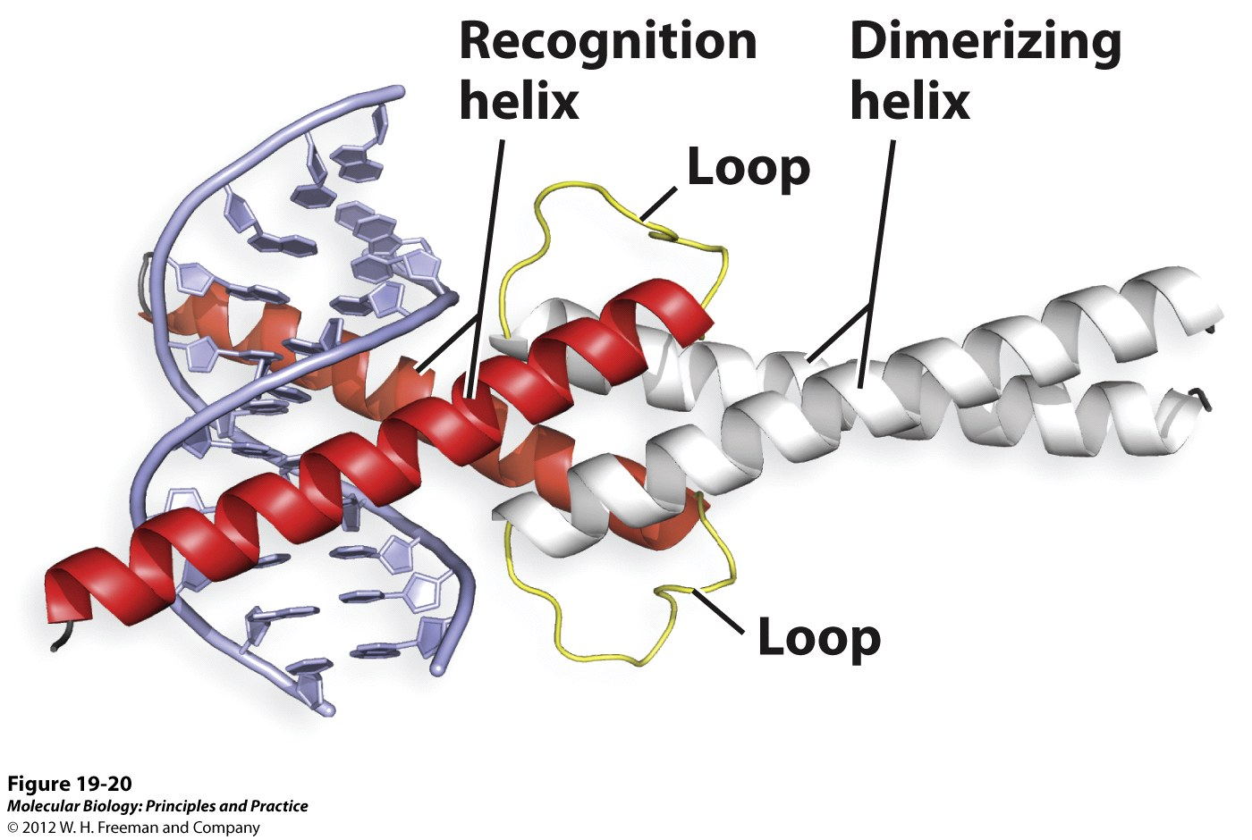
Txn Factors and DNA – Structure!
3. Helix loop helix Motif

Slide 11
Transcription Factors Have Two
Modular Domains
Specific DNA Binding
Domain
Specific Activation / Repression domain that binds to proteins
Different members of a txn factor family bind to different DNA sequences and interact with different proteins, like RNA polymerase or co-repressors. This facilitates the evolution of new transcription regulators.

Slide 12
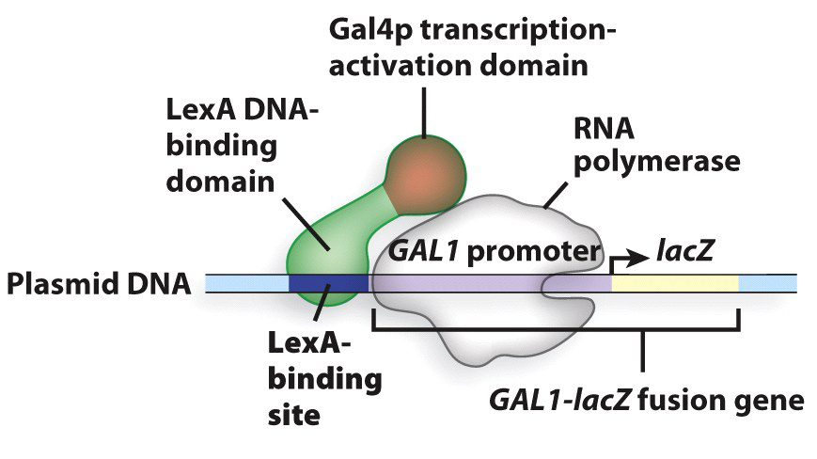
Modular Txn Factor Domains
Because of the conserved and modular structure of transcription factors, the DNA binding domains and the Activation/Repressor domains can be mixed and matched experimentally to create new transcription factors with new specificities and functions.

Slide 13
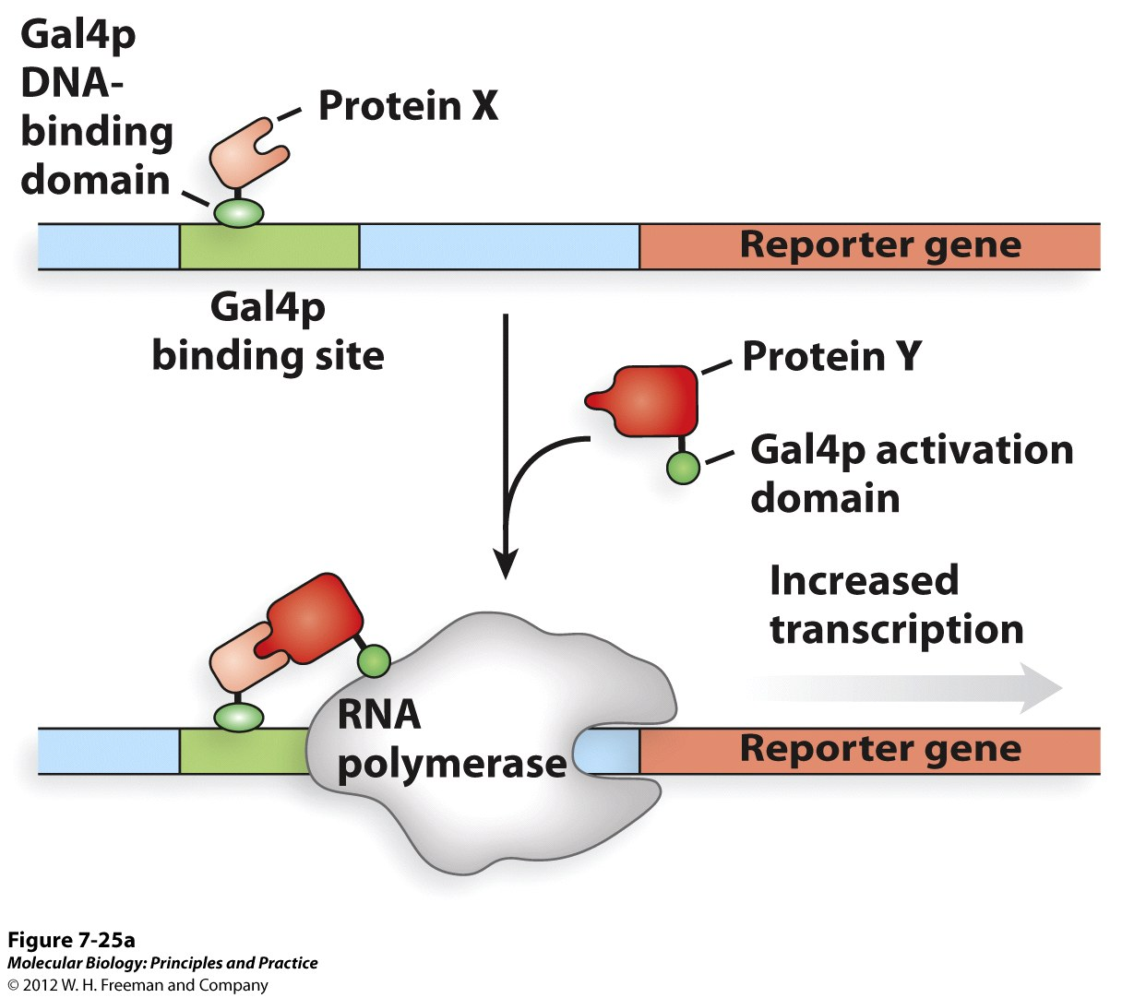
Exploiting transcription factor modularity to identify protein binding pairs: Yeast 2 Hybrid system
Purpose – What protein(s) does Protein X bind to?
Bait protein – Gal4 DNA binding domain fused to Protein X
Prey protein – Gal4 activation domain fused to Protein Y (DNA library)

Slide 14
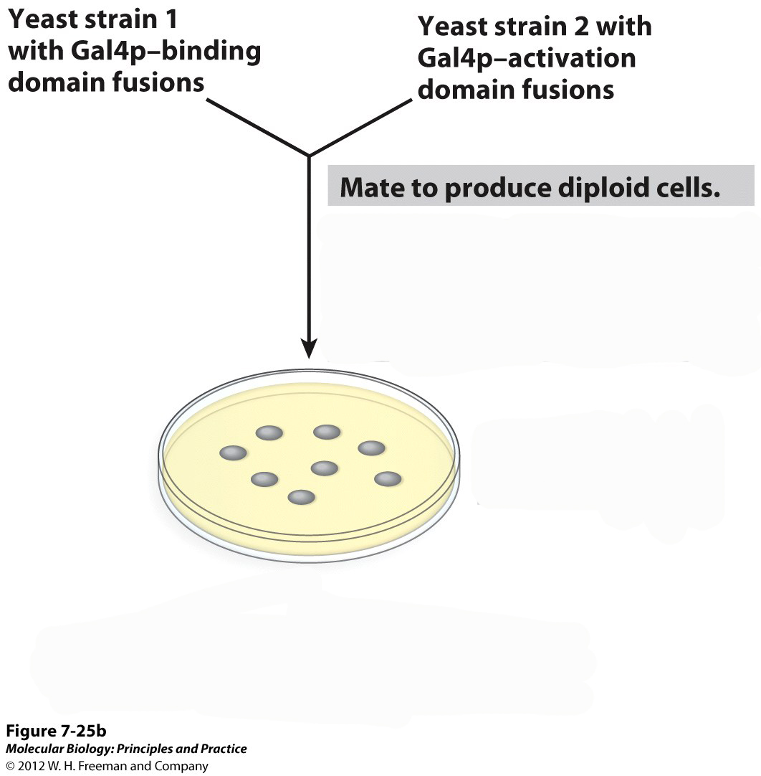
Txn Factor Domains – Yeast 2 Hybrid
Remove plasmids from colonies expressing reporter gene and sequence to identify interacting proteins

Slide 15
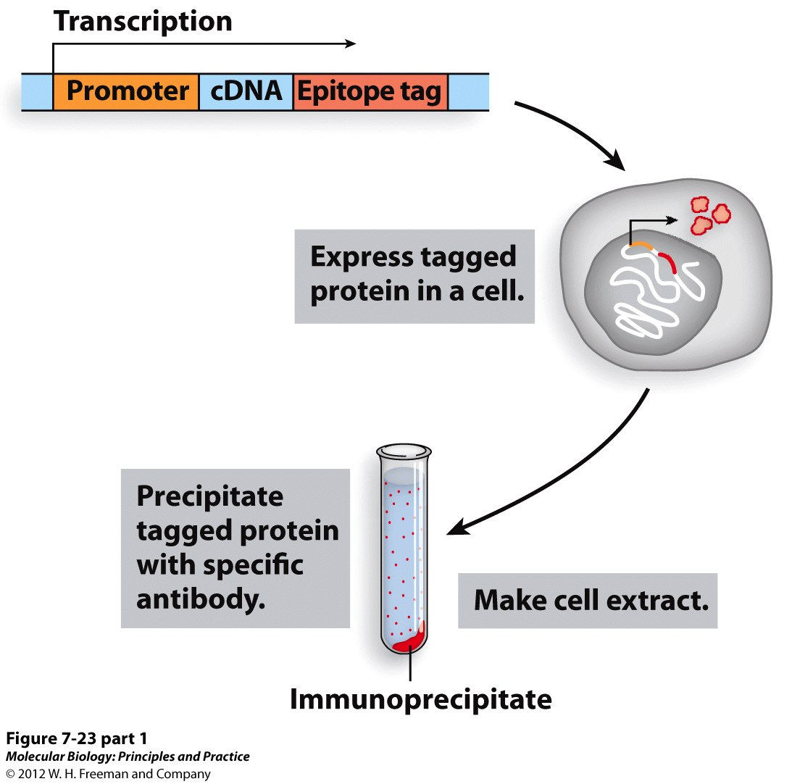
Confirm Protein/Protein binding - Immunoprecipitation
The epitope tag is a short piece of DNA that encodes a peptide sequence recognized by an antibody.
The epitope tag can be added to the end of any gene to allow the protein to be bound by the antibody.
To confirm that the protein-protein interaction occurs in vivo, you express the epitope tagged protein and use the antibody to pull down the tagged protein.
Then you check if the other protein was pulled down along with the tagged protein by Western blotting.

Slide 16
Pull down assay to confirm specific binding.
By RaihaT - Own work, CC BY-SA 3.0, https://commons.wikimedia.org/w/index.php?curid=32412686

Slide 17
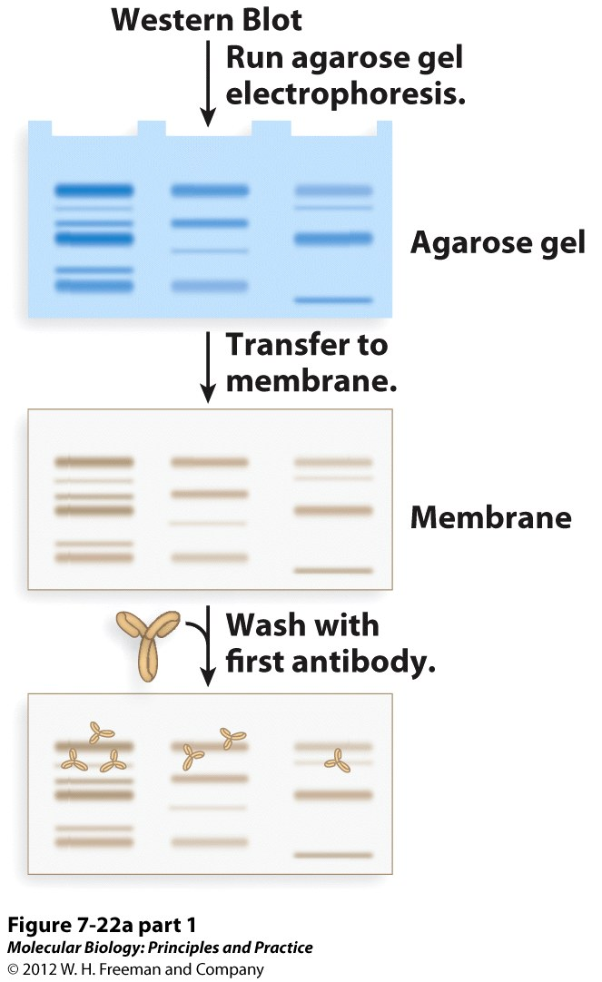
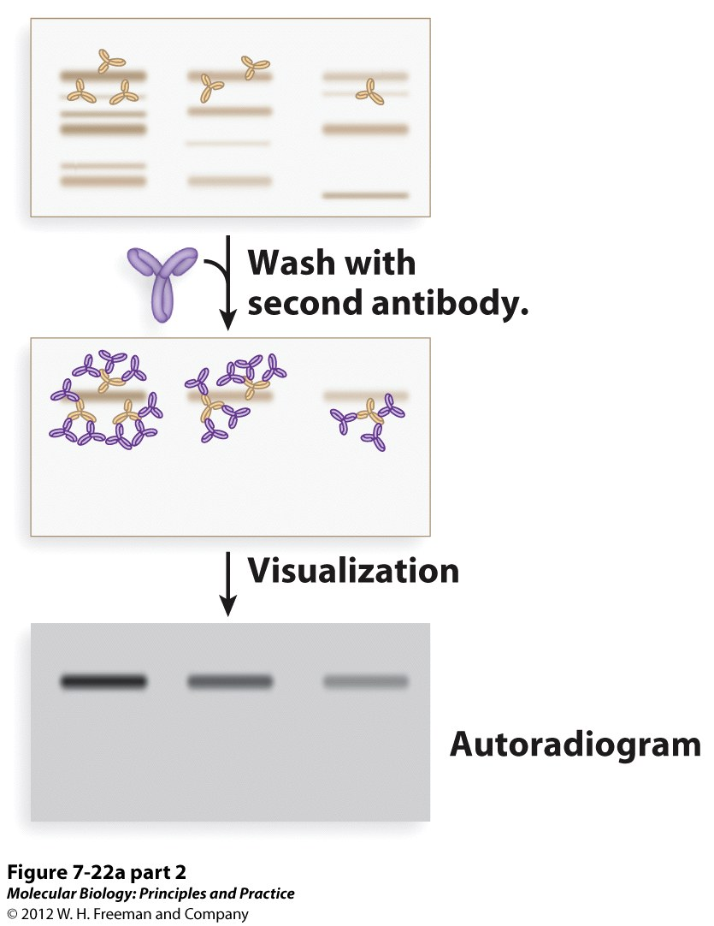
Western Blot

Slide 18
DNA Packaging and Transcription
Combinatorial Control in Gene Regulation.
(condensed)
(decondensed)
Txn Repressed Txn Active
3 mechanisms control chromatin structure:
Nucleosome positioning on the DNA.
Posttranslational modification of histones (eg acetylation).
Substitution of specialized histone proteins.

Slide 19
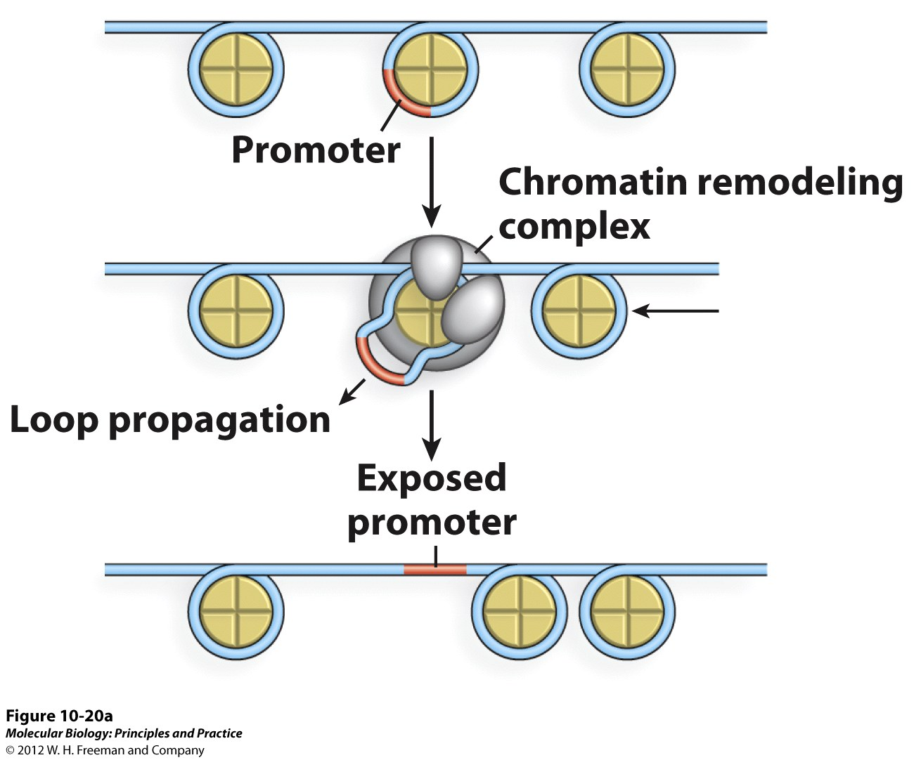
How to Alter DNA Packaging
Chromatin Remodeling

Slide 20
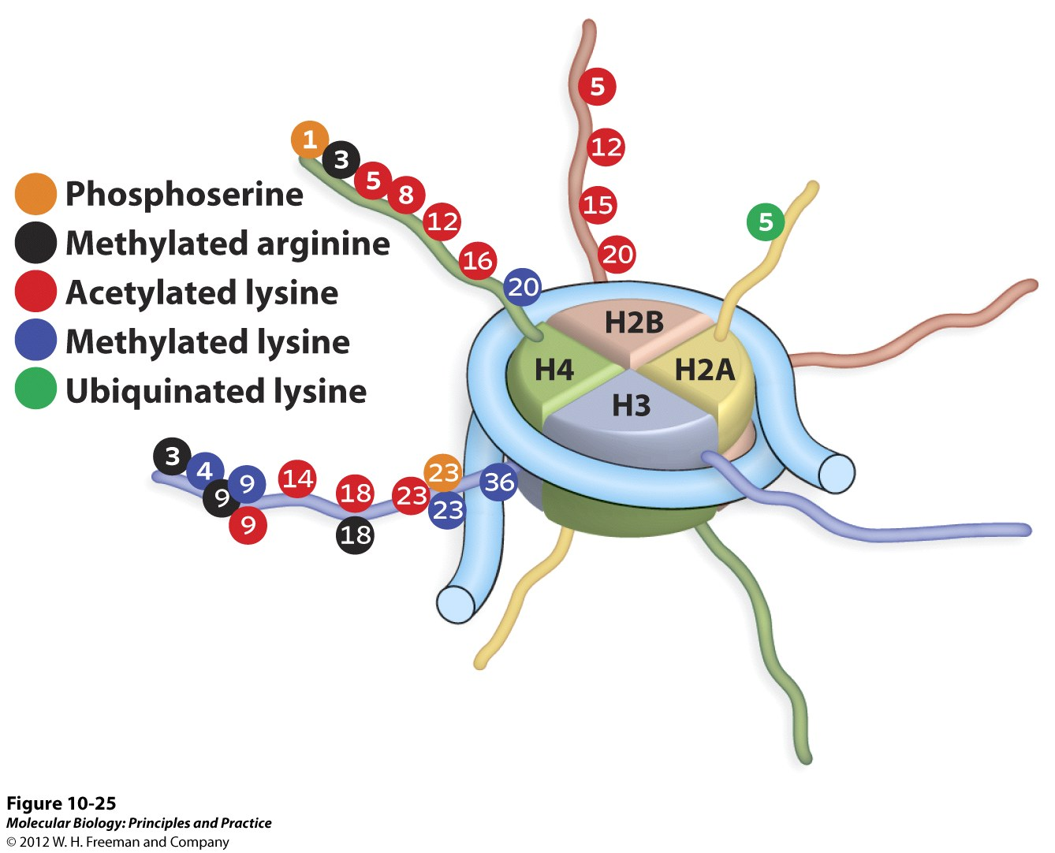
How to Alter DNA Packaging
Amino terminal “tails”
Histone tail modifications
Numbers refer to specific amino acid locations that are modified.

Slide 21
How to Alter DNA Packaging
Histone N-terminal tails mediate internucleosome contacts, which is controlled by the modification state of the tails.

Slide 22
How to Alter DNA Packaging
Euchromatin Heterochromatin
(Transcriptionally active) (Inactive)
Acetyl group
Methyl group
These are general rules – not always the case!
The real rules are much more complicated because the specific modification at the specific location matters

