Slide 1
Lecture 14 – Epigenetic Inheritance, mRNA processing and transport
Epigenetic Inheritance
5’ cap
Function of cap
Steps of cap addition
RNA splicing
Function of splicing
RNA Seq
Mechanism of splicing
Poly A tail
Function of tail
Steps of addition
mRNA export

Slide 2
Learning Goals
Be able to diagram how histone modifications are maintained during DNA replication.
For each of the mRNA processing types:
Be able to describe the function.
Be able to diagram the steps/mechanism to obtain the modification.
Be able to explain how that processing step is important for the export and translation of the mRNA.
Be able to explain mature mRNAs are transported from the nucleus to the cytosol.

Slide 3
DNA Packaging and Transcription
Combinatorial Control in Gene Regulation.
(condensed)
(decondensed)
Txn Repressed Txn Active
3 mechanisms control chromatin structure:
Nucleosome positioning on the DNA.
Posttranslational modification of histones (eg acetylation).
Substitution of specialized histone proteins.

Slide 4
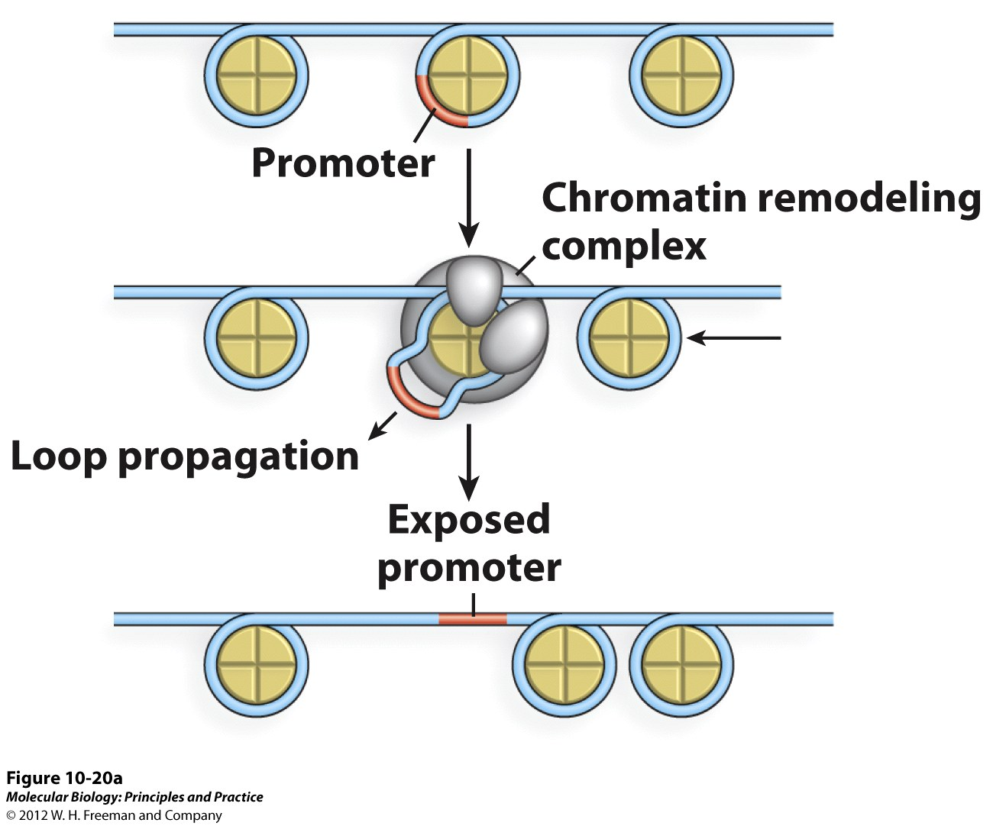
How to Alter DNA Packaging
Chromatin Remodeling

Slide 5
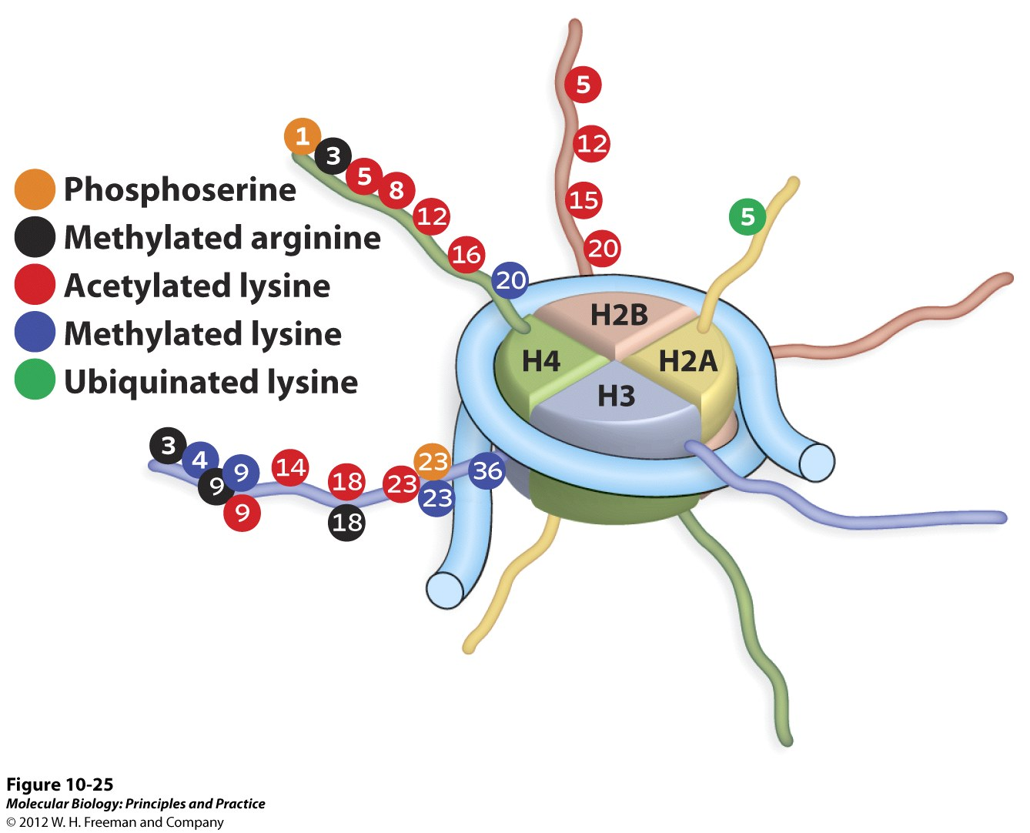
How to Alter DNA Packaging
Amino terminal “tails”
Histone tail modifications
Numbers refer to specific amino acid locations that are modified.

Slide 6
How to Alter DNA Packaging
Histone N-terminal tails mediate internucleosome contacts

Slide 7
How to Alter DNA Packaging
Euchromatin Heterochromatin
(Transcriptionally active) (Inactive)
Acetyl group
Methyl group
These are general rules – not always the case!
The real rules are much more complicated because the specific modification at the specific location matters

Slide 8
How to Alter DNA Packaging
Acetylation
Decondensation
HDAC
(Histone deacetylase)
HAT
(Histone
Acetyl-transferase)
Condensation

Slide 9
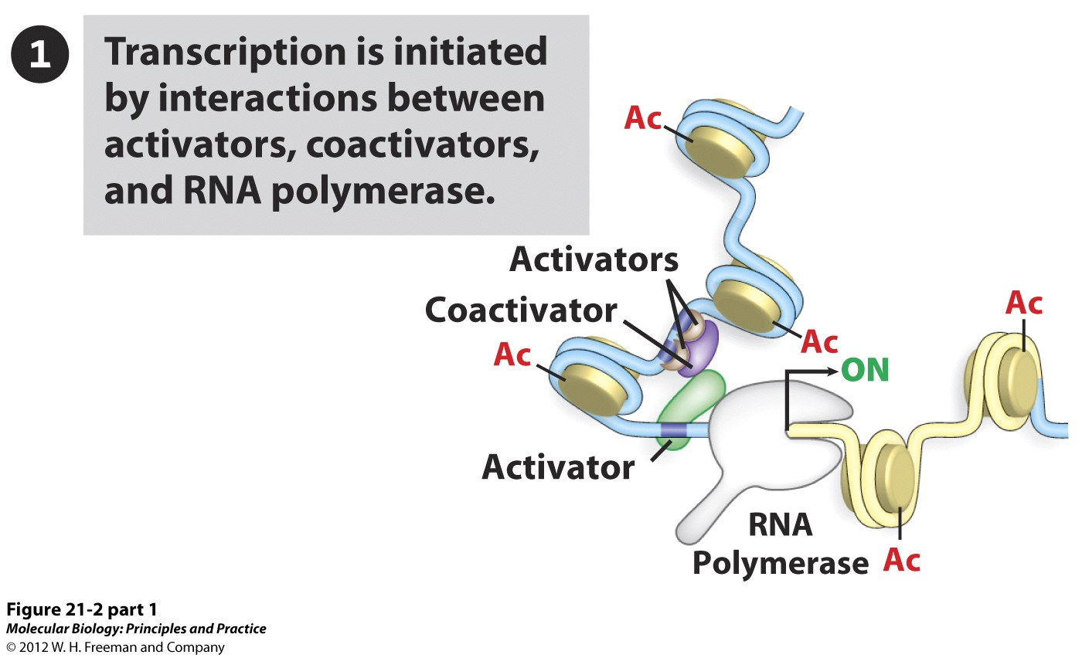
Gene Inactivation by Histone Deacetylation
Histone acetylation decondenses chromatin and exposes the binding sites for activators and RNA polymerase

Slide 10
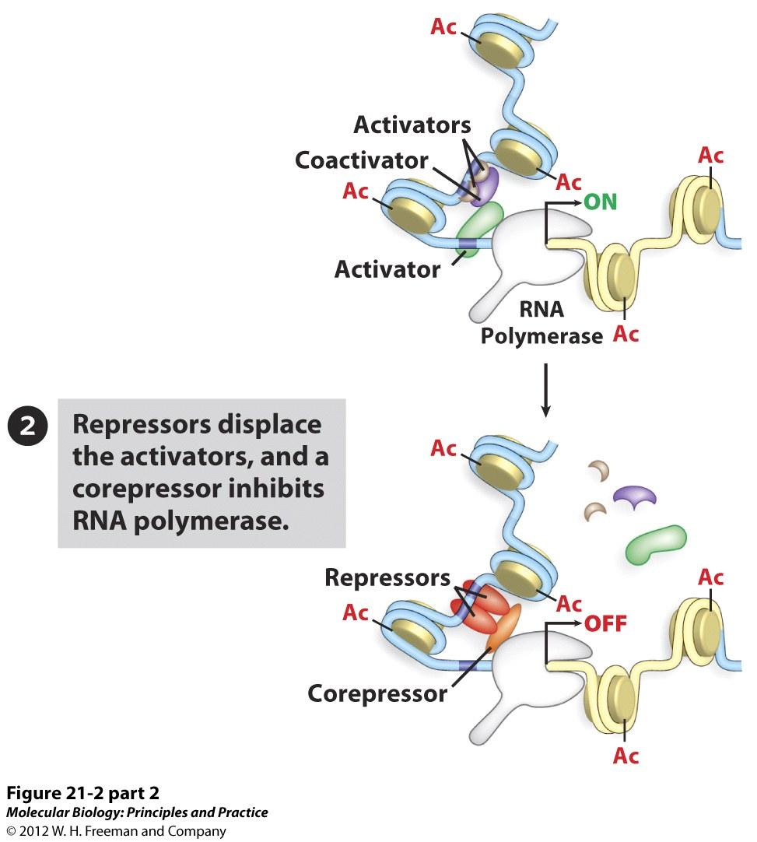
Gene Inactivation by Histone Deacetylation
Decondensation also exposes binding sites for repressors.

Slide 11
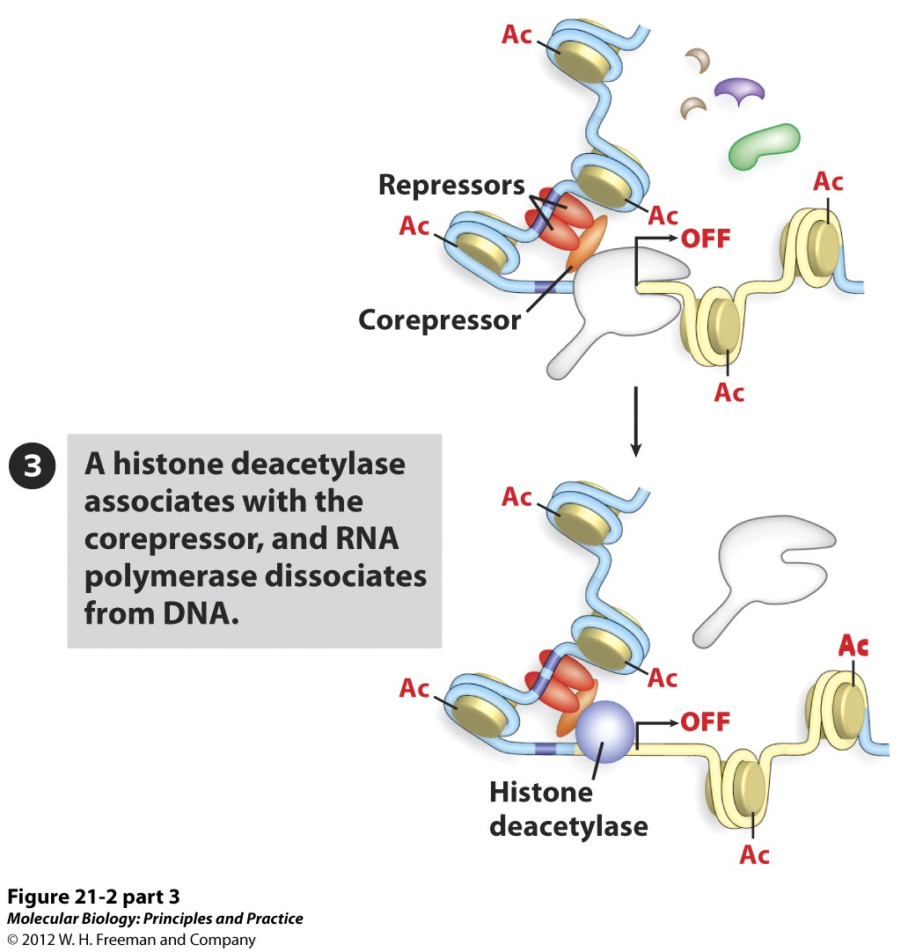
Gene Inactivation by Histone Deacetylation
Corepressor recruits HDAC to chromatin.

Slide 12
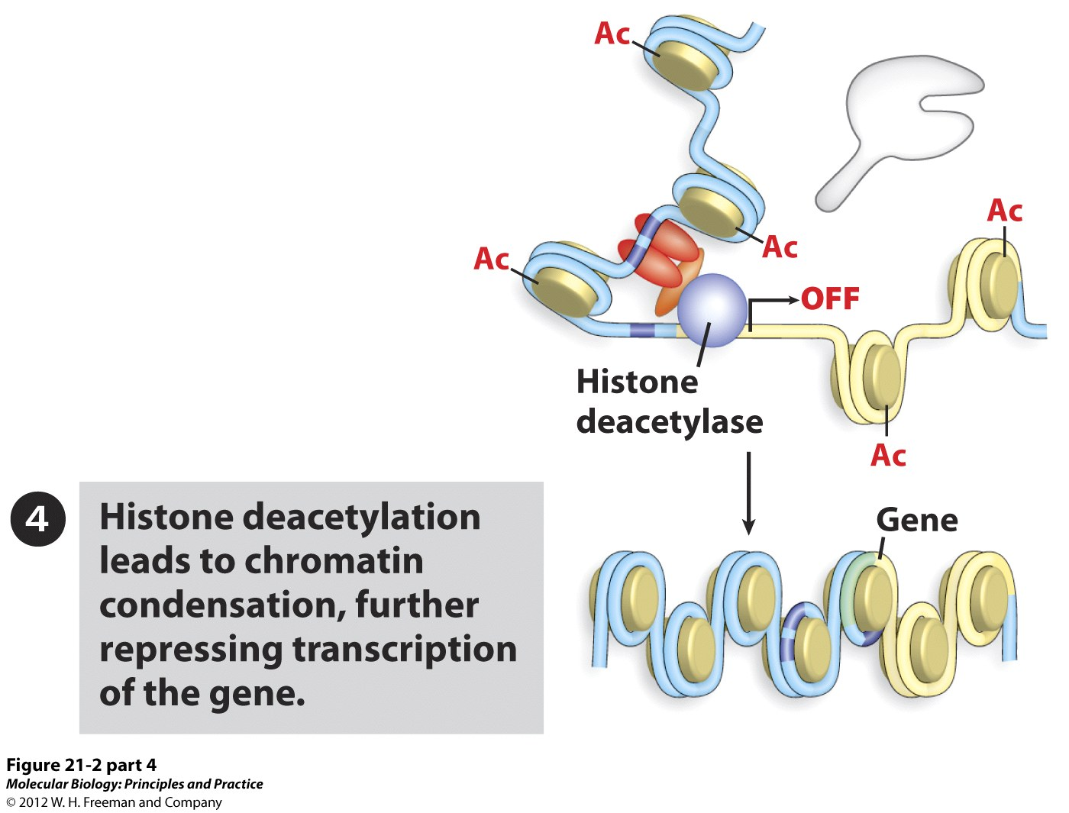
Gene Inactivation by Histone Deacetylation

Slide 13
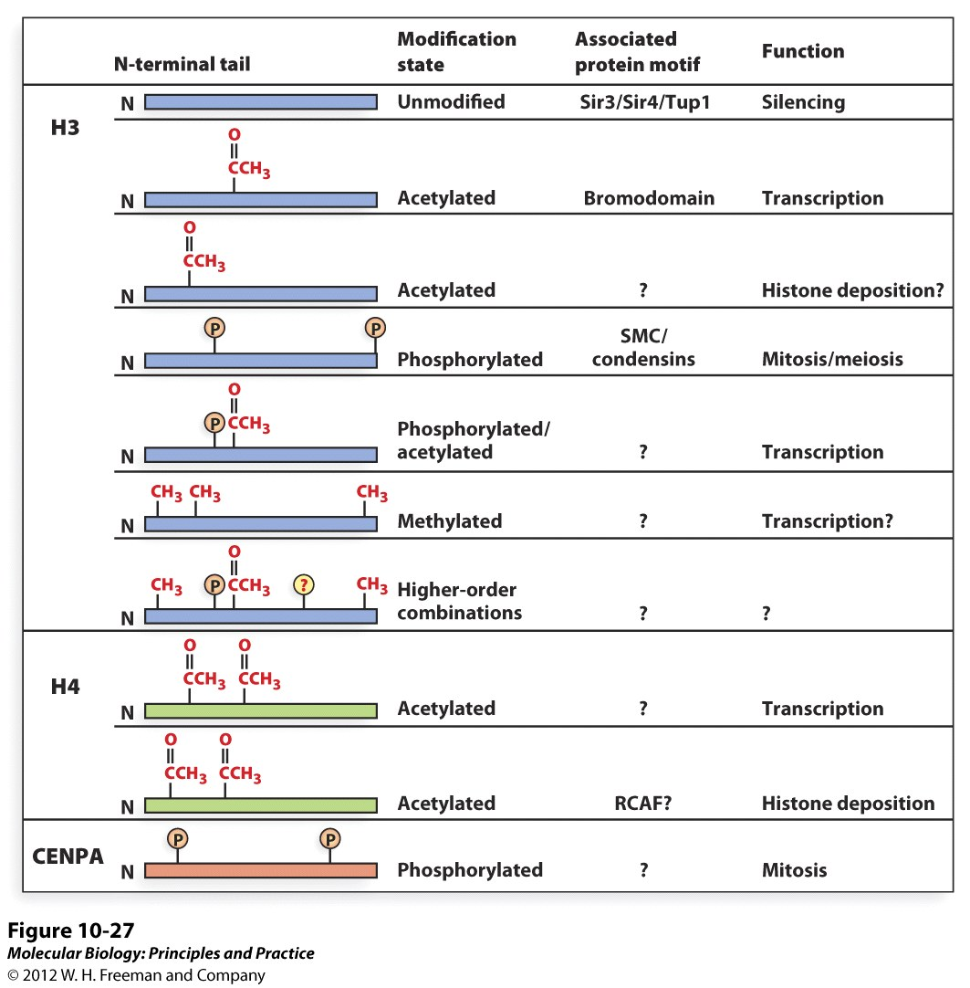
How to Alter DNA Packaging
In the cell – the effects of each type of modification can vary

Slide 14
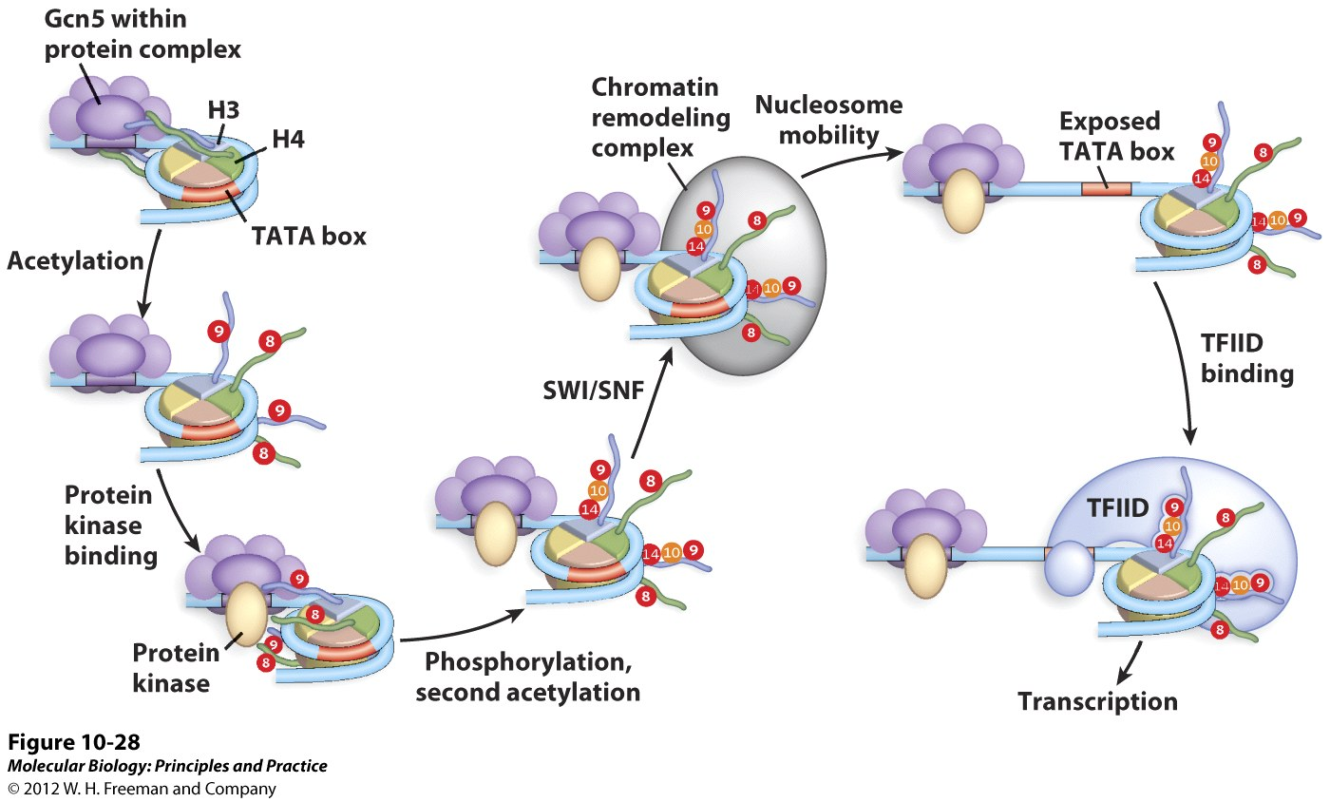
Histone code example
Activation of the promoter requires an ordered succession of events.
Gcn5 is a histone acetyltransferase (HAT)
SWI/SNF is a chromatin remodeling complex

Slide 15
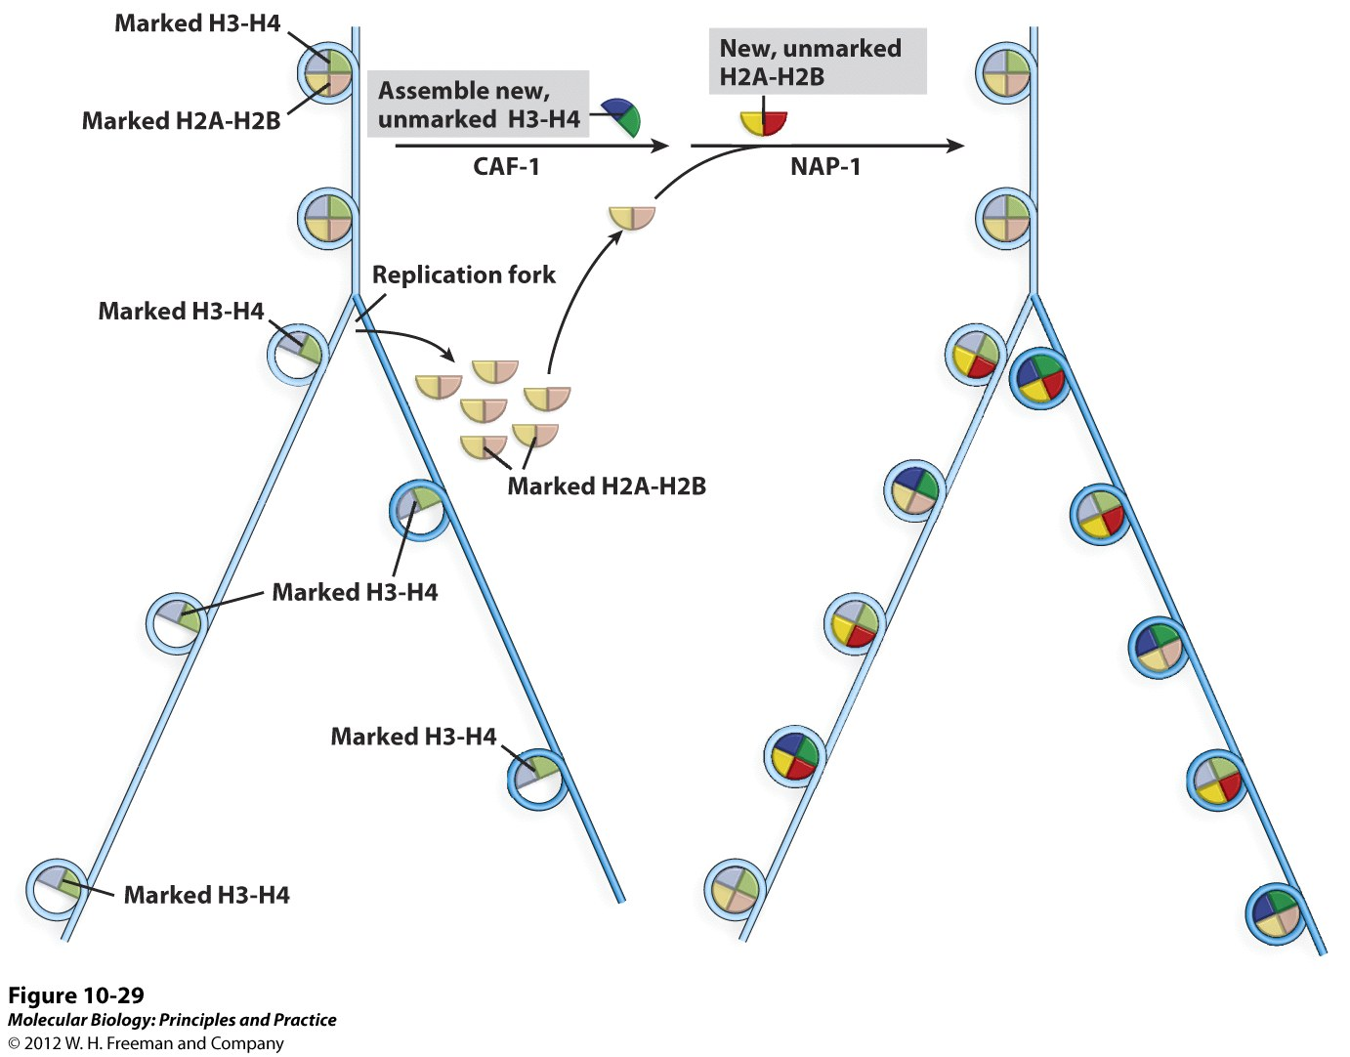
Epigenetic Inheritance
Chromatin state is inherited after DNA replication.
Old, marked histones are indicated by pastel color.
New, unmarked histones are indicated by bright color.

Slide 16
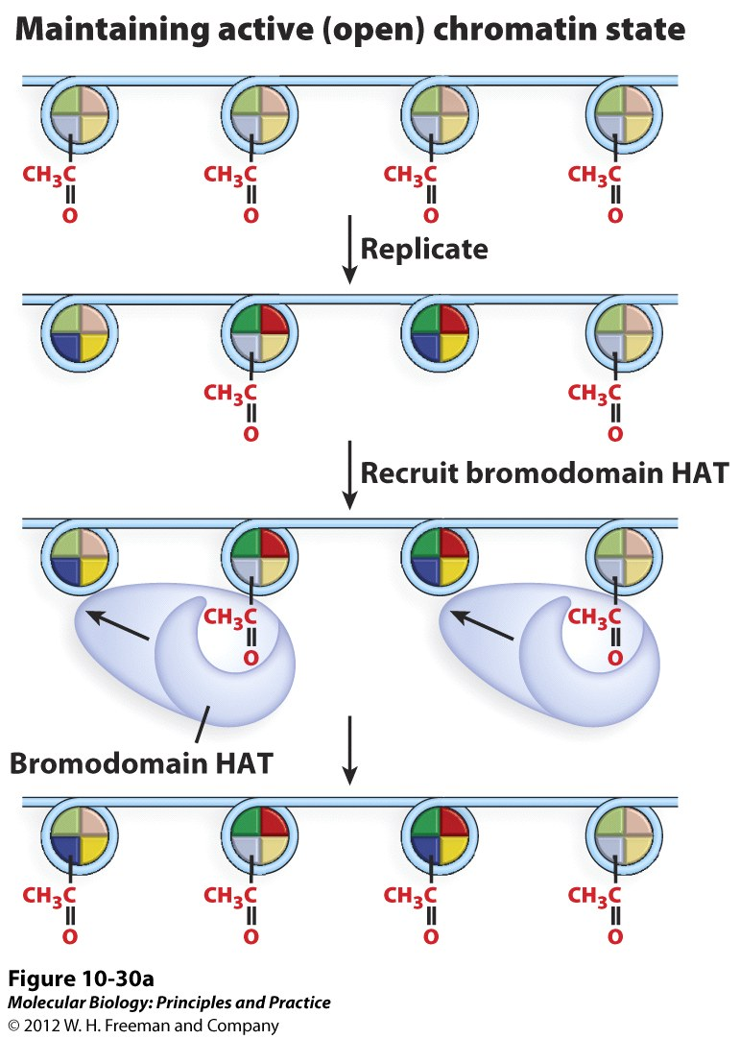
Epigenetic Inheritance
Epigenetic states spread locally after DNA replication.
Original active acetylated state
Replicated state with mixture of old acetylated and new non-acetylated
Bromodomain protein binds to acetylated lysine residues and associated HAT acetylates adjacent unmarked nucleosome.
Epigenetic state is fully replicated.

Slide 17
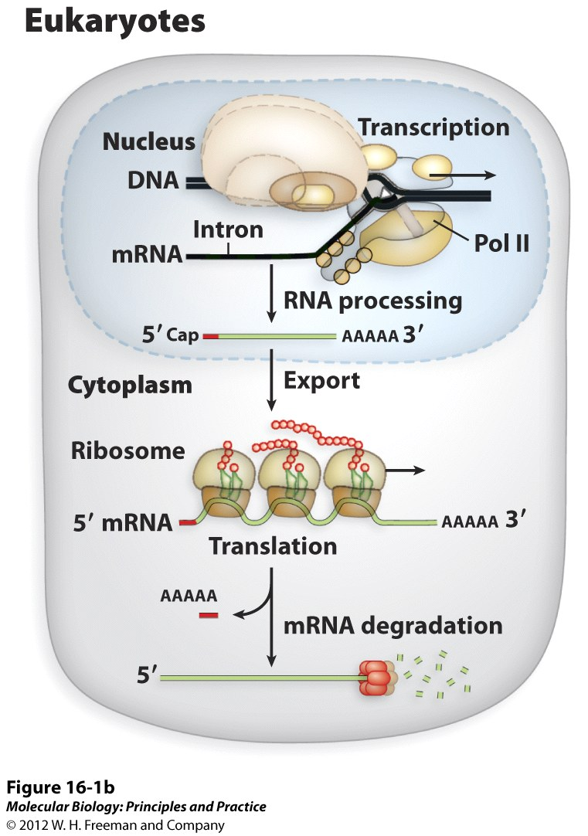
mRNA processing
5’ Cap
Intron splicing
Poly A tail

Slide 18
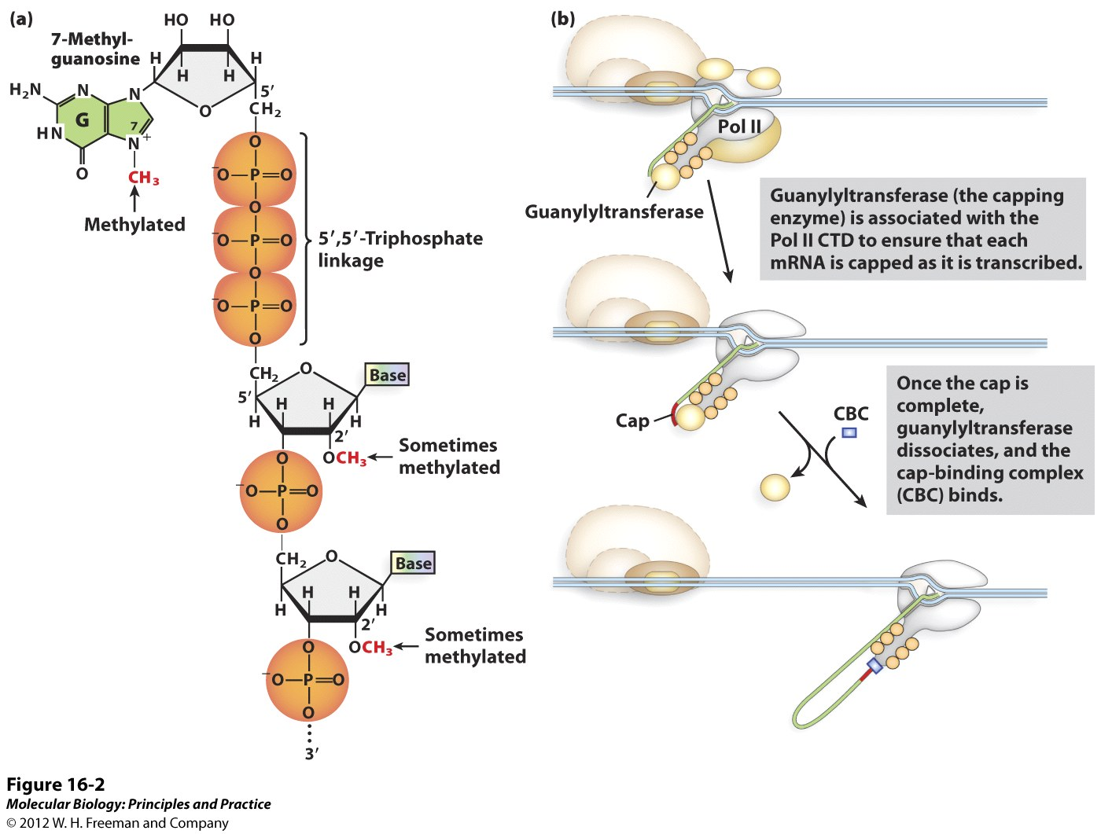
mRNA processing

Slide 19
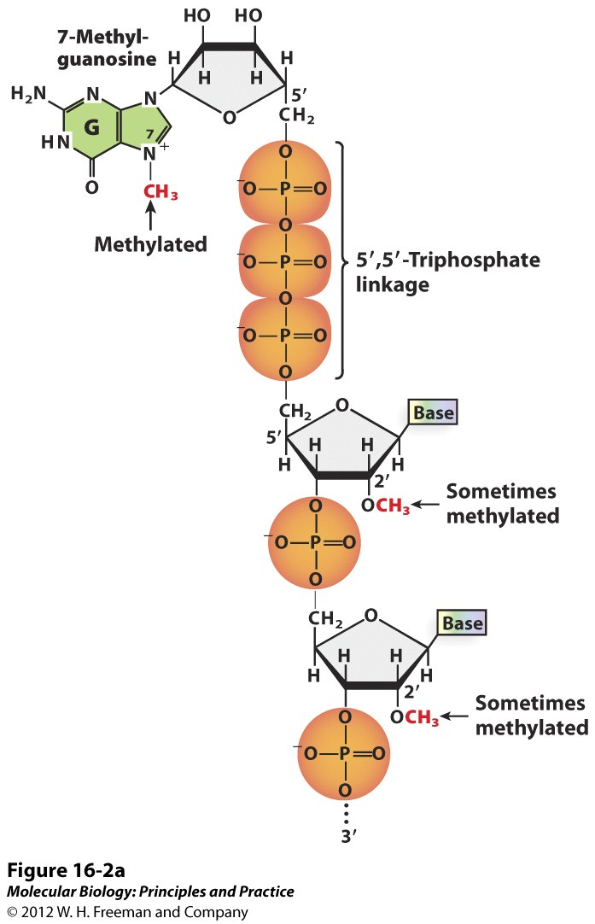
5’ Cap addition
Function
Protects mRNA from nucleases
Distinguishes mRNA from other types of RNA
Impt for mRNA export
Impt for translation initiation

Slide 20
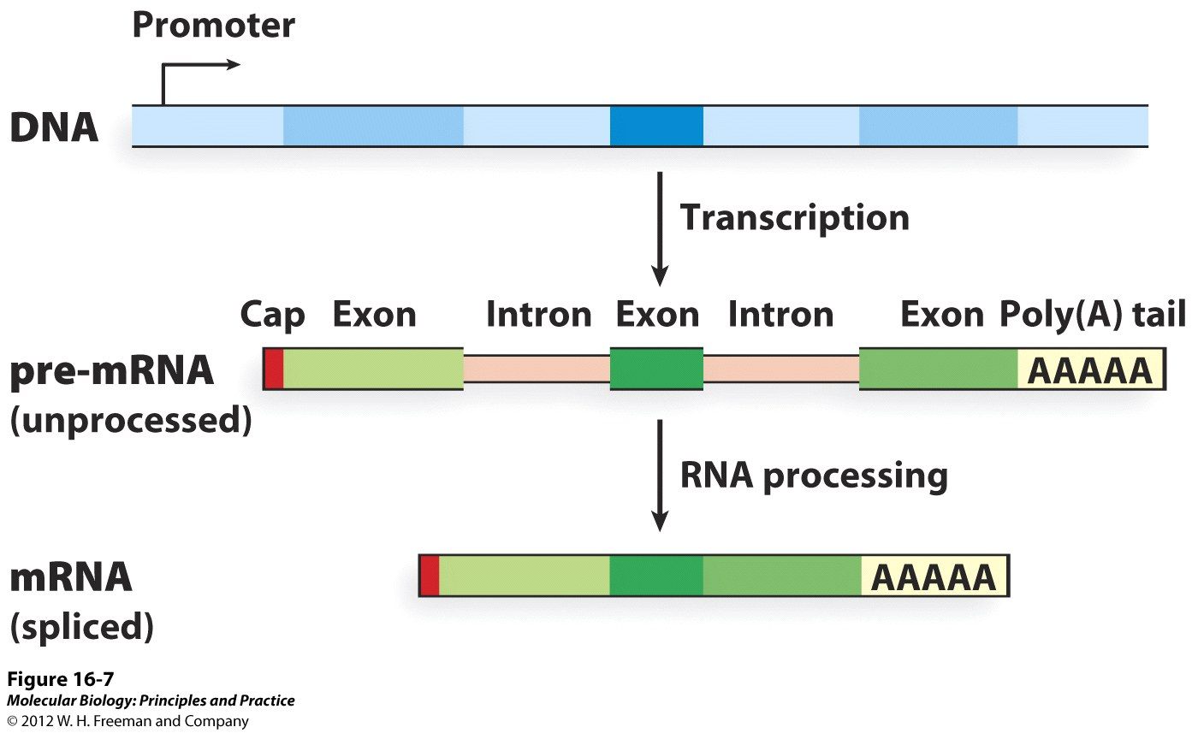
Poly A Tail addition
Function
Protects mRNA from nucleases
Important for mRNA export
Important for translation
Allows for the isolation of mRNA in the lab

Slide 21
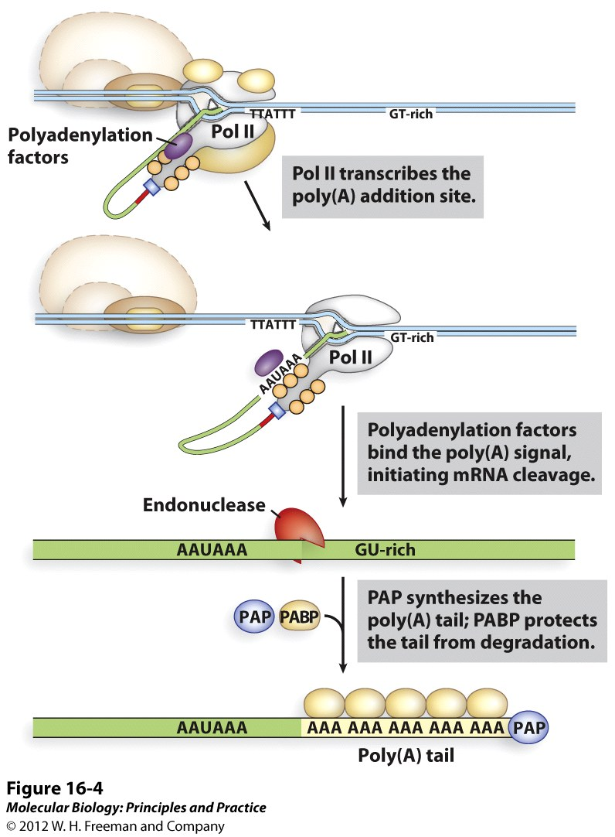
Poly A Tail addition

Slide 22
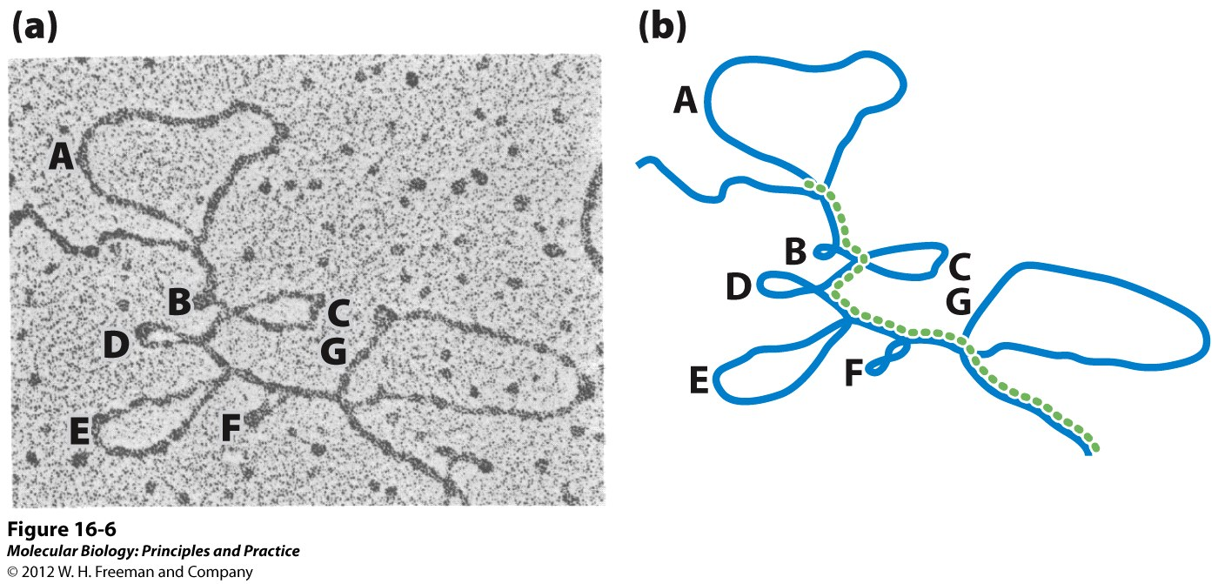
mRNA Splicing
Function
Allows for multiple versions of a protein to be produced by 1 gene
Important for mRNA export
Important for translation (nonsense mediated decay)
Genomic DNA hybridized to cDNA

Slide 23
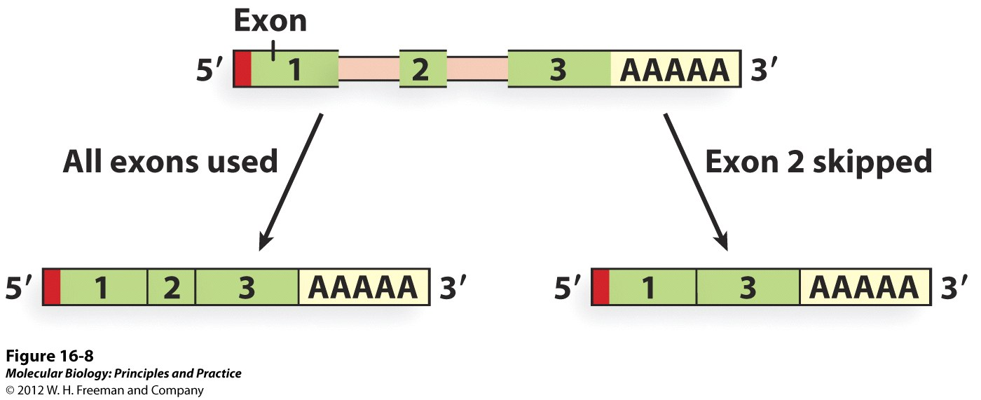
mRNA Splicing
How many proteins does one gene make?

Slide 24
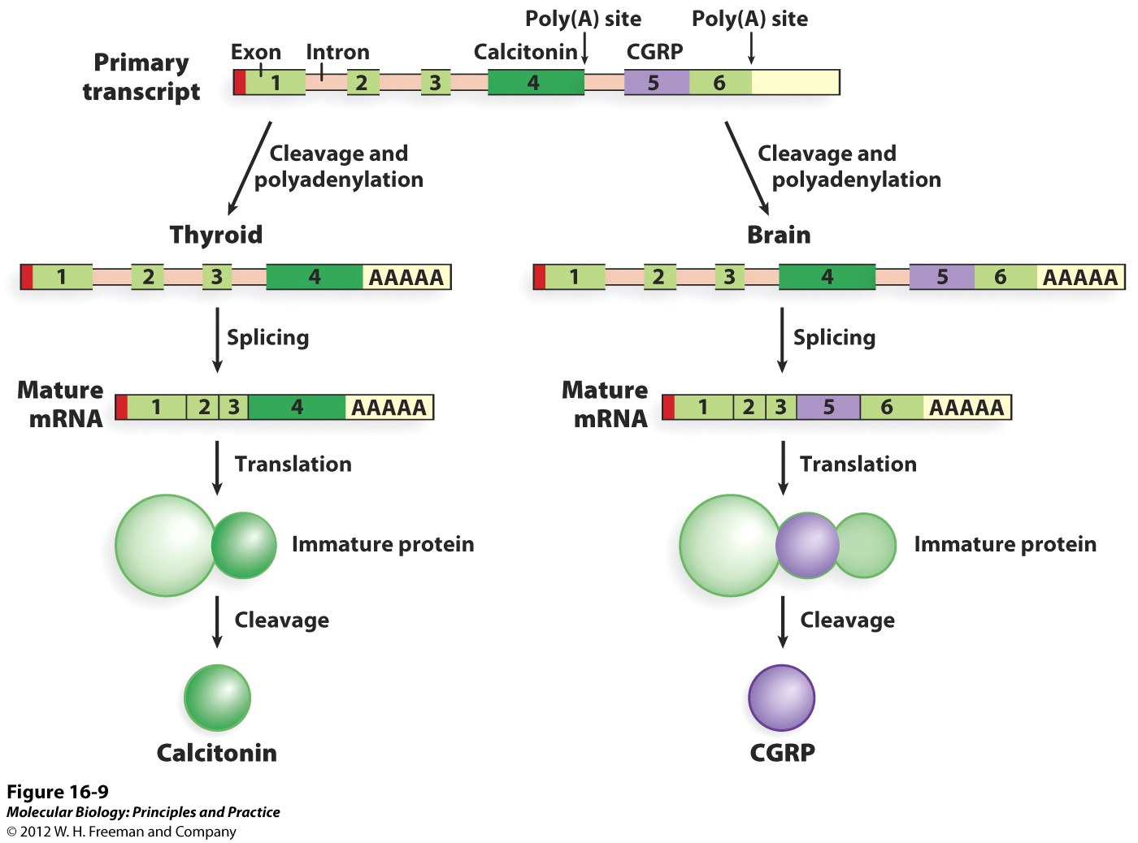
Alternative mRNA Splicing

Slide 25
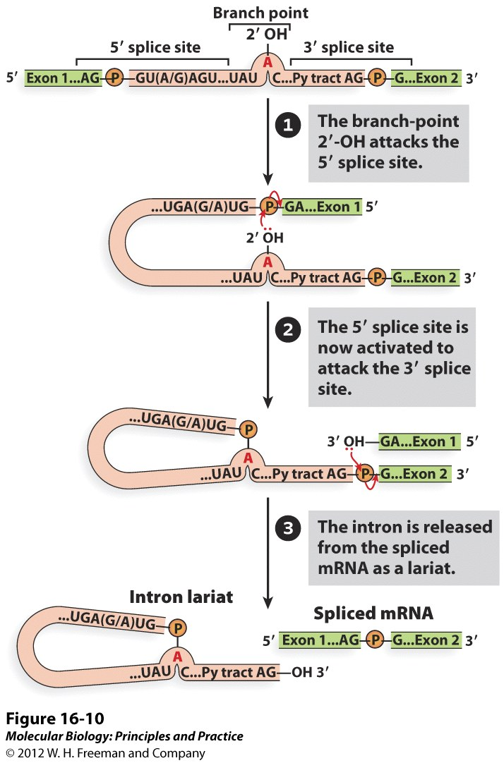
mRNA Splicing

Slide 26
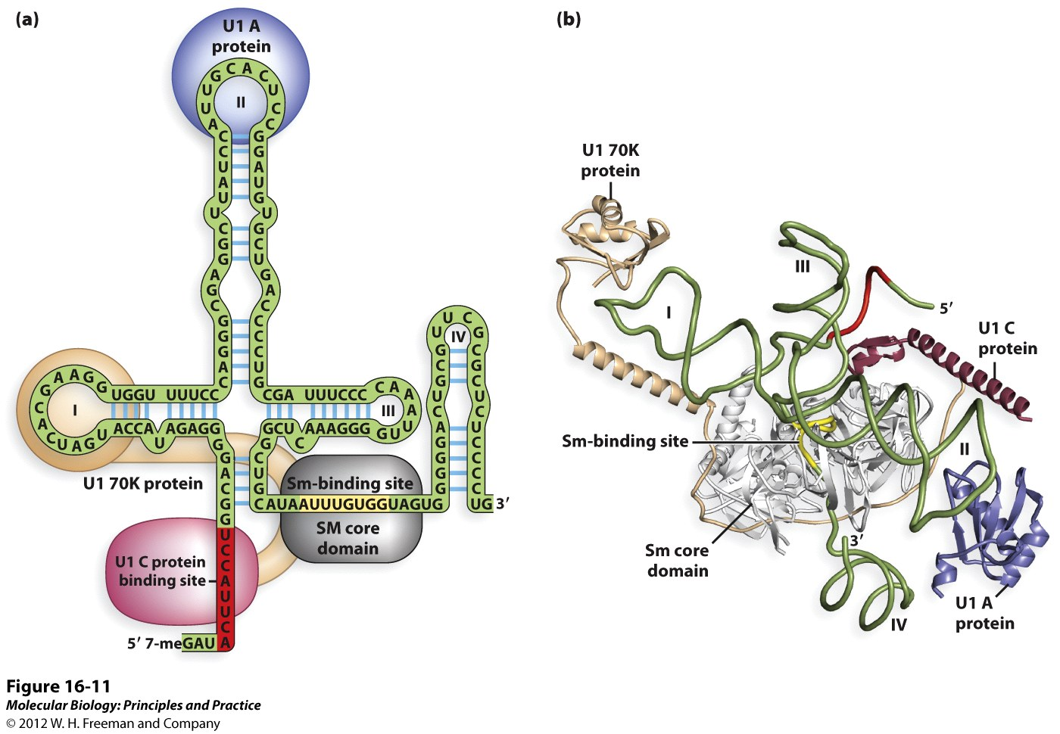
mRNA Splicing
Splicing and the spliceosome
RNA/protein complex - snRNPs

Slide 27
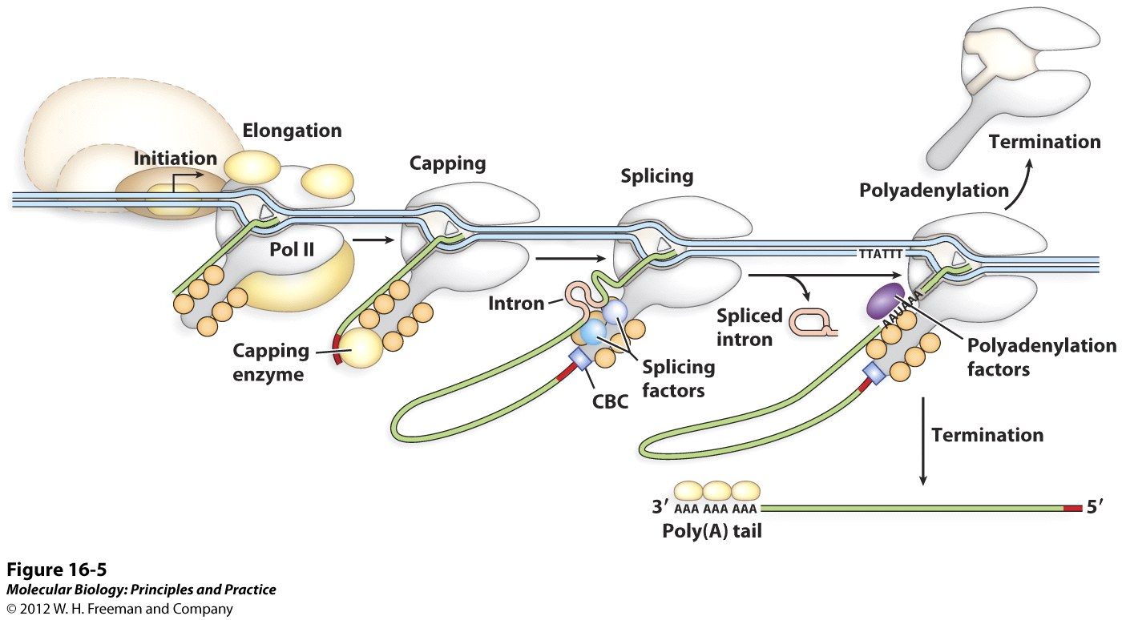
Coordination of Transcription and mRNA processing

Slide 28
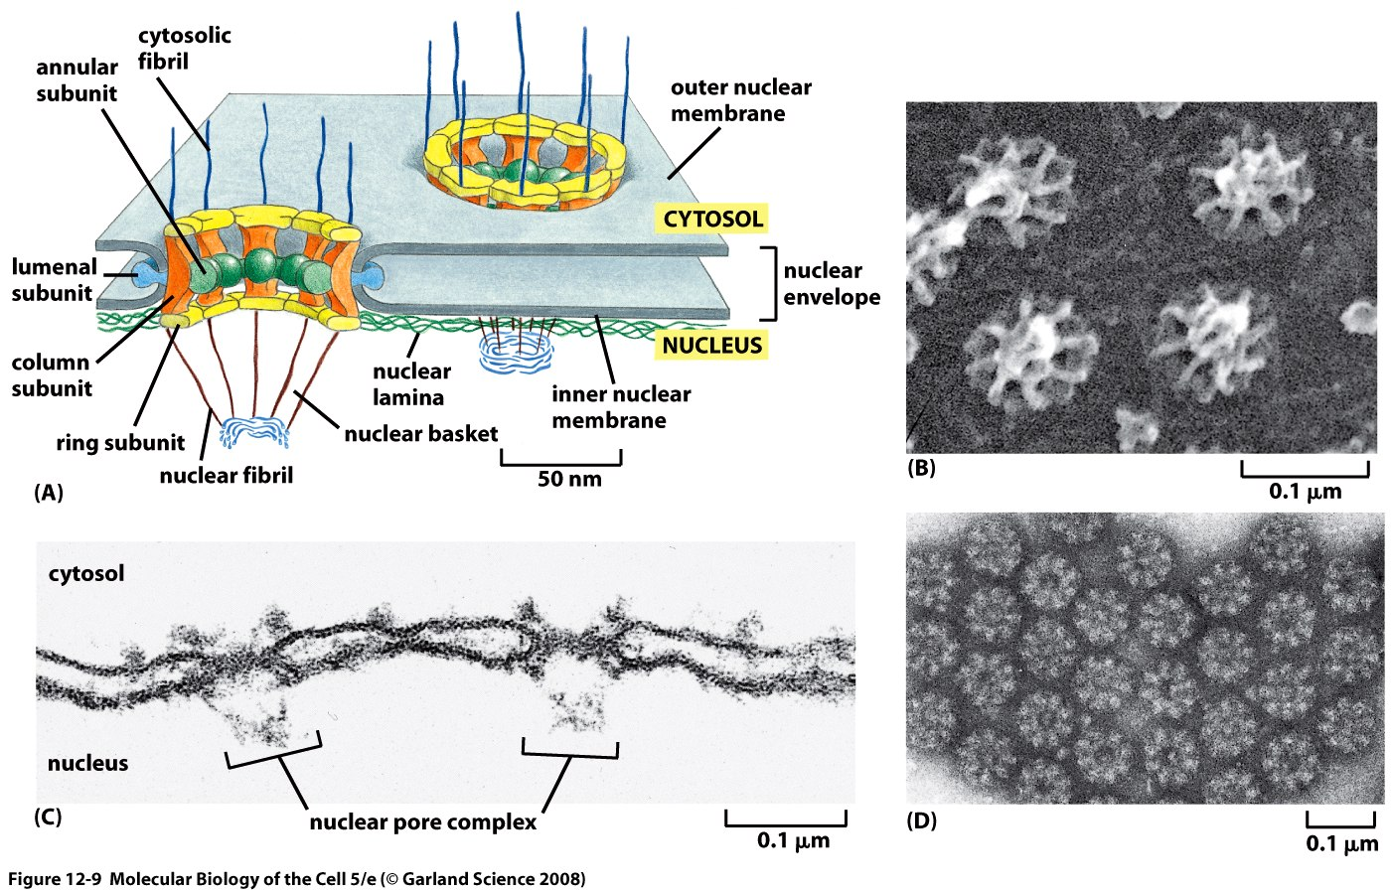
mRNA Export
Why is a specialized export pathway necessary?

Slide 29
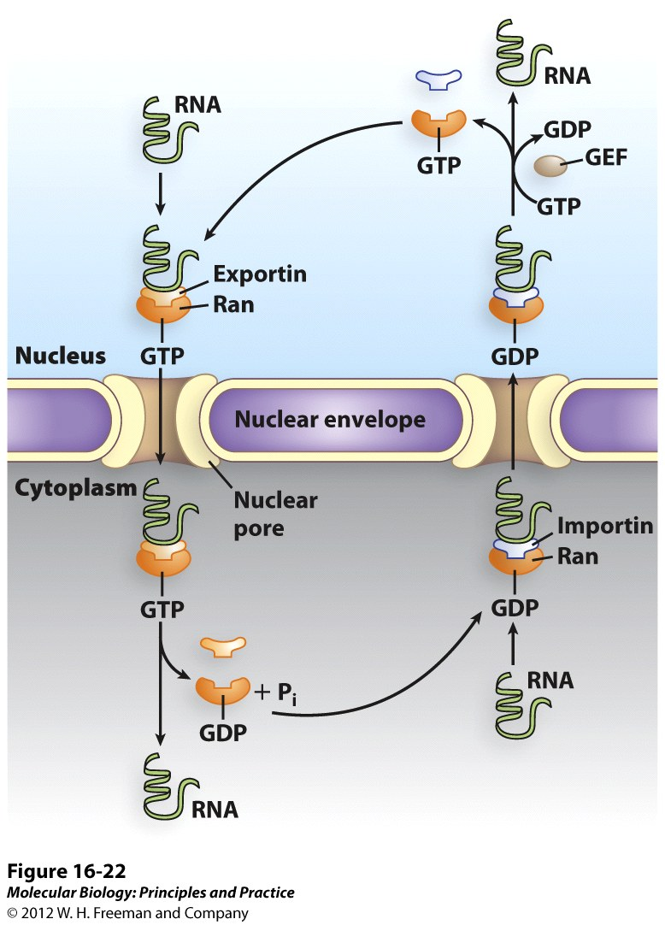
mRNA Export
Details not important!

