Slide 1
Lecture 15 – mRNA splicing, nontranslated RNA & one gene, one protein dogma
mRNA splicing
Function of splicing
Mechanism of splicing
RNA Regulation of Gene Expression
siRNA
microRNA
Abundant RNAs
rRNA
tRNA
Development of the “One gene, one protein dogma”.

Slide 2
Learning Goals
Be able to describe the functions of mRNA splicing.
Be able to diagram the mechanism of mRNA splicing.
Be able to list the similarities and differences between siRNA and microRNA and the effect they have on mRNA
Be able to analyze data from experiments utilizing siRNA
Be able to describe how mutations in genes that are involved in the synthesis of a specific nutrient can be isolated in fungi.

Slide 3
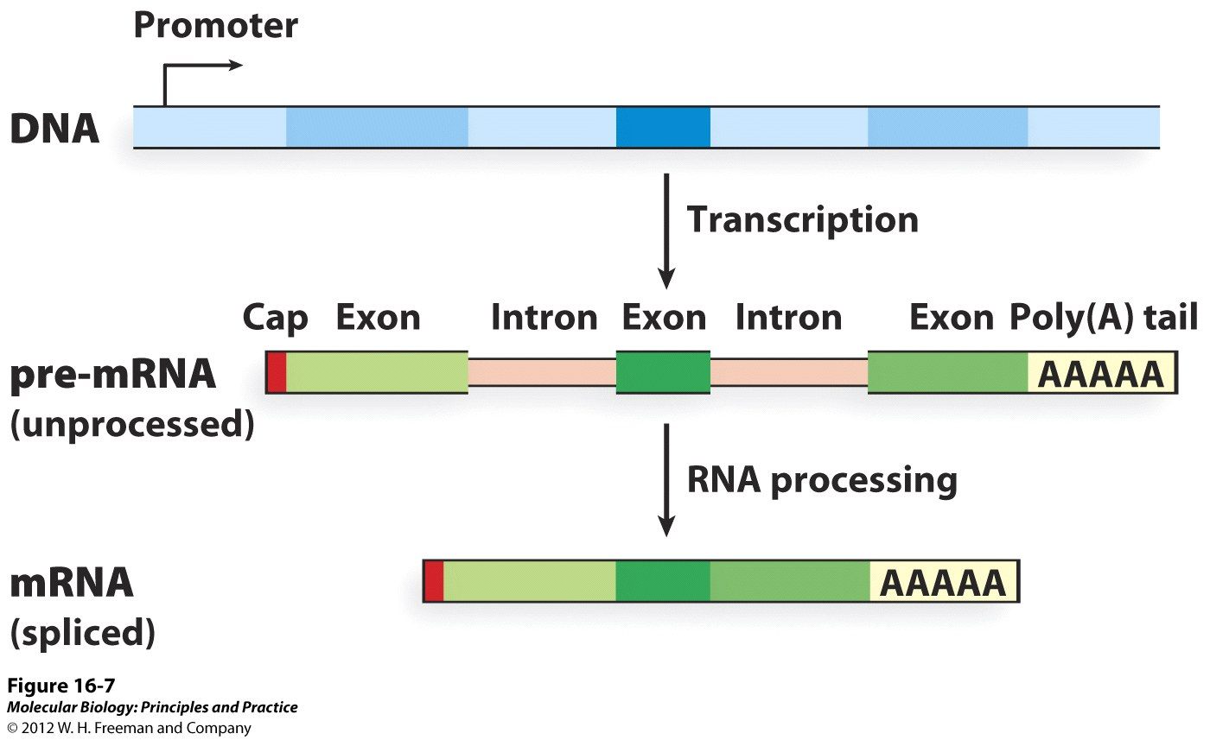
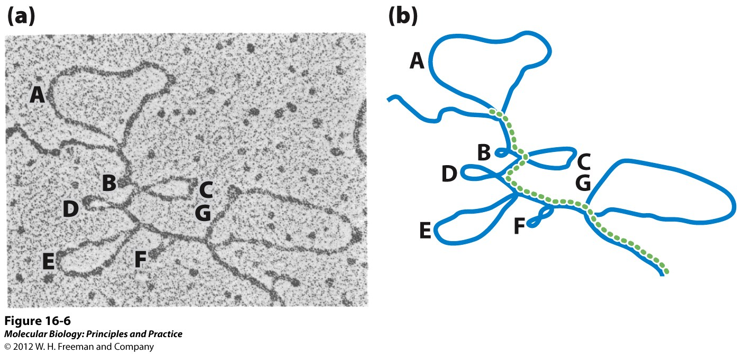
mRNA Splicing
Function
Allows for multiple versions of a protein to be produced by 1 gene
Important for mRNA export
Facilitates evolution by mixing and matching domains
Genomic DNA hybridized to mRNA

Slide 4
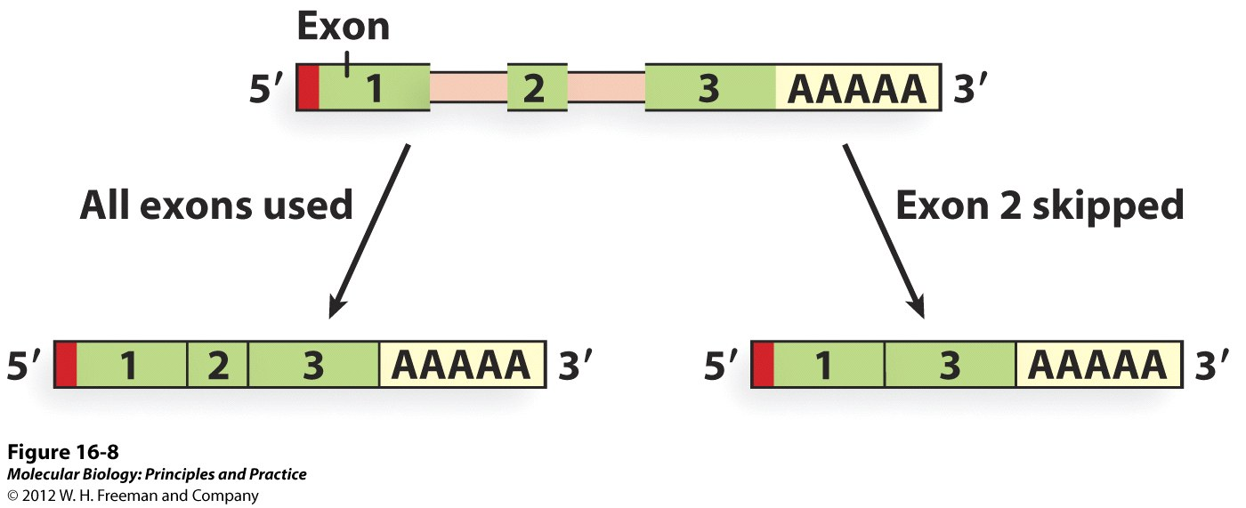
mRNA Splicing
How many proteins does one gene make?

Slide 5
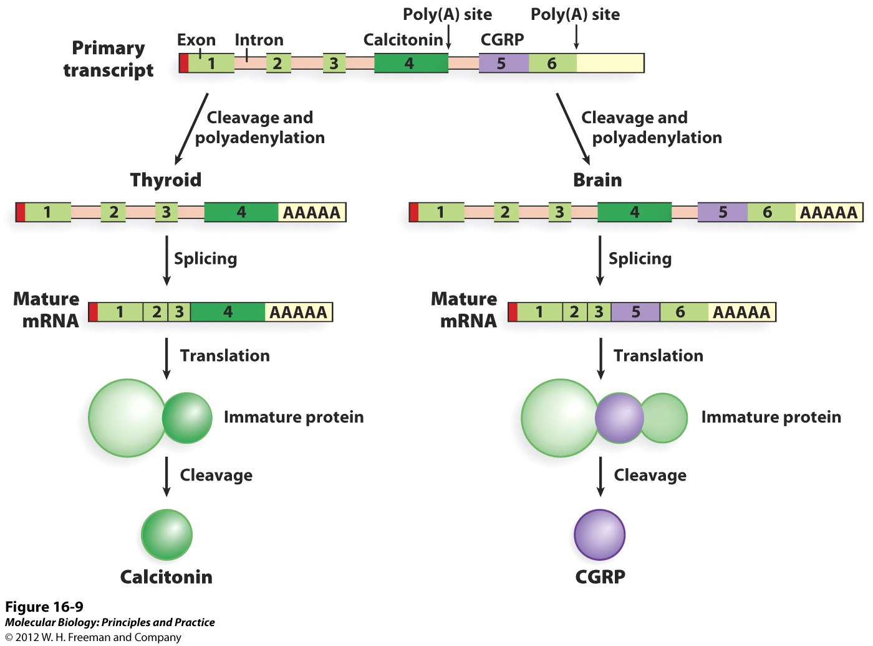
Alternative mRNA Splicing

Slide 6
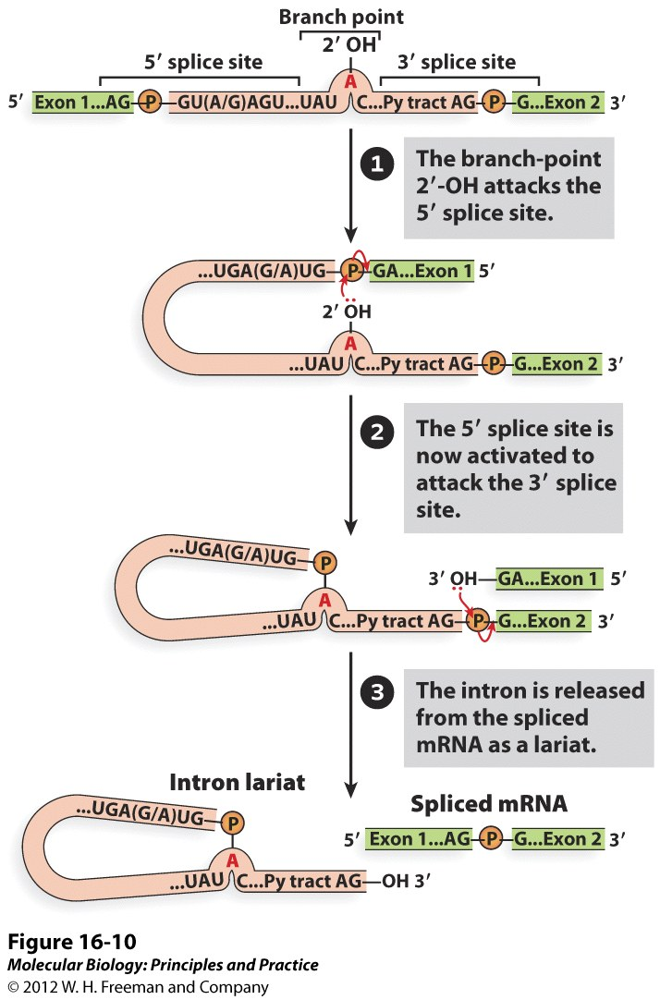
mRNA Splicing

Slide 7
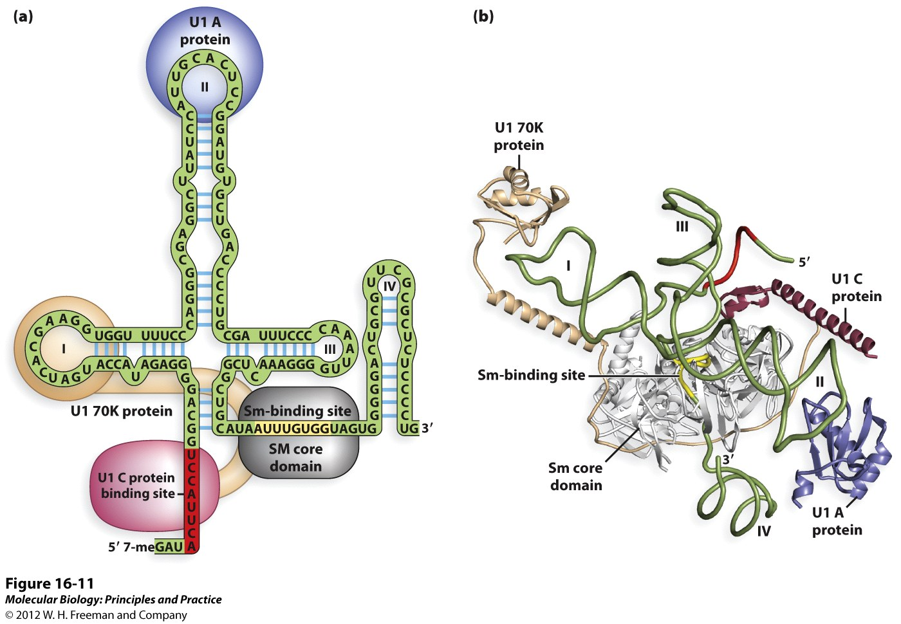
mRNA Splicing
Splicing and the spliceosome
RNA/protein complex – snRNPs, U1, U2, U4-U6
The U1 snRNP is just one of 5.

Slide 8
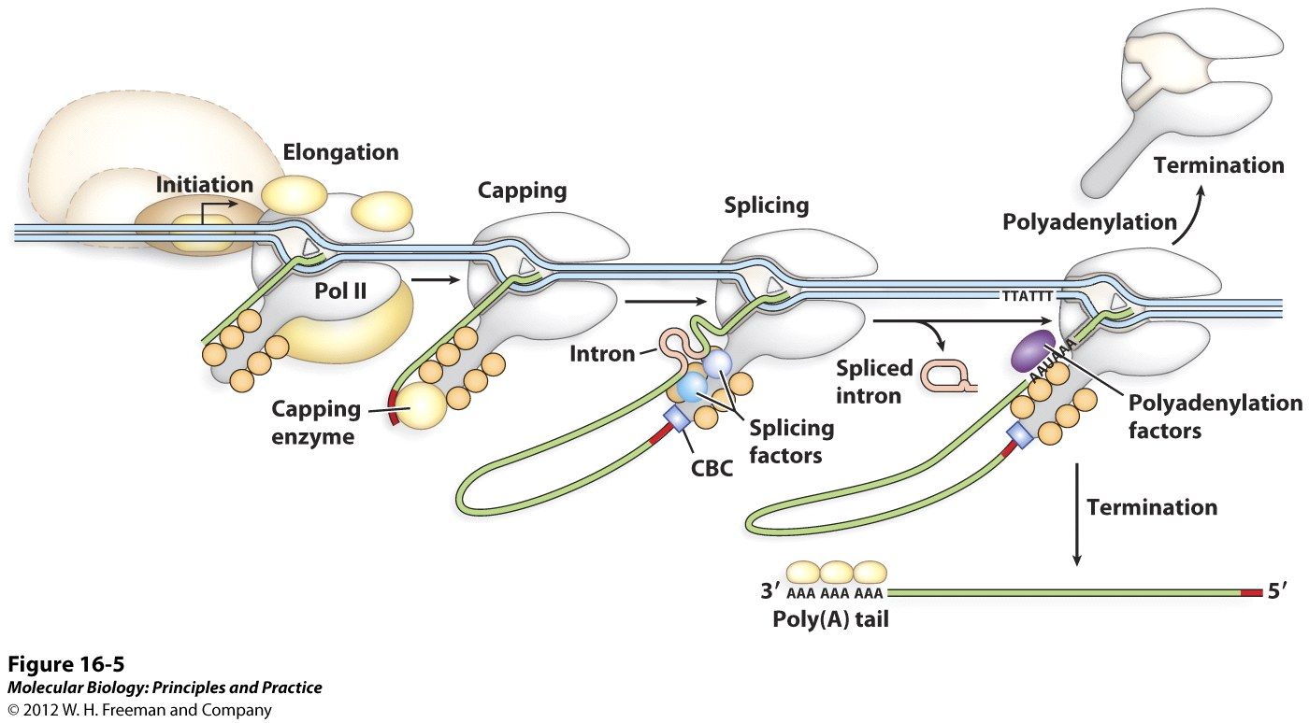
Coordination of Transcription and mRNA processing

Slide 9
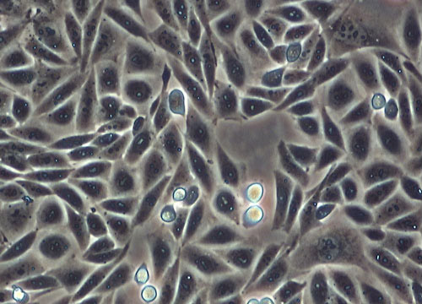
Small Interfering RNAs (siRNA)
Previously demonstrated (1980’s):
Target mRNA
Anti-sense RNA
Anti-sense RNA hybridizes to target mRNA causing target mRNA levels to decrease and decreasing translation of the mRNA by the ribosome.

Slide 10
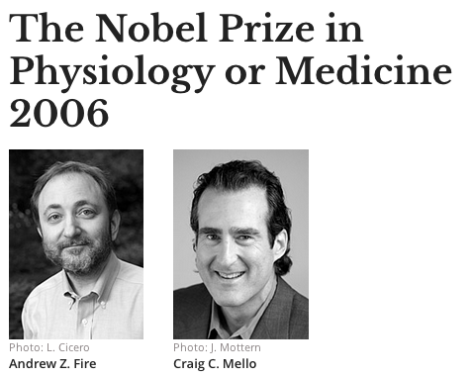
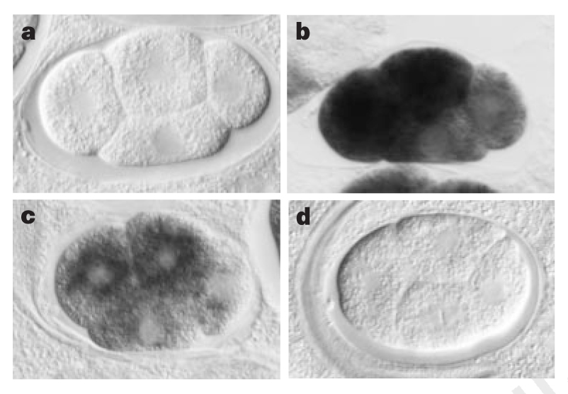
Small Interfering RNAs (siRNA)
Scientists had long assumed that is due to binding of anti-sense RNA to mRNA.
Fire and Mellow added a new control for single stranded antisense: double stranded antisense.
Surprisingly they found that double stranded RNA was much more efficient in inducing gene silencing than antisense RNA. They discovered micro RNAS and a new system for regulating gene expression!
Colored probe, but no added RNA
No probe
Probe + mex3 anti-sense single stranded RNA
Probe + mex3 double stranded RNA

Slide 11
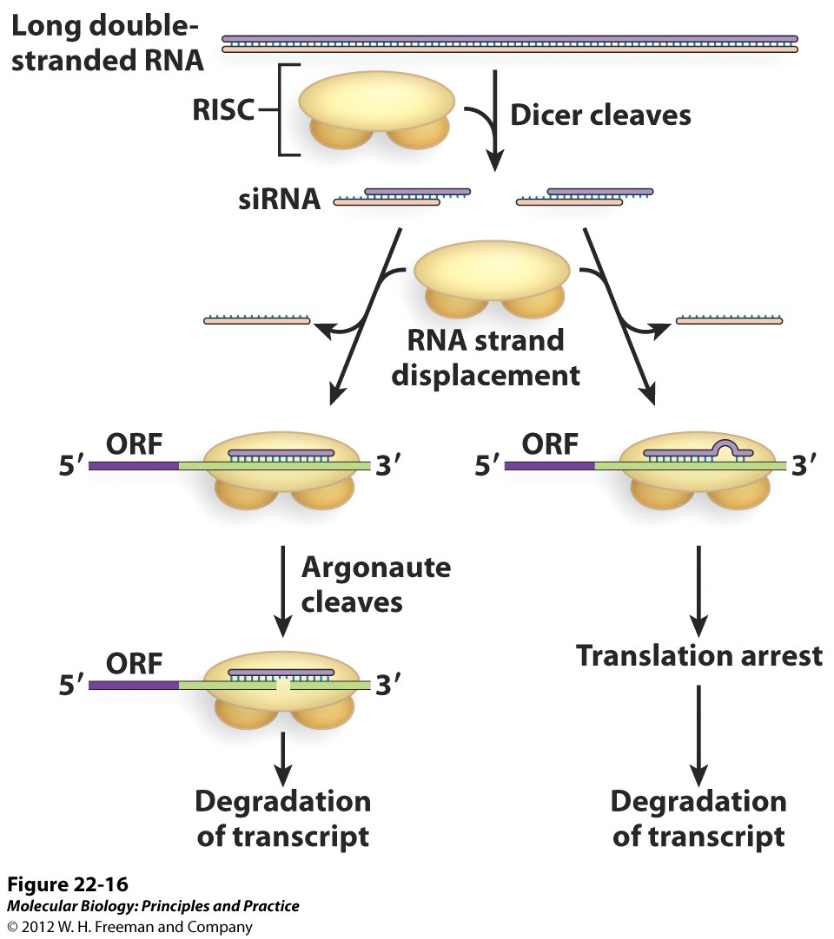
RNA Interference
RISC: RNA-induced silencing complex binds dsRNA.
DICER: endo ribonuclease cuts dsRNA into short 21-27 bp fragments.
ARGONAUTE: endo ribonuclease cuts siRNA – mRNA hybrid.
ORF = Open Reading Frame (protein coding sequence)
siRNAs can down regulate gene expression by two mechanisms: mRNA degradation and blocking translation.

Slide 12
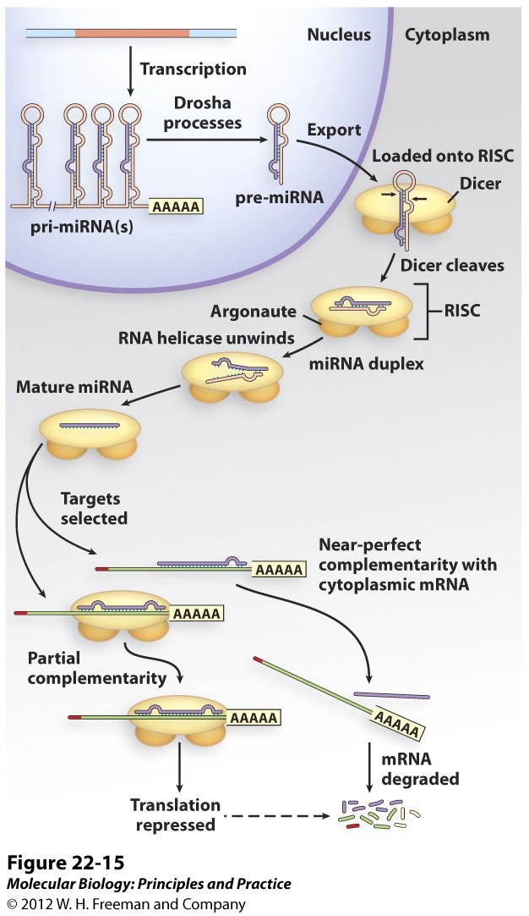
Endogenous RNAi - MicroRNAs
21 to 27 nucleotides
Primary mRNA transcribed by RNA Pol II

Slide 13
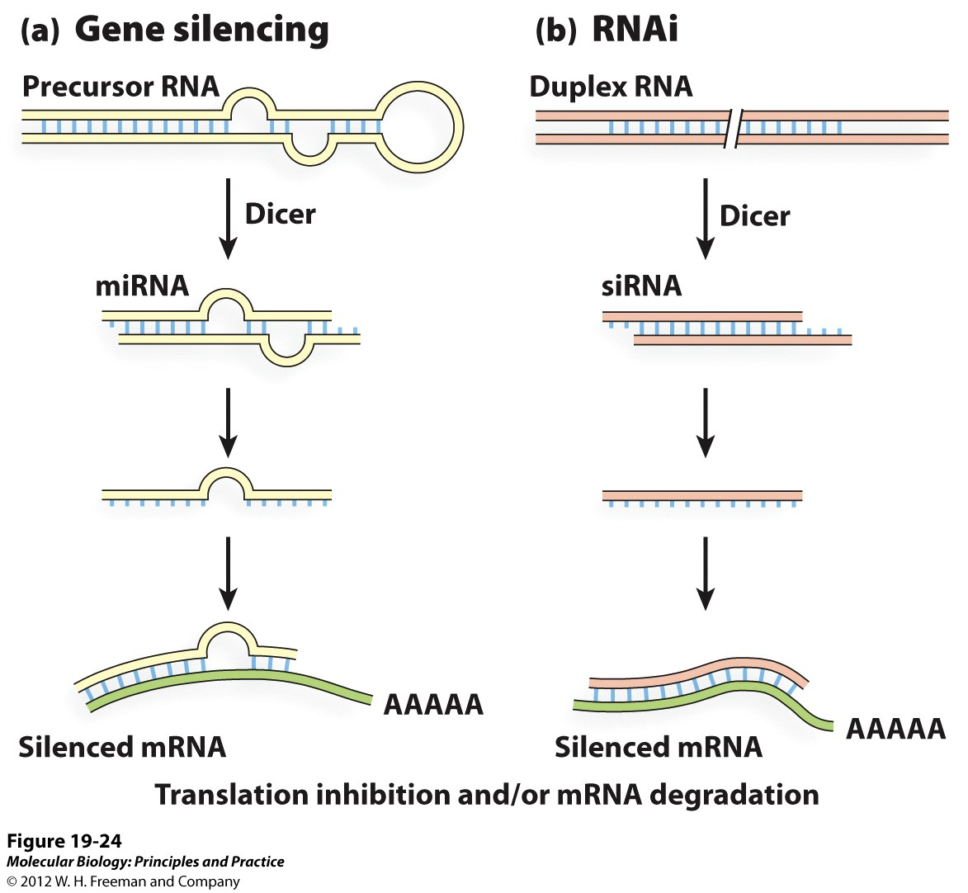
miRNA vs. siRNA
Encoded by genome
Exogenously added by researchers
Translation Inhibition
Translation Inhibition or mRNA degradation

Slide 14
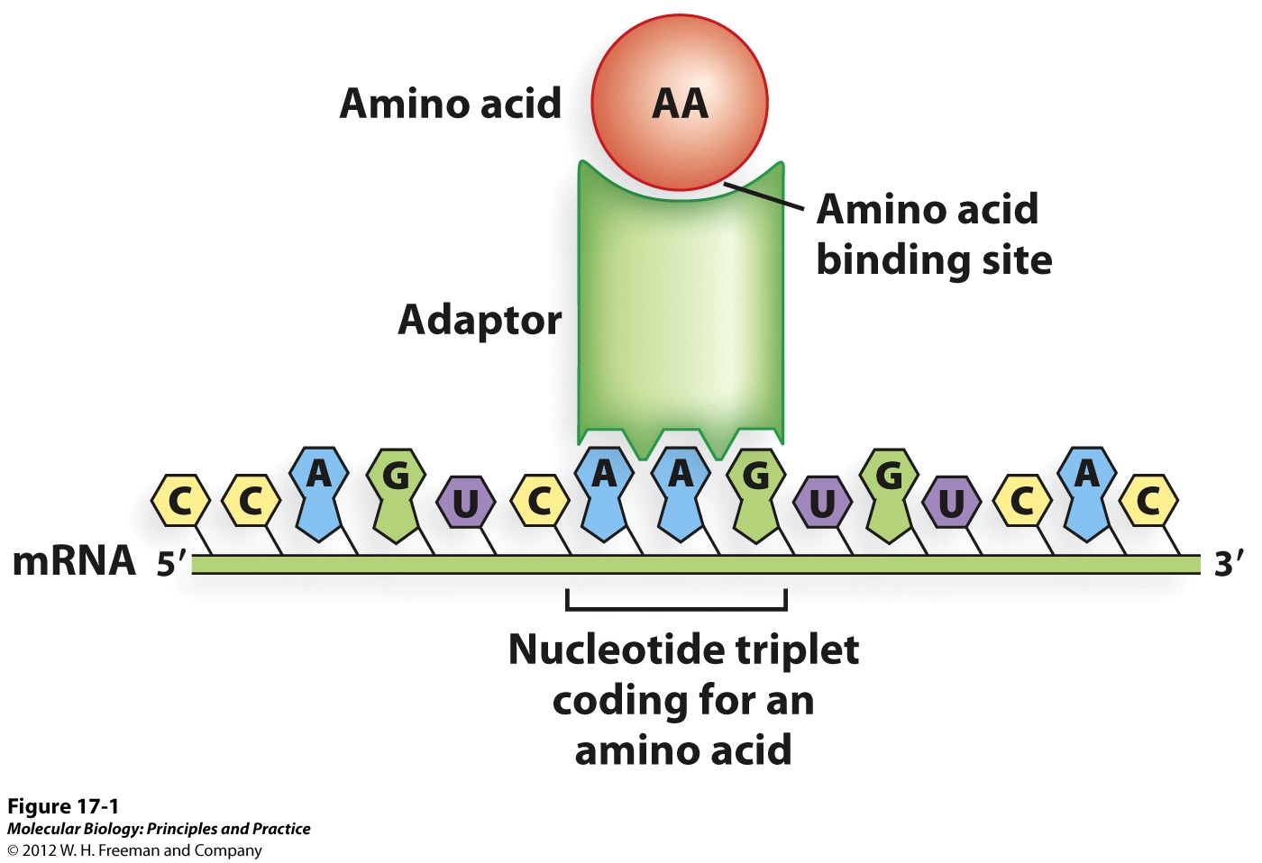
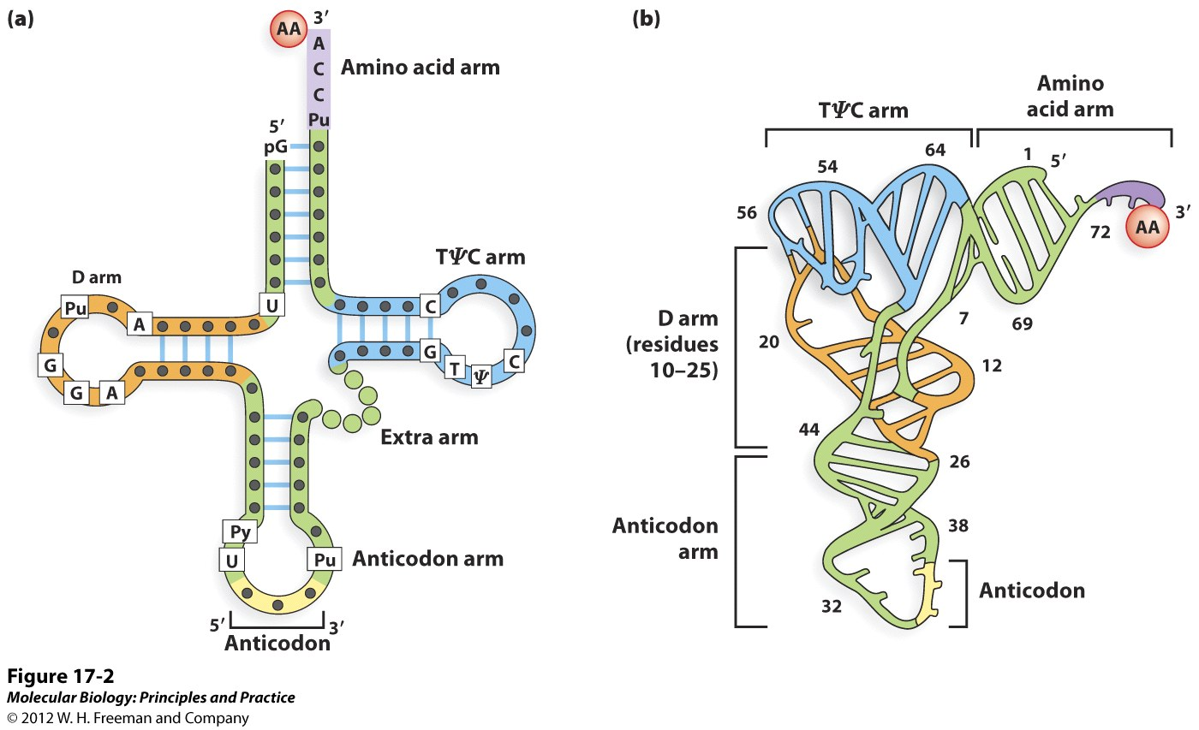
tRNA
Transcribed by pol III

Slide 15
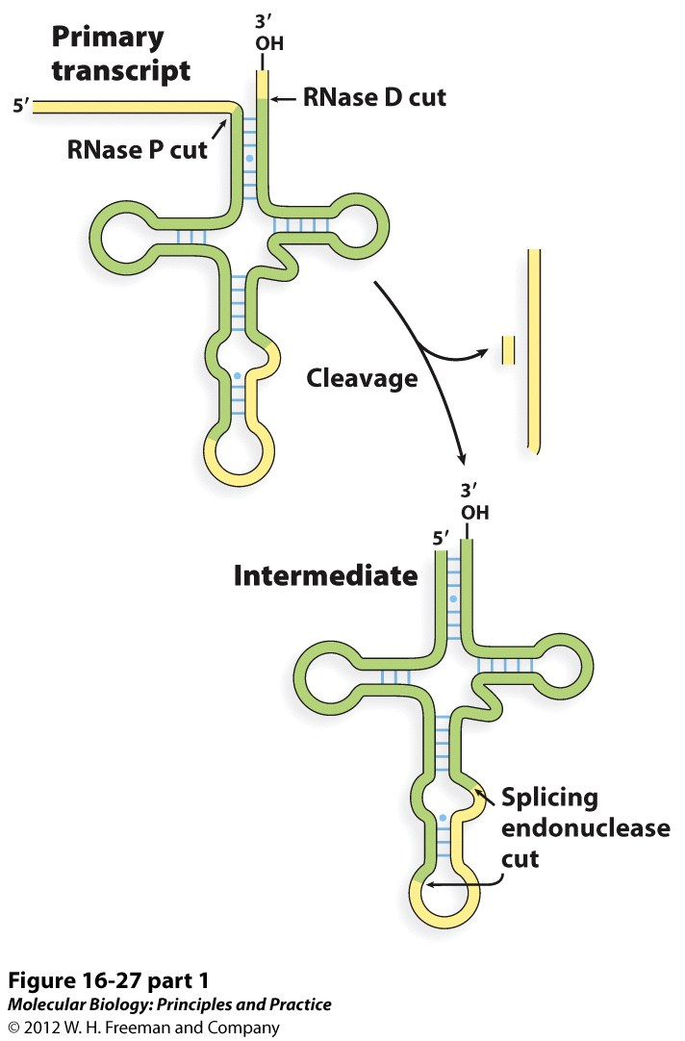
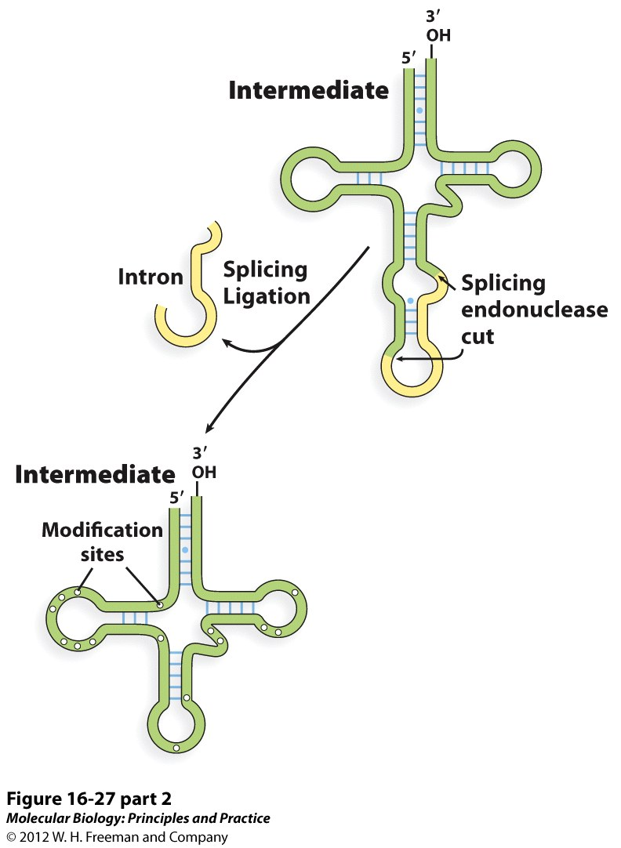
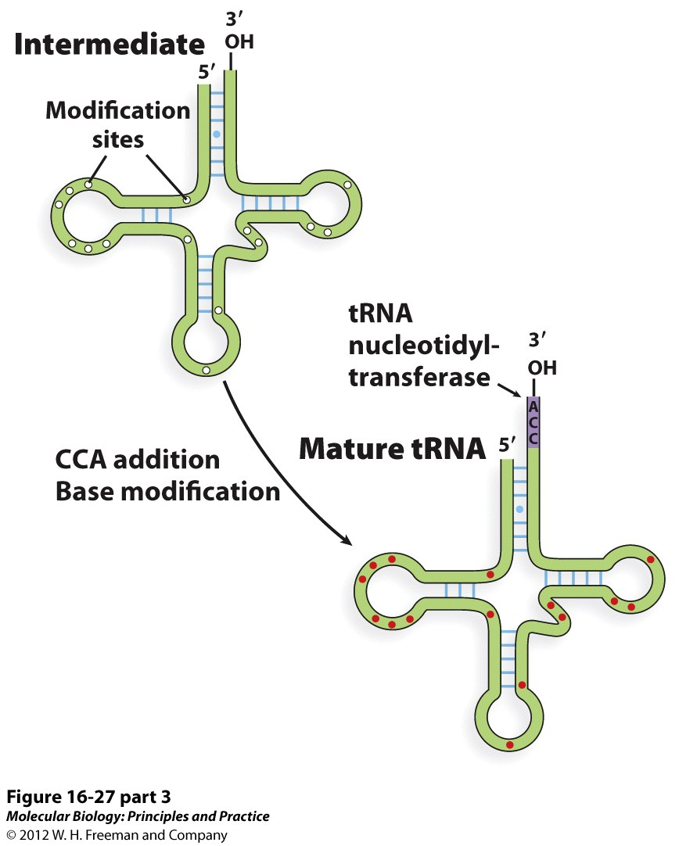
tRNA Processing
tRNA Nucleotidyltransferase:
Compare/contrast with RNA pol

Slide 16
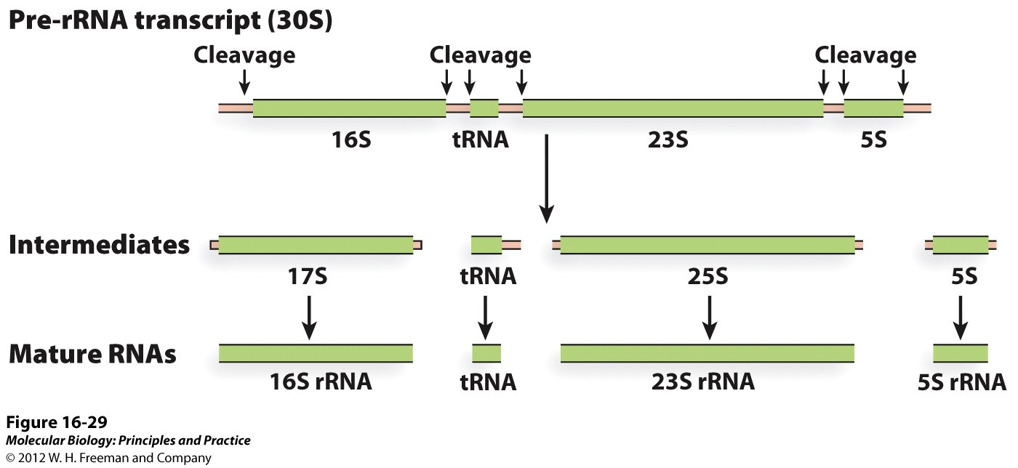
rRNA Processing
Transcribed by Pol I

Slide 17
The central dogma of molecular biology

Slide 18
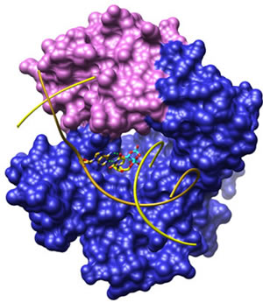
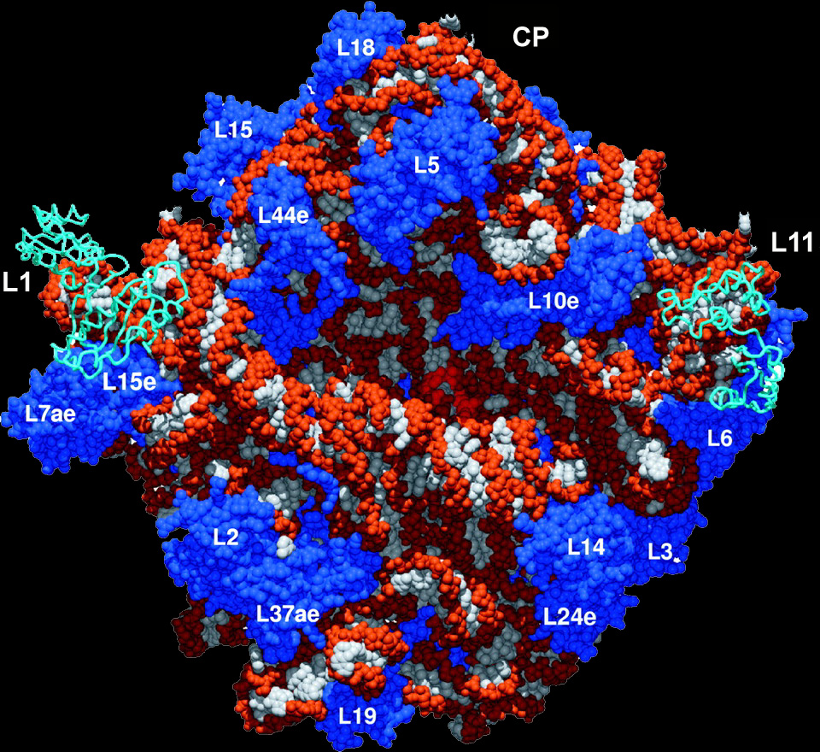
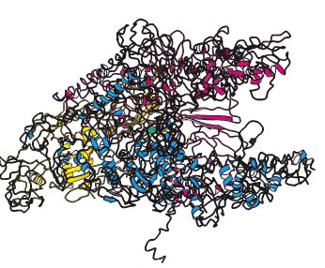
The Central Dogma is the Engine of Evolution
DNA polymerase
(replication)
RNA polymerase
(transcription)
Ribosome
(translation)

Slide 19
Classical vs. modern definition of a gene
Seventy years ago…
A. Classical genetic definition. Genes are discrete, heritable elements that control an observable phenotype or biological property (e.g. Mendel).
Now…
B. Modern Biochemical definition. Genes are pieces of DNA that direct the synthesis of proteins.

Slide 20
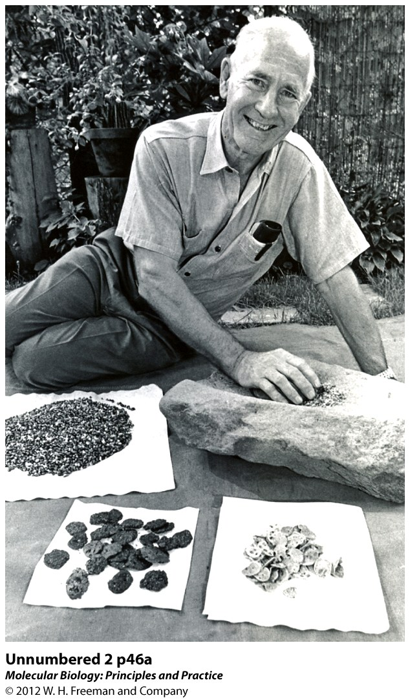
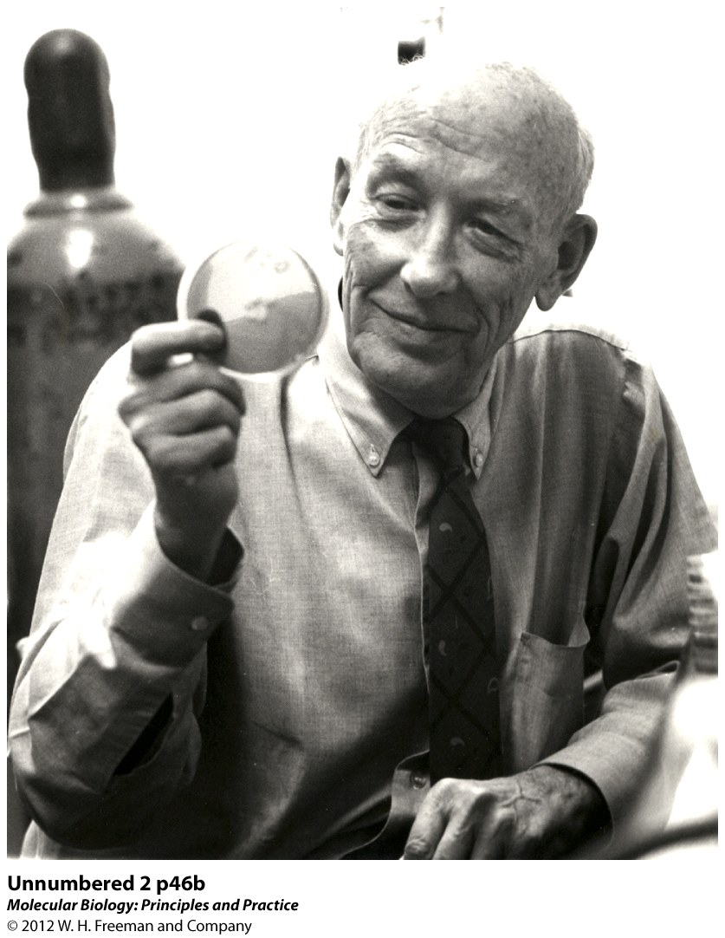
“One Gene, One Enzyme”
Beadle and Tatum: Nobel Prize, 1958.
Wild type mold can grow on minimal medium consisting of glucose and ammonium salts as a nitrogen source. Mutants could not grow on minimal media; had to supplement for growth..

Slide 21
“One Gene, One Enzyme”
Beadle and Tatum: Neurospora crassa (bread mold)
Mutants could not grow on minimal media; had to supplement for growth.
How did they use this system to refine our definition of a gene? Genes encode proteins.
Determined number of genes required for a specific biosynthetic pathway.
A
A
x
x
Concentration of C increases due to inactivation of z.
B
B
y
y
C
C
Mutation of enzyme z
z
mutation
D
D is not made

Slide 22
Prototrophs and Auxotrophs.
Wild type microbes can make everything they need to grow from a simple salts solution containing a carbon source and nitrogen source. They are called “prototrophs”.
Auxotrophic mutants: Microbes that require a particular nutrient in order to grow because of a mutation inactivating the enzyme that makes this nutrient.

Slide 23
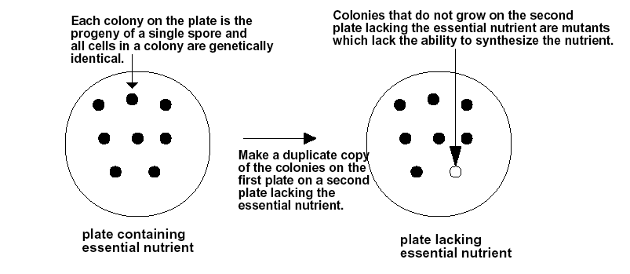
Replica Plating
How do you recover mutants that won’t grow on minimal media? Replica plating technique…

