Slide 1
Architecture Recovery
IN4MATX 221
Fall 2016
Slides by Joshua Garcia

Slide 2
Outline
Basic-Concepts Review
Example Architectures
Intermediate Concepts
Comparative Analysis

Slide 3
Outline
Basic-Concepts Review
Example Architectures
Intermediate Concepts
Comparative Analysis

Slide 4
Temporal Aspect
Design decisions are made and unmade over a system’s lifetime
→ Architecture has a temporal aspect
At any given point in time the system has only one architecture
A system’s architecture will change over time

Slide 5
Prescriptive vs. Descriptive Architecture
A system’s prescriptive architecture captures the design decisions made prior to the system’s construction
  It is the as-conceived, as-intended, as-documented, or conceptual architecture
A system’s descriptive architecture describes how the system has been built
  It is the as-implemented, as-realized, or concrete architecture

Slide 6
Two Architectures Side-by-Side
Which architecture is “correct”?
Are the two architectures consistent with
one another?
What criteria are used to establish the
consistency between the two architectures?
On what information is the answer to the
preceding questions based?
Prescriptive Architecture
Descriptive Architecture

Slide 7
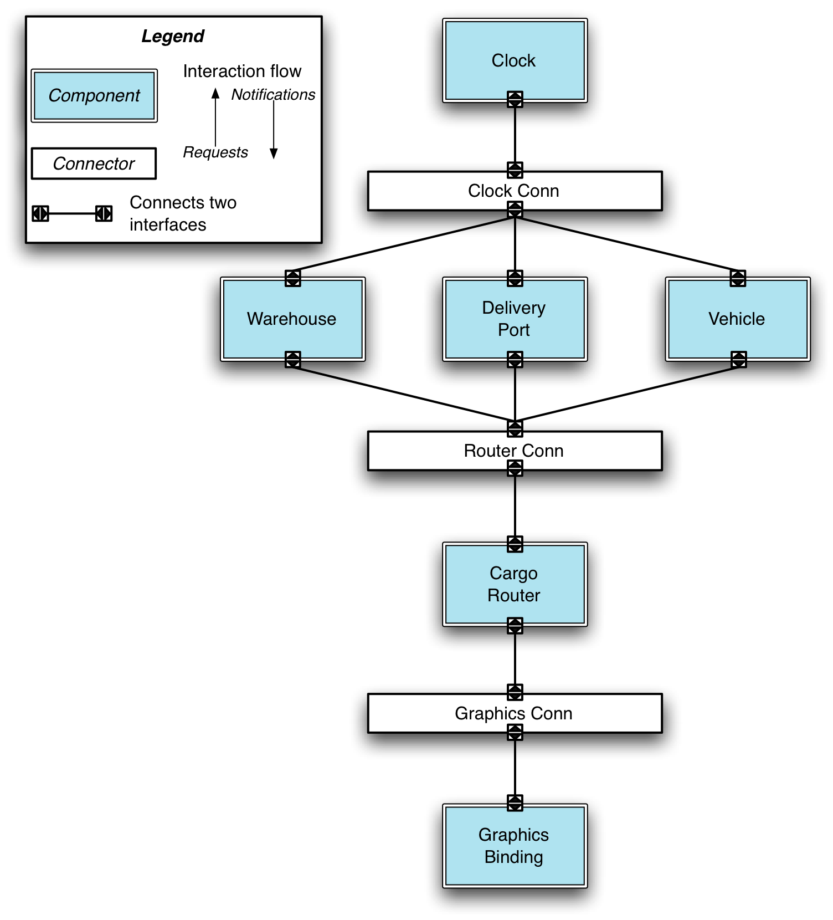
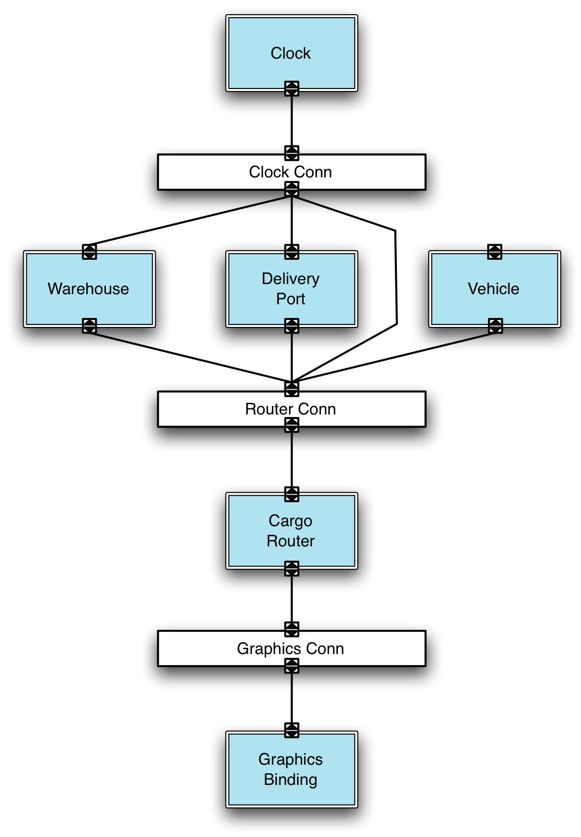
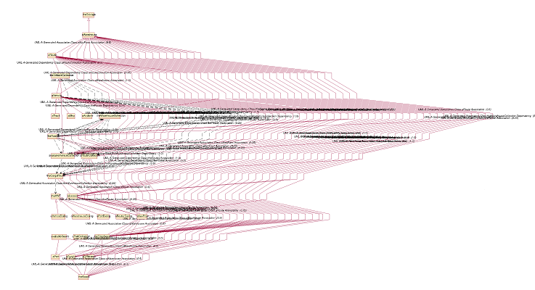
How Hard Is This?
Complex and virtually
incomprehensible!
Prescriptive Architecture
Descriptive Architecture

Slide 8
Architectural Evolution
When a system evolves, ideally its prescriptive architecture is modified first
In practice, the system – and thus its descriptive architecture – is often directly modified
This happens because of
  Developer sloppiness
  Perception of short deadlines which prevent thinking through and documenting
  Lack of documented prescriptive architecture
  Need or desire for code optimizations
  Inadequate techniques or tool support

Slide 9
Architectural Degradation
Two related concepts
  Architectural drift
  Architectural erosion
Architectural drift is introduction of principal design decisions into a system’s descriptive architecture that
  are not included in, encompassed by, or implied by the prescriptive architecture
  but which do not violate any of the prescriptive architecture’s design decisions
Architectural erosion is the introduction of architectural design decisions into a system’s descriptive architecture that violate its prescriptive architecture

Slide 10
Architecture Recovery
If architectural degradation is allowed to occur, one will be forced to recover the system’s architecture sooner or later
Architecture recovery is the process of determining a software system’s architecture from its implementation-level artifacts
  Often called architecture reconstruction or architectural recovery
Implementation-level artifacts can be
  Source code
  Executable files
  Java .class files

Slide 11
Outline
Basic-Concepts Review
Example Architectures
Intermediate Concepts
Comparative Analysis

Slide 12
How often does architectural degradation occur?
Let’s look at more examples

Slide 13
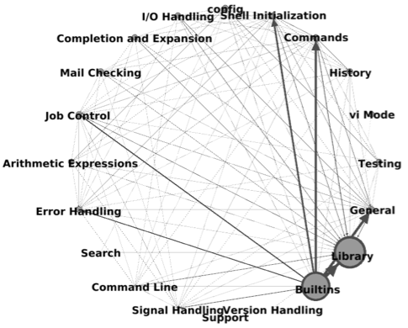
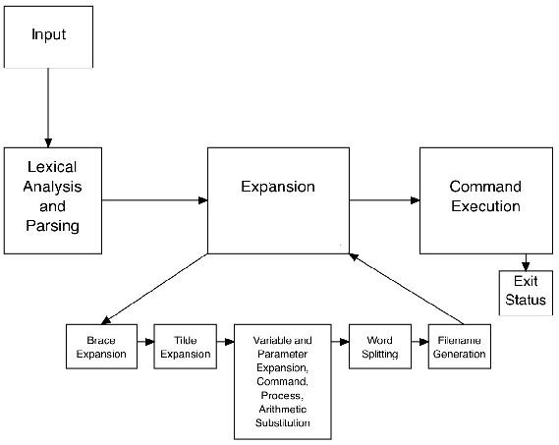
Bash
Prescriptive Architecture
Descriptive Architecture

Slide 14
Bash – Different Layout for Descriptive Architecture
Prescriptive Architecture
Descriptive Architecture – Concrete Layout

Slide 15
Hadoop
Prescriptive Architecture
Descriptive Architecture

Slide 16

Hadoop – Complete Architecture

Slide 17
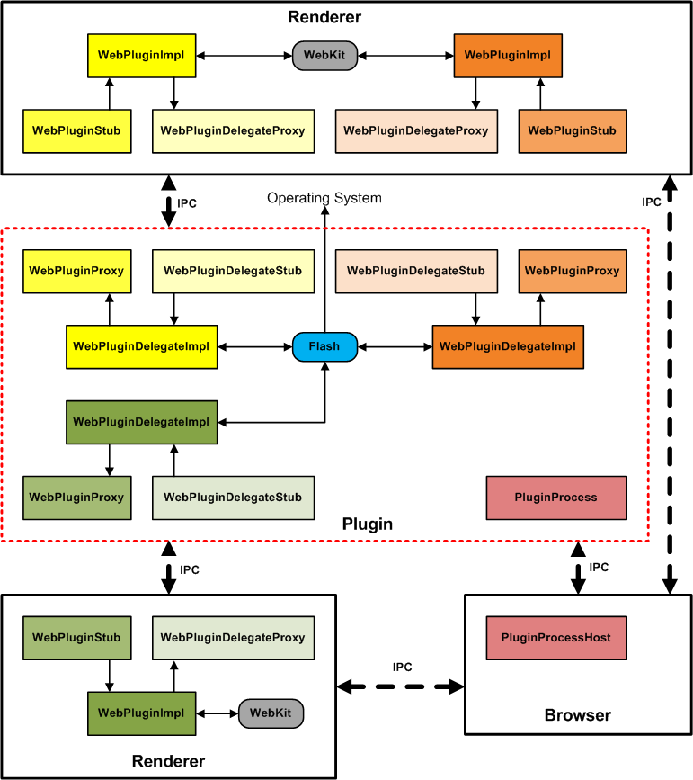
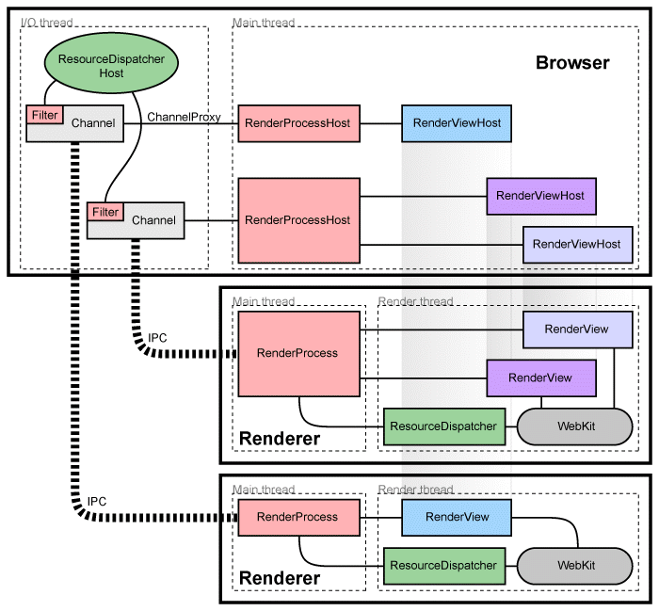
Chromium –
Prescriptive
Multi-Process View
Plugin View

Slide 18
Chromium – Descriptive Architecture

Slide 19
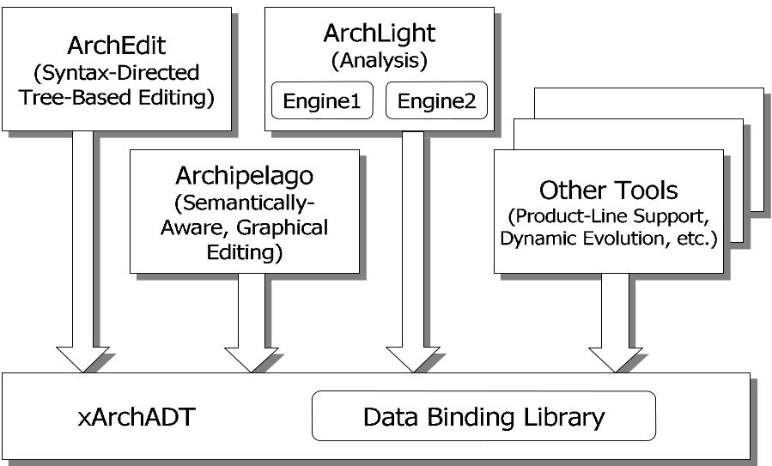
Is architectural degradation always this bad?
ArchStudio

Slide 20
ArchStudio – Prescriptive Architecture
ArchStudio – Descriptive Architecture
Notes:
This version of ArchStudio is actually larger, in terms of SLOC, than the version of Hadoop whose architecture we saw earlier.

Slide 21
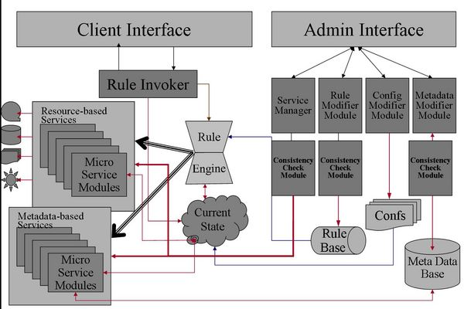
iRODS – Prescriptive Architecture
Source: https://www.irods.org/index.php/Introduction_to_iRODS

Slide 22
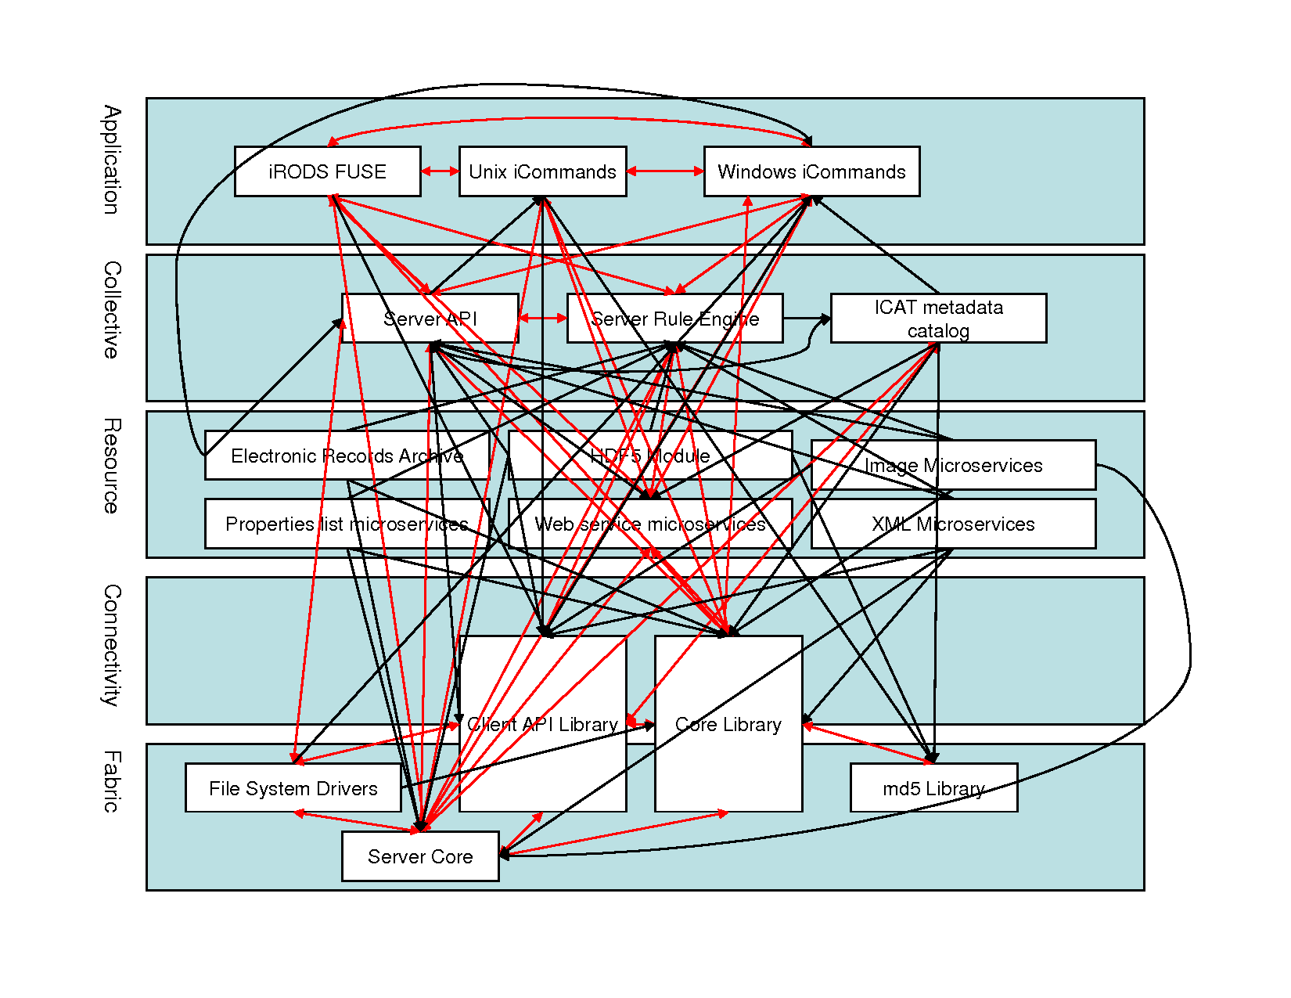
iRODS – Descriptive Architecture
Legend:
Layer
Component
Two-way dependency
One-way dependency

Slide 23
Architectural Degradation in iRODS
Dependency Cycle
Fully connected graph
Skipping Layers
Skipping Layers
Legend:
Dependency Inversion
Layer
Component
Excessive Load on Component
Two-way dependency
One-way dependency
Bloated Components

Slide 24

iRODS – Still Highly Complex
iRODS – Descriptive Architecture
Notes:
IRODS is only 84KSLOC

Slide 25
Bash – Descriptive Architecture
How do I get this architecture?

Slide 26
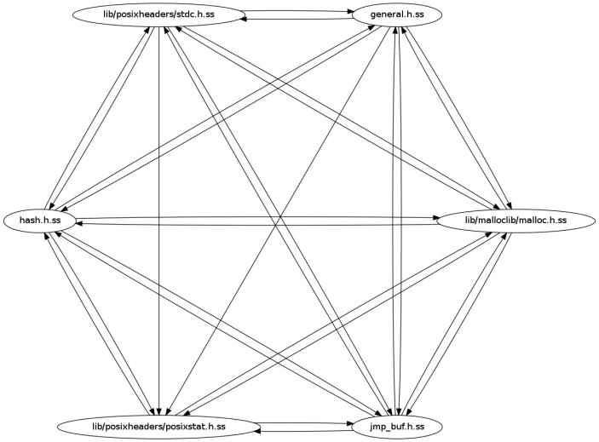

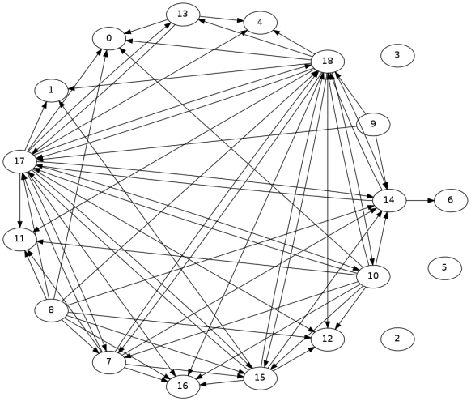
Many Architecture Recovery Techniques
Bash From ACDC
Bash From Bunch
Which technique do you choose?
Bash From Zone-Based Recovery

Slide 27
Outline
Basic-Concepts Review
Example Architectures
Intermediate Concepts
Comparative Analysis

Slide 28
Rules or Heuristics to Recover Architectures
Mapping principles: rules that determine mappings from implementation-level entities to architectural elements
Servlets grouped together as a Web Server
Each servlet mapped to a different component

Slide 29
Types of Mapping Principles
Generic principles: drawn from long-standing software-engineering principles
  Separation of concerns, isolation of change, coupling and cohesion
Domain principles: mapping principles based on domain information
  Example domains include telecommunications, avionics, robotics, etc.
Application principles: specific to application under recovery
System-context principles: infrastructure
  Choice of OS, programming language, implementation framework, etc.

Slide 30
Rules of Focus
Group based on isolated classes
Group based on generalization
Group based on aggregation
Group based on composition
Group based on two-way association
Identify domain classes
Merge classes with a single originating domain class association into domain class
Group classes along a domain class circular dependency path
Group classes along a path with a start node and end node that
reference a domain class
Group classes along paths with the same end node, and whose start node references the same domain class

Slide 31
More Generic Mapping Principles
Domain class rules
  Class with large majority of outgoing calls
Exclusion rules
  Class with large majority of incoming calls
  Utility classes
  Heavily passed data-structures
  Benchmarking and test classes
Additional groupings
  By exception
  By interface
  By package if idealized architecture matches first-class component

Slide 32
Domain Principles for Distributed Systems
Infer distributor connectors from idealized architecture
Classes with methods and names similar to first-class components are domain classes
Classes importing network communication libraries are domain classes
main() functions often identify first-class components
Classes deployed onto different hosts must be grouped separately

Slide 33
A Process-Oriented Taxonomy
Ducasse and Pollet. Software Architecture Reconstruction: A Process-Oriented Taxonomy.

Slide 34
Architecture Recovery - Goals
Redocumentation and Understanding
Reuse
Conformance
Co-Evolution
Analysis
Evolution and Maintenance

Slide 35
Architecture Recovery - Inputs
Source Code
Textual Information
Dynamic Information
Physical Organization
Human Organization
Historical Information
Human Expertise

Slide 36
Architecture Recovery - Techniques
Quasi-Manual
  Construction
  Exploration
Quasi-Automatic
  Clustering

Slide 37
Bottom-Up Process
Ducasse and Pollet. Software Architecture Reconstruction: A Process-Oriented Taxonomy.

Slide 38
Top-Down Process
Ducasse and Pollet. Software Architecture Reconstruction: A Process-Oriented Taxonomy.

Slide 39
Hybrid Process
Resulting architecture is informed by both low-level extraction and high-level hypothesizing and refinement

Slide 40
Outline
Basic-Concepts Review
Example Architectures
Intermediate Concepts
Comparative Analysis

Slide 41
What Are These Techniques?
ACDC – Algorithm for Comprehension-Driven Clustering
  Structural pattern-based clustering [Tzerpos WCRE 2000]
ARC – Architecture Recovery Using Concerns
  Concern-based hierarchical clustering [Garcia ASE 2011]
Bunch-NAHC & Bunch-SAHC
  Hill-climbing for maximizing modularization [Mancoridis ICSM 1999]
LIMBO – scaLable InforMation BOttleneck
  Probabilistic hierarchical clustering [Andritsos TSE 2005]
WCA-UE & WCA-UENM – Weighted Combined Algorithm
  Dependency-based clustering [Maqbool TSE 2007, Naseem CSMR 2011]
ZBR – Zone-Based Recovery
  Hierarchical clustering based on textual information [Corazza CSMR 2011]

Slide 42
How Do They Work?
Grouping of implementation-level entities
Three types of recovery criteria
  Similarity Measure
  Objective Function
  Patterns

Slide 43
Do They Really Work?
Bash “Ground Truth”
Bash from ACDC
Bash from Bunch
Bash from ZBR

Slide 44
A More In-Depth Study
Compared architecture-recovery techniques
Eight architectures of six open-source systems
Obtained ground-truths for each
System | Ver | Dom | Lang | SLOC | Comps
ArchStudio | 4 | IDE | Java | 280K | 54
Bash | 1.14.4 | OS Shell | C | 70K | 25
Hadoop | 0.19.0 | Data Processing | Java | 200K | 68
Linux-C | 2.0.27 | OS | C | 750K | 7
Linux-D | 2.0.27 | OS | C | 750K | 120
Mozilla-C | 1.3 | Browser | C/C++ | 4M | 10
Mozilla-D | 1.3 | Browser | C/C++ | 4M | 233
OODT | 0.2 | Data Management | Java | 180K | 217

Slide 45
Proximity to Ground Truth
MoJoFM metric
ARC’s Resulting Architecture
Ground-Truth Architecture
A
B
A’
B’
1
4
1
4
5
2
C
D
C’
3
5
2
3

Slide 46
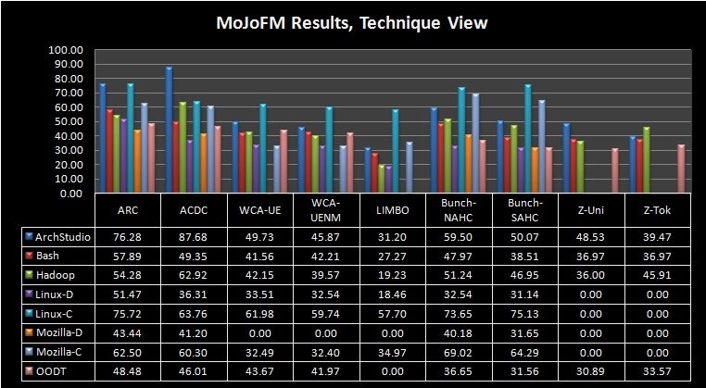
Proximity Results

Slide 47
Proximity Results

Slide 48
Proximity Results

Slide 49
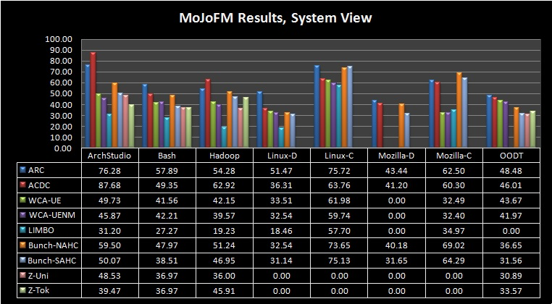
Proximity Results

Slide 50
Proximity Results
Average Proximity
45%
ARC Proximity
60%
ACDC Proximity
56%

Slide 51
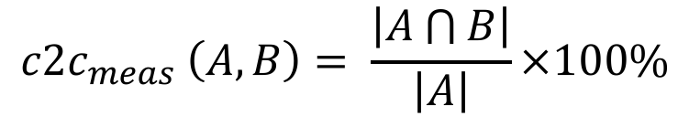
Comparing Clusters
cluster-to-cluster (c2c) analysis
A
B
1
2
1
2
4
3
$${c2c}_{meas }\left(A,B\right)= \frac{\left|A\bigcap{B}\right|}{\left|A\right|}×100\%$$

Slide 52

Comparing Clusters
cluster-to-cluster (c2c) analysis
A
B
1
2
1
2
4
3
$${c2c}_{meas }\left(A,B\right)= \frac{\left|\{1,2\}\right|}{\left|\{1,2,4\}\right|}×100\%$$

Slide 53
Comparing Clusters
cluster-to-cluster (c2c) analysis
A
B
1
2
1
2
4
3
$${c2c}_{meas }\left(A,B\right)= \frac{\left|\{1,2\}\right|}{\left|\{1,2,4\}\right|}×100\%$$

Slide 54

Comparing Clusters
cluster-to-cluster (c2c) analysis
A
B
1
2
1
2
4
3
$$66\%= \frac{2}{3}×100\%$$

Slide 55
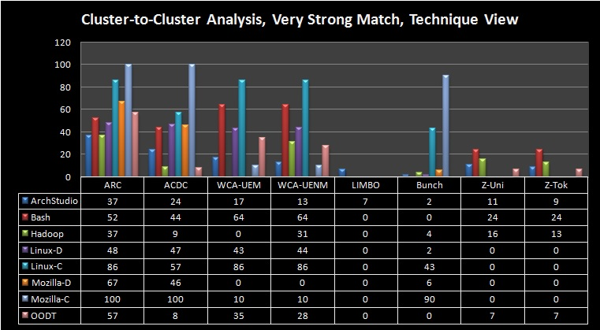
Cluster Comparison

Slide 56
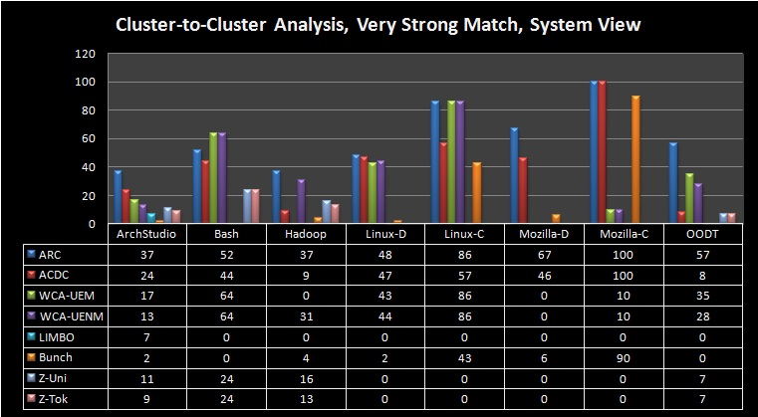
Cluster Comparison

Slide 57
Cluster Comparison
Average Cluster Similarity
20%
ARC Cluster Similarity
56%
ACDC Cluster Similarity
31%

Slide 58
Recovery-Criteria Indicators
Objective Function
Patterns
Similarity Measure

Slide 59



Criteria Indicator Example
Similarity Measure
Class 1
Concern | Probability
Weather | 0.5
Messaging | 0.2
Strategies | 0.3
A
1
2
3
Class 2
Concern | Probability
Weather | 0.1
Messaging | 0.0
Strategies | 0.8
0.7
0.8
1.0
$$critsim$$
$$\frac{Sim\left(1,2\right)+Sim\left(2,3\right)+Sim(1,3) }{3}$$
0.83
$$=$$

Slide 60
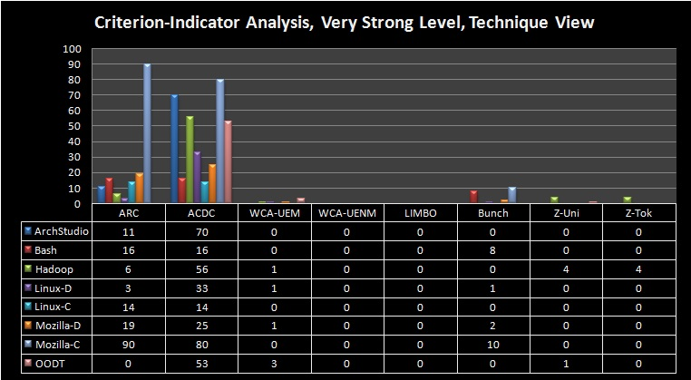
Effectiveness of Clustering Criteria

Slide 61
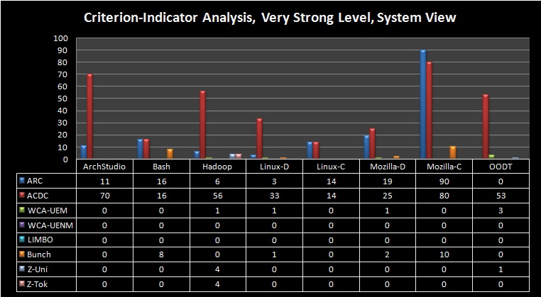
Effectiveness of Clustering Criteria
ACDC’s criterion on average 30% better than ARC’s criterion

Slide 62
Takeaways from Comparative Analysis
Significant room for improvement
A semantics-based recovery improves accuracy
Multi-criterion approach performed well
Criteria indicators are useful for evaluating recovery techniques

