Slide 1
Architecture-Based Self-Protecting Software Systems
Sam Malek
INF 221 ⎯ Software Architecture
Fall 2016

Slide 2
Outline
Motivating Problem
Research Positioning and Hypotheses
ARMOUR Framework
Implementation
Evaluation
Conclusions

Slide 3
The Cat-and-Mouse Game of Securing Your Software
Network-based Intrusion Detection System (N-IDS)
Traffic-filtering firewall
Notional Component Architecture
Web Browser
Load Balancer
Web Server 1
DB Connector
Growing Security Threats:
SQL Injection
Cross-Site Scripting (XSS)
Cross-Site Request Forgery
Denial-of-Service (DoS)
…
DB
Web Server 2
…
Host-based Intrusion Detection System
(H-IDS)
User
Event Bus
Access Control Lists (ACL)
Admin Console
Web App Traffic
Offline Mechanisms:
Static code analysis
Penetration testing, …
Legend
Component
Monitoring Event
Connector
Control Event
Limitations of Existing Defense Mechanisms:
Focused on protecting the system boundary
Manually configured, labor intensive
Slow in adapting to changing attack vectors

Slide 4
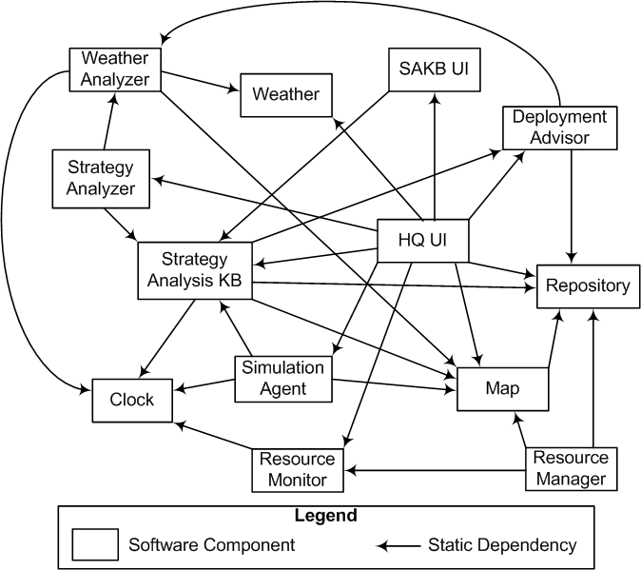
Context: Emergency Deployment System (EDS)
Large-scale component-based system
Each component represents a coarsely-grained software unit that deploys and runs independently
Main Use Cases:
Track emergency operation resources
Distribute resources to emergency response teams
Analyze / simulate deployment strategies
Advise deployment actions

Slide 5
Anatomy of an Attack
Strategy Analysis Use Case
HQUI
StrategyAnalyzer
Clock
Map
WeatherAnalyzer
Weather
StrategyKB
e₁
e₂
T₁
T₂
e₃
T₃
e₄
T₄
Compromised Component
e₇
e₅
T₅
T₇
e₆
T₆
e₈
T₈
e₉
T₉

Slide 6
Anatomy of an Attack
Web Attacks Resulting in Deviation from Normal Behavior
HQUI
StrategyAnalyzer
Clock
Map
WeatherAnalyzer
Weather
StrategyKB
ResourceManager
Repository
Compromised Component
Difficult to detect and mitigate with traditional security mechanisms

Slide 7
Outline
Motivating Problem
Research Positioning and Hypotheses
ARMOUR Framework
Implementation
Evaluation
Conclusions

Slide 8
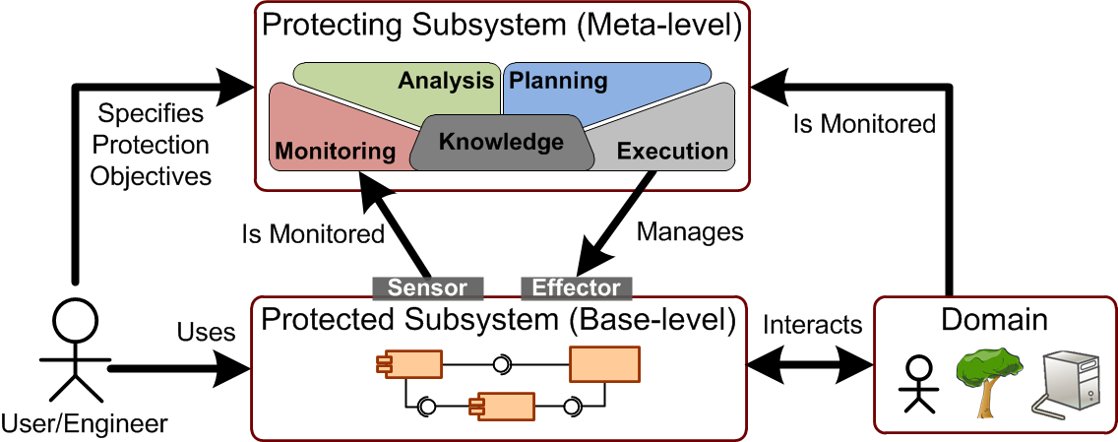
Architecture-based Self-Protection (ABSP) Addresses These Challenges by Securing the Architecture as a Whole
Self-Protection: A self-* property under the Autonomic Computing (AC) Context [Kephart & Chess 2003]
Dynamic, self-adaptive, at runtime
Both reactive and proactive
Architecture-based:
Incorporating security goals as part of the system’s architecture properties
ABSP
Reference
Architecture

Slide 9
Benefits of Architecture-Based Self-Protection (ABSP)
Defense in depth: By modeling the internal structure of a software system, ABSP provides an effective mechanism to deal with threats in multiple stages and at different levels
Impact Analysis: The architectural models allow us to identify the dependencies among the system's constituents, thereby track the impact of a compromised element on the other parts of the system and formulate globally coordinated defense strategies
Insider attack: Modeling and monitoring the architecture of a software system allows us to mitigate the security threats that originate from within the system
Reuse: By implementing self-protection patterns as orthogonal concerns, separate from application logic, the former may be easily reused in other applications
Dynamism: Separation of concerns also allows the self-protection mechanisms to evolve independent of the application logic, to quickly adapt to emerging threats

Slide 10
Research Hypotheses
Self-Protection Challenges:
Difficult and costly to develop and maintain accurate architecture models
Poor Documentation
Architecture Decay, …
Difficult and costly to analyze and maintain a database of attack signatures for threat detection
Ever-changing attack signatures
Insider attacks, …
Slow and costly to counter security attacks at runtime, even when vulnerabilities are detected
Downtime / revenue loss
Software revisions and patches, …
Hypothesis #1: It is possible to mine a probabilistic architectural model that captures a software system's normal behavior from its execution history
Hypothesis #2: Using an automatically mined architectural model, it is possible to detect a large-class of security threats that violate normal system usage
Hypothesis #3: Software architecture provides an additional line of defense for mitigating security threats autonomously

Slide 11
Outline
Motivating Problem
Research Positioning and Hypotheses
ARMOUR Framework
Implementation
Evaluation
Conclusions

Slide 12
ARMOUR: Proposed ABSP Framework
Hypothesis #1
Hypothesis #2
Hypothesis #3
Mining the Model
Applying the Model (Detection & Mitigation)
Pattern Registry
Anomaly
Events
Model Pruning
Behavior Model
ABSP
Patterns
Model Mining
Anomaly Detection
Event Evaluation
MAPE-K
Loop
Event Pre-Processing
Event Log
Defensive Adaptation
Model Adapt.
Use Case Identification
Architecture Layer
Sensors
Effectors
System Layer
Users
Target System
Intruder
SysAdmin

Slide 13
Definitions and Assumptions
Components C = { Map, … }
Independently deployed
Component interaction events e = < c_{src} , c_{dst} , timestamp >
E.g. WeatherAnalyzer ➔ Clock
Assumed to be observable (i.e. from execution history)
Top-level use cases representing system “entry points” are assumed identifiable
E.g. HQUI ➔ StrategyAnalyzer
Full behavior model is often not specified, poorly documented, or even non-deterministic
Due to architecture decay, user-controlled behavior, etc.
Emergency Deployment System (EDS)

Slide 14
An example use case
HQUI
StrategyAnalyzer
Clock
Map
WeatherAnalyzer
Weather
StrategyKB
e₁
e₂
T₁
T₂
e₃
T₃
e₄
T₄
e₇
e₅
T₅
T₇
e₆
T₆
e₈
T₈
e₉
T₉

Slide 15
What we assume to know about the system
HQUI
StrategyAnalyzer
Clock
Map
WeatherAnalyzer
Weather
StrategyKB
e₁
e₂
We know the system’s components
We know the start and end of top-level use cases
We can observe the events occurring in the system
There may be many users in the systems
We do not know whether event e2 belongs to this use case or another concurrently running use case

Slide 16
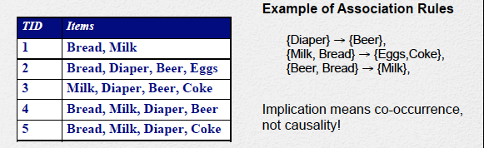
Mining Technique Overview (I): Association Rules Mining (ARM)
Given a set of transactions, find rules that will predict the occurrence of an item based on the occurrences of other items in the transaction
Association rule for itemsets X and Y: X ➔ Y : <s, c>
Support s = σ (X U Y) ⁄ N : “How strongly is the rule supported by sample data?”
Confidence c = σ (X U Y) ⁄ σ (X) : “How confident can I expect Y when I see X?”
σ (X): frequency count of occurrence of an itemset X
Algorithm: Apriori
Agrawal and Srikant 1994

Slide 17
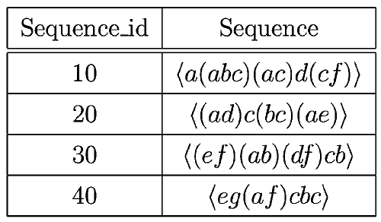
Mining Technique Overview (II): Generalized Sequential Pattern (GSP) Mining
Sequence S = < s₁ s₂ … s_{n} > where s_{i} are itemsets of literals
E.g. X = < a (b c) d (e f g) >
Subsequence: e.g. <a b e> is a subsequence of X
GSP mining: find frequent subsequence patterns from a set of data sequences with minimum support count (minsupp)
Agrawal and Srikant 1996; Similar to Apriori
Captures temporal information!
E.g., <(a b) c>: support count = 2

Slide 18
Outline
Motivating Problem
Research Positioning and Hypotheses
ARMOUR Framework
Implementation
Evaluation
Conclusions

Slide 19
ARMOUR Framework
Mining the Model
Applying the Model (Detection & Mitigation)
Pattern Registry
Anomaly
Events
Model Pruning
Behavior Model
ABSP
Patterns
Model Mining
Anomaly Detection
Event Evaluation
MAPE-K
Loop
Event Pre-Processing
Event Log
Defensive Adaptation
Model Adapt.
Use Case Identification
Architecture Layer
Sensors
Effectors
System Layer
Users
Target System
Intruder
SysAdmin

Slide 20
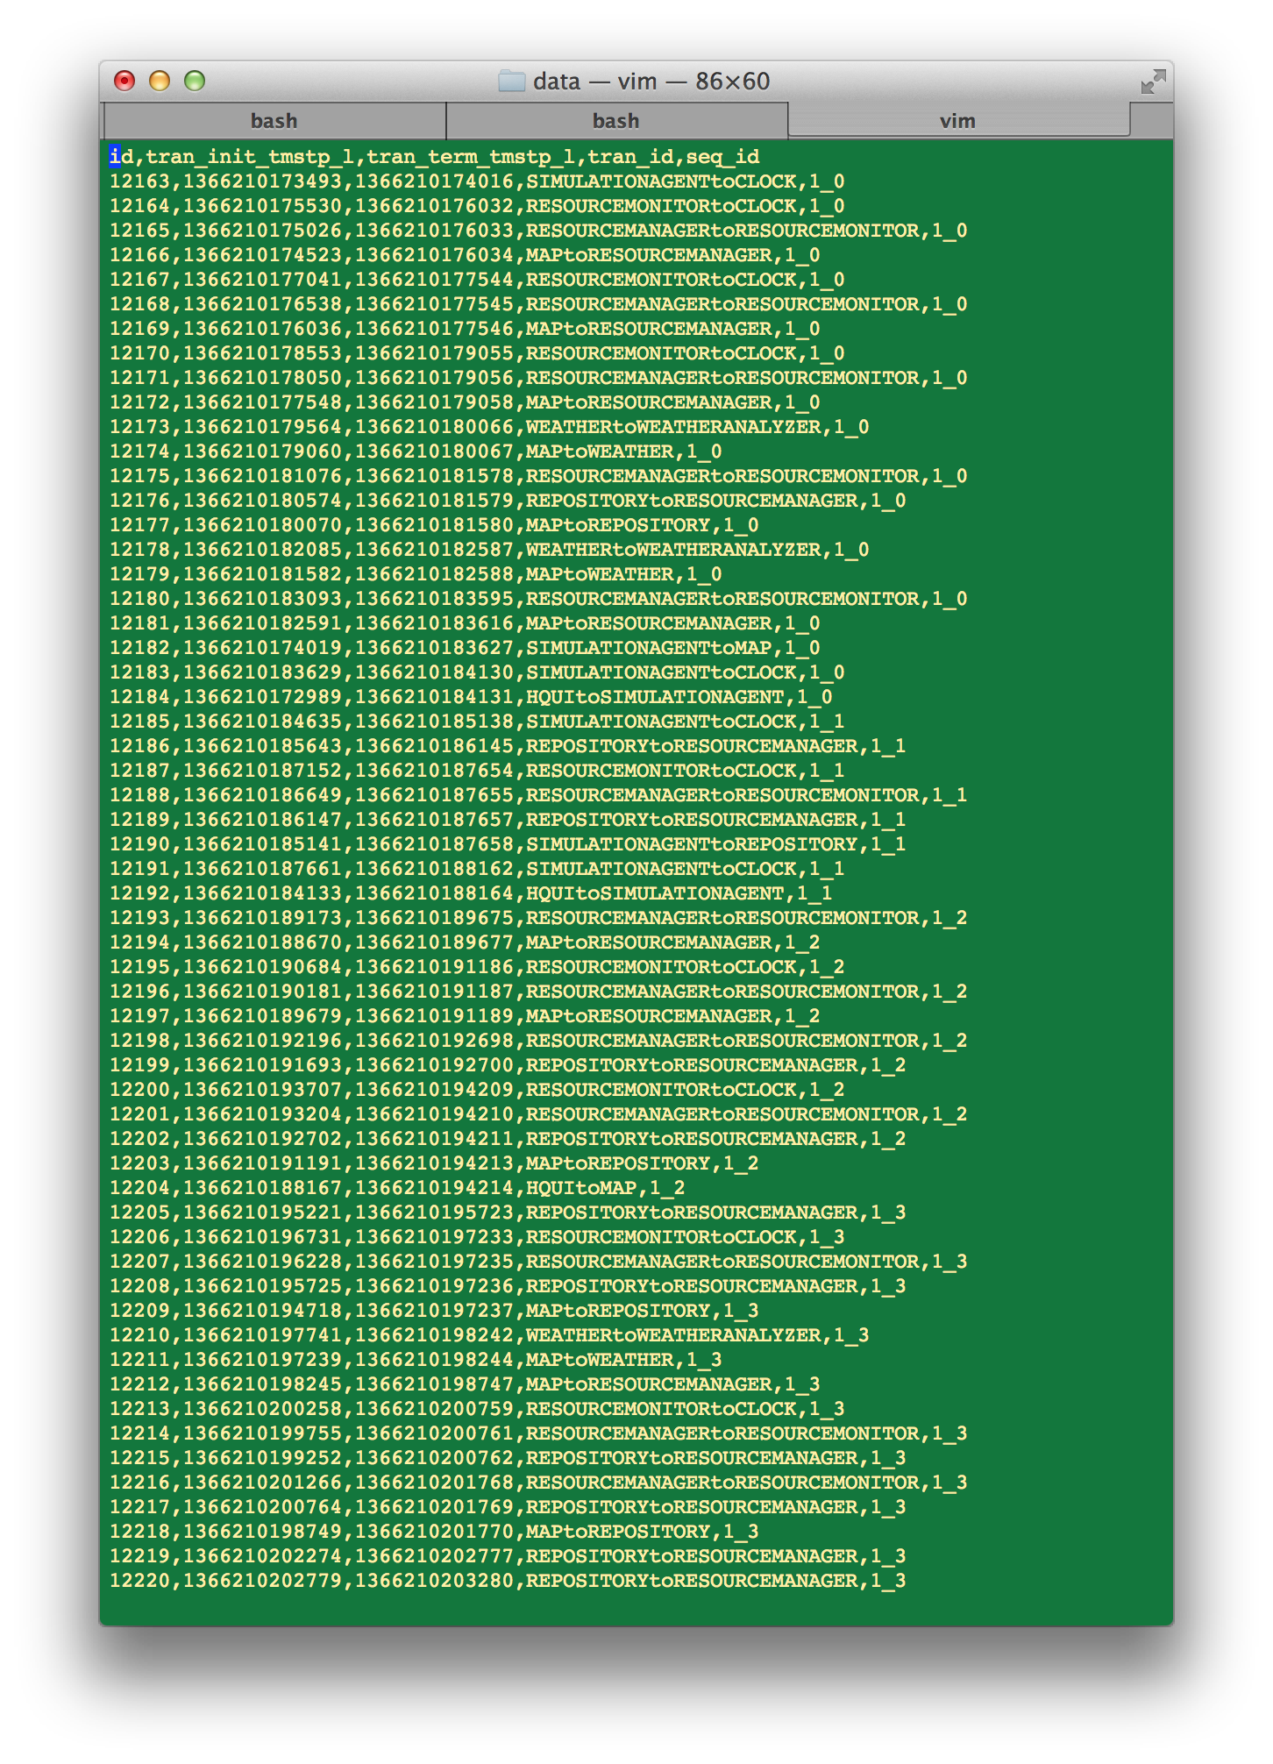
Pre-Processing the Event Log
Mining
Detection
Mitigation
Event Log
U₁
U₁⁺
U₂
U₂⁺
U₃
U₃⁺
U₄
U₄⁺
Component Event Log
…
Time

Slide 21
Pre-Processing the Event Log
Mining
Detection
Mitigation
Recall top-level, use case-initiated events (UIE) can be recognized
Use case-initiated top-level events (U_{i}) divide the event log into user sessions (U_{i}⁺)
Each becomes an event set / sequence that feeds into ARM / GSP mining
Note: the sessions overlap!
Event timestamps: need to take into account network time error, ε_{NTP}
E.g. < e₁ (e₂ e₃) e₄ >
Event Log
U₁
U₁⁺
U₂
U₂⁺
U₃
U₃⁺
U₄
U₄⁺
…
Time

Slide 22
Mining the System Behavior Model
Mining
Detection
Mitigation
Associations Mining
Sequential Pattern Mining
Pre-processed event itemsets are fed to the Apriori algorithm to generate a set of Event Association Rules (EAR)
E.g.
Pre-processed event sequences are fed to the GSP algorithm to generate a set of Event Association Patterns (EAP)
E.g.
EARs / EAPs are stored in the pattern registry, which constitutes a probabilistic model for normal system behavior at the component level
Support value of the EAR / EAP indicates probability of occurrence
Analogous to collection of DNA fragments representing a genome!
Need to set minimum support level (minsupp) of the mining algorithm to a low level to capture vast majority of normal component interactions (Different from normal associations / GSP mining)

Slide 23
Tailoring the Mining Algorithms
Mining
Detection
Mitigation
Problem: Some legitimate use of the system may not occur very often, thus may be mistakenly treated as anomalies
E.g. adding a user account
Solution: Take into account use case context by mining event association patterns with respect to the UIEs
Compute conditional support values w.r.t. a specific UIE
Other customizations include architecture-based pattern pruning heuristics to compensate for low minsupp threshold
See paper for details

Slide 24
ARMOUR Framework
Mining the Model
Applying the Model (Detection & Mitigation)
Pattern Registry
Anomaly
Events
Model Pruning
Behavior Model
ABSP
Patterns
Model Mining
Anomaly Detection
Event Evaluation
MAPE-K
Loop
Event Pre-Processing
Event Log
Defensive Adaptation
Model Adapt.
Use Case Identification
Architecture Layer
Sensors
Effectors
System Layer
Users
Target System
Intruder
SysAdmin

Slide 25
Threat Detection Using the System Behavior Model
Mining
Detection
Mitigation
The registry of EAPs { p|S : <supp_{p}> } represent normal system usage
A normal event y should be “explained” by one or more encompassing use cases, i.e., there should exist 1+ patterns in the model that leads to y; e.g.
< U₂, x, y > : 0.25 | U₂
< U₂, y > : 0.45 | U₂
For malicious events (e.g. e, f), due to their rare occurrence, they are not likely to be “explained” by any use cases
Novel detection algorithm developed based on this intuition to compute anomaly likelihood
Event Log
U₁
U₁⁺
U₂
x
y
U₂⁺
U₃
U₃⁺
U₄
e
f
U₄⁺
Time
…

Slide 26
ARMOUR Framework
Mining the Model
Applying the Model (Detection & Mitigation)
Pattern Registry
Anomaly
Events
Model Pruning
Behavior Model
ABSP
Patterns
Model Mining
Anomaly Detection
Event Evaluation
MAPE-K
Loop
Event Pre-Processing
Event Log
Defensive Adaptation
Model Adapt.
Use Case Identification
Architecture Layer
Sensors
Effectors
System Layer
Users
Target System
Intruder
SysAdmin

Slide 27
Threat Mitigation Using Self-Protection Patterns
Mining
Detection
Mitigation
ABSP Patterns: Repeatable strategies and tactics that software systems employ for self-protection purposes
Countermeasures without necessarily changing any individual components
Structural Patterns
Protective Wrapper
Countermeasure Broker
Agreement-Based Redundancy
Implementation Diversity
Aspect Orientation
Behavioral Patterns
Protective Recomposition
Attack Containment
Software Rejuvenation
Reconfiguration on Reflex
Artificial Immunization

Slide 28
Protective Wrapper Pattern
Mining
Detection
Mitigation
Architecture-aware “App Guard” as protective wrapper
Architecture model augmented with additional connector and sensor/effector mechanisms
Can be effective against many types of attacks
SQL injection
Broken authN/session mgmt
Failure to restrict URL access
HTTP
Request
Load Balancer
Attack
Detection
HTTP
Response
Policy Enforcement
Application Guard
Web Browser
Load Balancer
Web Server 1
DB Connector
4
DB
Web Server 2
…
1. Illegal access alert
User
Event Bus
Architecture
Layer
M
A
P
E
•Structural models
•Arch. properties
3. Adaptations
2. Update
model

Slide 29
Software Rejuvenation Pattern
Mining
Detection
Mitigation
Software Rejuvenation involves gracefully terminating then reviving an application to its “known good” state [Huang et al. 1995]
Advantages
A proactive security strategy, does not depend on threat detection
Limits damage of compromises
Limitations
For stateful systems, preserving state may need extra care
Not effective against DoS attacks
Idle Server Pool
Web Server 2’
…
Web Server 1’
deactivate
activate
Active Server Pool
Web Browser
Load Balancer
Web Server 1
DB Connector
DB
Web Server 2
User
Event Bus
Architecture
Manager
M
A
P
E
•Structural models
•Arch. properties

Slide 30
Software Rejuvenation Pattern (Cont.)
Mining
Detection
Mitigation
The Architecture Manager periodically orchestrates seamless transition to a pristine web server instance (sequence diagram)
Although the pattern doesn’t eradicate the underlying vulnerability, it can effectively limit potential damage and restore system integrity under various types of attacks
Architecture Manager
Load
Balancer
Web Server 1
Web Server 1’
Timer
Event
Initialize
Activate
Add server 1’ to pool
Start receiving user requests
Connect
Remove server 1 from pool
Stop receiving user requests
Disconnect
Deactivate
Gracefully terminate user sessions
Save logs
Rejuvenate
Initialize

Slide 31
Agreement-based Redundancy Pattern
Mining
Detection
Mitigation
Inspired by Byzantine Fault Tolerance (BFT) schemes [Castro and Liskov, 2002]
Effectively tolerate f faulty nodes with 3f + 1 replicas within a short window of vulnerability
Architectural adaptations:
“DB Guard” connector handles SQL requests from web servers using a voting / agreement-based protocol, as dictated by the Architecture Manager
N number of identical DB instances
Architecture models updated accordingly
DBCon.
DB Replica 0
DB Guard
Web Browser
Load Balancer
Web Server 1
DB Connector
DBCon.
DB
DB Replica 1
Web Server 2
DBCon.
DB Replica 2
…
Agreement Protocol
User
Event Bus
Architecture
Manager
M
A
P
E
•Structural models
•Arch. properties

Slide 32
Agreement-based Redundancy Pattern
Mining
Detection
Mitigation
SQL Injection Example:
News article search using keyword:
string kw = req.getParameter("keyword");
string query = "SELECT * FROM my_news
WHERE keyword = "’” + kw + "'";
…
Malicious input:
xyz’; DELETE FROM news; --
Resulting in two SQL statements:
SELECT * FROM my_news WHERE
keyword = ‘xyz’;
DELETE FROM news;
-- ’
Caveat: not effective for read-only type of SQL injection attacks
DB Guard
Replica 0
Replica 1
Replica 2
…
𝓡
𝓡
Property Check
Vote
𝓡 Valid
𝓡
𝓡
Vote
Result
𝓡 invalid
_
𝓡 (rollback)
Error

Slide 33
Rainbow Framework as “Architecture Manager”
Reusable software infrastructure developed by CMU
Design time and runtime support including:
Language constructs for defining architecture models and styles
Adaptation language for defining strategies and tactics
“Probes” that capture lower-level system events
“Gauges” that convert base system events into architecture-layer triggers
“Effectors” that execute tactics on the base system
Runtime master-delegate framework using RMI messages

Slide 34
Rainbow Framework Overview
Architecture Layer
Adaptation
Manager
Strategy
Executor
Architecture
Evaluator
Model Manager
Gauges
Translation
Infrastructure
System Layer
System API
Effectors
Resource
Discovery
Probes
Target System

Slide 35
Outline
Motivating Problem
Research Positioning and Hypotheses
ARMOUR Framework
Implementation
Evaluation
Conclusions

Slide 36
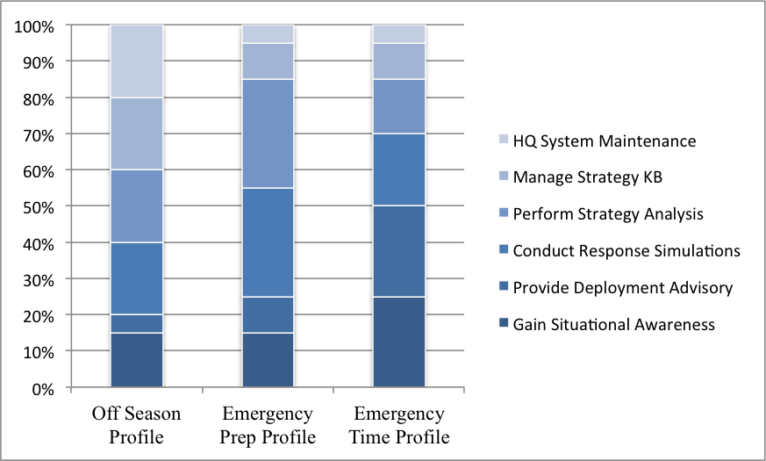
Evaluation – Setup
Use realistic behavior profiles to generate test runs
Configuration
Two attack scenarios (SQL injection and insider attack)
Test runs with 10, 20, 50, 100 concurrent users
Prior probability of attack events: ~ 0.27% (3-sigma rule)
GSP minsupp = 0.1
Training set size: 2,500 user sessions
Test set Size: 1,000
Implementation Details:
EDS Messaging | Java RMI
Event Log | MySQL RDBMS
GSP Mining | Weka 3.7.9
Pattern Pruning | Custom Java code
Detection Algorithm | Custom Java code

Slide 37
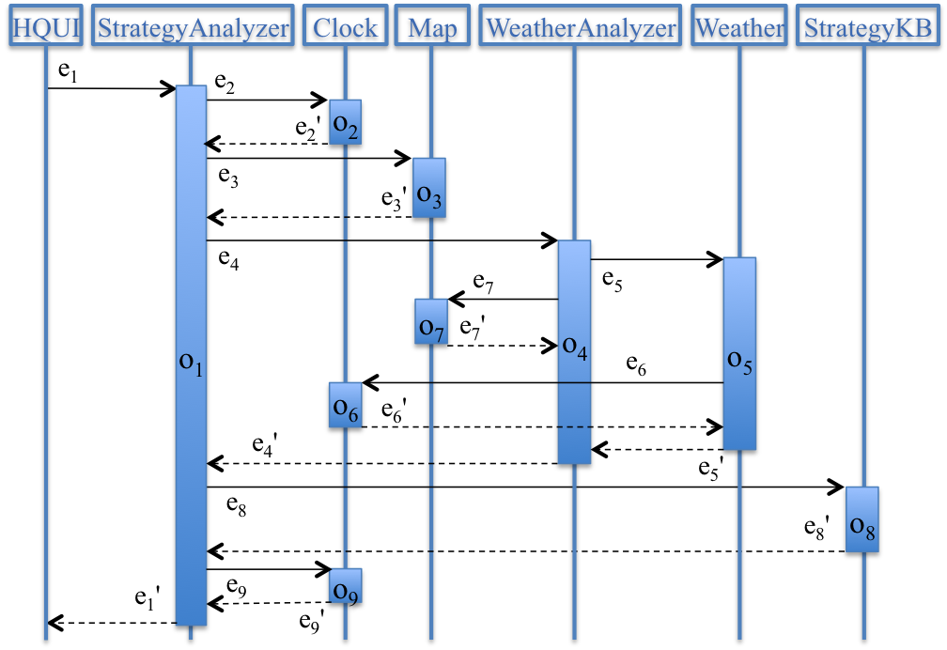
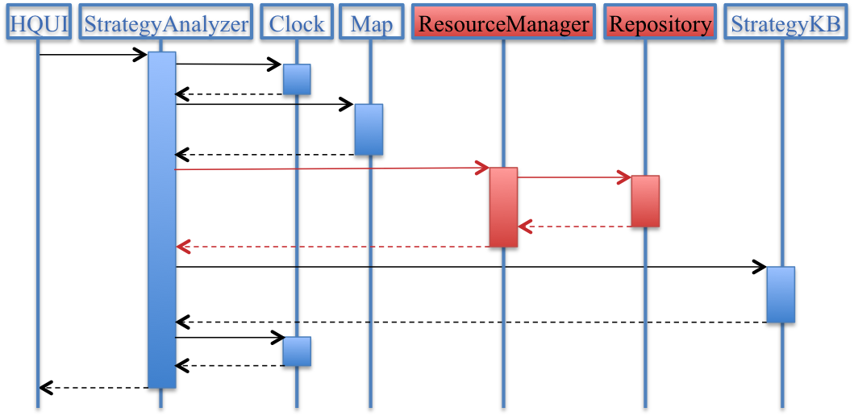
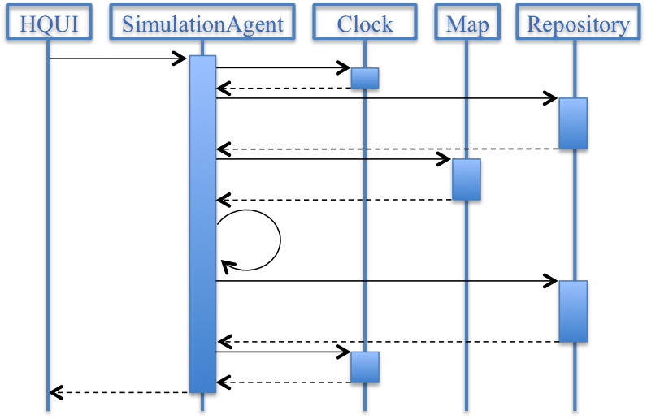
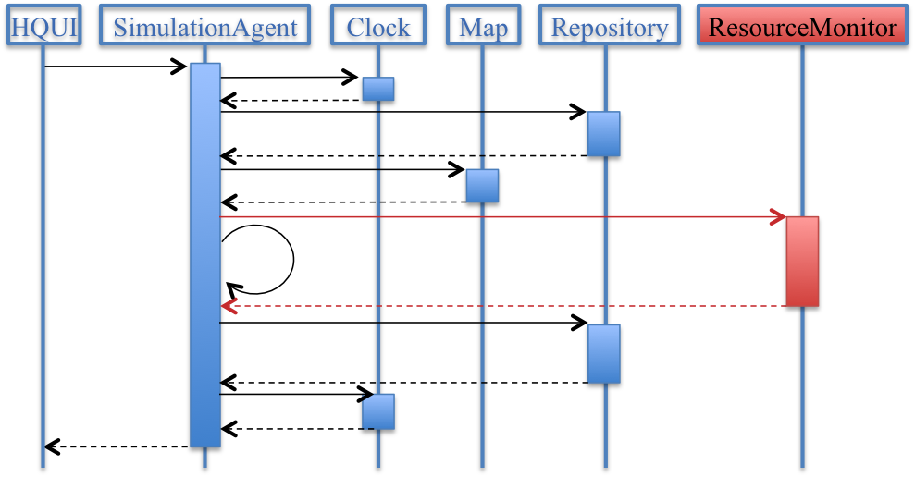
Attack Scenarios
UC1 – Strategy Analysis
Compromised UC1 (SQL Injection)
UC2 – Scenario Simulation
Compromised UC2 (Insider Attack)

Slide 38
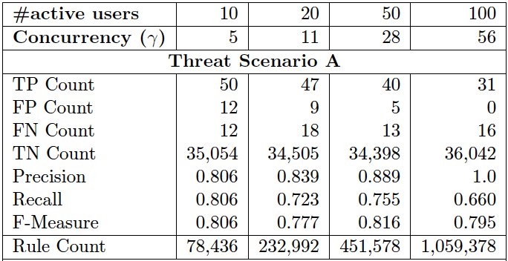
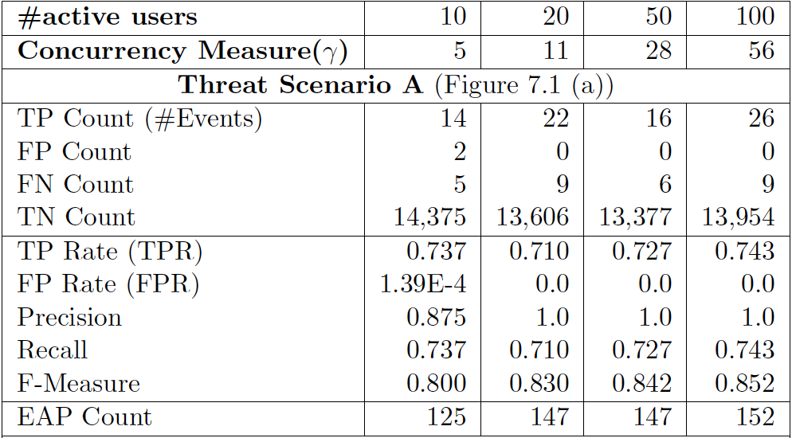
Evaluation – Detection Accuracy
ARM
Effective detection of rare anomalies with both high precision and high recall
Adaptive to system concurrency levels (10x increase)
Runs “in line” with the target system; no need for clean training environment (natural feature of GSP / associations mining) !
GSP model is much more compact!
GSP

Slide 39
Evaluation – Computational Efficiency
By capturing temporal information in the model, both mining efficiency and detection performance improve drastically
The GSP-based implementation is more than capable of keeping up with the target system at runtime, therefore has practical potential

Slide 40
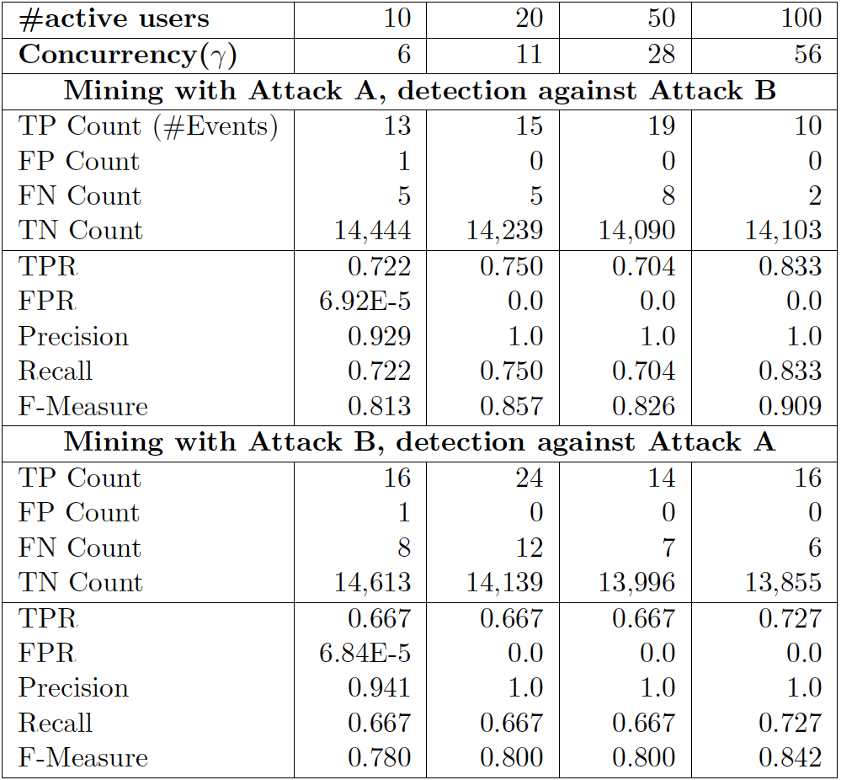
Evaluation – Detecting Unknown Threats
Effective against threats not encountered during mining phase
Superior to signature-based detection approaches

Slide 41
Outline
Motivating Problem
Research Positioning and Hypotheses
ARMOUR Framework
Implementation
Evaluation
Conclusions

Slide 42
Conclusions
Software architecture can play an important (and yet often overlooked) role in security
Autonomic, responsive, and reusable (not domain-specific)
Able to reason about security posture globally, and determine intent of the threat
Applicable to both external and inside attacks
?
?

Slide 43
Conclusions (Cont.)
Use machine learning techniques to “mine” an accurate architecture model at runtime
Develop an autonomic framework that applies the mined architecture model to detect security threats
Develop repeatable architecture-aware strategies and tactics to mitigate security threats
Demonstrate holistic, architecture-level self-protection of software systems

Slide 44
Conclusions (Cont.)
ARMOUR is useful when architecture artifacts are absent / eroded
Anomaly-based detection approach enables ARMOUR to detect unknown threats
Runs unsupervised and “on-the-fly”; no need for clean training data
Not aimed at replacing conventional security mechanisms (firewalls, IDS, static analysis, etc.) but rather complement them as an extra line of defense

