Slide 1
Class details
Details about class are:
1. In the LAB MANUAL
2. On the WEBSITE
LAB MANUAL:
1. Must be printed out
2. Must be carried to every lab class
3. Must be the one posted on the website

Slide 2
Class details
GENERATE LAB CHECKLIST
Hand in to lab TA BEFORE lab (2 minutes!)
“To-do” list for experiments
NOT copy/pasted from manual!
Hand in before lab; show notebook copy after lab

Slide 3
Honesty
VERY SERIOUS!
1. DO NOT CHEAT
2. DO NOT PLAGIARIZE
3. DO NOT TRY TO GAME THE SYSTEM
OFFENDERS WILL BE TREATED HARSHLY!
1. Automatic “F”
2. Will be reported
3. Notation for the rest of your academic career

Slide 4
Lab Safety
BE SAFE!
PAY ATTENTION TO TA INSTRUCTIONS
PAY ATTENTION TO YOUR WORK
WHEN IN DOUBT, ASK!
READ LAB SAFETY/CLEAN UP SECTION

Slide 5
Lab safety
NO FRIENDS/FAMILY
PANTS
WILL BE ASKED TO LEAVE LAB!
CLOSED-TOE SHOES
LAB COATS
GLOVES

Slide 6
Goals
1. Experimental techniques
“Doing”
2. Critical thinking, experimental design
“Thinking,” “Independence”
3. Reading & writing (papers, lab reports, etc.)
“Communication”
4. Discipline & Rigor
“Self-management”

Slide 7
Procedural display…
It is very important that you learn about traxoline. Traxoline is a new form of zionter. It is monotilled in Ceristanna. The Ceristannians gristerlate large amounts of fevon and then bracter it to quasel traxoline. Traxoline may well be one of our most lukised snezlaus in the future because of our zionter lescelidge.

Slide 8
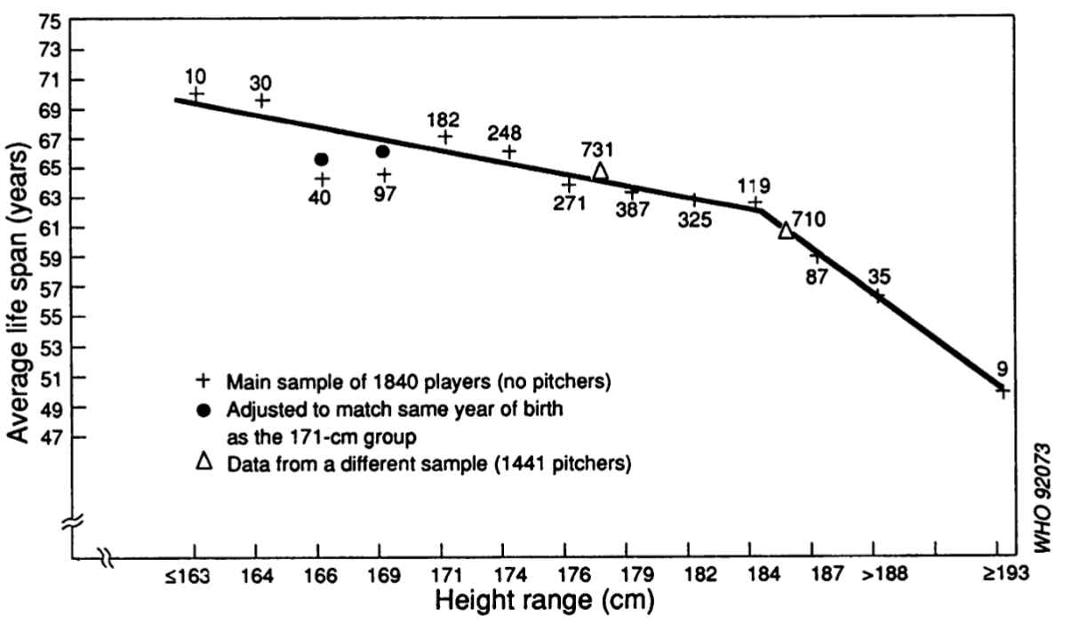
What is a “conclusion” / “explanation”?
WHO Bulletin OMS.Vol 70, 1992

Slide 9
Switch!
STOP trying to merely “know” material.
TEST yourself for understanding (how would you explain a concept to a 5th grader?!).
TEST yourself for synthesis (how would you use this concept in another context?)
CREATE hypotheses based on your understanding (if this is true, then what else must be true/false?)
DESIGN experiments to test your hypotheses (make predictions!)

Slide 10
Expectactions: You
Self-motivated learning; Independent learning
Not just memorization; Understand, apply
Apply yourself, ask yourself questions (What if…? How would I…?)
Be a good lab citizen; Be safe
Active participant in class
Be a little uncomfortable
Communicate – surveys, evals, DB

Slide 11
Expectations: Me
Help you learn & understand (NOT “know” or memorize)
Challenge you, make you a little uncomfortable
Available, approachable
Try to teach you to think scientifically; help you teach yourself

Slide 12
Dr. K
Sarchasm! Please don’t take it personally!
Set up lunch/coffee meetings!
Role = Guide + Mentor (use me!)
Go to office hours!
Current research: How to improve learning

Slide 13
D1S80 = VNTR
VNTR =
Tandem =
AGGCTAGGCTAGGCTAGGCT
Multiple repeats of same sequence; number of repeats is variable =

Slide 14
D1S80 = VNTR
Follow inheritance
X

Slide 15
D1S80
Located on chromosome 1
Like a “gene,” but not associated with any phenotype
Non-protein coding region
Each individual should have ______ alleles
Use PCR to amplify region

Slide 16
PCR Amplification

Slide 17
“Multiplex” PCR
How many products from the following PCR?

Slide 18
How many repeats?
PCR: 100 bp
Repeat: 10bp
PCR: 140 bp
PCR: 170 bp

Slide 19
D1S80
Use PCR to amplify region
- Works because?
- Each allele seen by?
D1S80 basic length = 142bp
D1S80 length of each repeat = 16bp
Calculate number of repeats in each allele
= (Observed size – 142) ÷ 16

Slide 20
PCR Data
Perform PCR on D1S80. New set of primers. See two bands. INVALID conclusion?

