Slide 1
Propositional Logic
Feb 23th

Slide 6
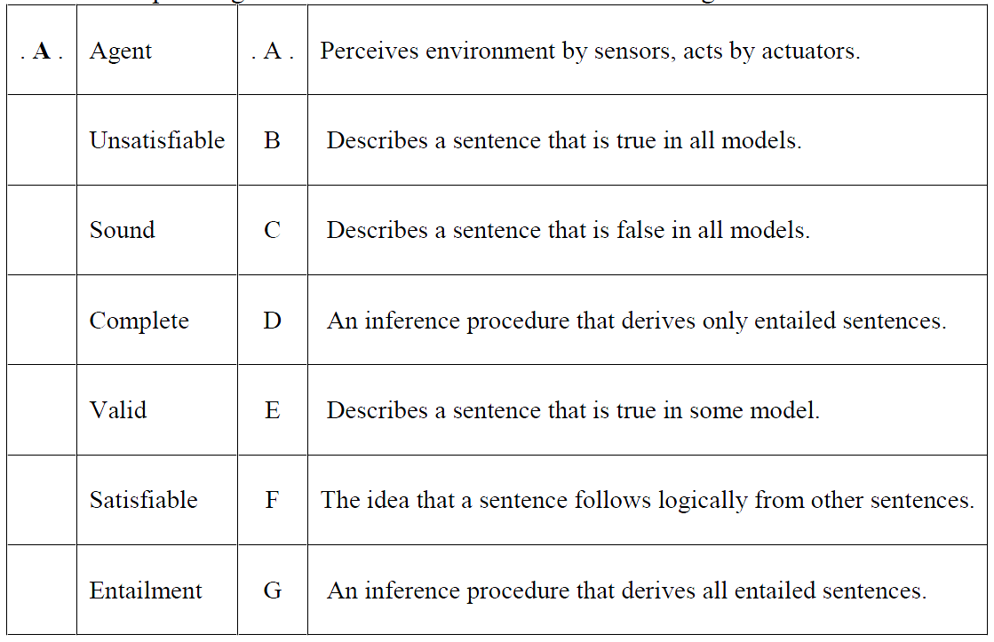

Slide 7
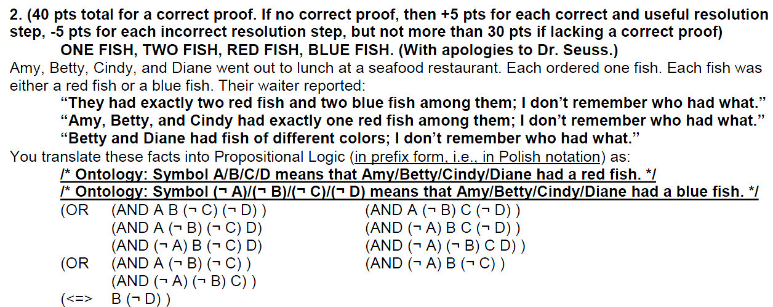

Slide 8
Resolve B with ¬A ¬B to produce ¬A
Resolve B with ¬B ¬C to produce ¬C
Resolve ¬A with ABC to produce BC
Resolve ¬A with ACD to produce CD
Resolve ¬C with CD to produce D
Resolve B with ¬B ¬D to produce ¬D
Resolve D with ¬D to produce ()

Slide 9
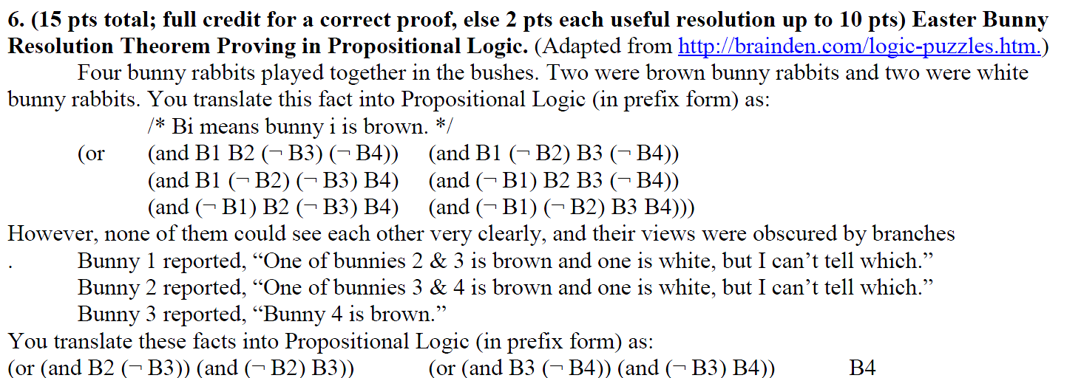
Final-2017

Slide 10
Resolve B1 with ¬B1 ¬B2 ¬B4 to produce ¬B2 ¬B4
Resolve B4 with ¬B2 ¬B4 to produce ¬B2
Resolve ¬B2 with B2B3 to produce B3
Resolve B3 with ¬B3 ¬B4 to produce ¬B4
Resolve ¬B4 with B4 to produce ()

