Slide 1
Constraint satisfaction problem
03/09

Slide 2
FOL –Q3 2017
A) C
B) C
C) N
D) N

Slide 5
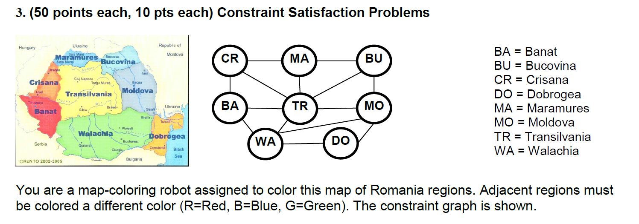
Q3 2017

Slide 6
WA = RED
NT= G , B
SA = G , B
Q= Blue
NT = G
SA = G
…

Slide 7
Q2 2017

Slide 9
Q3 2017

Slide 11
Q3 2017
BA
DO
MO
TR

Slide 13
Q3 2017
TR

Slide 15
Q3 2017
G=3
B=1
R=2

