Slide 1
First Order Logic
03/02

Slide 6
FOL
All persons are mortal.”
∀x person(x) => Mortal(x)
Somebody likes everybody.
∃ x∀y person(x) ∧ person(y) => Likes(x,y)
A grandparent x of y is defined to be x is a parent of a parent of y.
∀x ∀y ∃z Grandparent(x,y) ⬄ (parent(x,z) ∧ parent(z,y))

Slide 7
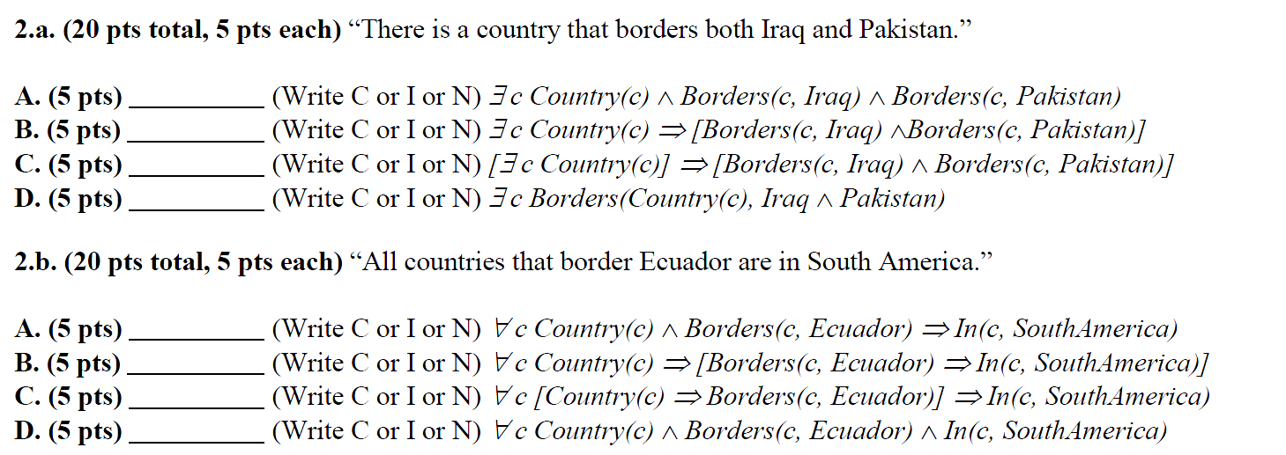
Q3 -2017
A) C
B) N
C) I
D) I
A) C
B) C
C) N
D) N

Slide 8
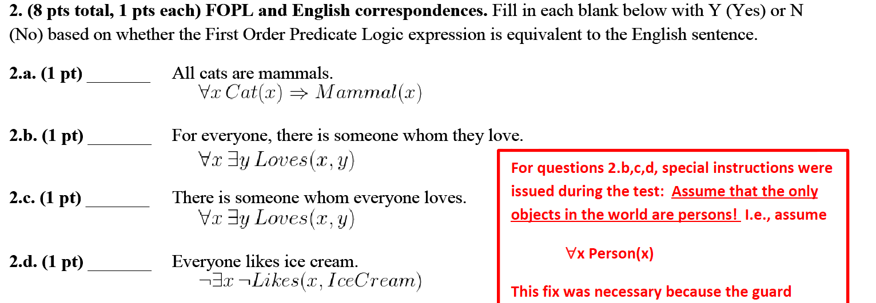
Final 2017
A) Y
B) Y
C) N
D) Y

Slide 9
E) N
F) Y
G) Y
H) N

Slide 10
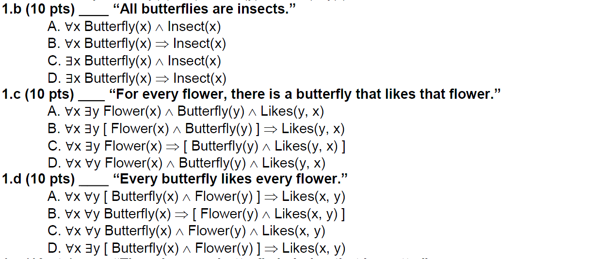
2016 – Q4
b) B
c) C
d) A

