Slide 1
Introduction to Machine Learning
3/16

Slide 2
Decision Tree
9 input features.
Target:
True(Green)/
False(red)
Example
(patron=Full,
WaitEst = 15,
Hungry=No)
=> Target = True

Slide 5
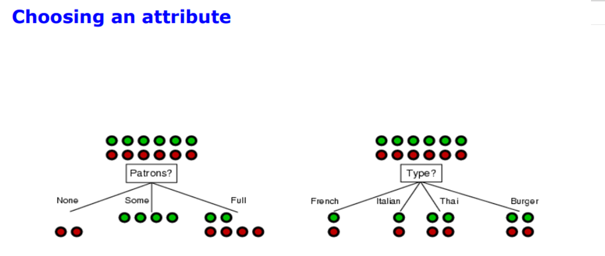
12 instance of data: 6 of them are Green, 6 of them are Red.
Best feature?
Patron
It makes better classification on target values in the dataset.

Slide 6
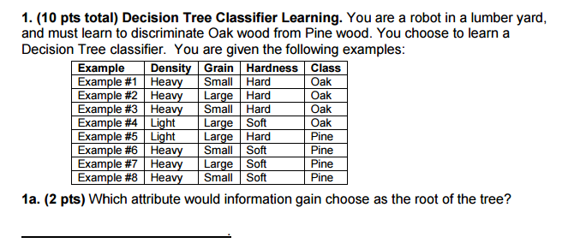
Density: Heavy=OOOPPP Light=OP
Grain: Small= OOPP Large = OOPP
Hardness: Hard= OOOP Soft=OPPP
Hardness is best attribute

Slide 7
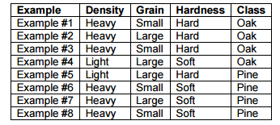
Hardness:
Hard= OOOP
Grain: Small:OO Large:OP
Density: Heavy:OOO Light:P
Soft=OPPP
Grain: Small: PP Large: PO
Density: Heavy: PPP Light: O

Slide 8
1-c) Pine
1-d)Oak

Slide 9
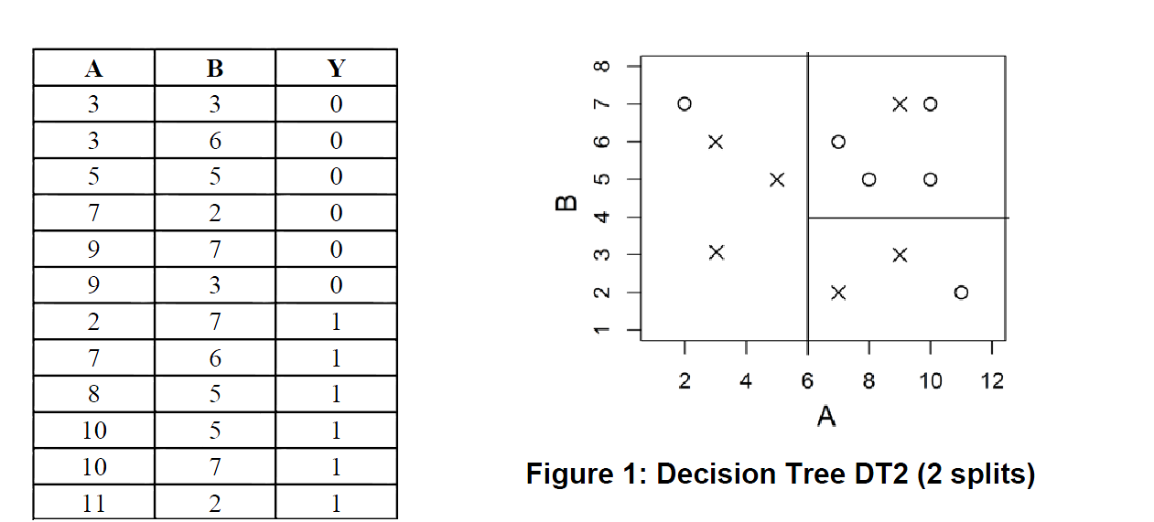
Final – 2016- Summer Quarter

Slide 10
Final – 2016- Summer Quarter
A=2, B=7, Y=1

Slide 11
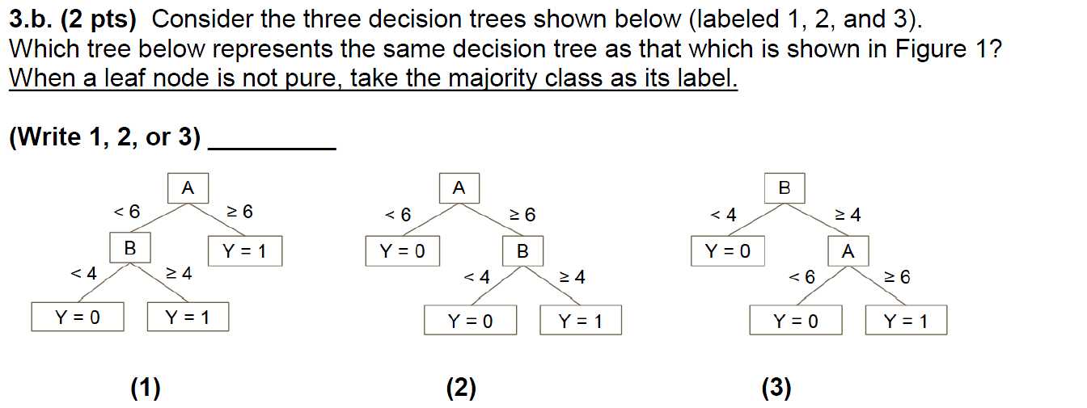
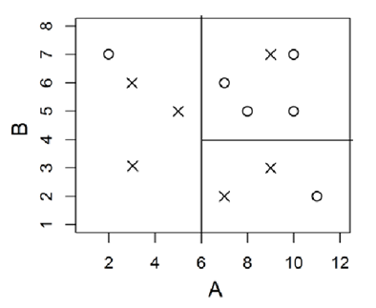
Final – 2016- Summer Quarter
Root A, split on 6
For A>=6, split on B =4
Answer is (2)

Slide 12
Final – 2016- Summer Quarter
3-c) X (cross)
3-d) X (cross)

Slide 13
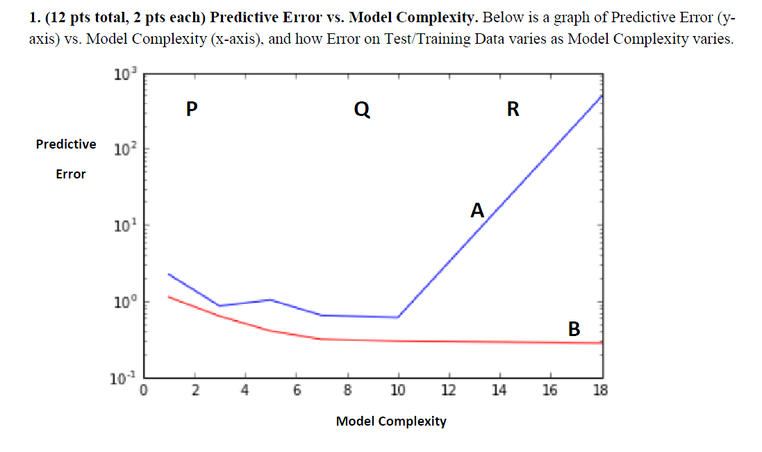
Q1 – 2017 - Final
Train error= B
Test error=A
Underfitting = P
Overfitting=R
Ideal Model=Q

Slide 14
2015-final Winter-Q1
1.b.i)C
1.b.ii)A
1.b.iii)B

