Slide 1
RIP Proposal

Slide 2
Project and Audience
Project: A fake, real looking Buzzfeed quiz determining whether or not someone has hardboiled detective characteristics. It will explain the hardboiled detective while doing so.
Audience: Teenagers and young adults (males) who seek entertainment in order to escape from the corrupt world.

Slide 3
3 Moves to Reach Audience
Using entertaining images will appeal to teenagers and young adults because they seek distraction from the world through entertainment and they will be able to relate to these images (which will relate to hardboiled detectives, thus engraving the image of one into their minds).
Using slang will reach teenagers and young adults because it will make them feel as if they can trust whoever created the quiz, considering that people of the same generation use similar slang.
Links to social media will reach teenagers and young adults because, if they share their results of the quiz, more people from this age group (who predominantly occupy social media) will learn the characteristics of hardboiled detectives through the quiz. The main purpose of these quizzes though is to gain money, so the more they share to social media, the more money earned.

Slide 4
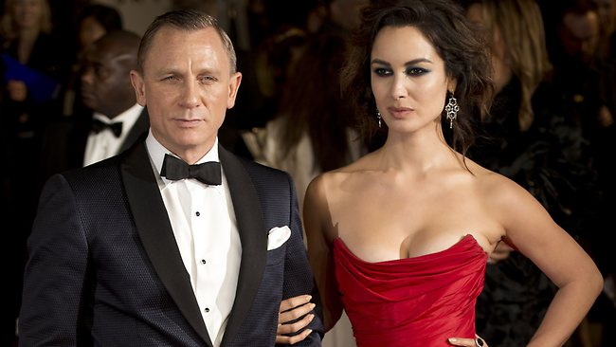
Question 1
Do you keep your cool under pressure?
Yes No
Hardboiled detectives never seem to break a sweat. Think of the coolest guy you know, then think ten times cooler. Are you that guy? Probably not. This dude can take a punch to the kidney, a bullet to the arm, and a stab in the heart without flinching. If you’re this badass, you probably have no trouble with the ladies.

